Slide 1


Prof. Dr. Dnyandev. N. Zambare
(M. Sc. Ph. D.)
Department of chemistry
Kisan Veer Mahavidyalaya, Wai.
Dist- Satara pin- 412803
Mob. no.-9890891947

Slide 2
1.Acid, Bases and Non-aqueous Solvent
Contents … [8]
  1.1.Introduction to theories of Acids and Bases-
  1.1.1.Arrhenius concept,
  1.1.2.Bronsted-Lowry concept,
  1.1.3.Lewis Concept,
  1.1.4.Lux-Flood Concept (definition and examples)
  1.2Hard and Soft Acids and Bases. (HSAB Concept)
1.2.1. Classification of acids and bases as hard, soft and borderline.
    1.2.2. Pearson’s HSAB concept.
    1.2.3. Acid–Base strength and hardness-softness.
    1.2.4. Applications and limitations of HSAB principle.
  1.3Chemistry of Non-aqueous Solvents.
    1.3.1. Introduction, definition and characteristics of solvents.
    1.3.2.Classification of solvents.
1.3.3 Physical properties and Acid-Base reactions in Liquid Ammonia(NH₃) and Liquid Sulphur Dioxide (SO₂).

Slide 3
INTRODUCTION
1.1 Introduction to theories of Acids and Bases-Arrhenius concept, Bronsted-Lowry concept, Lewis Concept, Lux-Flood Concept
Introduction of Acids and Bases:
properties of acids such as :
a sour test,
ability to change the color of certain plants dyes to red,
high dissolving ability,
liberates gaseous hydrogen from metals, in most cases,
get spent or neutralized by and alkali etc.
properties of bases such as :
have a bitter taste,
are slippery in nature Soapy to tough,
change the colour of plant dye to Blue,
Counteract with acids and produce salts.

Slide 4
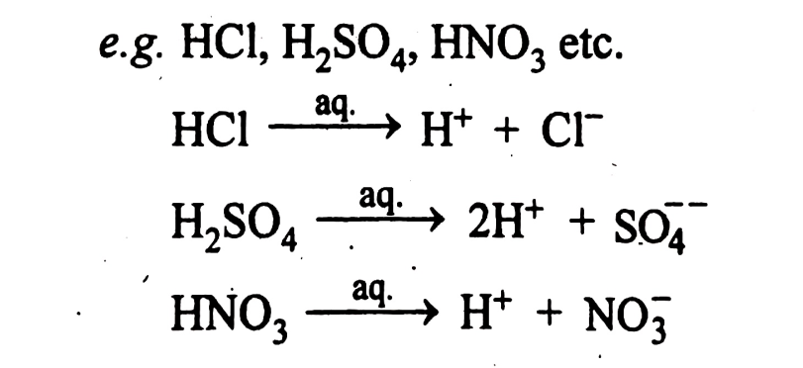
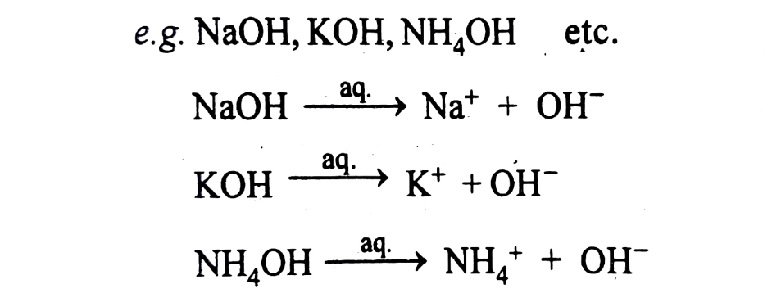
1. Arrhenius Concept (the water-ion system)
In 1887, a young Swedish chemist Svante August Arrhenius, while working for his doctor’s thesis offered the first Revolutionary approach to the acid base concept, based on self-ionization of water:
Definition:
According to Arrhenius, an acids and bases can be defined as:
Acids : an acid is a substance which produces H⁺ ions, when dissolved in water. This definition is limited to aqueous solutions only.
Bases :, base is a substance which produces OH⁻ ions when dissolved in water. This definition of acids and bases is limited to aqueous solutions only.

Slide 5
Merits:
This concept has been invaluable in elucidating the behaviour of aqueous solutions.
This theory correlated the catalytic action of acids with the concentration of hydrogen ions.
This concept also leads to quantitative determinations of acid or base strengths.
Limitations :
The Arrhenius theory lacks in generality.
According to this concept, a neutralization process is restricted to aqueous medium alone but many non-aqueous solvents like liquid NH₃, liquid SO₂ etc. are known to undergo comparable acid-base neutralization reactions.
It cannot explain the acidic behaviour of certain salts such as AlCl₃ in water.
A proton is non-existent and is generally present as the hydrated H₃O⁺ ion :
H⁺ + H₂O → H₃O⁺
A proton is also formed in other solvents like NH₃, ROH, etc.
There are non-protonic and non-hydroxylic compounds which may yield H⁺ or OH⁻ ions in water.

Slide 6
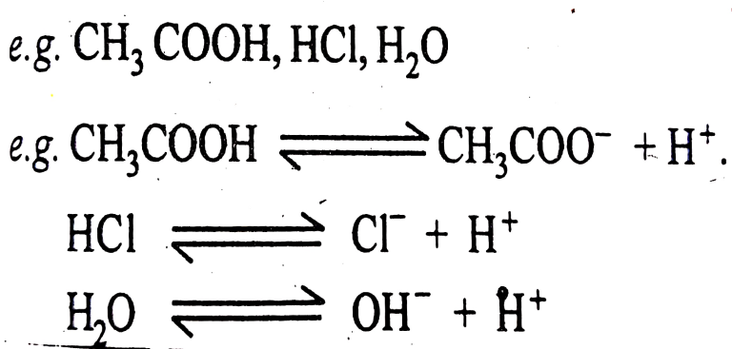
2. The Bronsted-Lowry concept: The protonic concept
(The Proton – Donor – Acceptor – System)
In 1923, J.N. Bronsted is copenhagen (Denmark) and T.M. Lowry in Cambridge (England) independently defined acids and bases irrespective of solvents; to overcome the limitations of Arrhenius theory. Since the contribution by Bronsted is much more, the concept is generally designated as the Bronsted theory. According to the Bronsted concept, an acid is any substance that can donate a Proton to any other substance and a base is any substance that can accept a Proton from any other substance. Thus “an acid is a Proton Donor and a base, a Proton acceptor”.
Definition: According to Bronsted, an acids and bases can be defined as:
Acids : an acids are a substance which donate proton

Slide 7
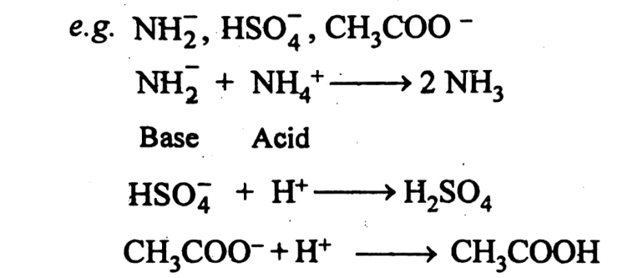
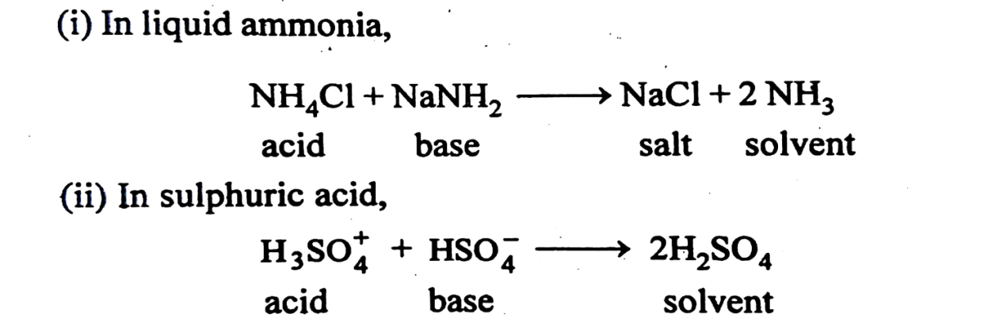
This concept is not much different from Arrhenius concept in an aqueous media, but has some advantages in non-aqueous solvents. It covers reactions in non-aqueous solvents such as liquid ammonia, glacial acetic acid, anhydrous sulphuric acid and all hydrogen containing solvents .
Bases: an bases are a substances which accept proton
This concept is not much different from Arrhenius concept in an aqueous media, but has some advantages in non-aqueous solvents. It covers reactions in non-aqueous solvents such as liquid ammonia, glacial acetic acid, anhydrous sulphuric acid and all hydrogen containing solvents .

Slide 8
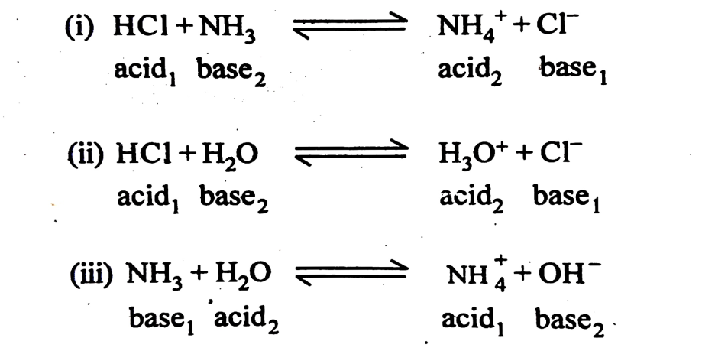
Conjugate Acid-Base Pairs:
Chemical species that differ in composition only by a proton are called as conjugate acid-base pair. Hence every acid has a conjugate base and every base has a conjugate acid
Bronsted pointed out that the reaction of an acid with a base produces an another acid and base. The fundamental relationship between acids and bases maybe related by the following three reactions:
In reaction (i). HCl is an acid as it donates proton. When proton is donated Cl⁻ a conjugate base is formed. Similarly H₂O forms a conjugate acid H₃O⁺ and NH₃ gives NH₄⁺ (ammonium ion) as conjugate acid. In the above examples, acid₁-base₁ and acid₂-base₂ are conjugate acid-base pairs. Thus, it can be represented as,

Slide 9
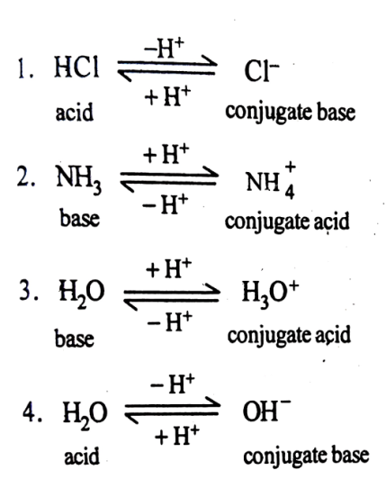

Such acid-base pairs, the members of which are formed from each other by mutual gain or loss of proton are called the conjugate acid-base pairs.
Amphoteric nature of water: The same substance when act as an acid and a base under different circumstances is call amphoteric substance.
Water as an acid: Water acts as a acid in presence of base.
NH₄⁺ + OH⁻
Acid₁ Base₂ Acid₂ Base₁
substance.
Water as an acid: Water acts as a acid in presence of base.
H₂O + NH₃
Water as a Base: Water acts as a base in presence of acid.
H₂O + HCl
H₃O ⁺ + Cl⁻
Base₁ Acid₂ Acid₁ Base₂
Notes:
Water as a Base: Water acts as a base in presence of acid.
H₂O + HCl H₃O ⁺ + Cl⁻
Base₁ Acid₂ Acid₁ Base₂

Slide 10
Merits:
1. This theory applies to proton transfer behaviour in any solvent or even in no solvent at all.
2. The concept covers a large number and variety of substances under base, for example, hydroxide ion, amide ion, ethoxide ion, pyridine, alcohols and many others.
3. Bronsted-Lowry concept is useful in accounting for the hydrolysis of salt solutions
4. The protonic concept includes a large variety of substances: cations, anions, salts, protonic solvents etc. in the realm of acid and bases as outlined above.
5. Relative strengths of acids and bases can be expressed in terms of dissociation constants or pK_{a} and pK_{b.}
6. This theory applies to proton transfer behaviour in any solvent or even in no solvent at all.
7. The concept covers a large number and variety of substances under base, for example, hydroxide ion, amide ion, ethoxide ion, pyridine, alcohols and many others.
8 .Bronsted-Lowry concept is useful in accounting for the hydrolysis of salt solutions
Demerits:
1. It fails to explain role of non-protonic substances such as AlCl₃, BF₃, SO₃, SO₂, POCl₃, SOCl₂, COCl₂, etc.
2. Secondly, the acidity or basicity of the substance depend largely on the nature of the solvent according to this concept.
3. Bronsted concept fails to account high temperature reactions and the acidic / basic behavior of metallic oxide having no protons.
4. This concept cannot explain acid-base reaction in non protonic solvents like liq. BF_{3,} liq. SO₂ etc.

Slide 11
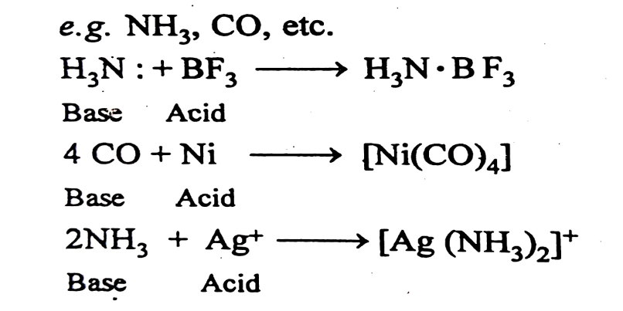
3. The Lewis Concept (The electronic theory)
(The Electron – Donor - Acceptor System) The Lewis Definition:
Introduction:
In 1923, G.N. Lewis, Professor of chemistry at the University of California, Berkeley: broadened the scope of the acid-base concept on the fundamental aspects namely, the electronic theory of valency This was rather the most general and useful of all the definitions as it was independent of any element or any given combination of elements, the presence of Ions, the presence or absence of solvent etc.
Definition (The Electron Shell Game)
According to Lewis,
“An acid is any species that can accept a pair of electrons to form a covalent bond; and a base is any species that can donate a pair of electrons to establish a (co-ordinate) covalent bond.”
Acid: In short “A Lewis acid is an electron pair-acceptor”
Base : In short “ A Lewis base is an electron pair-Donor”.

Slide 12
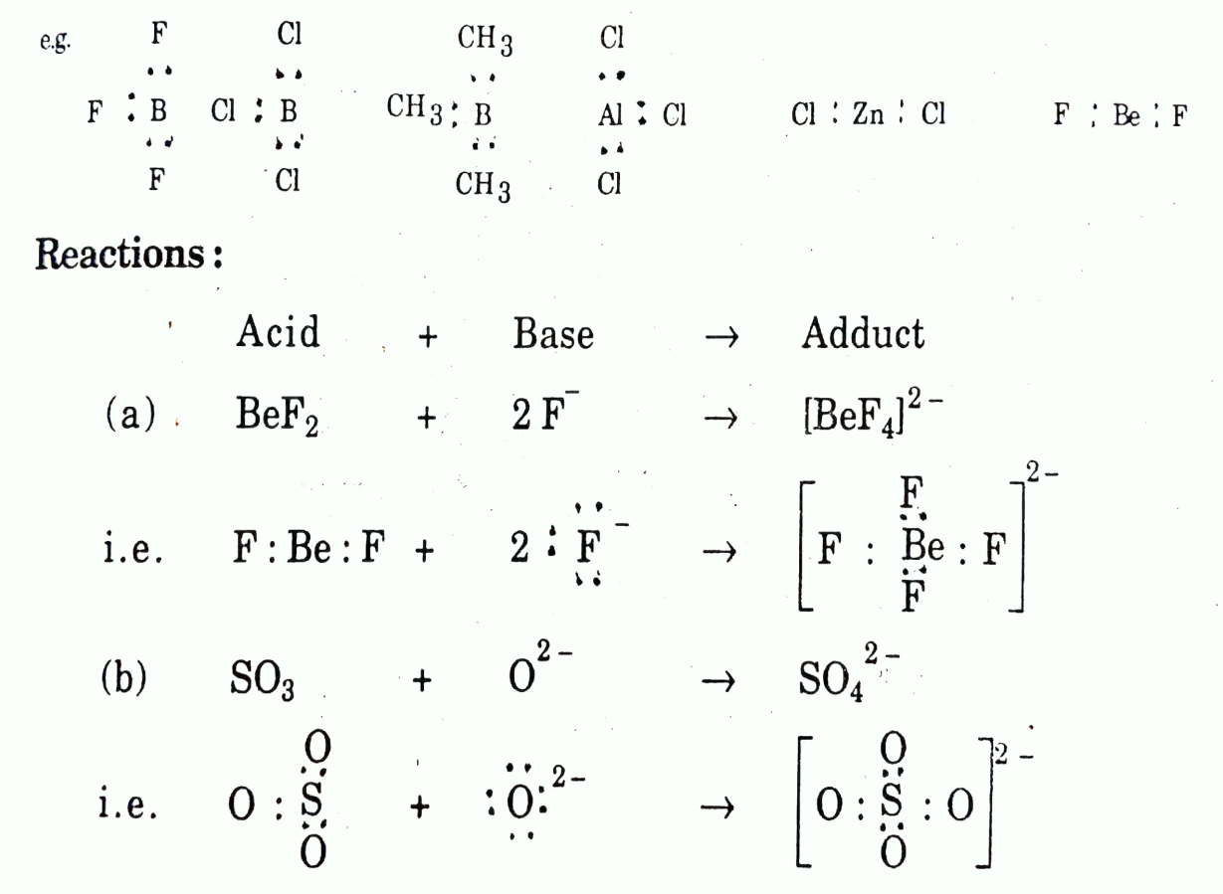
Classification of Lewis acids and bases:
(a) Lewis Acids:
Lewis acids are electron pair acceptors. Lewis acids, should therefore possess an empty orbital which may accommodate a pair of electrons. Lewis acids are classified as:
(i)Electron Deficient Molecules:
This is the most important class of Lewis acid where compounds have central atom with incomplete Octet, hence electron seeking.e.g.BF_{3,} AlCl_{3,} SnCl_{2,} PCl₃

Slide 13
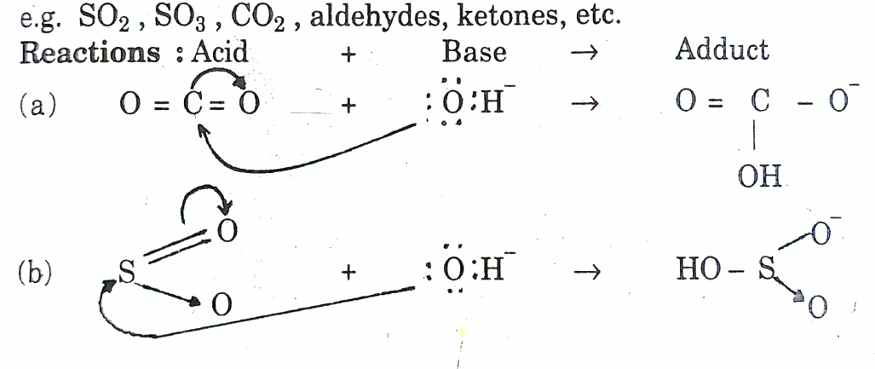
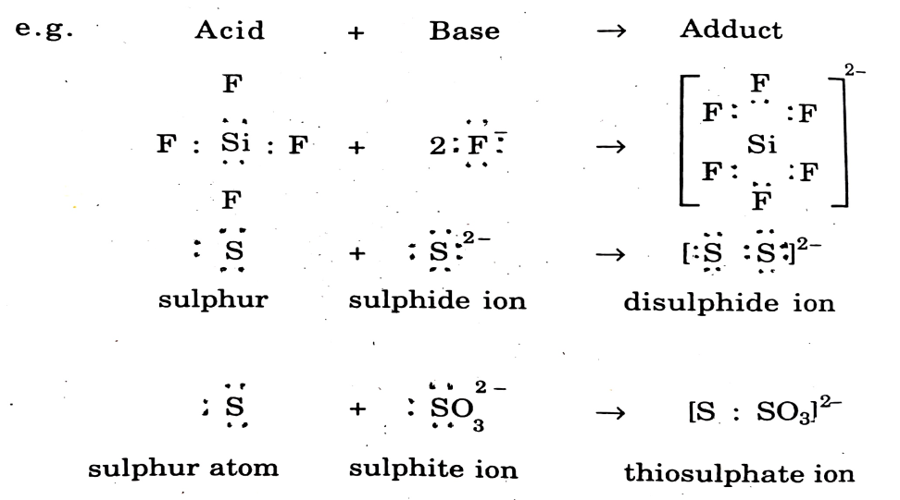
(ii)Simple Cations:
All simple cations having incomplete orbitals accept electrons from legands and act as Lewis acids. Ions of transitional elements are all Lewis acids. e.g. Ag⁺,Ni⁺²,Zn⁺², Co⁺³,Th⁺⁴
(iii) Molecules in which central atom has one or more double bonds:
The compounds (except C = C) having multiple bonds act as Lewis acids.
(iv)Molecules in which the central atom has one or more multipule bonds with more electronegative atoms .Similarly, elements with electron sextant such as S,O can accept electron pairs in co-ordination process and act as Lewis acids.

Slide 14
Lewis Bases:
Lewis base which can be classified as:
(i)Neutral molecules: Molecules containing 15th(V_{A}) and 16th (VI_{A}) group atoms, having lone pair of electrons act as Lewis bases
e.g. :NH_{3,} H₂:O:,C:O:
(ii)Anions: almost all negative ions act as the Lewis bases.
e.g. Cl⁻, Br⁻, I⁻, H⁻, S²⁻, SO₃²⁻ etc.
(iii)Compounds with (C = C) Carbon-Carbon double bonds.
e.g. Alkanes, alkynes, benzene, acetylene etc. act as Lewis bases.
Merits:
Lewis theory is an improvement over the Bronsted theory. It covers almost all the Bronsted acid and bases, at the same time include the non-protonic substances.
Lewis acid and bases can be titrated to an end point using a colour-indicator and strength can be evaluated.
It includes complex-formation by metals, under acid base reaction.
It introduce a Parallelism between acid-base character and oxidizing reducing power of a substance.
It is with great generality. It accounts for gas phase, high temperature and non-solvent reactions as neutralization process. It can be applied to almost all problems. Because of such generalizations, Lewis concept has to face certain limitations.

Slide 15
Demerits:
Almost all reactions become acid-base reactions under electron-donor-acceptor-system, which appears to be unlogical.
This theory fails to account relative strength of acids and bases
There is no uniform scale of acid or base strength, since the strength of an acid or a base is not constant, and varies from one solvent to another, and also from one reaction to another. E.g. Be(II) is stronger acid than Cu(II) if [BeF₄]²⁻ and [Cu F₄]²⁻ are compared. But when [Cu(NH₃)₄]²⁺ and [Be(NH₃)₄]²⁺ are compared, Cu(II) appears to be a Stronger Lewis acid, where [Cu(NH₃)₄]²⁺ is more stable.
According to the Lewis approach acid base reactions should be fast. But this is not so in practice, for number of reactions, due to Kinetic factor
e.g. Cr³⁺ + 6NH₃ → [Cr(NH₃)₆]³⁺ is slow.
(v) As for as catalytic activities are concerned, there is no harmony between the protonic acid and Lewis acid. the
reactions catalyzed by Lewis acids are generally not catalysed by the protonic acids.
(vi)The conventional protonic acids like HCl or H₂SO₄ are not covered directly as Lewis acids. The substances like
metal ions, BF₃, etc. normally not considered as acids are called Lewis acid. For many reactions, no explanation
is sought by Lewis concept.
e.g. Ni + 4CO → Ni(CO)₄
O + C₆H₅N → C₆H₅N: → O(Pyridine oxide)

Slide 16
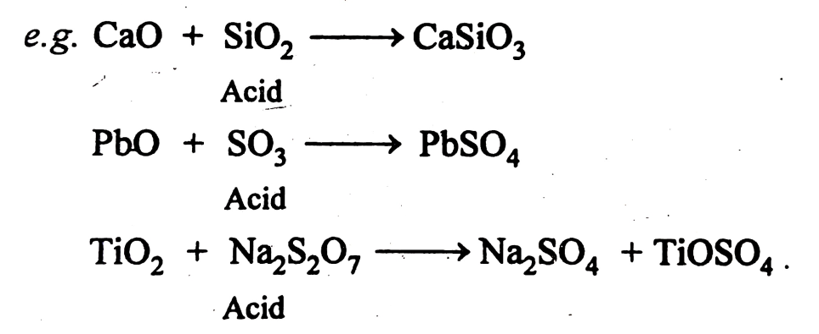
4. The Lux flood definition: the Lux flood concept
(The non protonic concept) Oxide Ion theory
The Bronsted concept fails to account acidic and basic character of oxides. This was the basis for Lux to put forth his concept of acids and bases in 1939. Flood and his co-workers extended the Lux concept to other systems. Hence the theory carries the name Lux-Flood Concept or oxide Ion theory .According to Lux Flood acids and bases are defined as,
Acid : acids are oxides which accept oxygen, or the substance which accept oxide ion or anion
Base : bases are oxides which donates oxygen, or the substance which donate oxide ion or cation
CaO + SiO₂ ⎯→ CaSiO₃
Base Acid
The substances showing tendency to loose and gain an oxide ions are termed as amphoteric.

Slide 17
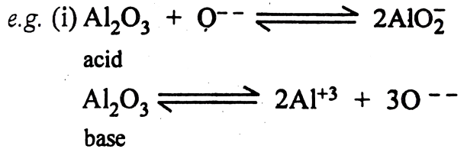
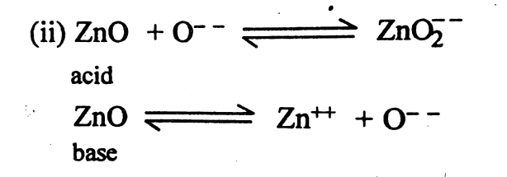
According to Lux-Flood, a substance is amphoteric if it shows both tendencies of taking up and giving up oxide ion.
In other words, an acid is any species which gains oxide ions and a base is any species which gives a oxide ions; (an acid is oxide Ion acceptor, and a base is oxide ion Donor).
Acid + Oxide ion → Base
Ca²⁺ + O²⁻ → CaO
SO₂ + O²⁻ → SO₃²⁻
SO₃ + O²⁻ → SO₄²⁻
The system is much useful in dealing with anhydrous reactions in fused melts of oxides, and similar higher temperature reactions, commonly found in Metallurgy and ceramics.
Limitation:
(i) The protonic concept being very limited, Lux-Flood concept is obviously much limited.
(ii) Autoionisation is very difficult in many cases

Slide 18
  1.2 Hard and Soft Acids and Bases. (HSAB Concept) :
In 1958, this was done by Ahrland, Chatt and Davies by classifying acids or bases into general categories : Class 'a' and Class 'b'. According to them the two categories of metal ions (Lewis acids) are as follows :
(i) Class (a) :
The metal ions which prefer to form stable complexes with the ligands having donor atoms of first members of group 15th (N), 16th (O) and 17th (F) in the periodic table.
Examples : Alkali metals, alkaline earth metals and the first row transition metals in high oxidation state (e.g. Fe³⁺, Co³⁺ etc. belong to class (a) acids).
(ii) Class (b) :
The other metal ions which prefer to form their most stable complexes with the ligands having donor atoms of lower members of group 15th (P, As, Sb), 16th (S, Se, Te), and 17th (Cl, Br, I) in the periodic table.
Lighter transition elements in low oxidation state and heavier transition elements, say Cu⁺, Ag⁺, Hg⁺, Pt²⁺, Pd²⁺ etc. act as class (b) acids.
(i) Hard acids : The class ‘a’ metal ions which are smaller in size , less polarisable, lighter in weight, prefer to combine with Class ‘b’ ligands or hard bases non-metals . Pearson called such metal ions as Hard Acids .
(ii) hard bases : The class ‘a’ ligands having high electronegativity, less polarisability,small size, which prefer to bin with hard acid and gives stable complexar called as hard bases
(iii) Soft acids : The class ‘b’ metal ions having large size, more polarisability,zero or low positive oxidation state, prefer to combine with non-metals or ligands having similar properties. Pearson called such metal ions as soft acids and the ligands as soft bases.
(iv) Soft bases: The class ‘b’ ligands having less electronegativity, more polarisability, bigger size, which prefer to bind with soft acid and gives stable complexar called as soft bases
(v) Borderlined acids and bases: The acids and bases having properties in between hard and soft acids and bases are called as borderlined acids and bases The details of distinguishing features of hard and soft acids and bases are summarized in table 1.1

Slide 19
Hard | Borderline | Soft
1. Alkali metals : H⁺, Li⁺, Na⁺, K⁺. 2. Alkaline earth metals : Be²⁺, Mg²⁺, Ca²⁺, Sr²⁺. 3. Lighter transition metals : Co³⁺, Cr³⁺, Al³⁺, La⁺³, Ce⁺³, SO₃, BF₃, BCl₃. | Fe²⁺, Co²⁺, Ni²⁺, Cu⁺², Zn²⁺, Pb²⁺, SO₂, BBr₃. | Heavier transition metals having zero or low oxidation state metals : Cu⁺, Ag⁺, Au⁺, Ti⁺, Hg⁺, Pd²⁺, Cd²⁺, Pt²⁺, Hg²⁺, BH₃, Br₂, Br⁺.
Features :
Hard Acceptor atoms are marked by | Soft Acceptor atoms are marked by
1. Small size. | 1. Large size.
2. High positive oxidation state. | 2. Zero or low positive oxidation state.
3. Absence of any outer electrons which are easily excited to higher states. | 3. Presence of several excitable valence shell electrons.
4. Absence of d-electrons. | 4. With nearly full d-electrons.
5. Usually light metal ions. | 5. Mostly heavy metal ions.
6. Known as Lewis acids which are not easily polarisable and prefer to coordinate with hard bases. | 6. Known as Lewis acids which are easily polarisable and prefer to coordinate with soft bases.

Slide 20
(B) Bases :
Hard | Borderline | Soft
F⁻, OH⁻, H₂O, NH₃ | CO NO SO Br⁻ | H⁻, R⁻, CN⁻, CO, I⁻
CONO₃, O²⁻ | N | SCN⁻, R₃P, C₆H₆
SOPOClO (Cl⁻) | SCN⁻ | R₂S
Features :
Hard | Soft
1. High electronegativity. | 1. Low electronegativity
2. Low polarisability. | 2. High polarisability.
3. Presence of filled orbits; empty orbitals may exist at high energy level. | 3. Partially filled orbitals, empty orbitals are low-lying.
4. These are anions or neutral molecules known as Lewis bases or ligands, prefer to co-ordinate with hard acids. | 4. These are anions or neutral molecules called similarly as Lewis bases or ligands, prefer to bind with soft acids.
From Table 1.1 it is clear that there is no line of demarcation between hard soft species.
Within each group, there exists no equal hardness or softness e.g. Alkali metal ions are all hard but within the group :
Li⁺ > Na⁺ > K⁺ > Rb⁺ >Cs⁺ hardness decreases, hence Li⁺ is hardest while Cs⁺ is softer, as it is larger and more polarisable as compared to Li⁺.
Similarly nitrogen is a hard base say as NH₃ being of a small size and if polarisable substituents are present, it will turn to be sufficiently softer e.g. Pyridine, where polarisable substituents are present. Further we may use terms such as “a moderately weak and fairly soft”, “very hard but weak” by considering the strengths of acids and bases.

Slide 21
1.2.2 Pearson’s HSAB concept :
In 1963, R.G. Pearson extended and generalized the qualitative correlation between Lewis acids and Lewis bases by classifying them into two categories Hard and Soft.
(i) Class ‘a’ : The class ‘a’ metals which are small and less polarisable, prefer to combine with non-metals or ligands which are also small and not very polarisable. Pearson called such metals as Hard Acids and the corresponding ligands as Soft Bases.
(ii) class ‘b’ : The class ‘b’ metals having large size, more or easily polarisable, prefer to combine with non-metals or ligands having similar properties. Pearson called such metals as soft acids and the ligands as soft bases.
The attempt of classification of acids and bases as hard and soft by Pearson is known as Hard and Soft Acids and Bases (HSAB) or Pearson’s concept.
Principle of Pearson’s concept :
Pearson suggested a simple rule (sometimes called Pearson’s principle) for predicting the stability of complexes formed between hard and soft acids and bases.
“Hard acids prefer (tend) to bind (co-ordinate) with hard bases and soft acids prefer to bind with soft bases and give stable complex compound”.
It should be noted that the statement given above is not a theory or an explanation but it is simple rule of thumb which enables us to predict the relative stabilities of acid-bases adducts qualitatively.
1.2.3. Acid–Base strength and hardness-softness :
Inherent acid-base strength is quite distinguished feature from the hardness and softness.
Hardness - softness pertains to the stability achieved due to hard-hard and soft - soft interactions.
The insight can be collected from the following observations.
1. (i) OH⁻ and F⁻ are hard bases whereas OH⁻ is 10¹³ times stronger base than F⁻.
(ii) Et₃P and SOare both soft bases whereas Et₃P is 10⁷ times stronger base than SO towards CH₃Hg⁺.
These facts pertaining to inherent strength violate the Pearson’s principle “hard prefers hard and soft prefers soft”.
(a) Soft base SOcan displace hard base F⁻.
SO + HF → HSO + F⁻, K_{eq} = 10⁴

Slide 22
(b) Hard base OH⁻ can displace soft base SO.
From soft-soft combination of CH₃HgSO
OH⁻ + CH₃HgSO → CH₃HgOH + SO K_{eq} = 10
In these cases, the strengths of bases are SO > F⁻ and OH⁻ > SO are e nough to force the reactions to right irrespective of hard soft considerations.
2. If both strength and hardness softness are applied under competitive conditions the hard soft rule will be found to be applicable.
e.g.
(i) CH₃HgOH + HSO → CH₃HgSO + HOH K_{eq} = 10⁷
Soft-Hard Hard-Soft
(ii) CH₃HgF + HSO → CH₃HgSO K_{eq} = 10³
3. While acid-base interactions are considered one has to account both strength as well as hardness softness.
Table 1.2 : Basicity towards (H⁺) and (CH₃Hg⁺)
Base |  | pK(CH₃Hg⁺) | pK_{n}(H⁺)
F⁻ | F | 1.5 | 2.58
I⁻ | I | 8.6 | − 9.5
OH⁻ | O | 9.37 | 15.7
S²⁻ | S | 21.2 | 14.2
SO | S | 8.11 | 6.79
NH₃ | N | 7.6 | 9.42
Et₃P | P | 15.0 | 8.8
CN⁻ | C | 14.1 | 9.14

Slide 23
Table 1.2 enlists the strengths of different bases towards methyl mercury cation CH₃Hg⁺ and the proton (H⁺). From the data it seems that the bases such as triethylphosphine (Et₃P) and the sulphides S²⁻ ion are very strong towards both CH₃Hg⁺ and H⁺. But both Et₃P and S²⁻ ion are about a million times better towards CH₃Hg⁺, hence both are considered to be soft bases.
The OH⁻ ion is a strong base towards both acids CH₃Hg⁺ and H⁺ but it is million times better base towards acid, H⁺. Hence OH⁻ is hard.
The F⁻ ion is not a good base towards CH₃Hg⁺ or H⁺ but little better towards H⁺ as it appears from its hardness.
4.The importance of both HSAB concept and inherent acid-base strength is well understood by
Irving-Williams series. Hard species coming earlier in the series like alkaline earth and early transition metal ions bind in the order O > N > S, While soft species like heavier transition metal ions bind in order S > N > O.

Slide 24
    Applications and limitations of HSAB principle.
(i) Applications :
With the help of HSAB, a large number of chemical reactions can be understood.
1. To determine the relative strength of hydracids HF, HCl, HBr and HI:
In aqueous solution the relative strength of HF, HCl, HBr and HI can be predicted.
The reaction of acids with water is :
HX + H₂O ⎯→ H₃O⁺ + X⁻ ( X= F, Cl, Br ,I )
The hardest base F⁻ will be most successfully and strongly bonded to the hard acid H⁺. Hence HF will be highly stable. It is therefore least dissociated. Hence acid strength increases as :
HF < HCl < HBr < HI
2. To determine the relative stabilities of complexes in aqueous solutions :
HSAB entails that [Cd(CN₄)]²⁻ is more stable than [Cd(NH₃)₄]²⁺. According to HSAB principle, hard prefers hard and soft prefers soft. Hence the soft acid Cd²⁺ will prefer to coordinate soft base CN⁻. It is clear from K_{inst} constants where cyano complex has K_{inst} = 1.4 × 10⁻¹⁹ while for ammine complex it is 7.5 × 10⁻⁸.Thus cyano is stable. Other examples are as’
[CoF₆]³⁻ is more stable than [CoI₆]³⁻.
[Co(NH₃)₅F]²⁺ is stable, [Co(NH₃)₅I]²⁺ is unstable.etc.
[Ag(CN)₂]⁻ is very stable but [AgCl₂]⁻ is very unstable.
3. To predict the course of reaction :
(i) H⁺ + CH₃HgOH ⎯→ H₂O + CH₃Hg⁺
(ii) H⁺ + CH₃HgSH ⎯→ H₂S + CH₃Hg⁺
The reaction (i) goes to right as the hard acid H⁺ binds strongly to hard base OH⁻ to produce stable product H₂O.
On the other hand, the reaction (ii) is favoured to left where soft base SH⁻ will tend to remain combined with soft acid CH₃Hg⁺ instead of joining to hard acid H⁺.

Slide 25
4. Classification of cations :
Fig. 1.1 shows trends in equilibrium constants for formation of complexes with halide ion-bases.
The values of K_{f} increase steeply from F⁻ to I⁻ when acid Hg²⁺ is used indicating it to be markedly soft. The curve is less steep but in the same direction for Pb²⁺ which indicated that Pb²⁺ is a borderline soft acid. The trend is in opposite direction for Zn²⁺ with moderate steepness from I⁻ to F⁻. Hence it must be hard but borderline hard acid. The very steep downward slope for Al³⁺ indicates clearly that Al³⁺ must be a hard acid. Thus the opposing trends in the reactivity of the halide ions towards Al³⁺ (F⁻ >> Cl⁻ > Br⁻ > I⁻) and Hg²⁺ (F⁻ >> Cl⁻ > Br⁻ > I⁻) are now easily rationalised.
5. Classification of neutral molecular compounds :
For neutral molecular acids and bases, a similar classification of hard and soft can be applied. For example, the Lewis acid phenol (C₆H₅OH) forms a more stable complex by hydrogen bonding to diethyl ether (C₂H₅)₂O than the thioether (C₂H₅)₂S. In contrast the Lewis acid I₂ forms a more stable complex with (C₂H₅)₂S. Hence we conclude that phenol is hard whereas I₂ is soft.

Slide 26
To determine hard-hard and soft-soft combinations (Pauling-Pearson Paradox) :
Hard-hard and soft-soft combinations determine the course of number of typical reactions, for example,
LiI + CsF
LiF + CsI
HgF₂ + BeI₂
BeF₂ + HgI₂
These reactions will illustrate the Pauling-Pearson Paradox of chemistry. As far as Pauling’s electro negativity concept is concerned, cesium and mercury should form more stable bonds with fluorine as their electronegativity differences are greater.
In reality however LiF if more stable than CsF (and BeF₂ than HgF₂), it is due to very large contribution of electrostatic interaction between Li⁺ and F⁻ and (Be²⁺ and 2F⁻).
The following data of enthalpies of atomization will support the facts.
LiI + CsF ⎯→ LiF + CsI
Hard-soft Hard-soft Hard-hard Soft-soft
kJ mol⁻¹ 347 501 573 335
HgF₂ + BeI₂ ⎯→ BeF₂ + HgI₂
Soft-hard Hard-soft Hard-hard Soft-soft
kJ mol⁻¹ 535 577 1262 292
7. Symbiosis :
BF₃ is a hard acid and combines readily with a further F⁻ ion which is a hard base. While BH₃ being a soft acid prefers to join the softer base H⁻ ion. This fact will easily account for the following :
BF₃H + BH₄F⁻ ⎯→ BF + BH
CF₃H + CH₃F ⎯→ CF₄ + CH₄
Such tendencies of fluoride ions or hydride ions to favour further coordination by a fourth F⁻ and H⁻ ion has been termed as “symbiosis” by Jorgensen (1964) for the symmetrically substituted species with a centre already having soft ligands or vice versa.

Slide 27
8. Occurrence of minerals :
Numbers of chemical aspects have been interpreted by the HSAB like
Catalytic power of metals may be accounted from the fact that the soft metal atoms will easily adsorb soft bases on their surface and they becomes stable .e.g.CuS,AgS,HgS occur in natuture as well asMgCO_{3,} CaCO_{3,} Al₂O₃. occur in nature but MgS, CaS or Al₂S₃ do not occur.
9. Solubilities:
It may be understood from the fact that hard solvents will prefer to dissolve hard solutes and soft solvents dissolve soft solutes e.g. Hg(OH)₂ dissolves in acidified aqueous solvent but HgS does not.
Some additional illustrations of HSAB concept are
(i) Substitution reactions can be kinetically studied from hardness and softness of species concerned.
(ii) [AgI₂]⁻ (produced by soft-soft combination) is stable and exists while [AgF₂]⁻ (produced by soft-hard combination) does not exist.
(iii) Ammonia, water, fluoride ion etc. prefer to bind to Be²⁺, Ti⁴⁺, Co³⁺ etc. and give very stable complexes.
(iv) Phosphines (R₃P), thioethers (R₂S) and other species of P and S as donor atoms prefer to bind to Pt²⁺, Pd²⁺, Hg²⁺ etc.
Referring to Table 1.1 all such cases may by easily tackled by soft hard - hard soft - soft or hard soft combinations relating to the Pearson rule.
For soft acids : K_{f} ≡ F⁻ << Cl⁻ < Br⁻ < I⁻ R₂O << R₂S, R₃N << R₃P

Slide 28
1.2.5 Limitations of HSAB Concept / Principle
Hard and soft classification is useful concept, no doubt but it has some tricky limitations as pointed out below.
The prime limitation of the HSAB concept is that it is widely general and has no any direct quantitative scale of acid-base strength.
The inherent acid-base strengths are not accounted, for example, OH⁻ and F⁻ ions are both hard bases whereas OH⁻ is nearly 1013 times stronger base than F ions. Correlation between hardness and inherent acid base strength is yet to be developed.
3. Interpretation of different reactions by splitting the participants into acid base fragment is quite arbitrary to some extent. The reaction between ethanol and acetic acid may be interpreted for etherification in two ways :
Break I : CH₃COO⁻ H⁺ + C₂H₅OH⁻
Break II : CH₃CO⁺ OH⁻ + C₂H₅OH⁺
The hard-hard combination of H⁺ with OH⁻ for both is justifiable. But there is nothing to exclude the break (I) on the basis of hard - soft interactions between CH₃COO⁻ and C₂H₅⁺.
4. This theory fails to determine the relative strengths of acids and bases.
e.g. CH_{3 (g)} + H_{2 (g)} → CH_{4 (g)} + H
This reaction must be favoured in view of soft-soft combination between CH and H⁻. But in actual practice the combination is endothermic by about +360 kJ moI⁻¹. This unfavourable entropy change does not allow the reaction to proceed.
(In favour of reaction the explanation may be given in terms of greater acidity of proton H⁺ relative to CH cation.)

Slide 29
1.3.1 Introduction, definition and characteristics of solvents.
Introduction :
No other solvent displays so wide range in physical and chemical properties and hence water occupies an exceptional position among various solvent media. These features have made water a “Universal Solvent.”
The majority of chemical reactions are carried out in a sol­vent. Solvent is a substance in which other substances can be dissolved. Many measurements of properties are also carried out in a solvent. Water is the most widely used solvent and it will continue to be. Thus, water is the universal solvent. However, water is not only the solvent for inorganic reactions.
Many other solvents have been tried and found useful. These include liquid ammonia, liquid sulphur dioxide, acetic acid, ethyl alcohol, diethyl ether, hydrogen sulphide etc. A few of them and concepts that influence the choice of the solvent are discussed here. Thus, solvent plays an important role in chemical reactions that are carried out in it. The usefulness of a solvent depends upon its physical and chemical properties.

Slide 30
1.3.2. Classification of solvents :
Solvents may be classified in a number of ways. All the attempts of their classifications are based on particular physical or chemical properties: polar-nonpolar, ionizing-nonionizing, protic – aprotic, acidic-basic, organic- inorganic or series or such properties taken together. Table 1.3 shows a summary of types of solvents at a glance.
Table 1.3: Types of Solvents
Solvent Type | Protonic Characters | Examples
1. Protonic/protic (a) Acidic/ Protogenic | Tendency to release proton | HF, H₂SO₄, HCN CH₃COOH, C₆H₅OH
(b) Basic/ Protophilic | Tendency to accept proton. | NH₃, N₂H₄, amines.
2. Aprotic/ Non-protonic | Tendency neither to release proton nor to accept proton. | C₆H₆, CHCl₃, CCl₄, SO₂
3. Amphiprotic | Tendency either to release protons depending upon the nature of reacting species. | Water and lower alcohols.

Slide 31
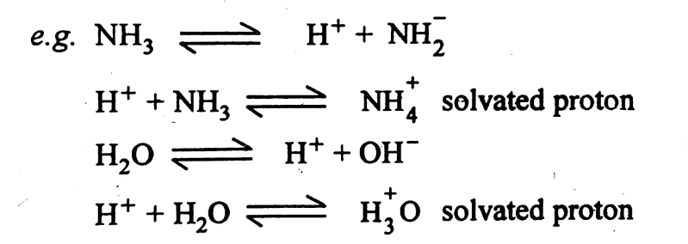
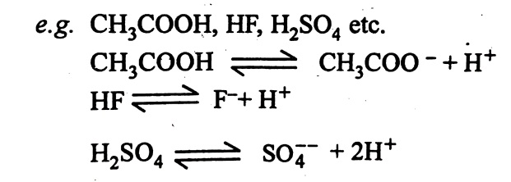
Classification of solvents :
(A). Protonic solvents and Aprotic solvents or Non-protonic
1. Protonic solvents :
These are the solvents which can donate or accept the protons. For example, H₂O, HCl, HF, H₂SO₄, CH₃COOH, HCN, etc. These are further classified in three types :
Further protonic solvents are classified as (i)Acidic solvents (ii)Basic solvents,, (iii) Amphiprotic or amphoteric solvents
(i)Acidic solvents: like HCl, H₂SO₄, HF, CH₃COOH etc. have tendency to donate the protons.
(ii)Basic solvents like liquid NH₃, liq .ethylene diamine C₆H₅NH₂ which have tendency to accept the protons are known as basic solvents.
NH₃ + H⁺ ----→

Slide 32
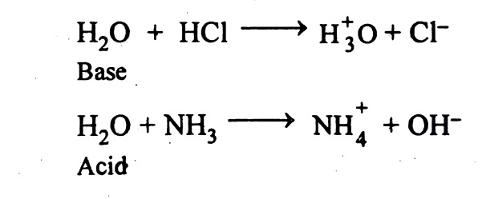
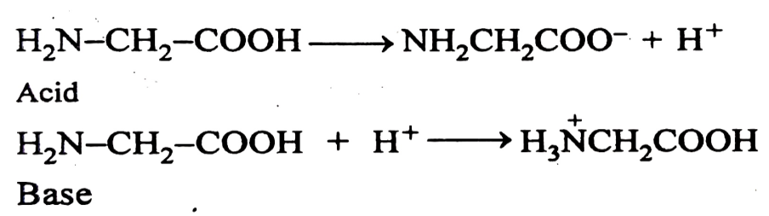
(iii)Amphiprotic or amphoteric solvents:
which can either accept or donate the protons which depend on the nature of reaction. e.g. water, acetic acid etc
2. Aprotic solvents or Non-protonic :They do not ionize like protonic solvents. They do not have any tendency to accept or to loose the protons. For example, CCl₄, CH₃CN, C₆H₆, DMF (dimethyl formamide), DMSO (dimethyl sulphoxide) etc. There are three broad classes of these aprotic solvents.
(i) Non-polar or non-dissociated liquids: which do not solvate strongly. e.g. CCl₄ and hydrocarbons. They have low polarity and low dielectric constant, poor donor power, no self-ionising capacity. They do not take part in chemical reactions with solute.
(ii) Non-ionized (non-dissociated) but strongly solvating solvents e.g. CH₃CN, DMF, DMSO and SO₂. They are mainly aprotic and have no self-ionizing capacity, but have tendency to solvate the ions. Some of these solvents like DMSO have high dielectric constants and some have low dielectric constants. These solvents solvate cations best by using negatively charged oxygen atoms.

Slide 33
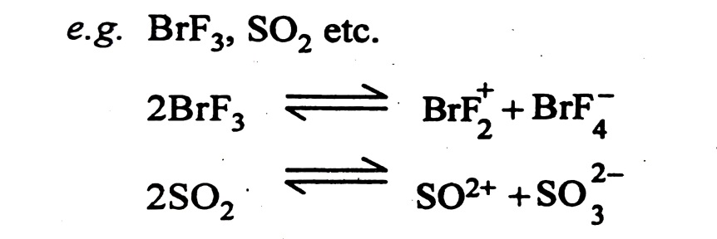
(iii) Highly polar, autoionizing solvents : They have high dielectric constants and dipole moment val­ues. These solvents are highly reactive. They are extremely sensitive to the moisture. These solvents can undergo autoionization. e.g. H₂O, BrF₃, IF₅ etc
(B) Ionising and non- Ionising solvent :
This classification is based on the polar and non-polar nature of the solvents.
1.Ionising solvents:
They undergo autoionisation and bring about ionisation of the solutes. Thease are polar in nature and have high dipole moment and dielectric constant. They are good solvents for ionic solutes. e.g.Water, liquid hydrogen fluoride, NH₃ etc.
2.Non-ionising solvents:
They undergo autoionisation and do not bring about ionisation solute. These are non-polar and have low dipole moment. They are suitable for covalent compounds.

Slide 34
1.3.3.Physical properties and Acid-Base reactions in Liquid Ammonia (NH₃) and Liquid Sulphur Dioxide (SO₂).
1. Liquid Ammonia :
Physical properties and Acid-Base reactions in Liquid Ammonia (NH₃)
Liquid ammonia is Inorganic: Non-aqueous – Protonic, Basic natured, Auto-ionizing-Polar solvent.
Ammonia as a Solvent: Solvent Character:
Liquid ammonia – as a solvent – has striking similarities with water; hence it is a “Waterlike” solvent. It undergoes auto-ionization like water but its degree of ionization is much less.
NH₃ + NH₃
NH + NH; K_{ion} = 1.9 × 10⁻³³ (223 K)
Physical properties of liq. NH₃ are:
Boiling point: 240 K (−33°C);
Freezing point: 195 K (−78°C);
Dielectric constant: 22 (240°K);
Specific conductance: 1 × 10¹¹ ohm⁻¹ cm⁻¹ (240 K)

Slide 35
Solvent Action:
There are some striking differences between ammonia and water in their solvent actions towards different substances. Some representative examples are:
(a) Halides:
Solubility of halides decrease from iodides (highly polarizable) – to fluorides (the trend is reverse in water)
i.e. Iodide > bromide > chloride >> fluoride
e.g. Only BeCl₂ and NaCl are soluble in liq. NH₃.
Salts of highly charged ions:
Oxides, sulphides, sulphates, phosphates, fluorides and carbonates, etc. are all insoluble in liquid ammonia.
Salts with poor charge:
Nitrites, nitrates, cyanides and thiocyanate are soluble, mostly being polarizable.
Ammonium salts:
Most of the ammonium salts, regardless of the anion are freely soluble in liquid ammonia.
Organic compounds:
Ammonia dissolves a variety of organic compounds such as alcohols, amines, esters, ethers, hydrocarbons and other aromatics. Thus liquid ammonia serves as a better solvent for non-ionic, non-polar covalent substances.
Metal ions forming Ammine complexes:
The metal ions such as Co²⁺, Ni²⁺, Cu²⁺, Zn²⁺, Pd²⁺, or Pt²⁺ can form stable ammine complexes. Therefore, salts of such metal ions (Lewis acids) are freely soluble in liquid ammonia (base).
(g) Alkali metals and Alkaline earths:
Ammonia having relatively low degree of auto-ionization dissolves alkali metals giving a deep blue solution without any chemical action.
The solubility of alkali metals increases from Li to Cs, down the group. Li (10.9 g), Na (24.8 g), K (46.4 g) (at 240 K per 100 g).
Alkaline earth metals dissolve in ammonia but they seem to form hexammonates, M(NH₃)₆, which are separated as solids on evaporation e.g. [Ca(NH₃)₆], [Ba(NH₃)₆] and [Sr(NH₃)₆].

Slide 36
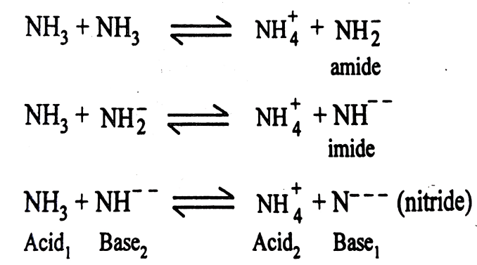
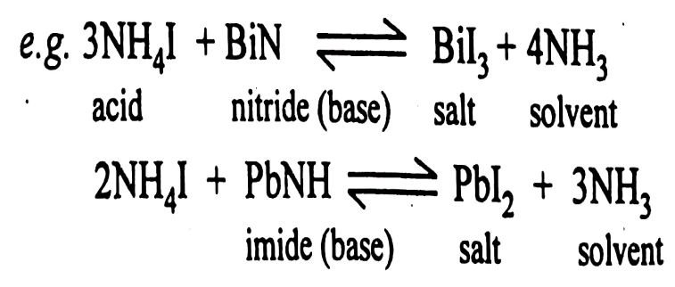
Acid-Base reactions in Liquid Ammonia(NH₃):
(i) The auto-ionization reactions of water and ammonia are just similar.
From these reactions, it may be pointed out that the acid-base behavior depends upon:
1. The inherent acid-base nature of the solvent,
2. The inherent character of the solute, and
3. The solute-solvent interactions.
The neutralization reactions (a) to (e) may be run in ammonia parallel to those in water. The course of reaction may be followed by titrating a solution of ammonium salt (Acid₁) against standard solution of amide/imide/nitride/hydroxide using phenolphthalein as a indicator. End point will be colourless to pink as usual. These reactions can also be followed by conductometric or potentiometric titrations.
From reactions (c) and (e), it may be seen that in liquid ammonia, dissolution of hydroxides and oxides by ammonium salts is also the acid-base reaction.

Slide 37
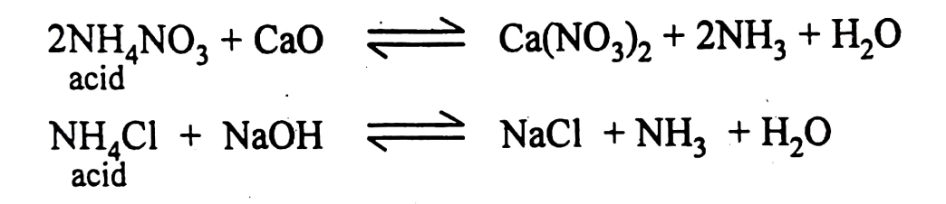
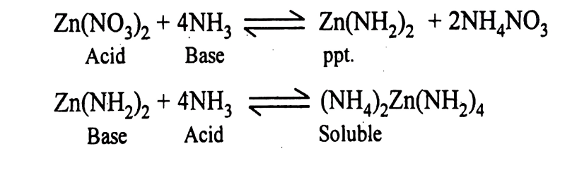
Levelling Effect :
Based on solvent type, the properties of substances are altered as compared to their properties in water. Ammonia is a protonic, basic type of ionizing solvent that strongly exerts its basic nature on solutes during ionization.
(a) Effect on Strong Acids:
All acids which act as strong acids in water, behave as stronger acids in ammonia.
(b) Effect on Weak Acids:
Acids which are weak in water react completely with ammonia and hence behave as strong acids in basic medium of ammonia.
(c) Effect on Neutral Molecules:
Urea which is a neutral species in water, has no acidic reaction in water, behaves as an acid in ammonia.
(d) Effect on Bases:
The substances having basic character in water are either insoluble in ammonia or act as very weak bases in ammonia. But the substances which are strongly basic may be levelled to the strength of amide, NH₂, when dissolved in ammonia.
Thus, from the reactions (a) to (d), it may be said that the substances in their acid-base strength are levelled to the strength of NH (acid) and NH (base) in solvent, liquid ammonia.
Amphoteric Behaviour:
Similar to water, amphoteric behaviour of some metal compounds is also observed in liquid ammonia. Zn(OH)₂ is amphoteric in aqueous medium. Similarly, Zn(NH₂)₂ is amphoteric in liquid ammonia.
pH Scale:
Ammonia being an ionizing solvent, its pH scale may be set:
pH = 0 (1M NH); pH = 13.5 when [NH] = [NH]; pH = 27 [1M NH]

Slide 38
2. Liquid Sulphur Dioxide :
Physical properties and Acid-Base reactions in Liquid Sulphur Dioxide (SO₂). :
Liquid sulphur dioxide is a non-aqueous, inorganic aprotic, acid – type, polar, and ionizing solvent.
Solvent Character:
Sulphur dioxide is also a water-like solvent. It undergoes auto-ionization, but its degree of ionization is much less than that of water or ammonia and hence it ionizes very slightly.
Physical properties of liquid SO₂:
Boiling point: 263 K (−10°C)
Freezing point: 198 K (−75°C)
Dielectric constant: 17.3 (256 K)
Specific conductance: 3 × 10⁻⁸ ohm⁻¹ cm⁻¹ (263 K)
It has fairly high dipole moment (1.63 D), its molecular mass is fairly high (64) as compared to water or liquid ammonia. From its M.P. and B.P., it seems that its liquid range is sufficiently high to permit its use as a solvent. Its low dielectric constant compared to the high value (82) of water, indicates that SO₂ is not a very good solvent for ionic substances but rather a good solvent for many types of organic compounds and covalent solutes.
Sulphur dioxide being aprotic solvent, the Bronsted protonic concept will not apply, instead Lewis concept has to be followed to account its solvating role.
Solvent Action:
i) Sulphur dioxide dissolves alkali metal halides, where solubility decreases from iodides to fluorides.
ii) Ionic halides of bivalent metals show much lower solubility. Iodides are much soluble.
iii) Metal oxides, sulphides, sulphates, hydroxides, etc. are practically insoluble in liquid SO₂.
iv) Alkali metal sulphites, acetates, thiocyanates and cyanides are much soluble.
v) Many ammonium, mercury and thallium salts, etc. (due to covalence) are soluble in liquid SO₂.
vi) In fact, it is a good medium for the covalent compounds like hydrocarbons. It is much used in the purification of certain petroleum products.

Slide 39
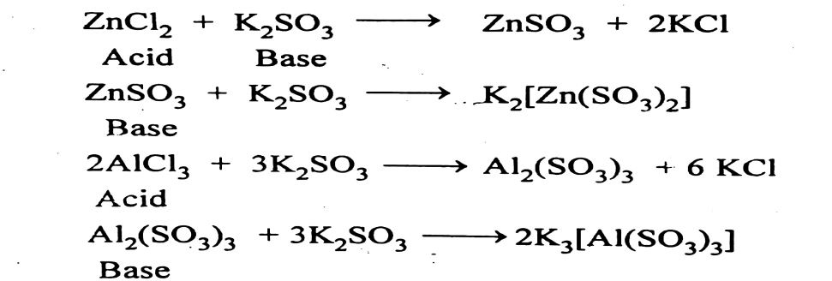
vi) Many covalent halides like BCl₃, AlCl₃, AsCl₃ and organic amines, ethers, alcohols, etc. are freely soluble in sulphur dioxide.
Similar to liquid ammonia, in liquid sulphur dioxide, all types of reactions have been studied. Let us concentrate on acid-base reactions only.
Acid-Base Reactions in liquid Sulphur dioxide
The liquid sulphur dioxide undergoes auto-ionization similar to water and liquid ammonia.
SO₂ + SO₂ → SO²⁺ + SO
Thionyl ion Sulphite ion
For example, the titration of potassium sulphite against thionyl chloride can be followed by conductometrically, and a typical neutralization curve is obtained:
The thionyl ions (SO²⁺) would act as Lewis acids whereas the sulphite ions (SO₃²⁻) would act as strong Lewis bases, hence the parent substances giving these ions in liquid sulphur dioxide can be treated accordingly and can be studied under acid-base reactions on the basis of Lewis concept.
For example, the titration of potassium sulphite against thionyl chloride can be followed by conductometrically, and a typical neutralization curve is obtained:
SOCl₂ + K₂SO₃ → 2KCl + 2 SO₂
Acid Base Salt Solvent
Similarly,
SO(SCN)₂ + Cs₂SO₃ → 2CsSCN + 2SO₃
Amphoteric Behaviour:
The Zn(II) and Al(III) salts show amphoteric behaviour in liquid sulphur dioxide.
Aluminium hydroxide is insoluble in water and in liquid sulphur dioxide. But it readily dissolves in either strong acidic or basic solution.
Similarly, aluminium sulphite Al₂(SO₃)₃ is found to be insoluble in water and liquid SO₂. But if addition of either base (SO₃²⁻) or an acid (SOCl₂) is followed, it dissolves freely.

Slide 40
Exercises
Q. 1 Choose the correct alternative and rewrite the sentence :
According to Arrhenius concept, an acid is…………….
Hydrogen containing compound, giving H⁺ Ion.
Proton acceptor.
Electron pair acceptor.
Electrophilic
ii)According to Bronsted, an acid is……………
Hydrogen containing compound.
Proton Donor.
Electron pair acceptor.
Nucleophilic.
iii)According to Lewis theory, and acid is……………
Hydrogen giving substance.
Proton Donor.
An electron pair acceptor.
Electrophilic.
iv. According to Lux Flood concept, an acid is…………..
Proton Donor.
Electron pair Donor.
Oxide which donates oxygen.
Oxide which accepts oxygen.
v. Arrhenius concept is called as…………..
Water Ion system.
Proton Donor acceptor system.
Electron donor acceptor system.
Oxide Ion theory.
vi. Bronsted concept is called as……………
Water iron system.
Proton Donor acceptor system.
Electron donor acceptor system.
The non protonic concept.
vii. Lewis theory is known as……………..
The cult of proton.
Proton Donor system.
Electron donor acceptor system.
Iron oxide theory.

Slide 41
11. According to Arrhenius, acid is the substance which is aqueous medium gives………….
H⁺
H_
Cl_
O_ _
12. HCl in gaseous phase is………….
Arrhenius acid.
Arrhenius base.
Either of them.
13. Bronsted-Lowry acid
Bronsted-Lowry defines base as…………..acceptor.
hydroxyl ion.
Oxide.
Proton.
Cl_
8. The Lux flood definition carries the name……………
The electron shell game.
The protonic concept.
The electronic theory.
The non protonic concept.
9. An acid is a substance having……………
A sour taste.
Bitter taste.
Soapy to tough.
Change the colour of plant dye to blue.
10. The electronic theory of acids and bases was put forward in…………
1887.
1923.
1939.
1929.

Slide 42
14. Lewis acid is…………acceptor.
Proton.
Electron pair.
Oxygen.
Nitrogen.
15. BF₃ is…………..molecule.
Lewis acid.
Lewis base.
Bronsted-Lowry acid.
Lux flood acid.
16. ………………is anion acceptor.
Lux flood acid.
Lux flood base.
Arrhenius base.
Lewis acid.
17. Metal ions act as……………
Lewis base.
Lewis acid and base.
Lewis acid.
Lux flood acid.
18. Compounds with carbon-carbon double bond act as…………
Bronsted acid.
Bronsted base.
Lewis acid.
Lewis base.
19. Cl⁻ is a base according to……………
Lewis concept.
Bronsted-Lowry concept.
Both a and b.
Arrhenius concept.
20. CO₂ is an example of Lewis……….
Acid.
Base.
Amphoteric.
Neutral.
21. Lewis acid is………….acceptor.
Proton.
Electron pair.
Oxygen.
Hydrogen.

Slide 43
22. Lewis base is…………Donor.
Electron pair.
Proton.
Hydrogen.
Nitrogen.
23. ……………is base according to Bronsted Lowry concept as well as Lewis concept.
NH₃
NaOH
C₆H₅OH
CH3OH
24. According to Lux flood theory base is donor of…………
Pair of electrons.
Protons.
Oxide Ion.
Neutrons.
25. Pearson’s principle states ……
(a) hard prefers to bind hard
(b) hard prefers to bind soft
(c) soft prefers to bind hard
(d) hard prefers to bind hard and soft prefers to soft
26. Li⁺ is the ……
(a) soft base (b) hard base
(c) soft acid (d) hard acid
27. Classification of acids and bases as HSAB is due to ……
(a) Lewis (b) Arrhenius
(c) Bronsted (d) Pearson
28. For hard acids KF, F⁻ >> Cl⁻ > Br⁻ > I⁻ ……
(a) false (b) reverse is true
(c) for soft acids (d) correct
29. H⁺ is called as hard acid whereas H⁻ is a soft base.
(a) false (b) reverse is true
(c) H⁺ is called soft acid (d) correct
30. Which of the following is hard acid?
(a) Pt⁺² (b) Ag⁺
(c) Hg²⁺ (d) Li⁺
31. Which of the following is soft base?
(a) NH₃ (b) H₂O
(c) OH⁻ (d) I⁻
32. …… is the borderline acid.
(a) Ag (b) Al³⁺
(c) K⁺ (d) Zn²⁺

Slide 44
33. …… complex ion is stable.
(a) [AgF₂]⁻ (b) [Cd(NH₃)₄]²⁺
(c) [CoI₆]³⁻ (d) [AgI₂]⁻
34. H⁺ is the ……
(a) soft base (b) hard base
(c) soft acid (d) hard acid
35. …… is more stable complex.
(a) MgS (b) CaS
(c) Al₂S₃ (d) MgCO₃
36. Which of the following is hard acid?
(a) [AgCl₂]⁻ (b) MgS
(c) [CoI₆]³⁻ (d) [CoF₆]³⁻
37. HSA.B concept is introduced by ……
(a) Lorry (b) Usanouich
(c) Lewis (d) Pearson
38. Hard acids are ……
(a) alkali metals
(b) alkaline earth metals
(c) lighter transition metals with higher oxidation states
(d) all of the above
39. Ammonia is ……
(a) soft base (b) hard acid
(c) soft acid (d) hard base
40. Most of the hard acid and hard base form ……
(a) covalent and ionic (b) covalent
(c) soft acid (d) ionic
41. Freezing point of liq. NH₃ is ……
(a) 198 K (−75°C) (b) 195 K (−78°C)
(c) 263 K (−10°C) (d) 240 K (−33°C)
42. Liquid sulphur dioxide ……
(a) is a protonic solvent
(b) is the aprotic, auto-ionizing non-aqueous solvent
(c) non autoionising solvent
(d) none of these
43. Dielectric constant of water is ……
(a) 100 (b) 82
(c) very low (d) 273
44. Boiling point of liq. SO₂ is ……
(a) 198 K (−75°C) (b) 263 K (−10°C)
(c) 240 K (−33°C); (d) 195 K (−78°C)
45. Amphiprotic solvent shows tendency to ……
(a) release protons
(b) either release or accept protons
(c) to accept protons only
(d) neither release nor to accept protons
46. Dielectric constant of SO₂ is ……
(a) 19.3 (285 K) (b) 17.3 (256 K)
(c) 20.3 (300 K) (d) 21.3 (315 K)
47. …… acts as the “universal solvent”.
(a) Benzene (b) Water
(c) Ammonia (d) Sulphur dioxide
48. Boiling point of liq. NH₃ is ……
(a) 198 K (−75°C) (b) 240 K (−33°C)
(c) 263 K (−10°C) (d) 195 K (−78°C)
49. Liquid ammonia ……
(a) is an aprotic non-aqueous solvent
(b) in dilute solutions, it gives blue colour with alkali metals
(c) does not undergo auto-ionization
(d) has higher dielectric constant than that of water

Slide 45
Q. 2. Answer the following in one sentence.
1. State Pearsons principle.
2. Define hard acid .
3.Define soft acid.
4. . Define hard base.
5.Define soft base.
6.Define acid and base according to Arrhenius theory.
7.Define acid and base according to Bronsted- Lowry theory.
. 8.Define acid and base according to Lewis theory.
9.Define acid and base according to Lux-Flood concept.
10.Give the auto ionization reaction in liquid ammonia.
10.Give the auto ionization reaction in liquid sulphur dioxide.
11. Define Solvent
12. Define Solute
13 Define Levelling effect
14. Define Dielectric constant
15. Define Dipole moment
16.Define acid and base on the basis of Arrhenius Concept.
17.Define acid and base on the basis of Bronsted Lowry concept.
18.Define acid and base on the basis of Lewis concept.
19.Define acid and base on the basis of Lux-Flood concept.
3. Short and answer type Questions
1.On the basis of Bronsted-Lowry Concept, explain the term conjugate acid-base pair.
2.Explain in brief classification of Lewis acids and bases.
3What are limita.tions of Arrhenius concept of acids and bases?
4.Explain in brief atmospheric nature of water on the basis of Bronsted-Lowry concept.
5. What are the limitations of Bronsted-Lowry or Arrhenius or Lewis or Lux flood concept of acids and bases
6. Arrhenius concept of acid and bases.
7 .Lewis concept of acids and bases.
8. Bronsted-Lowry concept of acids and bases.
9 .Lux Flood concept of acid and bases.
10. What is a “solvated electron”? Comment.
11..Explain liquid ammonia as non-aqueous solvents
12. Explain liquid sulphur dioxide as non-aqueous solvents.
13. Distinguish between acid-base reactions for water and ammonia as solvents.
14. Distinguish between sulphur dioxide and ammonia as non-aqueous solvents.
15. Write short note on levelling effect in liquid ammonia.
16. Give acid-base reactions in liquid sulphur dioxide liquid ammonia.
17. Give the auto-ionization reactions in liquid ammonia.
18. Give short precise note on protic-aprotic solvents

Slide 46
19. Explain in brief amphoteric nature of water according to Bronsted-Lowwry theory
20.Explain in brief acid-base reactions in liquid SO₂
21. Give auto-ionization reaction in liquid ammonia
22. Explain the leveling effect in liquid ammonia
23. Write a short note on Person’s principle
24. Distinguish between hard acids and soft acids
25. Distinguish between hard basis and soft basis
27. Give limitations of Pearsons’s principles
28. Give an account of acid-base strength and hardness-softness
29. Explain the conjugate acid-base pair formation according to Bronsted-Lowwry theory
12. Explain: “CH₃COOH is a strong acid in liquid NH. Give the acid-base reactions with reference to liquid NH₃ as a solvent.
13. Discuss the classification of solvents with suitable examples. Explain solutions of metals in liquid ammonia are better reducing agents.
14. Give the physical properties and acid-base reactions in liquid NH₃ as non-aqueous solvents
15. Give the physical properties and acid-base reactions in liquid SO₂ as non-aqueous solvents.
16. Explain types of solvents with suitable example.
17. Define the terms acid and base w.r.t. liquid ammonia and liquid sulphur dioxide as solvents, give suitable examples.
18. Why water is called as universal solvent? Give protic and aprotic solvents.
19. With reference to liquid sulphur dioxide as a solvent, classify the following as acids, bases or salts:
KBr, Cs₂SO₃, SO, (SCN)₂, SO²⁺, K₂[Zn(SO₃)₂], SO
20. Explain with suitable acid-base definition, and as appropriate illustration, wherever possible for:
(i) Ammonia is a “waterlike” solvent.
(ii) Strong acid such as HNO₃ act as a stronger acid in liquid ammonia.
(iii) Alkali metals in liquid ammonia are good reducing agents.
21. How acids and basis are defined according to Bronsted -Lowry theory? Explain in brief conjugate acid base pair. Give the merits and demerits of the theory.
22. Define and explain with suitable example acid and basis according to Lewis theory. Give the merits and demerits of the theory.
Q. 3 Long answer type questions :
1. Give a brief account of classification of acids as hard and soft.
2. Give an account of acid-base strength and hardness-softness.
3. How do you classify bases as hard and soft according to Pearson’s rule?
4. Write precisely on classification of acids and bases as hard and soft.
5. Comment on HSAB concept with suitable examples.
6. What do you know about acid-base strength and hardness-softness?
7. Write a critical note on applications and limitations of HSAB principle.
8. What do you mean by hard and soft acids and bases? Give their characteristics and classification.
9. Discuss theoretical bases of hardness and softness. How are they related to acid-base strength and electronegativity?
10. According to Pearson’s rule, distinguish between (a) Hard acid and soft acid, (b) Hard base and soft base

Slide 47
23. How acids and basis are classified as hard, soft and border lined according to HSAB concept.
24. Give the merits and demerits of Person’s HSAB concept
25. Explain in brief the classification or types of solvent
26. Explain in brief the acid-base reactions in liquid ammonia as solvent
27. Give the physical properties of liquid SO₂ . Explain acid-base reactions in liquid SO₂
28. Write precisely on classification on acids and basis as hard , soft and borderline.
29. Discuss the applications and limitations of HSAB concept

