Slide 1


Wel-Come

Slide 2
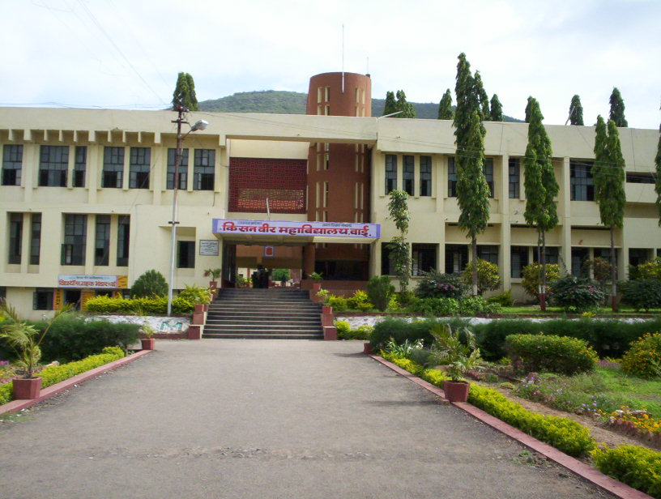
Dr. Dnyandev. N. Zambare
M. Sc. Ph. D
Associate Professor
Department of chemistry
Kisan Veer Mahavidyalaya, Wai.
Dist- Satara pin- 412803
Mob. no.-9890891947

Slide 3
Chapter 1. Manufacture of Heavy Chemicals (8)
Contents …
1.1 Introduction
1.2 Manufacture of Ammonia (NH₃)
i. Physico-chemical principles
ii. Manufacture by Haber’s process
1.3 Manufacture of Sulphuric acid (H₂SO₄)
i. Physico-chemical principles
ii. Manufacture by Contact process
1.4 Manufacture of Nitric acid (HNO₃)
i. Physico-chemical principles
ii. Manufacture by Ostwald’s (Ammonia oxidation process)
1.5 Manufacture of Sodium carbonate (Washing soda) (Na₂CO₃)
i. Physico-chemical principles
ii. Manufacture by Solvay process

Slide 4
.1 Introduction (General Account)
1.1 Introduction:
Industrial chemistry is the branch of chemistry which deals with the preparation of various chemicals on a large scale.
The chemicals which are manufactured and consumed on commercial scale are generally known as the heavy chemicals.
The rate of a chemical reaction depends on several factors such as temperature, pressure (of the gaseous reactants), concentration and use of catalyst.

Slide 5
:
1.2 Manufacture of Ammonia (NH₃)
i. Physico-chemical principles
ii. Manufacture by Haber’s process
This process was developed by Fritz Haber and Carl Bosch (German Chemists during 1904 to 1908), and therefore known as Haber Bosch process.
i. Physico-chemical principles
  The key reaction of Haber's process is
N₂ (g) + 3H₂ (g) → 2NH₃ (g) +100 kJ ....(1)
      1 vol 3vols 2 vols
(a) Effect of Concentration:
By applying Law of Mass action to reaction (1) the equilibrium constant, K_{c} (for molar concentrations) is:
to get good yield of NH₃, concentration of both N₂ and H₂ should be increased

Slide 6
(b) Effect of Temperature:
N₂ (g) + 3 H₂ (g)→ 2 NH₃ (g) + 100 kJ
Since the reaction is reversible and exothermic, the decrease in temperature should favour the formation of ammonia.
The effect of temperature on ammonia synthesis can be ascertained from the mass law equation as given below:
Experimentally, the optimum temperature is found to be 500 - 550°C,(773 - 823 K).

Slide 7
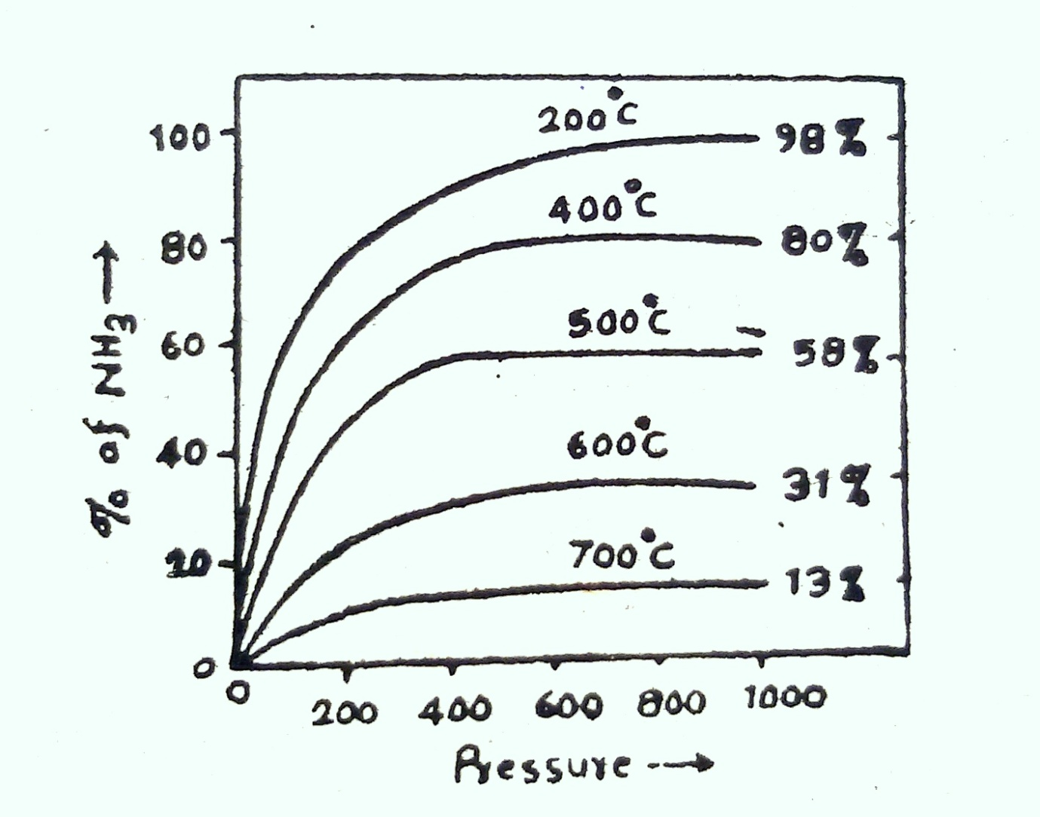
(c) Effect of Pressure:

Slide 8
(c) Effect of Pressure:
At a given temperature, increase in pressure increases the yield of ammonia.
In practice, the process is carried out by applying the pressure equal to 200 atmospheres (202 x 10⁵ Pa).

Slide 9
(d) Effect of Catalyst:
Time of Contact (Space Velocity) :
(i) Low Temperature (773 to 823 K) (500° - 550° C)
(ii) High Pressure ( 202 x 10⁵ Pa or Nm⁻²) ( 200 atm.)
(iii) Concentration of N₂: H₂1: 3
(iv) Space Velocity 600 - 1200 m³
(v) Catalyst: (Fe₂O₃ + Mo) or (Fe₂O₃ + Al₂O₃ + K₂O).

Slide 10
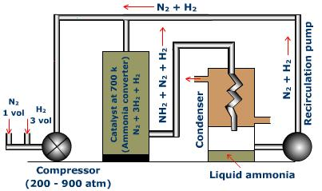
Manufacture by Haber’s process (Plant and Process):

Slide 11
Working:
(i)Production and purification of the reacting Gases:
Nitrogen and hydrogen are the basic requirements of Haber's process. Hydrogen can be obtained from water gas (CO + H₂), or from electrolysis of acidified water or from decomposition of steam or from natural gas. Nitrogen is obtained from producer gas (CO + N₂) or air or from liquid air by fractional distillation.
(ii) Conversion to Ammonia:
N₂+ 3 H₂ → 2 NH₃ + 100kJ
(iii) Liquefaction of Ammonia: This mixture is then passed through condensing coils (immersed in the refrigerated brine) where it is cooled to about −10° to −20°C (263 to 253 K). Gaseous ammonia condenses to liquid ammonia and is collected.

Slide 12
Merits of Haber's Process:
( i) Highly pure and concentrated ammonia is obtained.
(ii) Process is cheap and economical on unit cost basis.
(iii) The working conditions being simple, the process can be carried out at any place.
(iv) With no loss, 8 to 12 % of NH₃ is produced in each circulation by Haber process. In other methods, % yield of NH₃ is less than 5.
World production of NH₃ was 1 million tonnes per year in 1950 and it has risen to 98 million tonnes in 1988. The largest producers are Russia 27 %, China 21 %, USA 18 %, Canada 4 %, Romania 4 %, etc.

Slide 13
Manufacture of H₂SO₄ by Contact process:
In a nut shell:
S_{(g)} → SO_{2(g)} → SO_{3(g)} → H₂S₂O_{7(l)} → 2H₂SO_{4(l)}
(Conditions to get good yield of Sulphur trioxide):
The entire success of contact process lies in the catalytic oxidation of sulphur dioxide to sulphur trioxide by atmospheric oxygen. This reaction may be represented as:
2 SO₂ + O₂ 2 SO₃ +189 kJ
2 vols 1vol 2 vols

Slide 14
Physico-chemical principles
(i) Effect of Concentration:
In the reaction mixture proportion of nitrogen and hydrogen should be 1: 3
(b) Effect of Temperature:
N₂ (g) + 3 H₂ (g) 2 NH₃ (g) + 100 kJ
the optimum temperature is found to be 500 - 550°C, (773 - 823 K).
The process is carried out by applying the pressure equal to 200 atmospheres (202 x 10⁵ Pa).

Slide 15
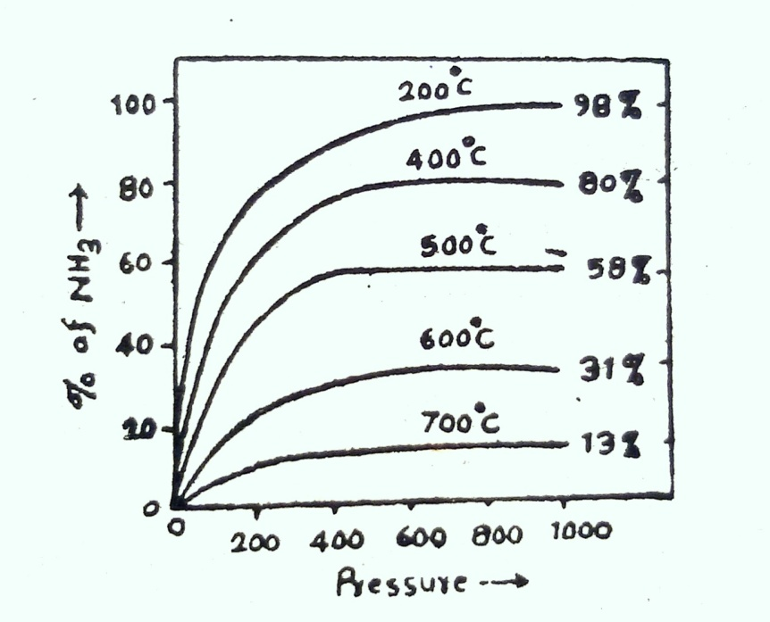
(c) Effect of Pressure:
Increase in pressure should lead to increase in yield of SO₃ because with increase of pressure volume is found to decrease. In actual practice, all contact plants are operated at atmospheric pressure that is, without appixing any pressure or at slightly higher pressure of 1.5-1.7 atmospheres.
The conversion of SO₂ to SO₃ in the presence of catalyst is made of following steps :
Diffusion of reacting gases (SO₂ + O₂) to the surface of catalys
Adsorption of reactants at the surface of catalyst.
Formation of product (SO₃) at the surface of catalyst.
Desorption of product from the surface of catalyst.
Diffusion of SO₃ away from the surface of catalyst.

Slide 16
(d) Effect of Catalyst:
Finely divided platinum is the most efficient catalyst. It is applied on several carriers such as asbestos, calcined magnesium sulphate, silica gel etc.
Asbestos fibers coated with finely divided platinum are called platinised asbestos.
Most widely used vanadium catalyst is V₂O₅. It is prepared in the form of pallets by igniting a mixture of zeolite (carrier) and suspension of V₂O₅.

Slide 17
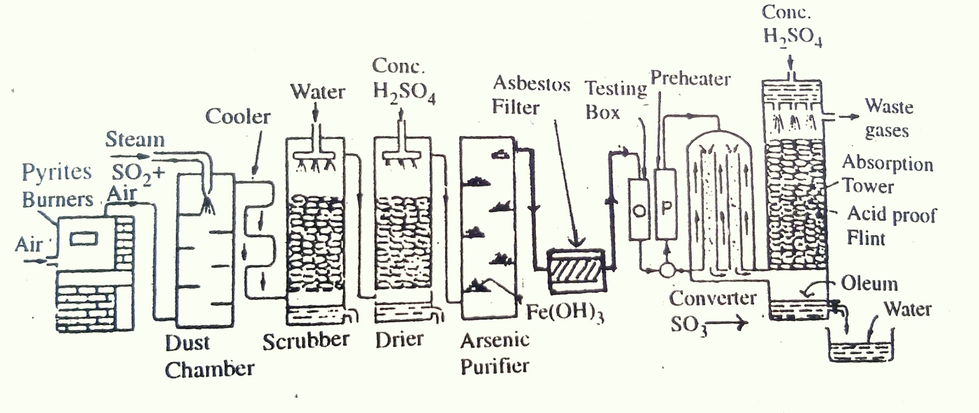
Manufacture by Contact process: (Plant and Process)

Slide 18
Working:
The contact plant consists of the following parts:
(1) Pyrites Burners
(2) Purification unit : (i) Dusting Tower, (ii) Cooler (iii) Scrubber, (iv) Drying Tower, (v) Arsenic Purifier,(vi) Asbestos Filter, (vii) Testing Box or Tyndall Box.
(3) Contact Converter or Contact Tower.
(4) Absorption Tower.
The manufacture of sulphuric acid by contact process is carried out in four steps as discussed below:
1. Production of SO₂,
2. Purification of reacting gases, (if pyrites are used),
3. Conversion of SO₂ to SO₃, and
4. Absorption of SO₃ in conc. H₂SO₄.
Merits and Demerits of Contact Process:
Demerits:

Slide 19
1.4 Manufacture of Nitric acid (HNO₃)
Physico-chemical principles:
(a) Effect of Concentration:
Consider the reaction:
4NH₃ + 5O₂ 4NO + 6 H₂O + 216.6 k cals
4 Vols. 5 Vols. 4 Vols 6 Vols.
(b) Effect of temperature
brings about this conversion very rapidly even at 750°-800⁰C.
(c) Effect of Pressure: three convenient ranges of pressure are found to be suitable.
1) A little above the atmospheric pressure,
2) The intermediate range (i.e. 3-4 atmospheres) and
3) The higher range (i.e. 7-9 atmospheres).
(d) Effect of Catalyst:
The oxidation of NH₃ without a catalyst does not take place sufficiently quickly,platinum as the best catalyst

Slide 20
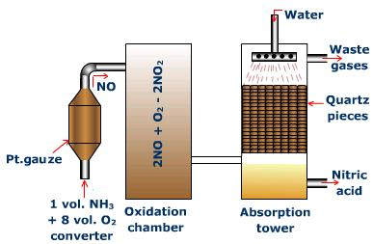
Manufacture by Ostwald’s (Plant and Process):
Working:

Slide 21
Working:
The Ostwald process is carried out in five steps.
i) Production of NH₃ by Haber process:
ii) Oxidation of NH₂ to NO,
iii) Oxidation of NO to NO₂,
iv) Absorption of NO₂ in water, and
v) Concentration of Nitric acid.
The details of working of Ostwald plant are as follows:
4 NO₂ + O₂ + 2H₂O → 4HNO₃

Slide 22
1.5 Manufacture of Sodium carbonate (Washing soda) (Na₂CO₃)
i. Physico-chemical principles:
From theoretical discussion it is clear that the Solvay process is based on the precipitation of sodium bicarbonate by the reaction between sodium chloride (brine) and ammonium bicarbonate from aqueous solution.
i.e. NaCl + NH₄HCO₃ → NaHCO₃ +NH₄Cl
Ionically, Na⁺ + Cl⁻ + NH₄⁺ + HCO₃⁻ → NaHCO₃ +NH₄⁺ + Cl⁻
By neglecting common ions, we get
Na⁺ + HCO₃⁻ → NaHCO₃
Solvay pointed out that precipitation of NaHCO₃ does not occur if NH₂HCO₃ is prepared first and followed by the addition of brine solution.

Slide 23
Thus NH₄HCO₃ is the most soluble while NaHCO₃ is the least soluble at 30⁰C.
Therefore NaHCO₃ is quantitatively precipitated out in the presence of braine at 30°C, due to common ion effect of Na⁺ ions (from NaC1) and HCO₃⁻ ions (which are obtained by passing CO₂ through solution).
The possible reactions are:
i) NH₃ + H₂O → NH_{3.}H₂O i.e NH₄OH
NH₄OH → NH₄⁺ + OH–
ii) CO₂ + H₂O → H₂CO₃
H₂CO₃ → H⁺ + HCO₃⁻
iii) CO₂ ₊ OH– → HCO₃⁻
iv) NaCl+ H₂O → Na⁺ (aq) + Cl⁻(aq) (Ionisation)
Thus the net reaction is:
v) Na⁺ + Cl⁻ + NH₄⁺ + HCO₃⁻ → NaHCO₃ +NH₄⁺ + Cl⁻
i.e. Na⁺ + HCO₃⁻ → NaHCO₃

Slide 24
Conclusion:
To get good yield of NaHCO₃, the following conditions have to be established.
Saturated brine solution to be used to get high initial concentration of Na⁺ ions.
High concentration of NH₃ is needed to get higher amount of NH₄HCO₃ that gives high concentration of HCO₃⁻.
Working temperature should be as low as possible to decrease the solubility product of NaHCO₃.
Ammonia should be first absorbed in brine and then CO₂ is to be passed in
Thus good yield of NaHCO₃ gives better yield of Na₂CO₃.
The Solution is filtered and NaHCO₃ is separated. It is dried and ignited to get anhydrous sodium carbonate called soda ash.
2NaHCO₃Na₂CO₃ ₊ H₂O+ CO₂

Slide 25
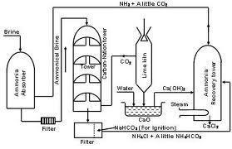
Manufacture by Solvay process (Plant and Process):

Slide 26
Working:For Solvay process,
(i)Purification of Brine and Saturation of Brine with Ammonia:
NH₃ + H₂O + CO₂ → ( NH₄)₂CO₃
CaCl₂ + (NH₄)₂CO₃ → CaCO₃ + 2NH₄Cl
MgCl₂ + ( NH₄)₂CO₃ → MgCO₃ +2NH₄Cl
(ii) Carbonation:
The reactions occurring in carbonation tower are as follows:
NH₃ + H₂O + CO₂ + NaCl → NaHCO₃ +NH₄Cl
Or NH₄HCO₃ + NaCl → NaHCO₃ +NH₄Cl
Ironically NH₄⁺ + HCO₃⁻ + Na⁺ + Cl⁻ → NaHCO₃ +NH₄⁺ + Cl
Discarding the common, we get;
Na⁺ + HCO₃⁻ → NaHCO₃
(iii) Filtration: ions
The solution collected at the base of the carbons ting tower is passed through a vacuum filter of a continuous rotary type. Sodium bicarbonate is separated out while the mother liquor containing NH₄Cl and a little NH₄HCO₃ is pumped up to the top of ammonia recovery tower to recover NH₃.

Slide 27
iv) Calcination:
Sodium bicarbonate, thus obtained is dried and heated at about 300°C in a specially designed vessel whereby Na₂CO₃ is obtained.
2NaHCO₃ → Na₂CO₃ + H₂O+ CO₂
(v) Generation of CO₂:
Limestone is heated in lime-kiln and CO₂ is produced for carbonation.
CaCO₃ → CaO + CO₂
(vi) Recovery of Ammonia :
Steam decomposes NH₄HCO₃ in the upper part of the tower.
NH₄HCO₃ → NH₃ + H2O + CO₂
Milk of lime decomposes NH₄Cl in the lower part of the tower.
2 NH₄Cl + Ca (OH) ₂ → 2NH₃ + CaCl₂. + 2H₂O

Slide 28
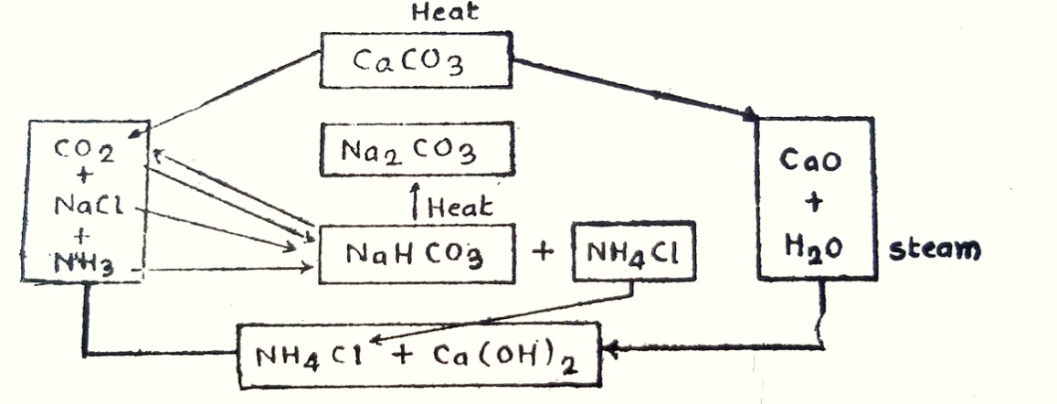
The flow-sheet of Solvay process may be shown as follows:

Slide 29
Advantages of Solvay Process:
(i) The raw materials required for Solvay Process are cheap and easily available on large scale.
(ii)The process is continuous and very efficient.
(iii) The process is more or less self-contained with a little loss of CO₂ and NH₃
(iv) The product obtained is quite cheap and highly pure.
(v) Low grade brine can be used, less raw materials are required. Power consumed is less, no investment for NH₃ plant corrosion problems are less. In short, the cost of production is low and thus the process is more economical.
(vi) The co-produce to be disposed of is CaCl₃ which is rather in expensive.

Slide 30


THANK YOU

