Slide 1

WEL-COME
Dr. D . N. Zambare
Department of Chemistry ,
Kisan Veer Mahavidyalaya, Wai (Satara)

Slide 2
4.Chemistry of Elements of 3d series elements
Contents …
4.1 Introduction of d-Block Elements
4.2 Study of Transition Elements with respect to Electronic Structure, Coloured Ions, Magnetic Properties, Character, Oxidation States, and Complex Formation.
---------------------------------------------------------------------
“Those who aspire not to guess and Devine, but discover and know, who propose not to devise mimic and fabulous world of their own, but to examine and dissect the nature of this very world itself, must go to facts themselves for everything. F. Bacon (1620)

Slide 4
4.1 Introduction to ‘d’ Block Elements
• The series of elements lying in between IIA and IIIA of the periodic table are collectively known as the d-block elements. They belong to groups 3 to 12 (the 1984 IUPAC recommendation) and are often called “transition elements” as they are positioned between the s and p block elements, in the middle of the periodic table. Their properties exhibit transition between highly reactive metallic elements of the s-block (which typically form ionic compounds) and the least metallic elements of the p-block (which form largely covalent compounds).
• The term ‘transition elements’ was introduced originally by Mendeleeff to describe the three triads of elements belonging to VIII group of the periodic table viz. Fe, Co, Ni; Ru, Rh, Pd; Os, Ir and Pt.
• And today, the term transition elements has logically turned to be the useful means to designate these elements in the middle of the Long form of the Periodic Table (the Bohr’s Periodic Table).
• For these elements, the penultimate shell of electrons is expanded from eight to eighteen i.e. (n-1) d¹ ns² to (n-1) d¹⁰ ns² by the addition to the differentiating (last incoming) electron in the (n − 1) d level, which is typically incompletely filled. Therefore, these elements are called d-block, d-type or simply d-elements.

Slide 5
Definition
• “The elements which have partly filled d orbitals, in their atoms or ions, in any of their commonly occurring oxidation states are called the transition elements.”
• Thus we treat the coinage metals Cu, Ag and Au as the transition metals since Cu²⁺, Ag²⁺ and Au²⁺ have 3d⁹, 4d⁹ and 5d⁸ configurations respectively.
• The terminal members in the d-block viz. Zn, Cd and Hg are characterized by the presence of completely filled d-orbitals (i.e. 3d¹⁰, 4d¹⁰ and 5d¹⁰ respectively). According to definition, these three elements are not to be regarded as the true transition elements.
• Due to this difference in their electronic configurations, Zn, Cd and Hg differ from rest of the transition elements in many physical and chemical properties.
• In general, based on the electronic structure, all the transition elements are classified into two broad classes. These are:
1. Main Transition Elements
There are four series of main transition elements corresponding to the filling in 3d, 4d, 5d and 6d sub-levels. (See Fig. 4.1).
2. Inner (Sub) Transition Elements
• There are two series of sub or inner transition elements having partly filled d and ‘f’ orbitals. For detailed information, refer Fig. 4.1.
• At present, out of the total number of elements known so far, about 60% are transition elements in the periodic table.
• In this chapter, we shall consider the characteristic properties of transition elements scandium to zinc belonging to the groups: (IIIB, IVB, VB VIB, VIIB, VIII, IB and IIB) i.e. 3 to 12 groups of the long form of the periodic table

Slide 7
1.2 Study of First Transition Series
(1) Electronic Structure:
Electronic structure is the fundamental basis of study of elemental chemistry. It may be regarded as a sketch-work of an element. Study of electronic configuration enables us to narrate the entire chemistry of the element.
Meaning:
By the term electronic structure we mean the study of distribution of electrons about the nucleus, in the available number of orbitals in accordance with the Aufbau principle.
Aufbau order: In multi-electron atoms, the sequence of energy levels depends on the electron nuclear attraction, and also on electron-electron repulsion. Therefore the Aufbau order for elements from scandium (Z = 21) onwards would be
1s < 2s < 2p <3s <3p <4s <3d <4p <5s etc.
General structure: The 3d-metals belong to the 4th period of the periodic table. The first member of this period is potassium K (Z = 19). Its electronic configuration is [Ar] 4s¹, where argon, Ar (Z = 18) has electronic configuration 1s², 2s², 2p⁶, 3s², 3p⁶. The next element, calcium, Ca (Z = 20) has configuration [Ar] 4s² and from scadium, Sc (Z = 21) onwards, the addition of electrons should take place in 3d-level, in a regular way 3d¹, 3d², 3d³ …… 3d¹⁰ with the exceptions of Cr and Cu.
The general electronic configuration: for 3d series may be given as: (2), (8), (2, 6, x), (2) OR 1s², 2s², 2p⁶, 3s², 3p⁶, 3d^{x} 4s² where x = 1, 2, 3, 4……… 10 OR [Ar], 3d^{x} 4s², where x = 1, 2, 3… 10.
Table 4.1 gives the detailed electronic configurations of the first-row transition elements.

Slide 13
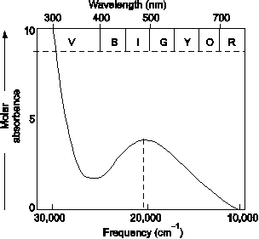

Slide 17
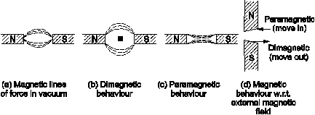
(3) Magnetic properties (Character):
Magnetic Behaviour:
• Different substances exhibit different behaviour when placed in the external magnetic field. Most of the substances are repelled by a strong magnetic field, while some are attracted by it. In a few cases, the force of attraction is found to be very large (e.g., iron, cobalt, nickel, magnetite (Fe₃O₄) and some Mn alloys). Such tendencies are called magnetic characters, or magnetic properties and the materials exhibiting these characters are called magnetic materials. The various kinds of magnetisms are Diamagnetism, Paramagnetism, Ferromagnetism and Antiferromagnetism. Substances showing these characters are called Diamagnetic, Paramagnetic, Ferromagnetic and Antiferromagnetic respectively (See Fig. 4.6)

Slide 18
Paramagnetism:
Because of electron spin, unpaired electrons give rise to paramagnetism. For the transition metals, where ‘d’ orbitals are partially filled, paramagnetism is more likely. Transition metals in atomic, ionic and molecular states exhibit paramagnetism resulting from the presence of one or more unpaired electron spins. In few cases, special reinforcement of paramagnetism occurs as an effect of extensive co-operative electron-spin alignment; and this gives rise to Ferromagnetism, e.g. Fe, Co, Ni, Fe₃O₄, some alloys of Mn are ferromagnetism, can be, therefore, converted into permanent magnets.

Slide 22
Calculations:
The oxidation number can be calculated for both ionic and covalent compounds and without the knowledge of multiplicity of the bonds.
For example,
1. The oxidation number of Cr in K₂CrO₄ can be calculated as follows: Remove 2K⁺ ions (which will leave two negative charges behind) and remove four O²⁻ ions (leaving eight positive charges behind), so that the charge left on Cr is (−2 + 8) = (+6).
2. Similarly, we can account (+7) and (+6) oxidation states of Mn respectively in KMnO₄ and K₂MnO₄. It should be noted that the oxidation number is not essentially the charge on the ion. For example, Mn²⁺ can exist but Mn⁷⁺ or Mn⁶⁺ do

Slide 23
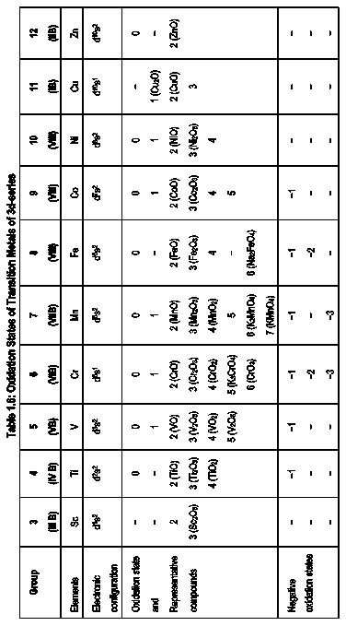

Slide 24
Trends:
(a) Range of oxidation states
There is a general trend between a minimum number of oxidation states at both extremes (Sc³⁺ and Zn²⁺) to a maximum number of states in the middle (Mn ≡ −3 to +7). The details are as follows:
(i) Scandium could have an oxidation state of (+2) if it’s both 4s electrons are used for bonding. It shows (+3) state when two s and d electrons are involved in bonding.
(ii) Titanium can have (+2) oxidation state when both s electrons are used for bonding, (+3) when two s and one d electrons are used and (+4) when all the four electrons, 3d² 4s² from outer orbitals, are used for bonding.
(iii) Similarly, vanadium exhibits (+2) to (+5) oxidation states.
(iv) In the case of chromium, use of single electron from 4s gives us oxidation state of (+1) and then by using different numbers of d electrons, it can show oxidation states of (+2), (+3), (+4), (+5) and (+6).
(v) Manganese can be accounted similarly and we may have its oxidation states (+2) to (+7).
Thus, in all these cases, there is a perfect correlation between the electronic configuration and minimum and maximum oxidation states, especially in simple compounds. Consequently, the transition metals can show some similarities with elements of the main groups in oxidation states, to certain extent. For example, SO and CrO are isostructural, as are SiCl₄ to and TiCl₄ etc.

Slide 27
(e) Complex Formation:
Review
• The transition metals have a much more diverse and interesting chemistry than those of the normal elements. Formation of complex ions is one such striking property of transition metals. This is in sharp contrast to the s and p block elements.
Definition
• "A complex ion is one that contains a central ion (of transition metal) linked to other atoms, ions or molecules, called ligands". The ligands contain at least one lone-pair of electrons which is donated to the central metal ion during the formation of a complex.
• Thus, a complex is a combination of a Lewis acid (the transition metal) with a number of Lewis bases (the ligands). A ligand may be a neutral molecule such as NH₃ or an ion such as CN− or Cl−. Cobalt forms more complexes than any other element.
For example:
Fe³⁺ + 6CN− → [Fe(CN)₆]³⁻ , Co³⁺ + 6NH₃→[Co(NH₃)₆]³⁺
Fundamental Characteristics
The chemistry of transition elements may be regarded as the chemistry of co-ordination compounds or the chemistry of complexes. The profuse ability to form complexes arises on account of the special properties associated with the transition metals. These properties are:
1. Transition metal ions have small ionic size.
2. They have comparatively high nuclear charge.
3. They are moderately basic.
4. They exhibit variable oxidation states.
5. Their electronic structure is rather suitable for bonding.
6. They are able to form σ and π bonds with the ligands.
7. They have vacant or partially filled [n − 1] d orbitals of suitable energy to accept lone pairs of electrons from the ligands to establish co-ordinate covalent bonds with them.

Slide 31
Catalytic Properties
Most of the transition elements and their compounds exhibit catalytic properties. Some of the important ones are:
TiCl₄ → Used as the Ziegler-Natta catalyst in the production of polythene.
V₂O₅ → For conversion of SO₂ to SO₂ in the manufacture of H₂SO₄ by contact process.
MnO₂ → Catalyst for decomposition of KClO₃ to manufacture O₂.
Fe → Promoted iron is used in Haber process for the manufacture of NH₃.
FeCl₃ → Used in the production of CCl₄ from CS₂ and Cl₂.
Ni → Raney nickel for number of reduction processes. Rappe synthesis (Polymerization of alkynes).
(Complexes)
Cu → Manufacture of (CH₃)₂SiCl₂ to get silicones.
Cu/V → Manufacture of Nylon-66.
CuCl₂ → Deacon process to get Cl₂ from HCl.

Slide 34

THANK YOU

