Slide 1
Wel-Come

Slide 2
Dr. Dnyandev. N. Zambare M. Sc. Ph. D
Professor
Department of chemistry
Kisan Veer Mahavidyalaya, Wai.
Dist- Satara pin- 412803
Mob. no.-9890891947

Slide 3
Chapter 4… 4. METALS AND SEMICONDUCTORS
4.1 Introduction.
4.2 Properties of metallic solids.
4.3 Theories of bonding in metal.
i) Free electron theory.
ii) Molecular orbital theory (Band theory).
4.4 Classification of solids as conductor, insulators and semiconductors on the basis of band theory.
4.5 Semiconductors.
Types of semiconductors - intrinsic and extrinsic semiconductors.
Applications of semiconductors.
4.6 Superconductors:
Ceramic superconductors - Preparation and structures of mixed oxide YBa2Cu3O7 – x
4.7 Applications of superconductors

Slide 4
4.1Introduction
The Solid State:
Matter is something that has mass and occupies space .It is characterized by a set of properties such as shape, size, mass, melting point, boiling point., color, texture, reactivity, etc. Based on size shape, volume and rigidity, matter is classified into three categories: solid, liquid and gaseous .There are some simplifying features of solids which allow considerable insight into their nature. The solids have definite shape and volume and are rigid.

Slide 5
Types of Solids:
Crystalline Solids : The Solids whose constituents are arranged in a regular geometrical pattern over the entire lattice are knows as the crystalline Solids .This is proved to be so by X –ray diffraction study .Due to the orderly arranged atoms, ions or molecules the crystalline Solids exhibit different elements of symmetry and accordingly belong to either of the crystal systems.
Metallic Crystals: The crystalline Solids having positively charged metal ions in the lattice points, surrounded by a sea of mobile electrons are known as metallic crystals. For example: Copper, Silver, gold, sodium, potassium, iron, cobalt, nickel, etc. Here the binding force is the electrical attraction between positively charged metal ions and negatively charged sea of mobile electrons METALS:
The most numerous of all the elements are the metallic elements. All the elements in the s, d and f blocks are metals: aluminium, gallium, indium, thallium, tin, lead and bismuth of the p-block are considered to be metals.

Slide 6
4.2 PROPERTIES OF METALLIC SOLIDS :

Slide 7
2.2 Precipitation
Definition:
“A chemical process in which the soluble substance under study is separated as an insoluble solid phase from the given solution is known as precipitation”.
Principle:
The process of precipitation of an electrolyte occurs provided that the product of ionic concentration exceeds the solubility product of the electrolyte in the given solution, at the given temperature. The process of precipitation continues until the system reaches the equilibrium conditions.
For example: Ba²⁺ + SO²⁻₄ → BaSO₄ ↓
The reaction proceeds in the forward direction and barium gets precipitated as barium sulphate, provided:
[Ba²⁺] [SO²⁻₄] > K_{sp} of BaSO₄
The factors which decide the success of precipitation methods are as follows:
(1)The factors pertaining to the precipitated form:
(2) The factors pertaining to the weighed Form:
Conclusion:
From the above discussion one may conclude that in gravimetric analysis, the compounds should be properly chosen and the precipitation must be carried out under suitably controlled conditions so that they fulfill the necessary requirements for the precipitated form and the weighed form.

Slide 8
2.3 Nucleation (Formation of Nuclei)
Definition:
The extremely small particles of precipitate (much less than microscopic size) that serves as the centers for subsequent growth of precipitate are called nuclei. “A process whereby some minimum number of ions (or molecules) (perhaps as minimum as 4 or 5) unite to form the smallest (or beginning) nuclei for the solid phase is known as nucleation”.
X + X → X₂
X₂ + X → X₃
X₃ + X → X₄
In general, X_{(n−1)} + X → X_{n} Where, X- an ion or a molecule, and
X_{n} - a crystal nucleus.
Ion pair → ion cluster → critical size → acts as nuclei
Types of Nucleation:-i)Homogeneous ii)Heterogeneous

Slide 9
2.4 Crystal Growth
Once the nucleus is formed, it continues to grow by a continued to grow by a continued deposition of the particles of the precipitate on the nuclei till the average size of the particle is reached for the initial precipitate. At the same time, the component ions (M⁺ and A⁻), are deposited at specified sites in an orderly and uniform geometrical pattern leading to the built of crystal lattice.
Ions (10⁻⁸ cm ) → Nucleation → Nucleation cluster (10⁻⁷cm) →Colloidal particles (10⁻⁴ cm) →Precipitate (>10⁻⁴ cm) →Thus crystal growth formation takes place
The rate of crystal growth is governed by the degree of supersaturation. In general, general, greater the supersaturation, much faster is the crystal growth.
The transfer of solute from the solution phase to the growing crystal is a two-stage process:
1. The diffusion of ions (or molecules) to the surface of the growing crystal, and then
2. The actual deposition of ions (or molecules) on the surface of the crystal, i.e. incorporation of ions into the crystal lattice.
Naturally, the step which is slower of the two determines the rate of crystal growth.
[The experimental condition will influence these processes differently. For example, diffusion will be affected by (a) concentration, (b) temperature, (c) stirring, and (d) the actual properties of the ions (or molecules) involved in the crystal growth.
On the other hand, deposition rates are affected by (a) concentration, (b) surface properties (i.e. the edges, faces, corners, etc.), and (c) the type of geometric arrangement

Slide 10
Crystal Structure
The distinctive properties of metals depend on their crystal structure .Metals have comparatively high melting points ,high boiling points and high densities .These indicate a close-packing of atoms .X-ray analyses have revealed that the metallic atoms give closest packed structures namely face centered cubic, body centered cubic and hexagonal close-packed .See Fig 4.1
Some examples of metallic crystals have been given in Table 4.1
Table 4.1: Crystal structure of Metals
Types of Lattice | Co-ordination number | Metals
1. Cubic closed packed (ccp) or (fcc) | 12 | Cu, Ag, Au, Ca, Sr, Fe, Co, Ni, Ru, Rh, Rd, Os, Ir, Pt, Sc, Y, La etc.
2. Body-centered cubic (bcc) | 8 | Li, Na, K, Rb, Cs, Ti, Zr, Hf, V, Nb, Ta, Cr, Mo, W etc.
3. Hexagonal close- packed | 12 | Be, Mg, Ca, Sc, Y, La, Ti, Zr, Hf, Co, Ni, Ru, Os, Zn, Cd etc
4. Complex structure | 12 | As, Sb, Bi, Se, Te, Po, Pa, U, Np, Pu, Ga, In, Ge, Sn etc

Slide 11
High Electrical Conductivity :
Conduction is mechanism of transmission of energy without transfer of mass. Electrical conduction arises due to the flow of mobile electrons through the vacant space between the metal ions. Conduction is effected by displacement mechanism. When an electric field is applied across a metal electrons enter at one end and kicked out form the other as shown in Fig 4.2 Conductivity is a periodic property. With increase of mobile electrons, conductivity increases.
e.g. Na < Mg < Al . Thus aluminium which contributes three valence electrons is the best conductor of electricity. With increase of temperature, atomic vibrations increase
Table 4.2 Electrical Conductivity of Solids
Solid matter | Bond type | Electrical conductivity
Silver Copper Sodium Zinc | Metallic Metallic Metallic Metallic | 6.3 × 10⁵ 6.0 × 10⁵ 2.4 × 10⁵ 1.7 × 10⁵
Sodium chloride | Ionic | 1 × 10⁻⁷
Diamond Quartz | Covalent Covalent | 1 × 10⁻¹⁴ 1 × 10⁻¹⁴

Slide 12
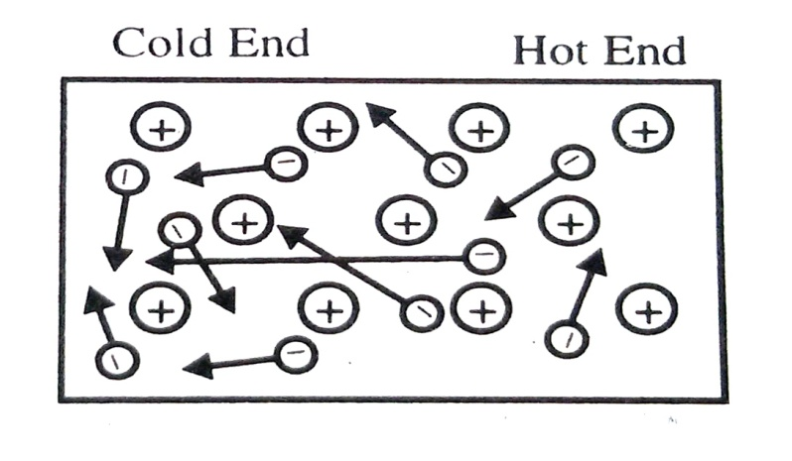
High Thermal Conductivity
Among solid substances metals are by far the best conductors of heat. If metal is heated at one end, the heat is carried to the other end. Mobile electrons absorb energy, become more mobile, collide on adjacent electrons and heat is transported to the other end .See Fig 4.3 similar to the electrical conductivity, the metals are characterized by high thermal conductivity. Thermal conduction increases if number of mobile electrons increases e.g. Na < Mg < Al. With rise in temperature, heat conductivity decreases as the vibrational motion of metal ions increases
Fig.4.3: Thermal conductivity in metal crystal
.

Slide 13
4. Metallic Lustre: (Reflectivity)
All metals typically have a lustrous shiny appearance .When a beam of light (i.e. electromagnetic radiations) falls on the surface of metal its electric field sets the mobile electrons in the surface of the metal into to and fro oscillations. We know that any m oving charge always emits electromagnetic energy. Hence, these oscillating electrons emits electromagnetic energy in the form of light .Thus when light falls on the surface of the metal it seems as if light is being reflected .This reflectivity is known as metallic luster.
In other words it may be commented that when a beam of light falls on a clean surface the mobile electrons move to some excited state. When these electrons jump back to ground state, light of all wave lengths is re-emitted. Hence show luster.
Note: Sodium, magnesium and aluminum being more reactive they react with atmospheric oxygen and form oxide layer on their surface. Under these conditions the mobile valence electrons are blocked by ionic bonds. Hence these metals do not show metallic luster when tarnished.
5. Emissivity: (Emission of Electrons)
Under the conditions of excitation emission of electrons is called emissivity. When a metal is heated strongly it emits electrons. e.g. W at (28000C) 3073 K and Th at (18000C) 2073 K. On heating the mobile electrons acquire kinetic energy and get boiled off the electron sea. This is known as thermionic emission. This property is used in thermionic valves.
On the other hand, the metals like sodium, potassium, selenium etc. emit electrons when irradiated with UV light. This is known as photo emissivity. This principle is exploited in photoelectric cells.
6. Melting and Boiling Points:
In metallic crystals the force of bonding between metal and metal is the strong electrostatic force of attraction between the positively charged metal ions and the negatively charged sea of mobile electrons. This force is essentially non-rigid and non-directional. Therefore metals have very high melting points and high boiling points.

Slide 14
7. Magnetism:
Many metals possessing one or more unpaired electrons especially the d-and f-block elements, shows considerable degree of paramagnetism
8. Malleability, Ductility and softness
Metals are malleable i.e. easily flattened into thin sheet and are ductile i.e. easily drawn into wire .These properties make the metals the most useful materials of construction.
Metallic elements have a close-packed structure with high coordination number say 8 to 12. The bonding in metallic crystals is the attraction between positively charged metal ions and the mobile electrons. These forces holding the metal ions together are therefore, non rigid and non-directional. On applying mechanical force one layer of ions slips over the other. As a result metal ions move easily from on e lattice site to the other. But in terms of crystal lattice, nothing is changed. The environment of every metal ion remains the same as before since the delocalized electrons are available everywhere which adjust the positions rapidly and the crystal lattice is restored See Fig 4.4

Slide 15
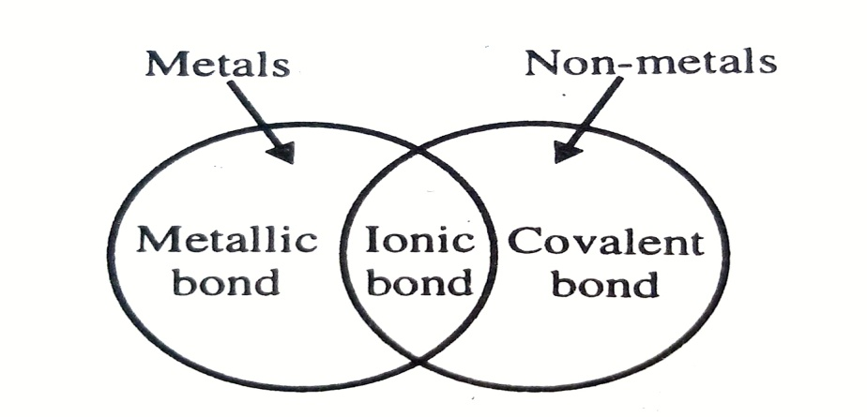
9. High Tensile Strength:
Metals have high tensile strength i.e. metals can resist stretching without breaking. This is attributed to the strong electrostatic force of attraction between the positively charged metal ions and the negatively charged mobile electrons surrounding to them. Thus metallic crystals differ from the covalent crystals or ionic crystals.
10. Elasticity
Elasticity is a property by virtue of which a substance can regain its original form as soon as the deforming force is removed .This property is attributed to the ease with which the metal ions can move from one lattice site to another.
4.3 THEORIES OF BONDING IN METALS
Review:
The metallic bond is a type of binding or linkage or attraction or force that holds the atoms of two or more metals together in an alloy or it is the force that links atoms of the pure metal together in a metallic crystal.
Fig.4.5: Bonding between atoms

Slide 16
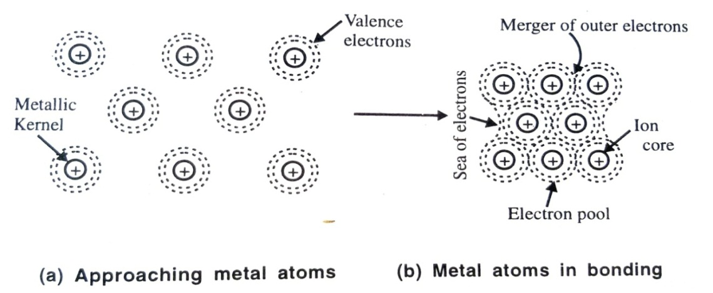
1. The Free Electron Theory of Metals:
As early as 1900 the free electron theory was first proposed by Drude and was further refined by Lorentz in 1932. The theory is based upon two assumptions
(a) Mutual repulsion between the negative electrons in absent.
(b) The potential field due to the positive ions is completely uniform throughout the metallic crystal. According to Drude metal is a lattice through which electrons move as freely as molecules of a gas .This idea was used primarily to account electrical conductivity of metals.
According to Lorentz metal is a lattice of rigid spheres (i.e. positive metal ions) embedded (fixed) in a gas of valence electrons which could move freely in the interstices of metal throughout the crystal.
Explanation:
We know that metals are poor in valence electrons and have low ionization energies. Hence metals lose some of their valence electrons and tend to be electropositive. The electrons so freed are not bound to any single nucleus but spread out around several nuclei. Such free electrons are referred to as non localized or delocalized or mobile electrons and their some total collection is appropriately termed as electron pool or electron cloud or electron gas according to the classical electromagnetic theory. For clear understanding take into consideration Fig 4.6
Fig.4.6: Metallic Bonding by Electron Gas

Slide 17
2. The Band Theory (Molecular Orbital Theory)
The characteristic physical properties as well as the high co-ordination number (either 8 or 1) suggest that the bonding in metals is quite different from those in other substances. There is ionic contribution and it is also not possible to have 2c ─2e covalent bonding between all the adjacent pairs of atoms since there are neither sufficient electrons nor sufficient orbitals. A satisfactory explanation has been provided for metallic bonding by the so-called band theory or molecular orbital theory.
The configurationally study of elements reveals that the presence of empty AOs in the valence shell is a prerequisite for metallic properties. The elements which lack in empty AOs in their valence shell are all non-metals. For example, carbon in excited state and N, O, F, Ne, etc. lack in empty AOs and are therefore non metals.
Formation of Energy Bands:
Basis: The band theory is put forward by Bloch in 1928. This theory is an extension of MOT to metallic structure. According to MOT formation of energy band may be outlined as follows:
We may recall that AOs combine to form MOs of which one half will be bonding type and the other half will be of the anti-bonding type .This mechanism results in the splitting of the original atomic orbital energy levels into different energy MOs.
Clue: In metal crystal there are numerous atoms which involve several combinations between their different types of atomic orbitals. Suppose in a metal crystal there are combinations between n orbitals where n may be considered to be 6x1023 (Avogadro Number) So that there will be 3x1023 bonding and 3x1023 anti-bonding MOs. If the starting AOs are all of similar energy (say 2s AOs in lithium crystal), the resulting boding and anti-bonding MOs give rise to series of very closely spaced energy levels that constitute an energy band .The building up to such MOs may be represented as in Fig 4.7

Slide 18
Fig. 4.7: The combination of n atomic orbitals to form n molecular orbitals of an energy band
Now suppose four Li atoms join to form Li₄ molecule. In Li₄ four AOs would form MOs –two boning and two anti-bonding. The bonding type as shown in Fig 4.9

Slide 19
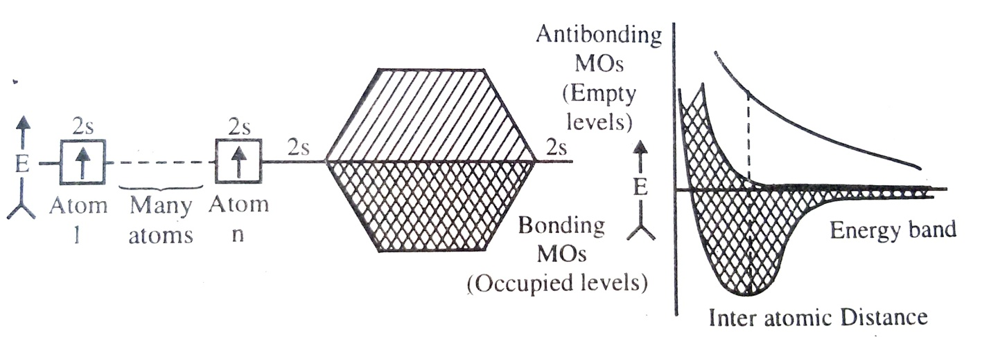
As the number of atoms is the cluster increases the spacing between the various orbitals decreases. And thus with a large number of atoms the energy levels of the orbitals are so close together that the virtually form a continuum i.e. band as shown in Fig 4.10
Fig.4.10: Many closely spaced MO levels constituting a well defined energy band in Li metal
The numbers of MOs are always equal to the number of AOs involved in bonding. Since there is only one valence electron per atom in lithium and a MO can hold two electrons it follows that only half the MOs. in the 2s valence band are filled i.e. the binding MOs are only filled while the anti-bonding MOs are completely empty.
In metals conduction occurs because MO extend over the whole crystal and because there is effectively no energy gap between the filled and lithium is because only half the MO band is filled with electrons. See Fig 4.10 and Fig 4.14 (a)

Slide 20
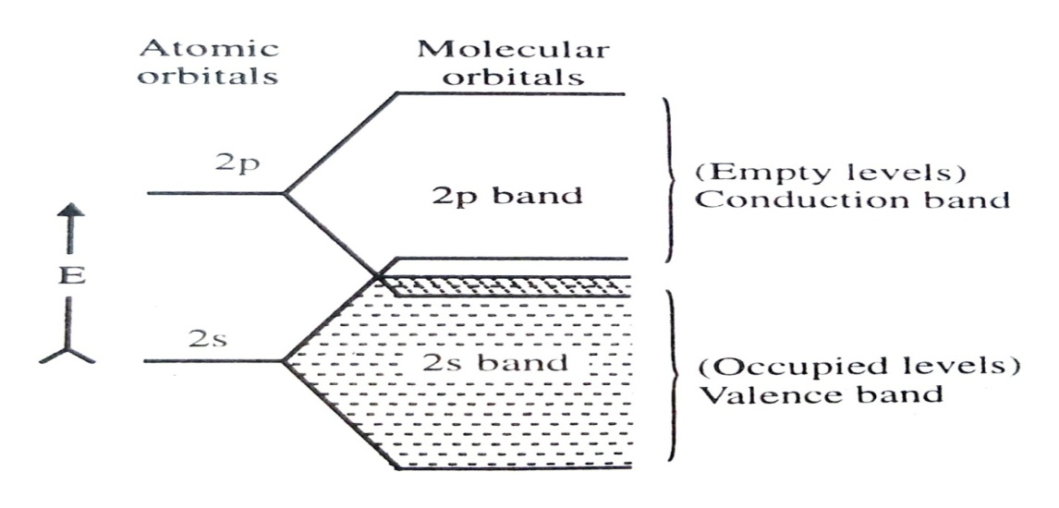
Beryllium Metal:
Be (Z = 4): 1s2 2s1 2p0
In the valence shell of beryllium atom there are two valence electrons which would just fill the 2 s valence band of MOs. In the isolated beryllium atom, the 2s and 2p AOs are some 160 kJ mol-1 different in energy. But in beryllium metal (say Ben) the 2p AOs form a 2p band of MOs just similar to the 2s band of MOs formed from the 2s AOs. The striking aspect is that the upper part of the 2s band overlaps with the lower part of 2p band See Fig 4.11
This overlap causes some of the 2p band occupied while some of the 2s band to be empty. Thus in metallic crystal the energy gap is absent so easy perturbation of electrons from the filled valence band to the empty conduction band. Hence beryllium behaves as a metal.
Fig.4.11: Metallic MOs of Be showing overlap of different bands

Slide 21
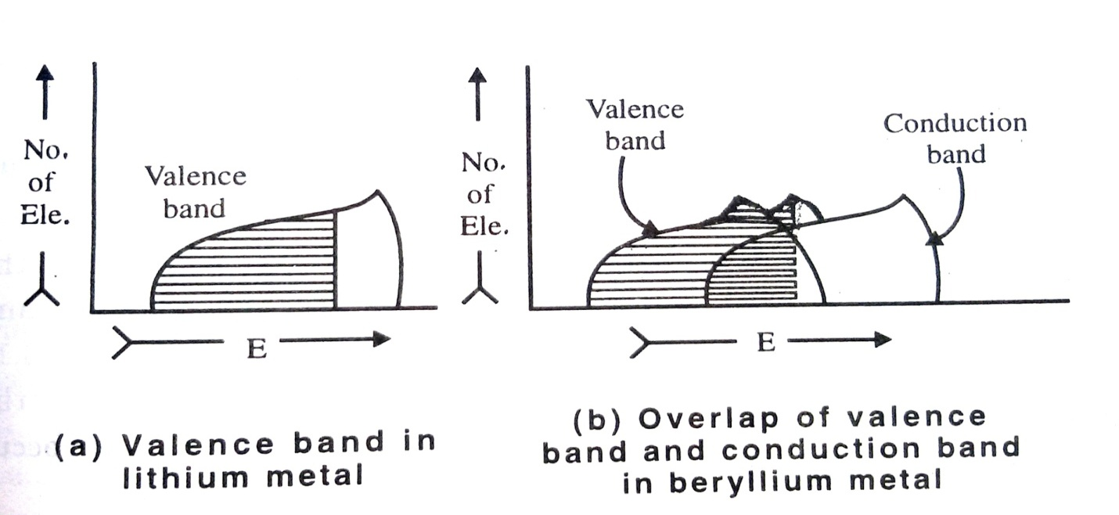
It should be noted that the energy bands thus produced belong to the crystal as a whole and act as a measure of the complete delocalization of electron cloud. This fact will naturally account all the properties of metals that we encounter.
For further understanding of formation of energy bands, another pictorial presentation may be shown where energy may be plotted horizontally and the number of electrons that may be accommodated at each value of the energy may then appear as an envelope on the vertical as shown in Fig 4.12. Here the shading represents the filling up of the bands with the available number of electrons .These are called N (E) curves which show the complete distribution of electrons between the various possible energy states and in turn the distribution of various possible energy states and in turn the distribution of various energy states over the energy range within a band.
As an illustration, N (E) curves have been given for Lithium and Beryllium metals as shown in Fig 4.12
Fig.4.12: N (E) curves for Li and Be

Slide 22
Band Theory and High Conductivity of Metals
According to MOT, energy states extend in 3D over the entire crystal lattice. It provides a great mobility to electrons under suitable circumstances and imparts high conductivity to metals.
For alkali metals (ns1), Li, Na, K etc. the lower half of ns band in filled while the upper half if completely empty to serve as a conduction band See Fig 4.10 and Fig 4.12(a) For alkaline earth metals (ns2) such as Be, Mg etc. the ns band is completely full while np band is completely empty where the upper np hand overlaps the lower ns band and as a result there remains no energy gap between the filled valence band and the empty conduction band. See Fig 4.11 and Fig 4.12 (b). This is the situation especially at absolute zero. Consequently at any other temperature the available thermal energy is just sufficient to excite a large number of electrons form the valence band to the conduction band where they can move very freely. Hence the metals exhibit electrical and thermal conductivities. See Fig 4.2 and Fig.4.3.
4.4 CLASSIFICATION OF SOLIDS (TYPES OF SOLIDS) :
1. Conductors (Metals)
The substances known as metals are classified as (electrical conductors)
Conductors are the metallic solids in which either (a) the valence band is only partially filled or (b) the valence and conduction bands overlap See Fig 4.11 Fig 4.12 and Fig. 4.13 (A) and (B). Thus there is practically no energy gap between the filled and unfilled MOs and perturbation of electrons can occur readily hence high thermal and electrical conductivities.
For example:
(a) Sodium and copper are the typical examples in which 3s and 4s bands respectively are only half filled.
(b) In magnesium the filled 3s band overlaps the 3p band whereas in nickel the 3d and 4s bands overlap

Slide 23
Semi conductors (Metalloids )
The solids which are basically insulators at absolute zero but which can conduct electricity to certain extent by migration of electrons at room temperature are called as the semi-conductors. The conductivity of a semiconductor lies between those of metallic good conductor and non metallic insulator.
Commercially, the best known semi –conductors are silicon and germanium Semi conductors are the solids in which there is only a small energy gap between the valence band and conduction band. See Fig 4.13 (d) and Fig (c). At absolute zero in such solids, all the electrons occupy the lowest possible energy levels (i.e. valence band) and thus the conduction band is devoid of electrons. At absolute zero the substance therefore acts as a perfect insulator. However as the temperature of the solid is increased a finite number of electrons do get promoted thermally from the full valence band to the empty conduction band. Both the promoted electrons in the conduction band the unpaired electrons left in the valence band can conduct electricity .The conductivity of semiconductors increases with temperature as the number of electrons promoted to the conduction band increases. This electrical conductivity of a semiconductor is termed as intrinsic conductivity and the pure semiconductor as intrinsic semiconductor
For example: Silicon and Germanium

Slide 24
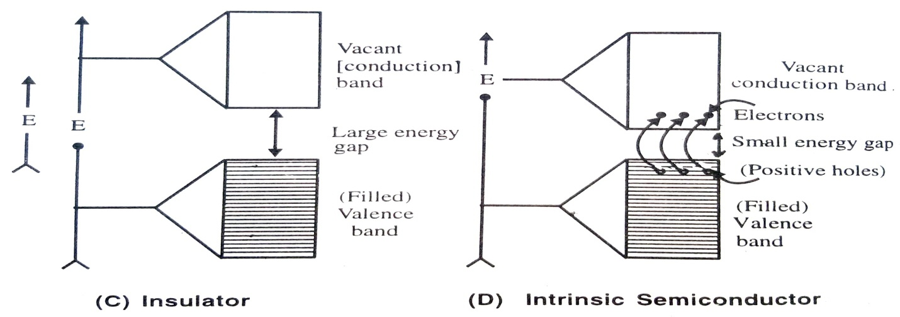
increased by adding small amounts of impurity atoms which can act as charge carriers between valence band so that electrons may be excited from the insulator bands to the impurity bands of vice-versa. Such electrical conductivity produced by doping with a suitable impurity is called extrinsic conductivity and such doped intrinsic semiconductors are turned to be extrinsic semiconductors. See Fig 4.13 (E). Both n type and p-type semiconductors are produced by doping an insulator with a suitable impurity. (The detailed discussion of semiconductors is given in the following section). The three types of solids are shown differently in Fig 4.13 and Fig 4.14 for comparison
Fig 4.13: Conductors, Insulators and Semiconductors

Slide 25
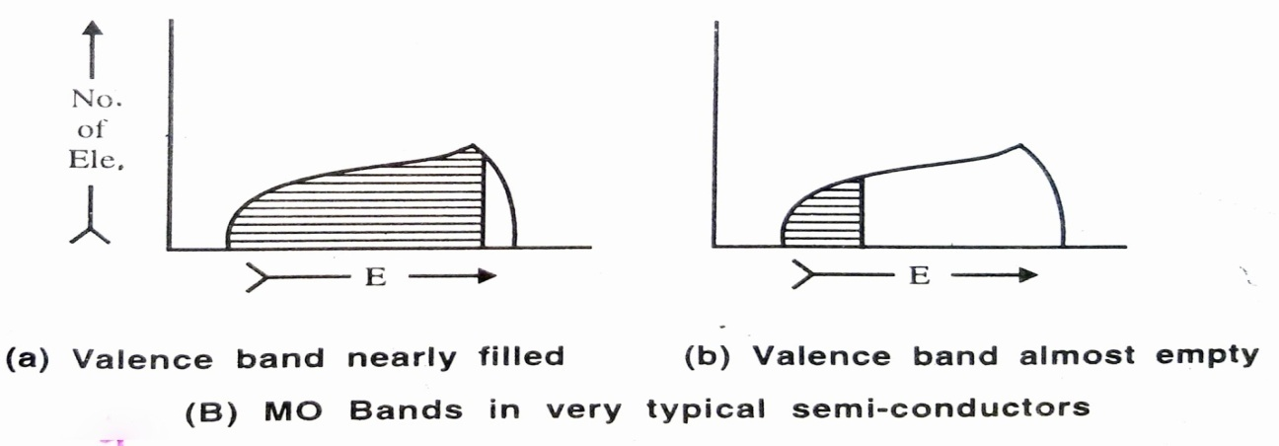
Fig. 4.14: N (E) Curves for Insulators and Semiconductors

Slide 26
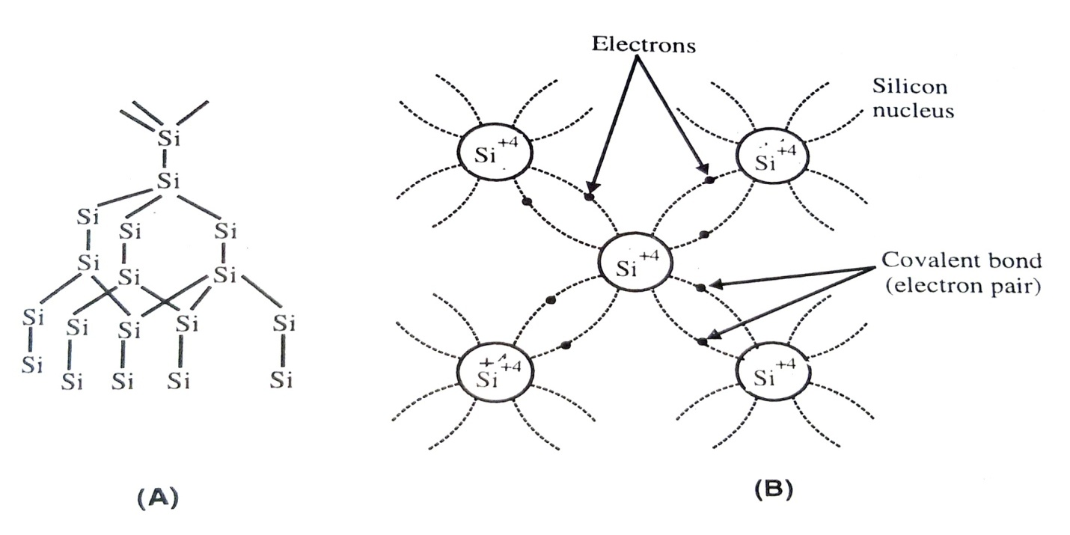
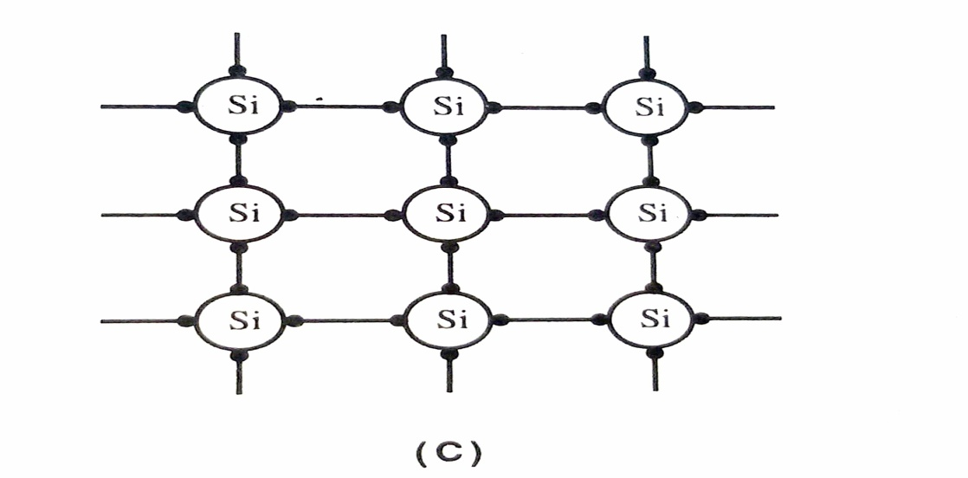
4.5 SEMICONDUCTORS: TYPES OF SEMICONDOCTORS
Intrinsic semiconductors:
(Photo-excited Semiconductors and Thermal Defects in solids)
Silicon and germanium both belong to group 14th (Gr. IVA) of the periodic table. The crystal structures of both are like diamond. In the outermost shell of atoms of Si and Ge, there are four electrons, which form four covalent bonds to the surrounding atoms, giving rise to a highly stable tetrahedral structure, as shown in Fig. 4.15
Fig. 4.15: (Pure) Silicon Crystal Structure with Tetrahedral Covalent Bonding

Slide 27
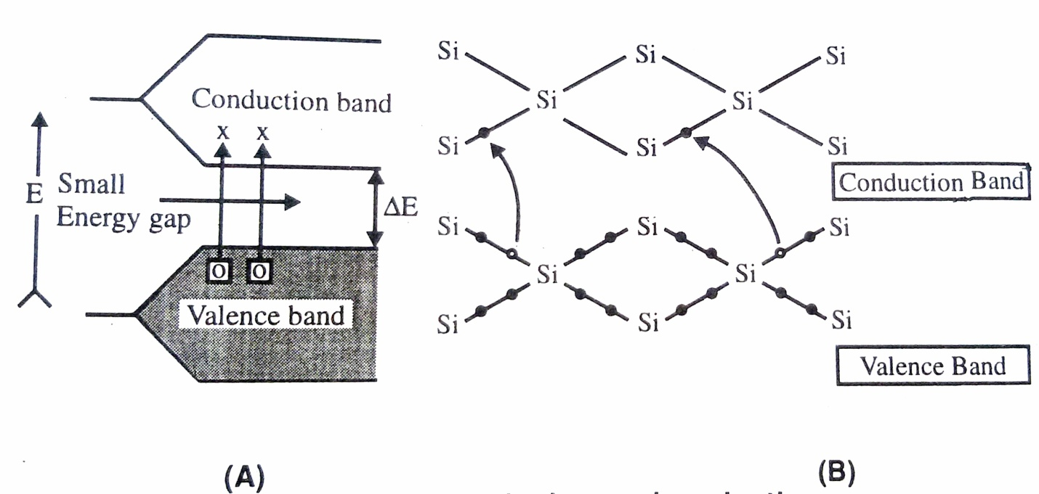
As the temperature is increased more and more electrons are promoted to the conduction band, and semiconductivity increases that is the electric resistance decreases (Not This is an opposite behavior as compared to those of metals) Above 423 K (150⁰C), too many electrons are promoted to the conduction band in silicon that the crystal lattice itself disintegrates as the valence band is devoid of bonding electrons. Similar is the case of Ge crystal above 373 K (100⁰C). Naturally, such intrinsic semiconduction is undesirable and one has to take precautions to limit the working temperature of semiconductors.
Instead of thermal energy if light energy causes excitation of electrons form valence band to conduction band the phenomenon may be termed as intrinsic photosemiconductivity. Intrinsic semiconduction may be shown as in Fig 4.13 (D) and a little crudely in Fig 4.16
Fig.4.16: Intrinsic semiconduction

Slide 28
Extrinsic Semiconductors
The semiconducting characteristics of pure Si and Ge can be improved by adding small amounts of either trivalent (Group 13) or pentavalent (Group 15) impurity atoms which act as charge carriers. Such electrical conductivity is called extrinsic semiconductivity and such doped intrinsic semi-conductors are called as extrinsic semiconductors or sometimes as impurity semiconductors or defect semiconductors.
The deliberate addition of impurity atoms to a sample of pure crystal is called doping. Based on nature of dopant, the semi-conductors can be classified into two categories as follows:
n-type semiconductors:
The intrinsic semiconductors(Si) containing pentavalent (donor) impurity atoms like P, As or Sb (of Group VA or Group 15) having 5 valence electrons are termed as p-type semiconductors.
p-type semiconductors:
The intrinsic semiconductors(Si) containing trivalent (acceptor) impurity atoms like B, Ga or In (of Group III _{A} of 13) having 3 valence electrons are terms as p-type semiconductors.

Slide 29
n-type semiconductors:
Suppose an impurity of Group V_{A} (or 15 ) like P As or Sb having five valence electrons (ns² np³ ) is added to the crystal lattice of silicon, some of the Si atoms are replaced by pentavalent impurity atoms .This process is called ‘doping’ the crystal. Each doped atom forms four covalent bonds with the surrounding four Si atoms by using its four valence electrons, and its fifth electron remains unused. See Fig 4.17. In this way an extra electron over and above the number required for symmetrical structure remains loosely bond in the silicon crystal. Such extra electrons occupy an energy level called donor (impurity) level just below the vacant conduction band of silicon crystal .At absolute zero or at low temperature, the extra electrons remain localized on parent atoms .However at room temperature, electrons from donor level can be easily excited to the vacant conduction band (by the application of electrical field or thermal energy) where they can carry current quite readily. Since the current is carried by negatively charged electrons it is n-type semiconduction and the silicon (or germanium) crystal doped with P/As/Sb is called n-type (extrinsic) semiconductor. The structure for n-type silicon may be depicted as in Fig 4.17 (A) (B) (C) or (D).

Slide 30
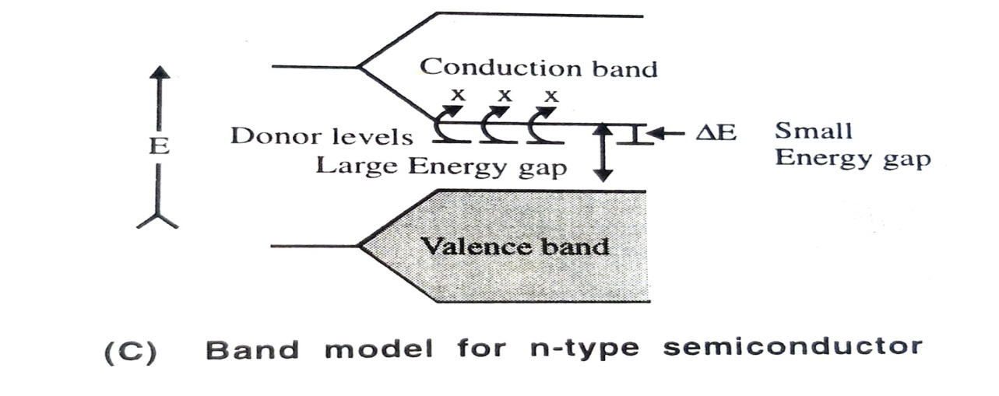
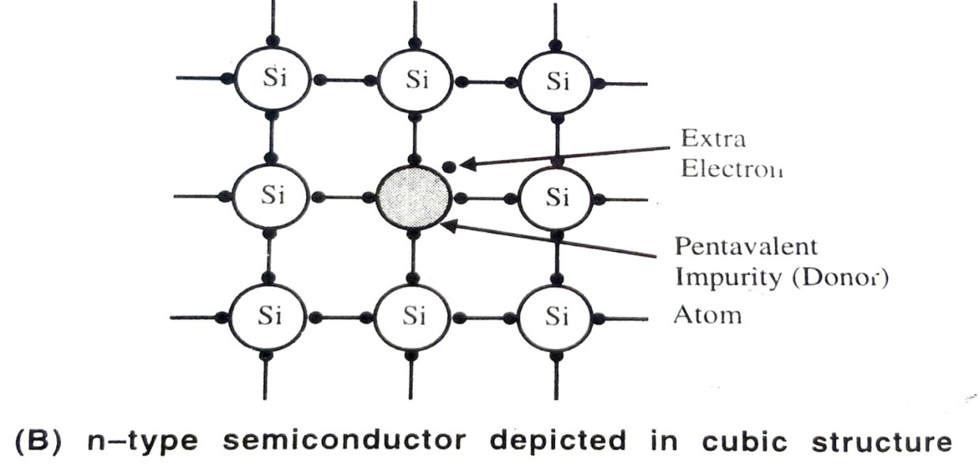
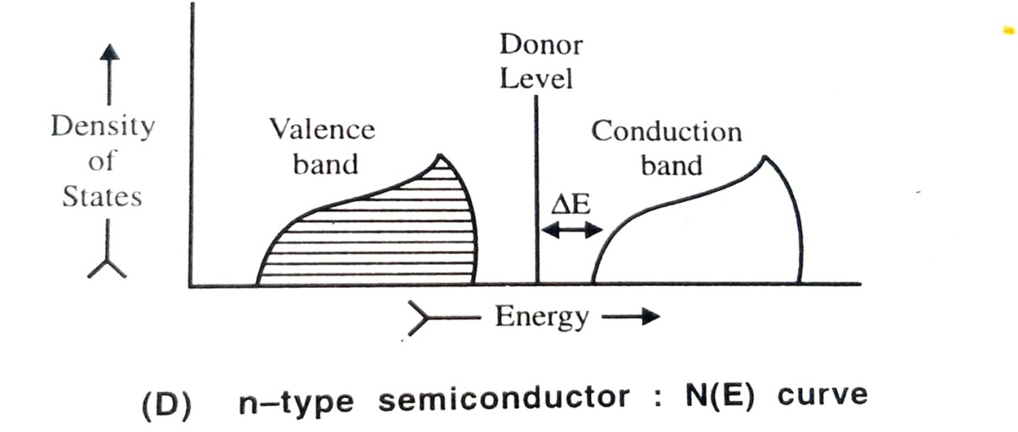

Slide 31
(b)p-type semiconductors:
If impurities of Group III A (or 13) say B, Al, Ga or In having three valence electrons (ns² np¹) is added to the crystal lattice of silicon (or germanium) some of the Si (or Ge) atoms are replaced by the trivalent impurity atoms. Since the impurity atoms contribute only three electrons some of the sites normally occupied by the electrons in the symmetrical structure (Fig 4.15) will be left empty. This process of doping creates electron vacancies called positive holes in the crystal .These occupy the energy level called acceptor (impurity) level that exists close to the filled valence band of Si (or Ge).
At absolute zero (or at low temperatures) the positive holes are localized around the doped atoms. However at normal temperatures or when an electric field is applied, adjacent electrons from the filled valence band are promoted to the vacant acceptor level of positive holes. In this way new electron vacancy i.e. positive holes are created in the silicon lattice. By a series of such jumps or hops the positive holes can migrate across the crystal. This is equivalent to moving an electron in the opposite direction and thus current is carried. Since the current is carried by migration of positive hole carriers this is p-type (extrinsic) semiconductor .The p-type semiconduction may be depicted variously as shown in Fig 4.20(A) (B) (C) and (D)

Slide 32
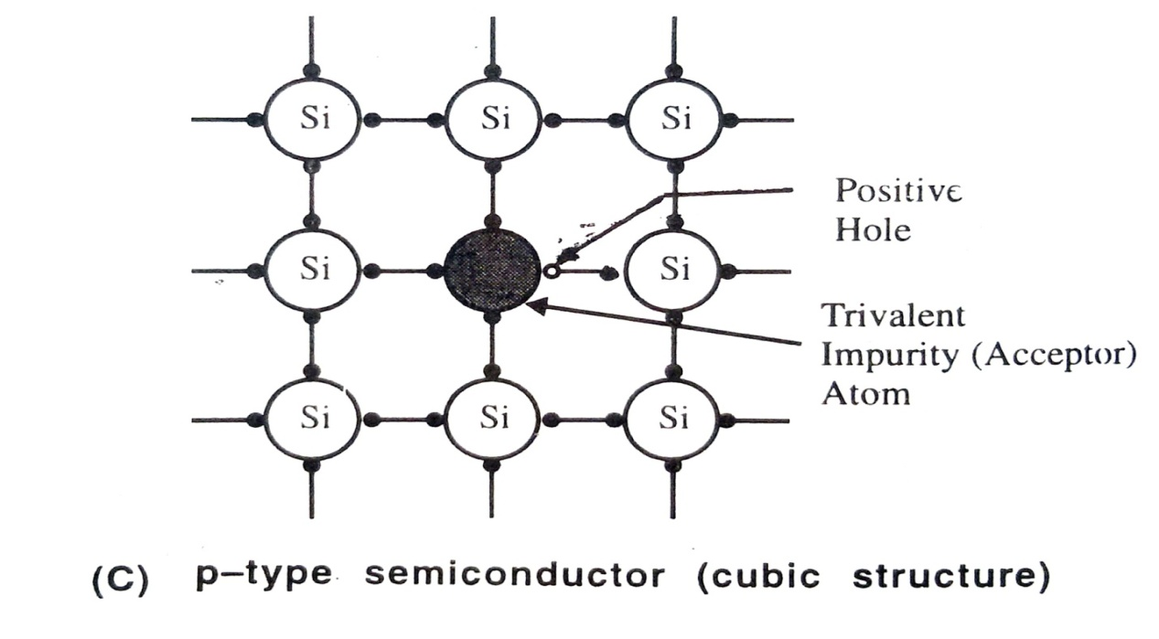
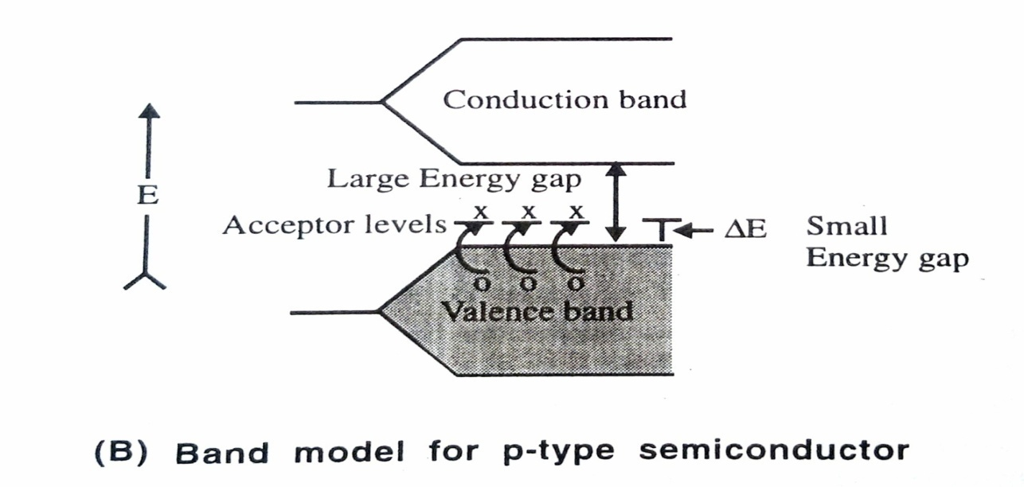
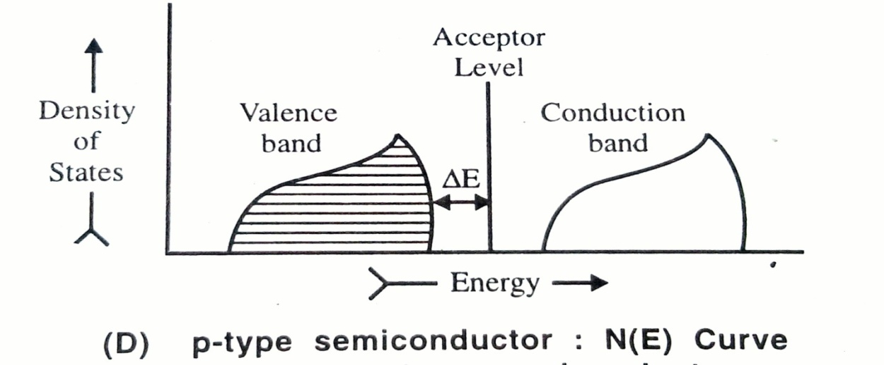

Slide 33
Applications of semiconductors:
Semiconductors have acquired a unique position in modern engineering and technology. Every day the applications of semiconductors are increasing in industry both in quantity and in diversity of forms. Semiconductors have limitless applications. We are enjoying today our standard of life only through the use of semiconductors. As n-type, p-type, p-n junction diodes and p-n-p or n-p-n junction triodes, semiconductors are used for numerous purposes. They find applications as calculator, electronic watches, hearing aids solar batteries computers, catalysts, satellites, radio and T.V sets. Thermocouples, thermistors, for battery charging, for electroplating, as refrigerators and what not!
In addition the semiconductors find several general applications such as:
(a) To control current intensity and voltage to desired extent.
(b) To protect high voltage transmission lines from over voltage.
(c) To convert sound energy into electrical energy and vice-versa.
(d) To convert heat energy into electrical energy (i.e. solar batteries)
(e) To enhance the rate of chemical reactions in chemical processes thus semiconductors can act as the catalysts etc.

Slide 34
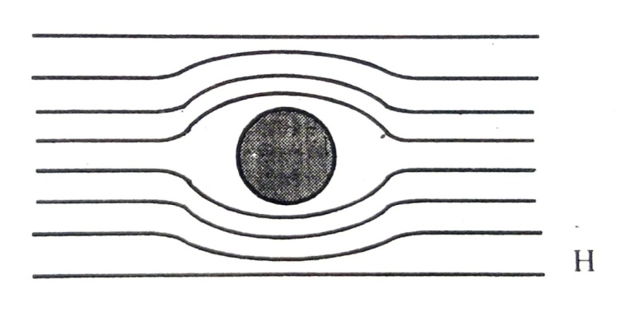
4.6 SUPERCONDUCTIONS: CERAMIC SUPERCONDUCTORS
Introduction:
Metals are good conductors of electricity and their conductivity increases as the temperature decreases. In 1911 the phenomenon of superconductivity was discovered by the Dutch scientist Kamerlingh Onnes when he was studying electrical properties of materials near absolute zero. A superconductor has zero or almost zero electrical resistance. It can therefore carry an electric current without losing energy. In other words the current can flow forever. It was proved that mercury is a superconductor below 4.2 K – (the critical temperature (T) at which the superconducting state is formed.
Following the discovery, physicists and chemists made slow but steady progress in the discovery of superconductors with higher values of T_{c}. After 75 years in 1986 high temperature super conductors were discovered. George Bednorz and Alex Mueller reported a new type of (mixed oxide) superconductor of lanthanum barium and copper (La_{2-x}Ba_{x}CuO_{4-y}) which exhibited superconductivity at 35 K For this significant work Bednorz and Mueller were awarded the Noble Prize for physics in 1987.
Meanwhile, Meissner and Ochsenfeld found that some low temperature superconductors exhibit the exclusion of magnetic field below T_{c} i.e. they do not allow a magnetic field to penetrate their bulk. This is known as Meissner effect. See Fig 4.19 Thus superconductors are essentially diamagnetic. Meissner effect gives rise to ‘Levitation’. Levitation occurs when objects float on air. Here repulsion is encountered between a permanent magnet and a superconductor

Slide 35
4.6.1 Ceramic Superconductor
The first non metallic superconductor was found in 1964. This was a metal oxide with a perovskite crystal structure and found to be quite different type of superconductor from the alloys. March 1987 one of the most significant ceramic superconductors was reported by Wu, Chu and co-workers. This is a mixed oxide type material based on the Y-Ba-Cu-O system formulated as YBa₂Cu₃O_{7-x} which became superconducting at 93 K. This temperature appeared to be quite significant for practical reasons. This temperature allowed liquid nitrogen to be used as coolant rather than the more expensive liquid helium which was used earlier. Such materials are also called as warm superconductors or high temperature superconductors as they work at higher temperatures than the temperature of liquid nitrogen (B.P. = 77 K).
4.6.2 Preparation:
There are different methods to prepare mixed oxide superconductors. For massive form chemical fusion of sintering is used. For film type, the methods used are
Chemical Deposition Method
Chemical Vapor Deposition Method
Electrical Deposition Method For illustration two different methods have been discussed below

Slide 36
Chemical Fusion: The synthesis of high temperature super conductors needs a variety of qualitative considerations. These materials may be prepared by fusing the mixture of metal oxides say oxides of yttrium barium and copper to 1073-1173 K (800-900⁰C), in an open alumina crucible or in a sealed gold tube.
Chemical Vapor Deposition Method: In electronic devices superconductors are used in the form of thin films. For this purpose the best suited method is chemical vapor deposition. The general procedure is to from a thin film by decomposing a thermally unstable compound on a hot solid substrate material See Fig 4.21
In this method, volatile complexes of metals Cu Y and Ba are held at temperatures T₁ T₂ and T₃ which provide desired vapor pressure of each reactant. The reactants are then swept into the reaction chamber by a reactive carrier gas mixture: Argon, oxygen, and water vapor through traps as shown in Fig 4.23. When conditions are properly controlled, the desired YBa₂Cu₃O_{7-x} film is deposited on the wedge shaped block, heated to a high temperature by an IR lamp. After deposition, the film may be amorphous it is annealed at high temperature to get the desired crystallinity of the film.

Slide 37
Fig. 4.20: Schematic Diagram of Chemical Vapour Deposition of Superconductor Films

Slide 38
4.6.3 Structure
Informally this, YBa₂ Cu₃ O_{7-x} ceramic super conductor, is called “123” (or ‘1-2-3’) superconductor from the proportions of metal atoms in the compound. Its structure is similar to perovskite but with some missing ‘O’ atoms, hence (7-x) in its composition.
Its structure comprises three cubic perovskite units stacked one on top of the other giving an elongated (tetragonal) unit cell See Fig 4.21.
From the figure it is clear that the lower and upper cubes have Ba²⁺ ions at the body centre while the smaller Cu⁺² ions at each corner. The middle cube had Y³⁺ ion at the body centre. A perovskite has formula ABO₃ and the stoichiometry of the compound would be YBa₂Cu₃O₉. But the actual formula being YBa₂Cu₃O_{7-x.} There is a massive deficiency of oxygen where about one quarter of the oxygen sites are vacant in the crystal. The copper atoms are surrounded by oxygen polyhedra which are in square –planar and square-pyramidal environments i.e. CuO₄ and CuO₅ units as shown in Fig 4.20(C

Slide 39
Fig. 4.21 : Structure of YBa₂Cu₃O_{7-x} (123)Superconductor showing positions of different atoms

Slide 40
4.6.4 Properties
(i) Ceramic superconductors have mixed oxide system and are called high temperature superconductors or warm superconductors or mixed superconductors. Many of them contain copper which exists in three oxidation state (+I), (+II) and (+III) where Cu (II) forms many tetragonally distorted octahedral complexes.
(ii) They have perovskite structure.
(iii) They exhibit critical deficiency of oxygen.
Superconductivity in the YBa₂Cu₃O_{7-x} is thought to be associated with ready transfer of electrons between Cu (I) , Cu (II ) and Cu (III)
Below critical temperature (T_{c}), at which the superconducting state is formed, the ceramic superconductors show zero electrical resistance.
Superconductors can repel magnets and are thus diamagnetic and hence they exhibit Meissner effect below T_{c}.

Slide 41
APPLICATIONS OF SUPERCONDUCTORS:
Ceramic Superconductors show zero electrical resistance. Thus the cables made of Superconducting materials if used then the 20 % loss of electricity during its transmission through aluminum or copper wires is avoided. Thus ceramic superconductors are useful to carry huge amounts of electricity without much loss.
Large magnetic fields can be generated by using the ceramic Superconductors. This property is applied in superfast magnetically levitated trains. Trains which can run with speeds of about 500 km per hour have been built in Japan on the principle of magnetic levitation.
Superconductors being diamagnetic they are used in Magnetic Resonance Imaging (MRI) which is a new diagnostic tool.
Superconductors are useful in computers satellites and variety of electronic devices.
Powerful electromagnets using Superconducting windings are quite useful especially at higher temperatures.

Slide 42
THANK YOU

