Slide 1
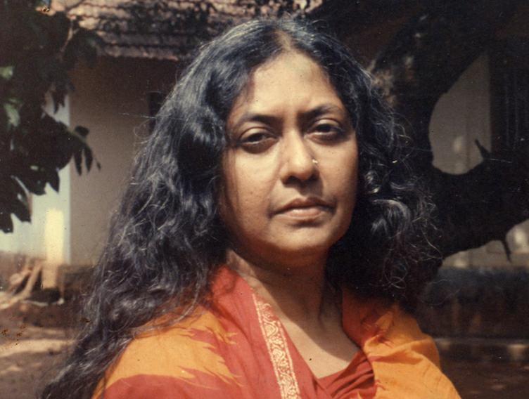
A HOT NOON IN MALABAR
Kamala Das (1934-2009)
Mr : J. B. Khot
MA SET
Department of English
Kisan Veer Mahavidyalaya, Wai (Satara)

Slide 2
Introduction to the Poet
Popularly known by her one-time pen name Madhavikutty and married name Kamala Das, was an Indian poet in English as well as an author in Malayalam from Kerala, India.
Her popularity in Kerala is based chiefly on her short stories and autobiography.
She was also a widely read columnist and wrote on diverse topics including women's issues, child care, politics among others etc.
Kamala's first book of poetry, Summer in Calcutta was a breath of fresh air in Indian English poetry.
She wrote chiefly of love, its betrayal, and the consequent anguish.

Slide 3
Introduction to the Poem
The poem, ‘A Hot Noon in Malabar’, is taken from the collection of poems titled ‘Summer in Calcutta” (1965).
It deals with Kamala Das’s happy childhood spent in her grandmother’s house in Malabar.
It is full of pathos which shows Kamala Das’s loss of happy and peaceful days of childhood which she spent in the loving and caring company of her grandmother.
The action of the poem tosses between memory and desire, between nostalgia and estrangement.
The poetess longs for the hot noon in Malabar which was full of life as compared to her torturing experience of noon in a big city where she settled after her marriage.

Slide 4
Poem
This is a noon for beggars with whining
Voices, a noon for men who come from hills
With parrots in a cage and fortune-cards,
All stained with time, for brown Kurava girls
With old eyes, who read palm in light singsong
Voices, for bangle-sellers who spread
On the cool black floor those red and green and blue
Bangles, all covered with the dust of roads,
Miles, grow cracks on the heels, so that when they
Clambered up our porch, the noise was grating,
Strange……… This is a noon for strangers who part

Slide 5
The window-drapes and peer in, their hot eyes
Brimming with the sun, not seeing a thing in
Shadowy rooms and turn away and look
So yearningly at the brick-ledged well. This
Is a noon for strangers with mistrust in
Their eyes, dark, silent ones who rarely speak
At all, so that when they speak, their voices
Run wild, like jungle-voices. Yes, this is
A noon for wild men, wild thoughts, wild love. To
Be here, far away, is torture. Wild feet
Stirring up the dust, this hot noon, at my
Home in Malabar, and I so far away ……..

Slide 6
Thank
You

