Slide 1
Unit 2.Skeletal System Bsc.3

Slide 2
What is Skeleton???

Slide 4
Types of Skeleton:
1.Epidermal Horny Skeleton
2.Dermal Bony Skeleton
3.Endoskeleton

Slide 6
1.Vertebral Column:
Notochord:
2. Vertebrae

Slide 10
Types of Process of Vertbra
1.Zygapophysis: In vertebrates from anterior & posterior faces of neural arch projects paired auricular facets the pre and post zygapophysis this process do note occur in fishes.
2. Transverse process:
Lateral transverse process arise from Centrum serve as attachment of ligament & muscles.

Slide 11
Types of Process of Vertbra
3. Diapophyses:
Each projects lateraly from centrum.
4. Paraphyses: Projects laterally from centrum articulate with ventral head& rib
5. Hypapophysis: It single prominent mid ventral projection of Centrum in certain vertebrae

Slide 12
Tyepes of Vertebra based on Shape of Centra:

Slide 14
Vertebrae of Fishes

Slide 15
Vertebrae of Amphibians

Slide 16
Vertebrae of Reptiles:

Slide 17
Vertebrae of Aves:

Slide 18
Vertebrae of Mammals:

Slide 19
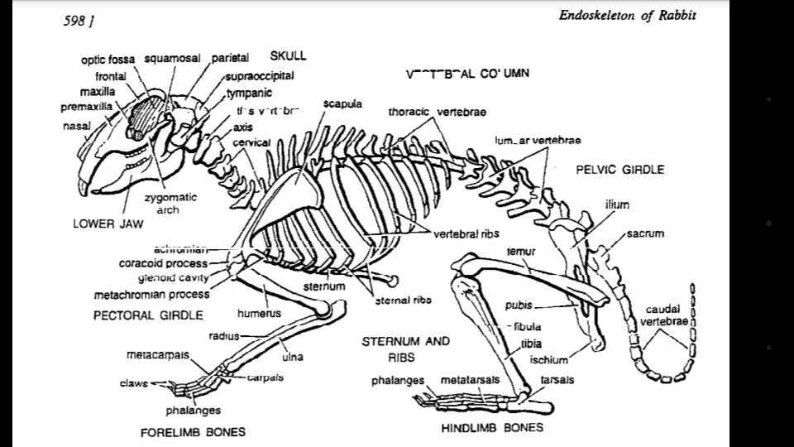
Pelvic Girdles in Vertebrates:

Slide 20
Pelvic Girdle in Fish: Pisces:

Slide 21
Pelvic Girdle in Amphibians:

Slide 22
Pelvic Girdles Reptiles:

Slide 23
Pelvic Girdle in Aves:

Slide 24
Pelvic Girdles in Mammals:

Slide 25
PECTORAL GIRDLES

Slide 26
Pectoral Girdles in Fishes:

Slide 27
Pectoral Girdles in Amphibians:

Slide 28
Pectoral Girdles in Reptiles

Slide 29
Pectoral Girdles in Aves:

Slide 30
Pectoral Girdles in Mammals:

