Slide 2
Janata Shikshan Sanstha’s
Kisan Veer Mahavidyalaya, Wai
Department Of Chemistry
B.Sc. III 2023-24
Topic Name – Bioinorganic Chemistry
Teacher Name – Miss. A.S.Sankpal

Slide 3
Outline
1.Very important terms of coordination chemistry
2.General aspects of bioinorganic chemistry 3.Coordination for uptake, transport and storage (Fe)
4.Hard ions: Na+, K+, Mg2+, Ca2+ 5.Cobalamines
6.Metals in Photosynthesis
7.Fe in bio systems
8.Function of Zn
9.Fixation of nitrogen

Slide 4
Coordination compound (complex)complex)‐‐basics
Central atom is bound to unexpectedly large number of ligands•
Usually discrete species in solution and solid•
Examples: K4[Fe(CN)6], CoCl2* 6 H2O•

Slide 5
Coordination compound (complex)complex)‐‐basics
Properties of central atoms (transition metals):•
Large charge/radius ratio•
Variable oxidation states (d‐electrons available)
Meta stable high oxidation states, s‐ electrons are removed first

Slide 6
Coordination compound (complex)complex)‐‐basics
Compounds are often paramagnetic (unpaired electrons)
•Formation of colored ions and compounds
•Compounds with profound catalytic activity
Formation of stable complexes (Lewis acids)
Trend to metal‐metal bonding (clusters, not important in biology

Slide 7
Coordination compound (complex)complex)‐‐basics
Properties of ligands
Monodentate or
poly dentate ligand•
Ambi dentate ligands (nitro‐, nitrito)

Slide 8
Coordination numberCoordination number‐‐examples
Higher CN’s are favoured:
Complexes containing central atoms of the periods 5 and 6, small ligands (size)•
Single bonds metal‐ligand (see MnO4‐…)
On the left of a row of the d‐block (size and small number of d‐electrons)
Central atoms with a high oxidation number (size and small number of d‐ electrons)

Slide 9
CN 2: linear (Cu+, Ag+, Au+, Hg)•
CN 3: trigonalplanar (HgI3‐, [Pt(P{C6H5}3]3) trigonalpyramid
CN 4: tetrahedron ([Al(OH)4]‐, [Cd(CN)4]2‐) square planar (d8, [PtCl4]2‐, [AuF4]‐) bisphenoidal (ψ‐trigonalbipyramid, [AsF4]‐ [SbCl4]‐)
tetragonal pyramid (ψ‐octahedron)
CN 5: trigonalbipyramid(Fe(CO)5, [SnCl5]‐)
tetragonal pyramid

Slide 10
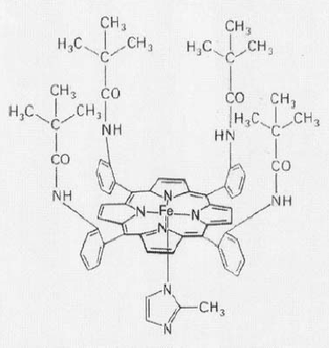
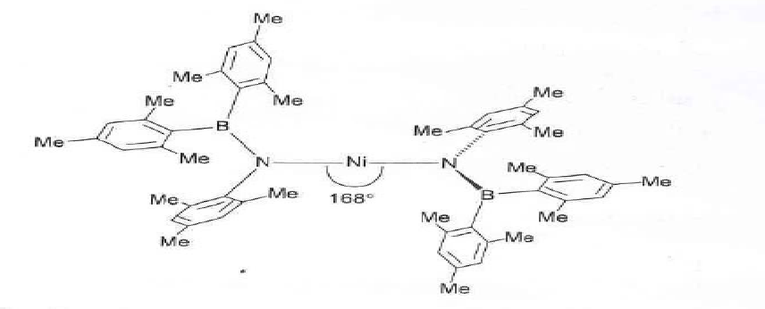
Coordination Number‐examples

Slide 11
Coordination number‐examples
Pseudorotation
•Exchange of a‐and e‐ligand, see MgATpase
•[Ni(CN)5]3‐: b) and a) in crystal structure
•Fe(CO)5: fast pseudorotationin solution

Slide 12
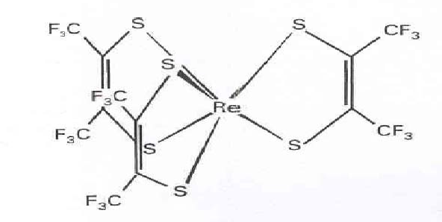
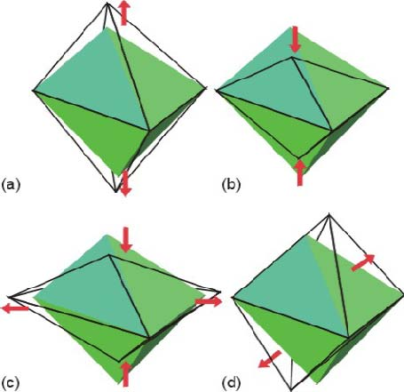
Coordination number‐examples
CN 6:
octahedron ([Cr(H2O)6]3+, [Fe(CN)6]3‐)
distorted octahedron
Trigonal prism

Slide 13
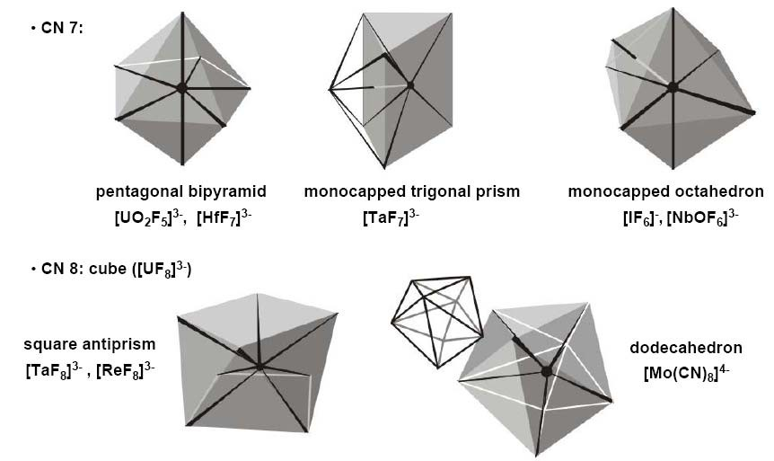
Coordination number‐examples

Slide 14
Isomerism
Two or more molecules or ions have the same molecular formula but the atoms are arranged differently
The structures of isomers are not super imposable
Isomers have different physical (color) and/or chemical properties.

Slide 15
Isomerism
Stereoisomerism
Optical isomerism:
Enantiomers
•Geometrical isomerism:
cis‐, trans; meridional, facial
Structural isomerism
Ionization isomerism ([CoCl(NH3)5]SO4
/[CoSO4(NH3)5]Cl)
Coordination isomerism ([Co(NH3)6] [Cr(CN)6] / [Cr(NH3)6] [Co(CN)6)
Linkage isomerism (cyano/ isocyano)

Slide 16
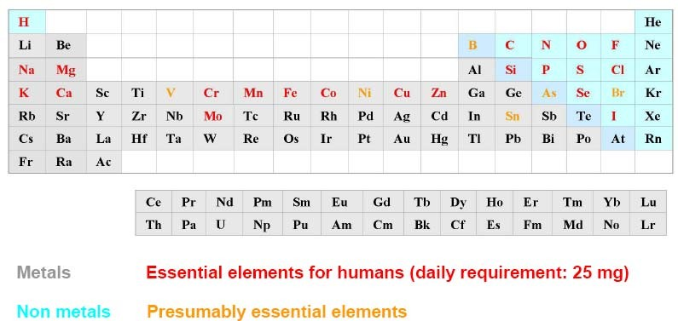
Periodic table of life
Symptoms of deficiency:
Mg (muscle cramps), Fe (animea), Mn (infertility)
Toxic effects in case of high doses (therapeutic width)
Occurrence of non essential elements (e.g. Rb: 1.1 g / 70 kg) and of contaminations (e.g. Hg)

Slide 17
Functions of “inorganic elements”
Assembly of structures (DNA, biomineralization), endo‐and exoskeletons. Ca, Mg, Zn, Si
Information carriers (muscle contractions, nerve function). Na, K, Ca, Mg
Activation of enzymes. Mg, Ca
Formation, metabolism and degradagationof organic compounds by Lewis acid/base catalysis. Zn, Mg
•Transfer of electrons (energy conversion), FeII/FeIII/FeIV, stable due to bioligands
Uptake, transport, storage and conversion of small molecules
O2: Fe, Cu (conversion), Mn (generation)
N2: Fe, Mo, V (conversion to ammonia)
CO2: Ni, Fe (reduction to methane)

Slide 18
Most prominent “bioelements”
Na+,K+: Electrolytes
Mg2+: Chlorophyll, energy production (ATP
→ADP), skeleton
Ca2+: muscle functions, HydroxylapatiteCa5(PO4)3(OH), CaCO3
VIV/V, MoIV/VI, WIV/VI, MnII/III/IV, FeII/III, NiI/II/III, CuI/II: electron transfer
Fe and Cu: transport and storage of oxygen
FeII, FeIII: Magnetite (Fe3O4)

Slide 19
Role of the metallic elements
The metallic elements playa variety of roles in biochemistry. Several of the most important roles are the following:
1. Regulatory action is exercised by Na+, K+, Mg²+, and Ca²+. The flux of these ions through cell membranes and other boundary layers sends signals that turn metabolic reactions on and off.
2. The structural role of calcium in bones and teeth is well known, but many proteins owe their structural integrity to the presence of metal ions that tie together and make rigid certain portions of these large molecules, portions that would otherwise be only loosely linked. Metal ions particularly known to do this are Ca²+and Zn²+.
3. An enormous amount of electron‐transfer chemistry goes on in biological systems, and nearly all of it critically depends on metal‐containing electron‐ transfer agents. These include cytochromes (Fe), ferredoxins (Fe), and a number of copper‐containing "blue proteins," such as azurin, plastocyanin, and stellacyanin.

Slide 20
Most prominent “bioelements”
Co: Cobalamine, e.g. Vitamin‐B12
Zn2+: Enzymes, zincfinger(gen. transcription), stabilization of proteins
SiIV: bones; SiO2/silicagel
PV: Hydroxylapatite, ATP, cell membrane, DNA
Se‐II: Selenocysteine
F‐: Fluorapatit(Ca5(PO4)3F) teeth; Cl‐: besides HCO3‐most important free anion, I‐: hormones of the thyroid, radiation therapy

Slide 21
Terms related to bioinorganic chemistry
Active center: Location in an enzyme where the specific reaction takes place
Allosteric enzyme:
Can bind a small regulatory molecule that influences catalytic activity
Apo‐enzyme:
An enzyme that lacks its metal center or prosthetic groups
•ATP: Adenosine 5’‐triphosphate•
Biomembrane: Sheet like assemblies of proteins and lipids (bilayer)
Calmodulin: Ca binding protein involved in metabolic regulation
Carbonic anhydrase: Zn‐containing enzyme that catalyzes the reversible decomposition of carbonic acid to carbon dioxide and water
Charge‐transfer complex: An aggregate of two or more molecules in which charge is transferred from a donor to an acceptor.
Chlorin: 2,3‐Dihydroporphyrin, reduced porphyrin with two non‐fused saturated carbon atoms (C‐2, C‐3) in one of the pyrrolerings.
Chlorophyll: Magnesium complex of a porphyrin in which a double bond in one of the pyrrole rings (17‐18) has been reduced. A fused cyclopentanonering is also present

Slide 22
Cluster: Metal centers grouped close together which can have direct metal bonding or through a bridging ligand, e.g. ferredoxin
•Cobalamin: Vitamin B12, substituted corrin‐Co(III) complex•
Coenzyme: A low‐molecular‐weight, non‐protein organic compound (often a nucleotide) participating in enzymatic reactions•
Cofactor: An organic molecule or ion (usually a metal ion) that is required by an enzyme for its activity. It may be attached either loosely (coenzyme) or tightly (prosthetic group).
•Cooperativity: The phenomenon that binding of an effector molecule to a biological system either enhances or diminishes the binding of successive molecules, e.g. hemoglobin
Corrin: Ring‐contracted porphyrinderivative that is missing a carbon
Cytochrome: Hemeprotein that transfers electrons, and exhibits intense absorption bands. The iron undergoes oxidation‐reduction between oxidation states Fe(II) and Fe(III).
Cytochrome C‐oxidase: The major respiratory protein of animal and plant mitochondria. It catalyzes the oxidation of Fe(II)‐cytochromec, and the reduction of dioxygento water. Contains two hemes and three copper atoms, arranged in three centers.

Slide 23
CytochromeP‐450: General term for a group of heme‐containing monooxygenases The reaction with dioxygenappears to involve higher oxidation states of iron, such as Fe(IV)=O•
Desferrioxamine(dfo): Chelating agent used world‐wide in the treatment of iron overload conditions, such as hemochromatosis and thalassemia.
Dismutase: Enzyme that catalyzes a disproportionation reaction•
Entaticstate: A state of an atom or group which has its geometric or electronic condition adapted for function. Derived from entasis(Greek) meaning tension
Enzyme: A macromolecule that functions as a biocatalyst by increasing the reaction rate•FeMo‐cofactor: An inorganic cluster found in the FeMo protein of the molybdenum‐nitrogenase, essential for the catalytic reduction of N2 to ammonia
Ferredoxin: A protein containing more than one iron and acid‐ labile sulfur, that displays electron‐transferactivitybut not classical enzyme function
Ferritin: An iron storage protein consisting of a shell of 24 protein subunits, encapsulating up to 4500 iron atoms in the form of a hydrated iron(III) oxide.

Slide 24
Heme: A near‐planar coordination complex obtained from iron and dianionicporphyrin•
Hemerythrin: A dioxygen‐carrying protein from marine invertebrates, containing an oxo‐bridged dinucleariron center•
Hemocyanin: A dioxygen‐carrying protein (from invertebrates, e.garthropods and molluscs), containing dinucleartype 3 copper sites•
Hemoglobin: A dioxygen‐carrying hemeprotein of red blood cells
HiPIP: High‐Potential Iron‐sulfur Protein (ferredoxin). Cluster which undergoes oxidation‐reduction between the [4Fe‐4S]2+and [4Fe‐4S]3+states
Holoenzyme: An enzyme containing its characteristic prosthetic group(s) and/or metal(s)•
Ion channel: Enable ions to flow rapidly through membranes in a thermodynamically downhill direction after an electrical or chemical impulse. Their structures usually consist of 4‐6 membrane‐spanning domains. This number determines the size of the pore and thus the size of the ion to be transported
Ionophore: A compound which can carry specific ions through membranes
Ion pumps: Enable ions to flow through membranes in a thermodynamically uphill direction by the use of an energy source. They open and close upon the binding and subsequent hydrolysis of ATP, usually transporting more than oneion towards the outside or the inside of the membrane

Slide 25
Terms related to bioinorganic chemistry
Metalloenzyme: An enzyme that, in the active state, contains one or more metal ions•Mitochondria: Cytoplasmic organelles, produce ATP by oxidative phosphorylation
Myoglobin: A monomeric dioxygen‐binding heme protein of muscle tissue, structurally similar to a subunit of hemoglobin
Photosynthesis: A metabolic process in plants and certain bacteria, using light energy absorbed by chlorophyll and other photosynthetic pigments for the reduction of CO2, followed by the formation of organic compounds

Slide 26
Terms related to bioinorganic chemistry
Plastocyanin: An electron transferprotein, containing a type 1 copper site, involved in plant and cyanobacterialphotosynthesis, which transfers electrons to Photosystem1•
Iron Sulfur protein: An iron‐sulfur protein of the mitochondrial respiratory chain, containing a [2Fe‐2S] cluster•
Rubredoxin: An single iron‐sulfur protein, function as an electron carrier•
SOD: superoxidedismutase, cataysisof disproportionation of superoxide
Substrates: A compound that is transformed under the influence of a catalyst
Trace elements: Elements required for physiological functions in very small amounts, e.g. Co, Cu, F, Fe, I, Mn, Mo, Ni, Se, V, W, and Zn

Slide 27
Terms related to bioinorganic chemistry
Type 1,2,3 copper: Different classes of copper‐binding sites in proteins, classified by their spectroscopic properties as Cu(II). Type 1, or blue copper centers the copper is coordinated to at least two imidazole nitrogens from His and one sulfur from Cys. In type 2, or non‐blue copper sites, the copper is mainly bound to imidazole nitrogens from His. Type 3 copper centers comprise two spin‐coupled copper ions, bound to imidazolenitrogens
Zinc finger: A domain, found in certain DNA‐binding proteins, comprising a helix‐loop structure in which a zinc ion is coordinated to 2 ‐4 Cyssulfurs, the remaining ligands being His

Slide 28
Principle of complementarity
The active sites of enzymes tend to be more complementary to the transition states than they
are to the actual substrates
Preformation of the transition state by strained enzyme (entactic state)
Energy aspect: small activation energy,
statistical aspect: more productive encounters
between reaction partners,
Kinetic aspect: faster reaction

Slide 29
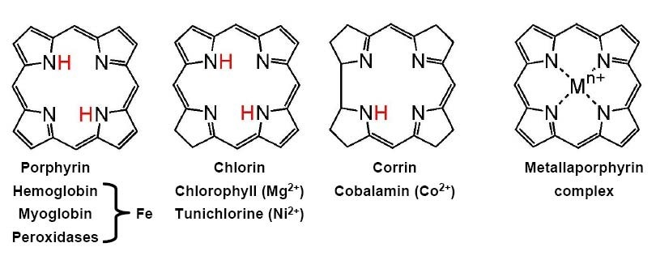
Cyclic ligandsligands—Porphyrin complexes
Unsaturated tetradentate macrocyclic ligands
Coordination of otherwise labile divalent metal ions
Porphyrin complexes: chelate‐effect and size selective as host
Porphyrin: very stable, Hückel‐aromatic (18 el = 4n +2), colored

Slide 30
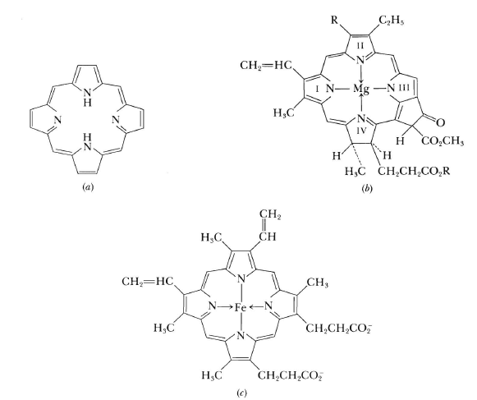
Porphyrins

Slide 31
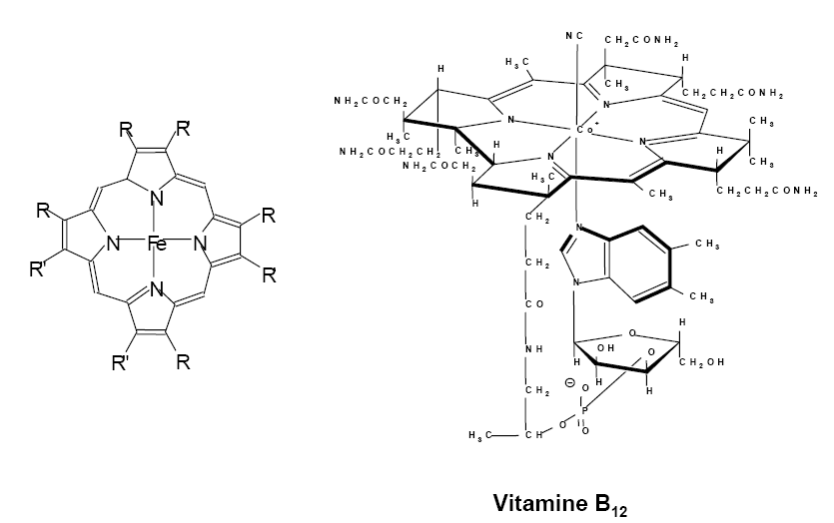
Cyclic ligandsligands—Porphyrin complexes

Slide 32
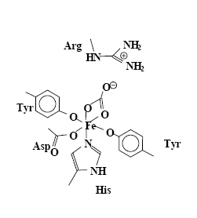
Fe in proteins
Transport: Transferrin
Coordination of Fe by caboxy‐and phenolate groups of residues
Uptake of two Fe(III) and one HCO3‐
Stability of complexes decrease with decreasing pH
High affinity of Apotransferrin, protection against infections
Not very specific (Cr3+, Al3+, Cu2+, Mn2+…)
Release of Fe(III): Reduction to Fe(II) and binding by porphyrine

Slide 33
Fe in proteins
Storage: Ferritin
High symmetry of Apoferritin: F432
Hollow sphere built from proteins (inner dia.: ~ 7 nm, outer dia. ~ 13 nm)
Capacity: up to 4500 Fe3+, biomineralization(?)
Carboxylate groups for Fe(III) binding, core‐ structure related to Ferrihydrite Fe10O₆(OH)₁₈
Exchange via channels (dia. 1nm), tuning of hydrophilic/hydrophobic character via residues
Release of Fe as Fe(II) via hydrophilic channels

Slide 34
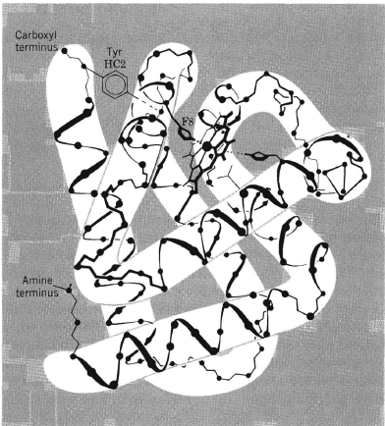
Fe in proteins
Hemoglobin

Slide 35
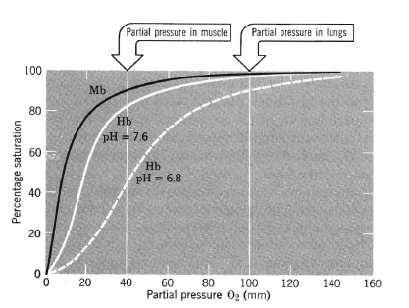
Hemoglobin ‐ Myoglobin
Bohr effect

Slide 36
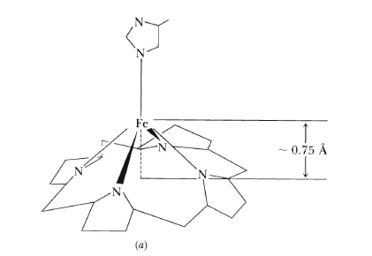
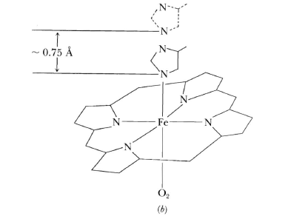
Bohr Effect

Slide 37
The Bioinorganic chemistry of Cobalt
The best‐known biological function of cobalt is its intimate involvement in the coenzymes related to vitamin B12
It consists of four principal components:
1. A cobalt atom.
2. A macrocyclic ligand called the corrin ring, which bears various substituents. The essential corrin ring system is shown in bold lines. It resembles the porphine ring, but differs in various ways, notably in the absence of one methine (=CH‐) bridge between a pair of pyrrole rings.
3. A complex organic portion consisting of a phosphate group, a sugar, and an organic base, the latter being coordinated to the cobalt atom.
4. A sixth ligand may be coordinated to the cobalt atom. This ligand can be varied, and when the cobalt atom is reduced to the oxidation state +1, it is evidently absent.

Slide 38
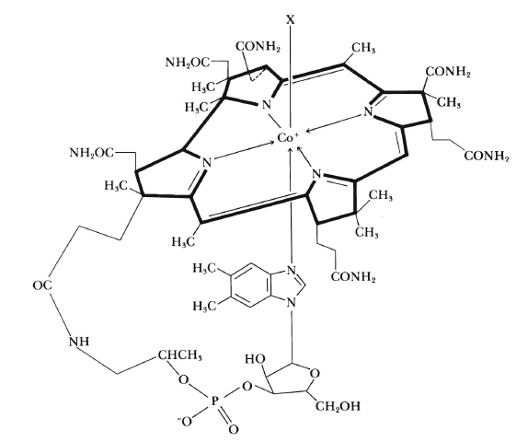
Structure of Cobalamin

Slide 39
Cobalamine
The cobalamins can be reduced in neutral or alkaline solution to give cobalt(Il) and cobalt(I) species, often called BI2r and BI2s respectively.
powerful reducing agent
decomposing water to give hydrogen and B12r
reductions can apparently be carried out in vivo by reduced ferredoxin.
cyano‐or hydroxocobalamin is reduced, the ligand (CN‐or OH‐) is lost, and the resulting five‐coordinate cobalt(I) species reacts with ATP in the presence of a suitable enzyme to generate the B12 coenzyme.

Slide 40
Nitrogen fixation
Nitrogenases
Consist of 2 proteins
A Fe protein
A MoFe protein
Each of them is inactive
Mixing them makes them active
The Fe‐protein consists of two identical subunits that clasp a ferredoxin unit (Fe4S4 ) between them by forming Fe‐S bonds to two cysteine residues in each subunit.

Slide 41
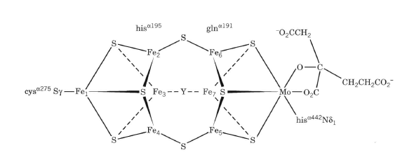
Nitrogen fixation
The MoFe‐protein, so‐called because it contains both molybdenum and iron.
X‐ray crystallographic study revealed a metal cluster arrangement
The structure is still somewhat inaccurate and one of the bridging groups (Y) has not yet been conclusively identified.

