Slide 1
Welcome
XIV- Bioinformatics, Biostatistics and Economic Botany
Unit No 2 Biostatistics
2.1 Introduction, definition , terminology.

Slide 2
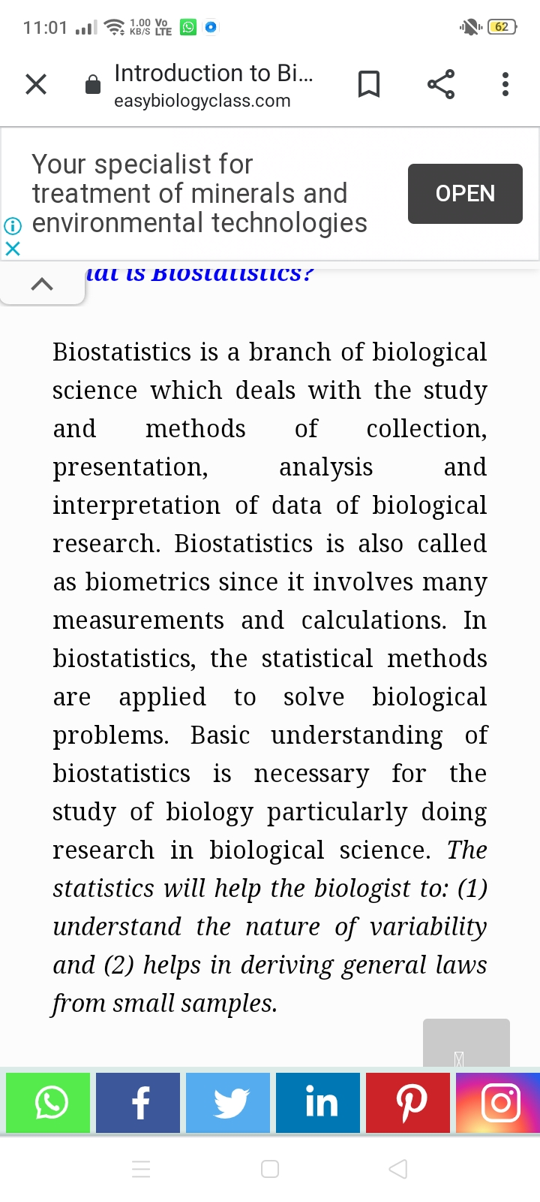

Slide 4
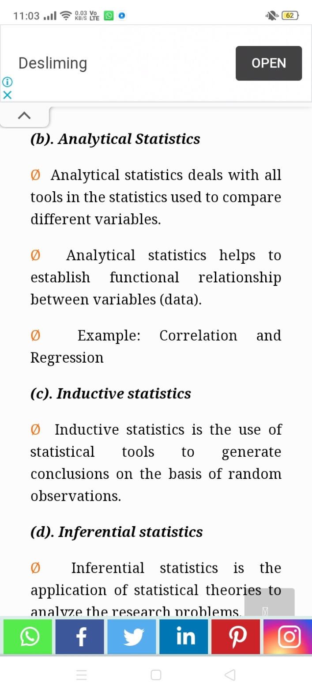

Slide 5
Terminology
DATA:
Data is a collection of observations expressed in numerical figures
PRIMARY DATA:
These data are collected directly from the field of enquiry for a specific purpose.
SECONDARY DATA:
These are numerical information which have been already collected by some agency for a specific purpose and are subsequently compiled from that source for application in different connection.
POPULATION:
It is an entire group of people or study elements-persons, things or measurements having some common
(a) Finite: If a population consist of fixed number of value, it is said to be finite e.g., numberof days in a week.
(b) Infinite: If a population consist of an endless succession of values, it is said to be infinite e.g., number of animals in ocean.

Slide 6
SAMPLING:
The technique of obtaining information about the whole group by examining only the part of the whole group is called sampling.
Types of Sampling:
(a) Random sample (Probability sample).
(b) Non-random sample (Non-probabilities sample).
SAMPLE:
It is a relatively small group of selected number of individuals or objects or cases drawn from a particular population and is used to throw light on the population characteristics.
VARIABLES:
Variables are the measurable characteristics which can be numerically expressed in terms of some unit. These are quantities which are capable of being measured by quantitative methods directly.
For example—Height in inches, cm, weight in kg, pound, marks in examination etc.

Slide 7
Application

Slide 8
ThankYou

