Slide 1
Cell biology
BSc1 Sem 2

Slide 2
Introduction
Invention of Microscope

Slide 3
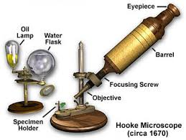

Slide 4
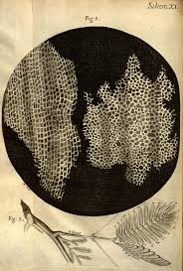

Slide 5
Cell structure
Cell theory
City in cell size and shape
Cell shape

Slide 6
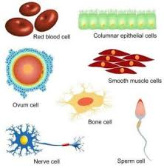

Slide 7
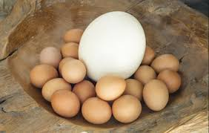

Slide 8
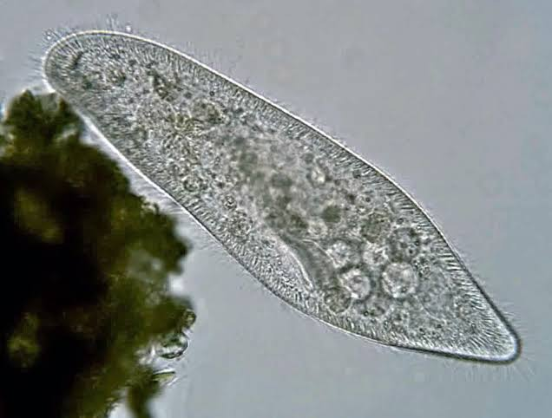

Slide 9
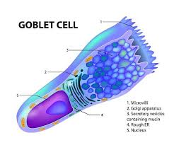

Slide 10
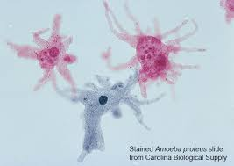

Slide 11
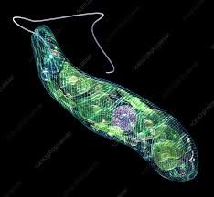

Slide 12
