Slide 1
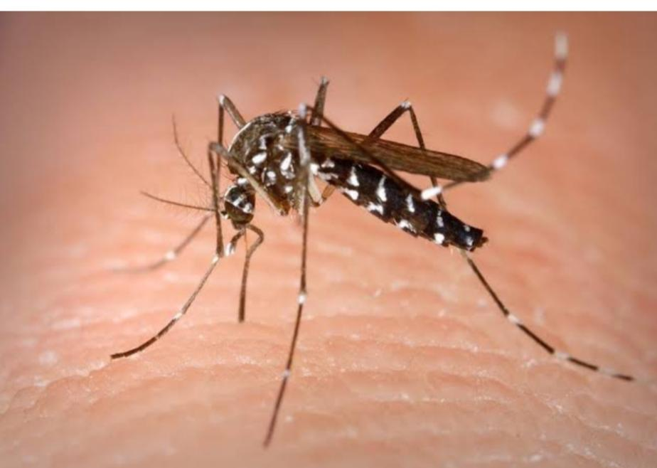
Chikungunya aedes mosquito

Slide 2
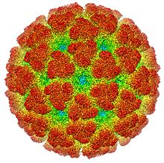
Alpha virus

Slide 3
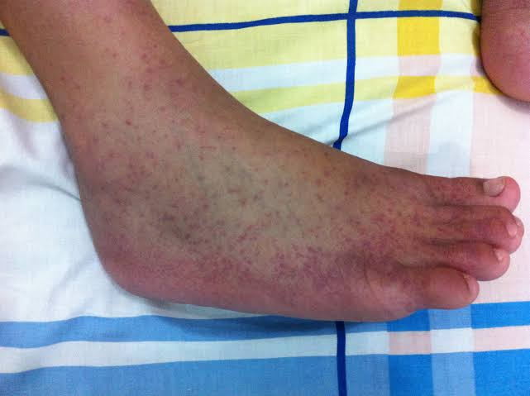
Rash on skin

Slide 4
Virus

Slide 5
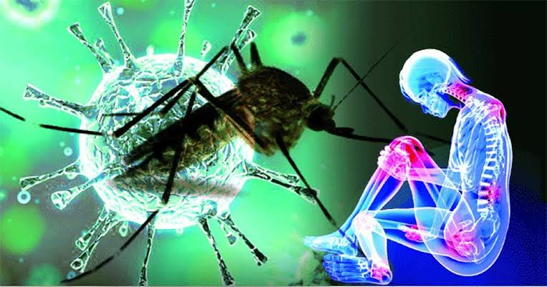

Slide 6
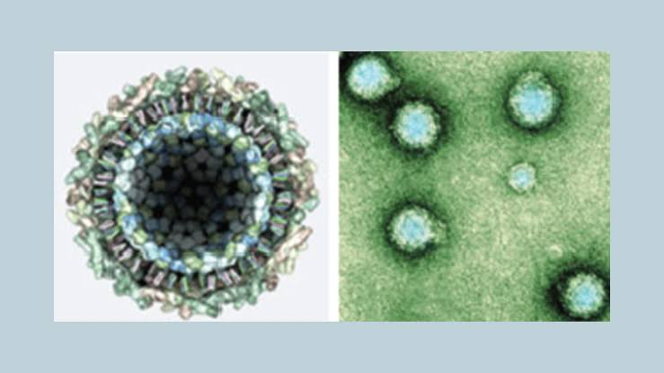
Microscopic view

Slide 7
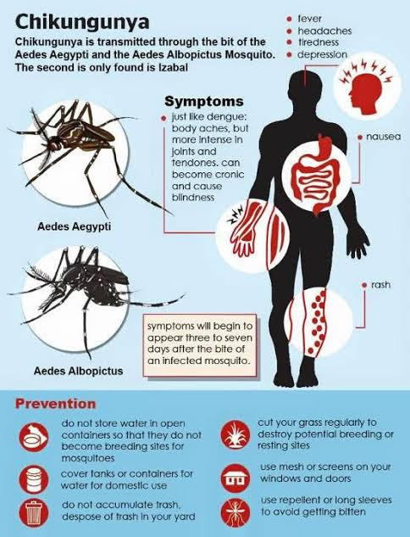

Slide 8
Thank you

