Slide 1
Introduction to the Company Act 2013
The Company Act 2013 is a crucial legislation governing the functioning of companies in India. It provides a comprehensive legal framework for various aspects of corporate governance and operations.
by Sanket Jamdade

Slide 2
Key provisions of the Company Act 2013
1
Legal Framework
The act lays down a structured legal framework for corporate entities, encompassing areas such as incorporation, governance, and compliance.
2
Dispute Resolution
It includes mechanisms for dispute resolution and mechanisms to safeguard the interests of various stakeholders.
3
Shareholding
Provisions outlining shareholding patterns and shareholders' rights are a key feature of the act.

Slide 3
Incorporation and registration of companies
Legal Procedure
Regulatory Compliance
The act details the legal procedures and requirements for the formation and registration of companies.
It outlines the regulatory compliances that companies need to adhere to during the registration process.
Certification
Provisions for obtaining certificates of incorporation and approvals are specified under this section.

Slide 4
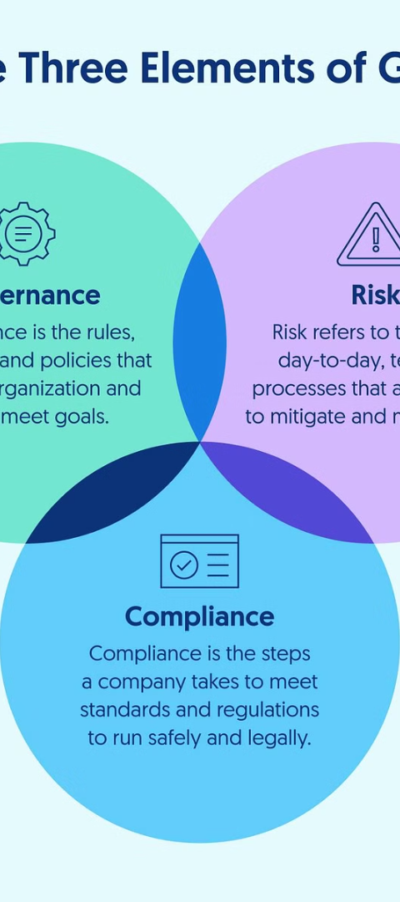
Corporate governance and compliance requirements
1
Board Oversight
2
Disclosure Norms
Roles, responsibilities, and obligations of the board concerning governance are clearly outlined.
Stringent disclosure requirements for ensuring transparency in the company's operations.
3
Compliance Standards
Requirements to adhere to the compliance standards and statutory regulations are detailed.

Slide 5
Share capital and shareholders' rights
Capital Structure
Shareholders' Rights
Listing Requirements
Provisions relating to the structure of share capital and capital variation.
Empowering shareholders with clear rights and resolutions for protecting their interests.
Guidelines for companies looking to list on stock exchanges and comply with regulations.

Slide 6
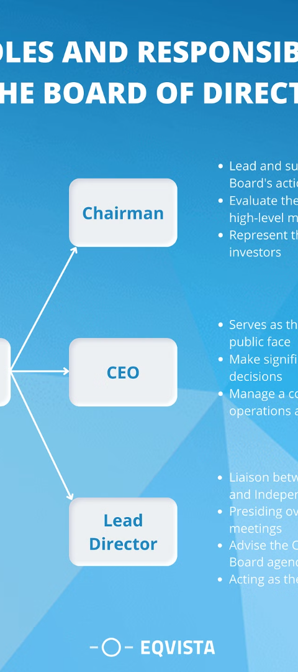
Directors' duties and responsibilities
Fiduciary Duties
Clear expectations for directors' fiduciary duties and obligations towards the company.
Accountability
Enforcement of corporate accountability through compliance and ethical responsibilities of directors.
Disclosure Norms
Mandated disclosures for directors, outlining reporting and transparency requirements.

Slide 7
Mergers, acquisitions, and restructuring under the Company Act 2013
Mergers & Acquisitions
Restructuring
Regulatory Compliance
Provisions for the legal framework of mergers, acquisitions, and amalgamations.
Details regarding the legal aspect of corporate restructuring and the process thereof.
Compliance and approval requisites for restructuring operations are addressed.

Slide 8
Enforcement and penalties under the Company Act 2013
Enforcement
Penalties
Deterrence
Regulatory Enforcement
Monetary Penalties
Compliance Deterrence
Financial repercussions for contraventions and violations of the Company Act 2013.
Penalties for non-compliance and the enforcement mechanisms for regulatory offenses.
Creating a deterrent effect to ensure adherence to the legal provisions.

