Slide 1
Electroanalytical Techniques
By
Dr. S. B. Wategaonkar
Assistant Professor,
Department of Chemistry,
Kisan Veer Mahavidyalaya, Wai

Slide 2
Electroanalytical Techniques
Electroanalytical techniques include a group of instrumental techniques like potentiometry, voltammetry, conductometry, coulometry, electrogravimetry in all of those techniques there is interaction of electricity with matter and in all the above mentioned techniques we measure the electrochemical properties like potential, current, charge etc with help of different instruments like potentiometer, pH meter, conductometer, voltammeter etc,. The use of electrical measurements for analytical purposes has found large range of applications including analytical, environmental monitoring, industrial quality control & biomedical analysis.
Why Electroanalytical Chemistry?
Electroanalytical methods have certain advantages over other analytical methods. Electrochemical analysis allows for the determination of different oxidation states of an element in a solution, not just the total concentration of the element.
Electroanalytical techniques are capable of producing exceptionally low detection limits and an abundance of characterization information including chemical kinetics information. The other important advantage is its low cost.

Slide 3
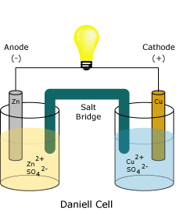
Instrumentation used in Electroanalytical Techniques (Electrochemical Cell)
Electrochemical Cell
Oxidation-reduction or redox reactions take place in electrochemical cells. There are two types of electrochemical cells. Spontaneous reactions occur in galvanic (voltaic) cells; nonspontaneous reactions occur in electrolytic cells. Both types of cells contain electrodes where the oxidation and reduction reactions occur. Oxidation occurs at the electrode termed the anode and reduction occurs at the electrode called the cathode.
Electrodes & Charge
The interface through which electricity is exchanged with electrolyte solution is called electrode. There are two types of electrodes anode & cathode. The anode of an electrolytic cell is positive (cathode is negative), since the anode attracts anions from the solution. However, the anode of a galvanic cell is negatively charged, since the spontaneous oxidation at the anode is the source of the cell's electrons or negative charge. The cathode of a galvanic cell is its positive terminal. In both galvanic and electrolytic cells, oxidation takes place at the anode and electrons flow from the anode to the cathode.

Slide 4
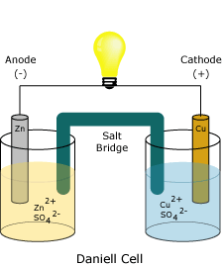
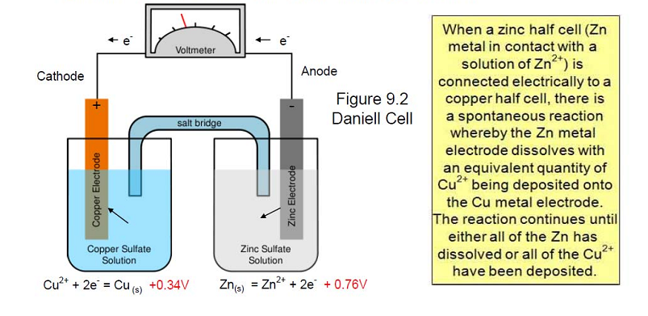
Galvanic or Voltaic Cells:
The redox reaction in a galvanic cell is a spontaneous reaction. For this reason, galvanic cells are commonly used as batteries. Galvanic cell reactions supply energy which is used to perform work. The energy is harnessed by situating the oxidation and reduction reactions in separate containers, joined by an apparatus that allows electrons to flow. A common galvanic cell is the Daniell cell, shown below.

Slide 5
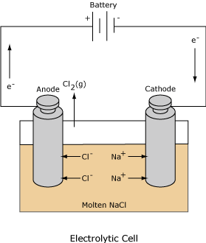
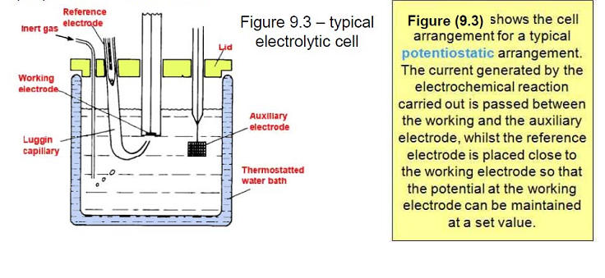
Electrolytic Cells:The redox reaction in an electrolytic cell is nonspontaneous. Electrical energy is required to induce the electrolysis reaction. An example of an electrolytic cell is shown below, in which molten NaCl is electrolyzed to form liquid sodium and chlorine gas. The sodium ions migrate toward the cathode, where they are reduced to sodium metal. Similarly, chloride ions migrate to the anode and are oxided to form chlorine gas. This type of cell is used to produce sodium and chlorine. The chlorine gas can be collected surrounding the cell. The sodium metal is less dense than the molten salt and is removed as it floats to the top of the reaction container.

Slide 6
Classification of Electroanalytical Techniques
Electrochemical methods may be split up into two major classes
Potentiometric and Amperometric
In Potentiometry the electron transfer (ET) reaction is kinetically facile (superficial) and we measure the potential of a Galvanic cell under conditions of zero current flow. The cell potential responds to changes in the activity of the analyte species present in the solution in a well defined manner described by the Nernst equation. Indeed the cell potential varies in a linear manner with the logarithm of the analyte activity.
In Amperometry the kinetics of the ET reaction will have to be driven by an applied potential and so we measure the diffusion controlled current flowing across the electrode/solution interface. This current is directly proportional to the bulk concentration of the analyte present in the solution.

Slide 7
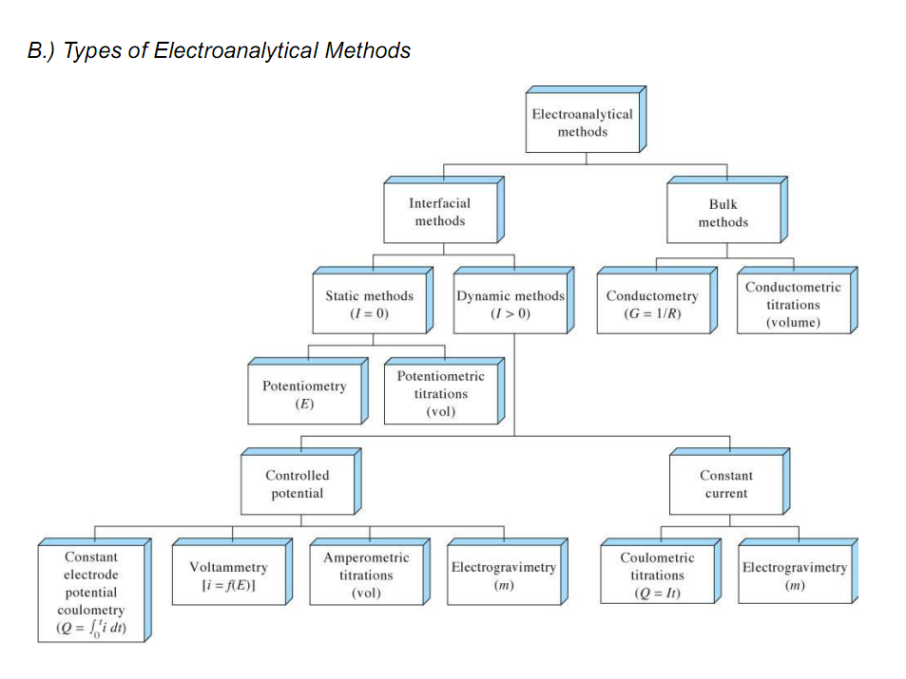

Slide 8
Potentiometry

Slide 9
Potentiometry
Potentiometry is a kind of electroanalytical techniques in that the potential difference of a solution between the two electrodes is measured with the help of electrochemical cell without drawing any substantial current from the solution components. Here the current is drawn from an external sources like battery or AC source i.e. electricity, that work in opposing order block the flow of electricity in the circuit of the electrochemical cell due to polarization of electrolyte solution. The potential at the surface of indicator electrode is then related to the concentration of one or more analytes based on Nernst equation that is called direct potentiometry. For example the electrode potential reaction on the surface of an indicator electrode in general is shown as below
Where “Ox” and “Red” denote the oxidized and reduced forms of a compound at the surface of indicator electrode, respectively The number of electrons involved in the reaction is n. The potential of the electrode, E, follows the Nernst equation:
Where E₀ is the standard electrode potential for the electrode reaction, R is the gas constant, T is the absolute temperature and F is the Faraday constant. The activities of the species Ox and Red are denoted by a_{Ox} and a_{Red}, respectively.

Slide 10
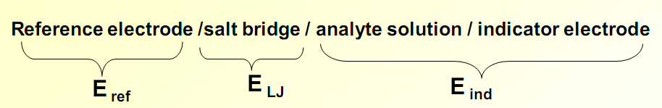
Potentiometric titration
While in potentiometric titration after addition of each ml of volume increments of the standard solution to the analyte solution the potential change of that solution is measured with the help of indicator electrode that is called potentiometric titration.
The potential at the surface of an indicator electrode inserted into the analyte solution can be measured by using an instrument called electrochemical or galvanic cell.
Instrumentation of Potentiometry
A modified electrochemical cell is used in potentiometry for the measurement of potential difference of a solution between the two electrodes without drawing any substantial current from the solution components.
The Electrochemical cell consist of
Reference Electrode
Salt bridge
Indicator Electrode
Potentiometer
Electrolyte solution
The cell notation

Slide 11
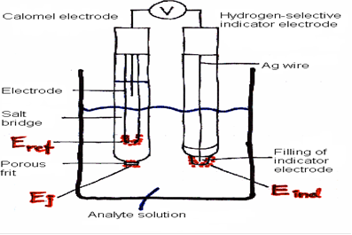
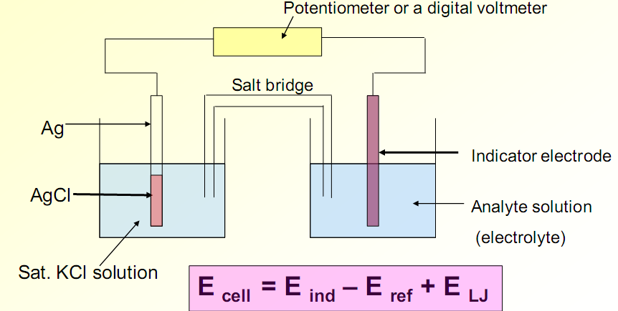
Potentiometric cell

Slide 12
This electrochemical cell (Potentiometric cell) consists of two half-cells, one is called reference electrode half cell it containing reference electrode whose potential is known, constant and independent of concentration of analyte. While the other half-cell is called working electrode half cell whose potential is unknown, and change by varying the concentration of analyte. It depends on analyte concentration. It also consist of potentiometer (or digital voltmeter) and salt bridge. The potentiometer (rheostat) is a device that pushes back the current produced in the circuit due to chemical reaction and thus minimizes the flow of current in the circuit so avoid the polarization of electrodes. It measure the amount of potential produced at the surface of indicator electrode by comparing the known potential of the source connected with the potentiometer. A salt bridge (i.e. filter paper soaked in KNO₃) is often employed to provide ionic contact between two half-cells with different electrolytes—to prevent the solutions from mixing and causing unwanted side reactions. As electrons flow from one half-cell to the other, a difference in charge is established. If no salt bridge were used, this charge difference would prevent further flow of electrons. A salt bridge allows the flow of ions to maintain a balance in charge between the oxidation and reduction vessels while minimize the liquid junction potential. It maintains the electrical neutrality in each half cell as ions flow into and out of the salt bridge.

Slide 13
Reference electrode
Reference electrode is that electrode whose potential is known, constant and does not change with electrode reaction. In addition this electrode should be rugged and easy to assemble and should maintain a constant potential while passing minimal currents.
There are three main types of reference electrodes which are commonly used
• Standard hydrogen electrode (SHE) (E=0.000 V) activity of H+=1
• Saturated calomel electrode (SCE) (E=+0.242 V saturated)
• Silver- Silver chloride electrode

Slide 14
Standard hydrogen electrode (SHE)
The SHE is the universal reference electrode for reporting relative half-cell potentials. It is a type of gas electrode and was widely used in early studies as a reference electrode, and as an indicator electrode for the determination of pH values. The SHE could be used as either an anode or cathode depending upon the nature of the half-cell it is used with.
The SHE consists of a platinum electrode immersed in a solution with a hydrogen ion concentration of 1.00M. The platinum electrode is made of a small square of platinum foil which is platinized (known as platinum black). Hydrogen gas, at a pressure of 1 atmosphere, is bubbled around the platinum electrode. The platinum black serves as a large surface area for the reaction to take place, and the stream of hydrogen gas keeps the solution saturated at the electrode site with respect to the gas. It is interesting to note that even though the SHE is the universal reference standard, it exists only as a theoretical electrode which scientists use as the definition of an arbitrary reference electrode with a half-cell potential of 0.00 volts. (Because half-cell potentials cannot be measured, this is the perfect electrode to allow scientists to perform theoretical research calculations.) The reason this electrode cannot be manufactured is due to the fact that no solution can be prepared that yields a hydrogen ion activity of 1.00M.

Slide 15
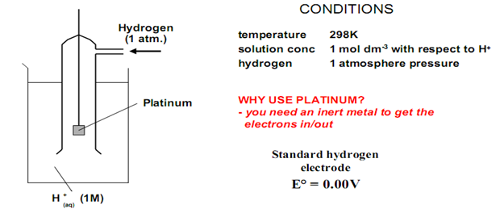
Standard hydrogen electrode (SHE)
The value is affected by ...
• temperature
• pressure of any gases
• solution concentration
Hydrogen electrode is based on the redox half cell:
2H+(aq) + 2e- → H₂(g)
This redox reaction occurs at platinized platinum electrode. The electrode is dipped in an acidic solution and pure hydrogen gas is bubbled through it. The concentration of both the reduced form and oxidized form of hydrogen is maintained at unity. That implies that the pressure of hydrogen gas is 1 bar and the activity of hydrogen ions in the solution is 1 molar. The activity of hydrogen ions is their effective concentration, which is equal to the formal concentration times the activity coefficient. Activity coefficients are close to 1.00 for very dilute water solutions, but are usually lower for more concentrated solutions.
Pt | H₂(g, 1.0 atm)|H⁺(aq, A= 1.0M)
½ H₂(g, 1.0 atm) = H⁺(aq, A= 1.0M) + e Eº = 0.000 V
The standard hydrogen electrode (S.H.E.) is difficult to set up so it is easier to choose a more convenient secondary standard which has been calibrated against the S.H.E.

Slide 16
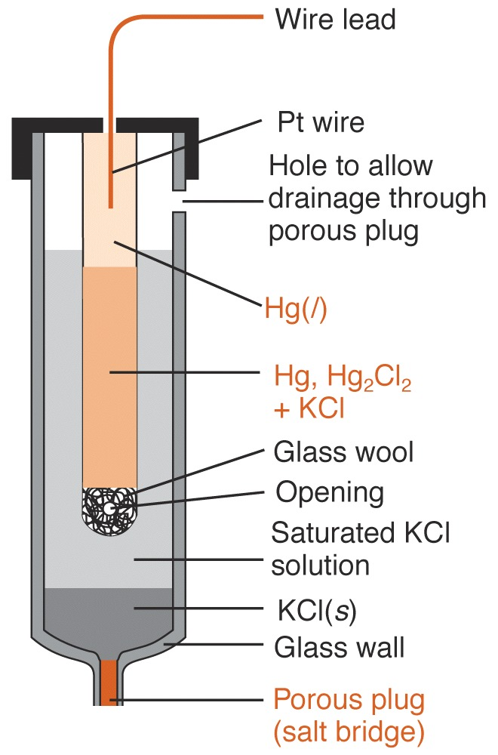
Saturated Calomel Electrode (SCE)
The SCE is a half cell composed of mercurous chloride (Hg2Cl2, calomel) in contact with a mercury pool. These components are either layered under a saturated solution of potassium chloride (KCl) or within a fritted compartment surrounded by the saturated KCl solution (called a double-junction arrangement). A platinum wire is generally used to allow contact to the external circuit. The half reaction is described by
Hg(l) | Hg₂Cl₂ (sat’d), KCl (sat’d) | |
electrode reaction in calomel hal-cell
Hg₂Cl₂ (s) + 2e = 2Hg(l) + 2Cl–
Eº = + 0.268V
E = Eº – (0.05916/2) log[Cl–]² = 0.244 V
Temperature dependent
A calomel electrode saturated with KCl is called a saturated calomel electrode, abbreviated S.C.E.
Advantage : using saturated KCl is that [Cl⁻] does not change if some liquid evaporates.

Slide 17
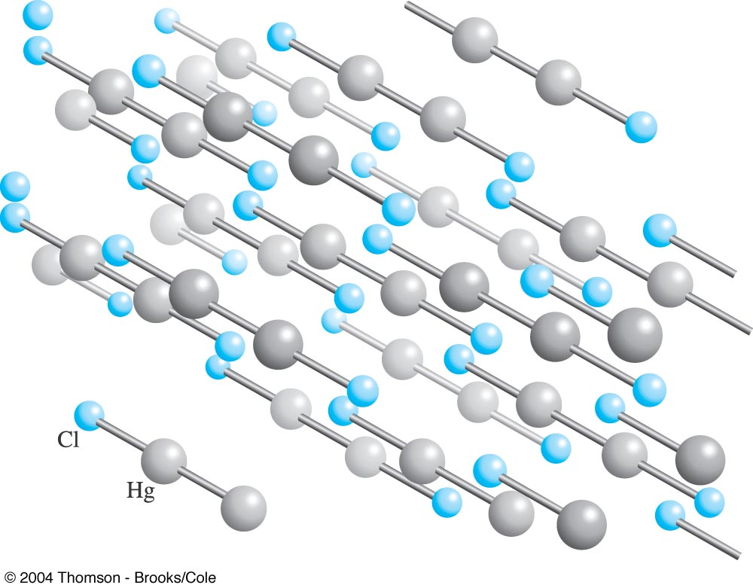
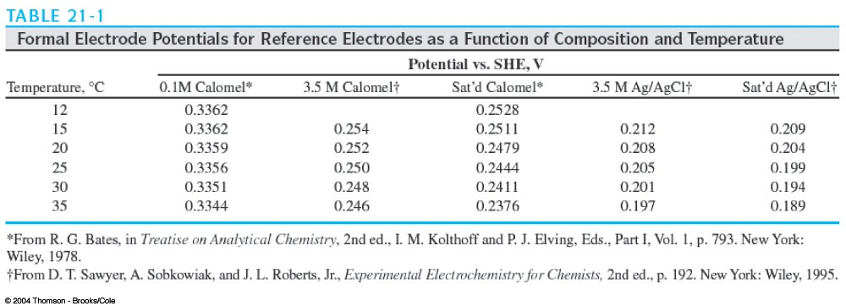
The crystal structure of calomel(Hg₂Cl₂), which has limited solubility in water (Ksp = 1.8 ×10^{–18}).
Hg₂Cl₂ = Hg₂²⁺ + 2Cl–
Ksp = 1.8 ×10^{–18}
Saturated KCl = 4.6 M KCl

Slide 18
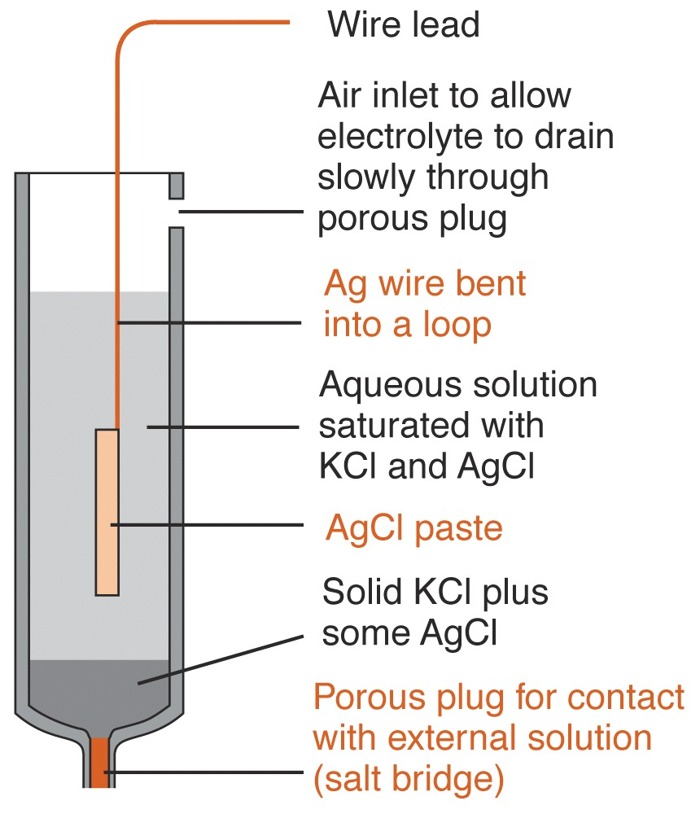
. Silver/Silver Chloride (Ag/AgCl)
The silver/silver chloride reference electrode is composed of a silver wire, sometimes coated with a layer of solid silver chloride, immersed in a solution that is saturated with potassium chloride and silver chloride. The pertinent half reaction is
AgCl (s) + e Ag (s) + Cl- (sat’d)
Ag(s) | AgCl (sat’d), KCl (xM) | |
AgCl(s) + e = Ag(s) + Cl–
Eº = +0.244V
E = Eº – (0.05916/1) log [Cl–]
E (saturated KCl) = + 0.199V (25ºC)
The electrode has many features making is suitable for use in the field:
Simple construction
Inexpensive to manufacture
Stable potential
Non-toxic components

Slide 19
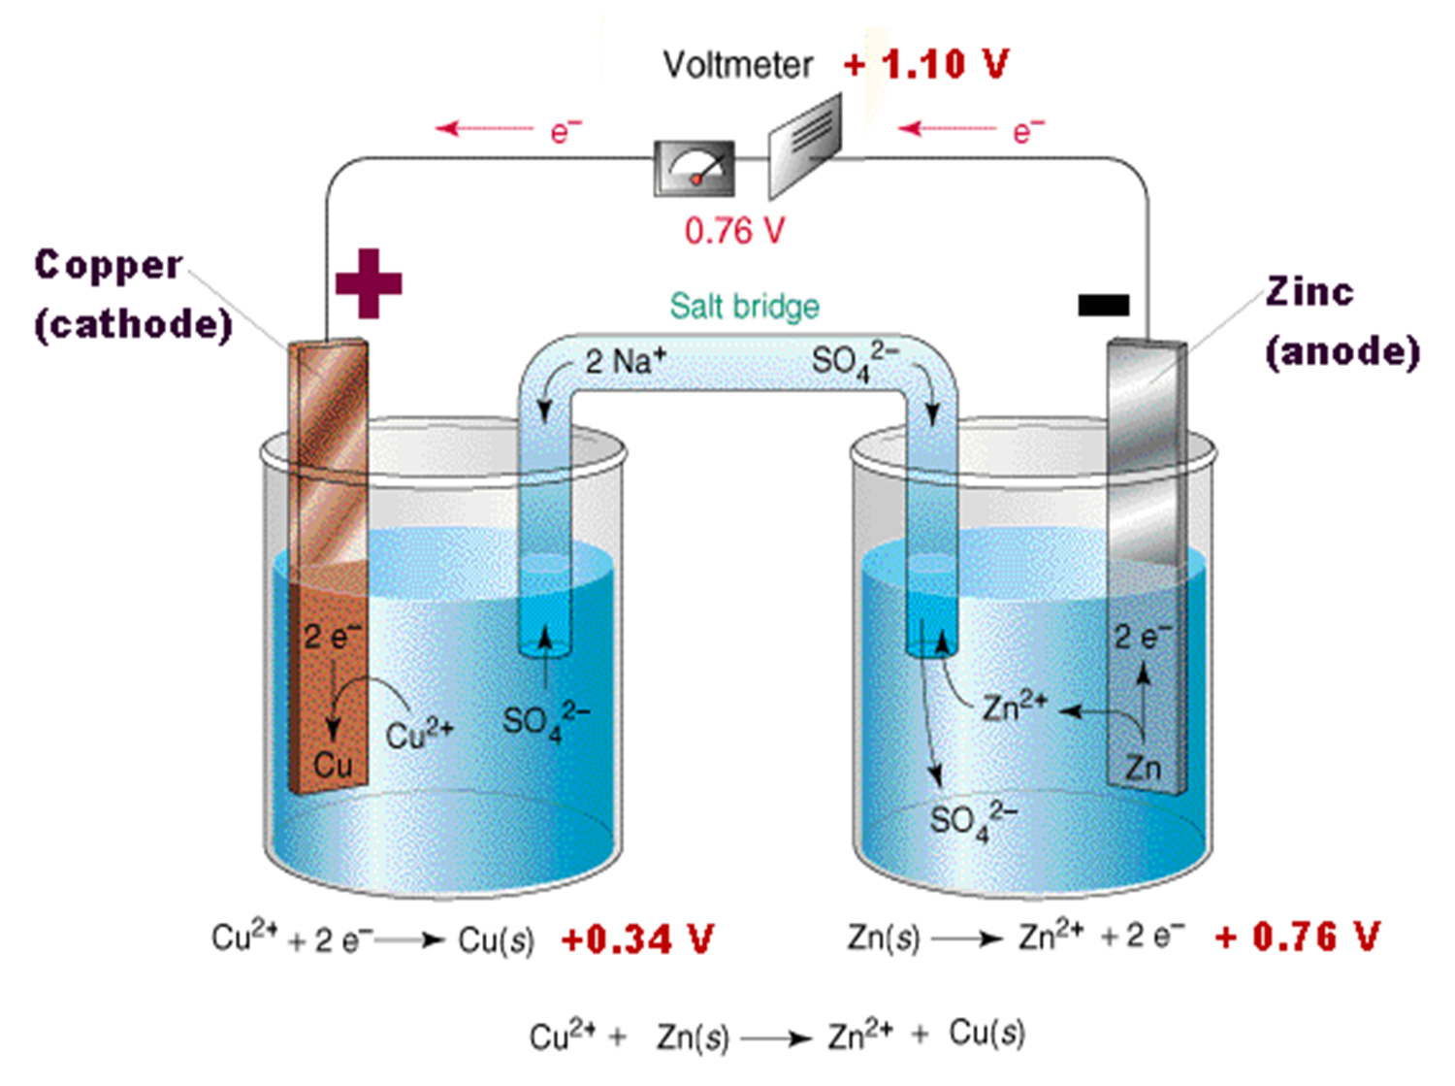
Indicator electrode
Indicator electrode is that electrode its potentional value depends on the concentration of analyte and the potentional value at it surface changes with the change of concentration of analyte. There are two types of indicator electrodes i.e. metallic indicator electrodes and Ion selective indicator electrodes.
Metallic indicator electrode: Metallic indicator electrodes are made of metals, there are three types of metallic indicator electrodes i.e. 1st kind, 2nd kind, 3rd kind
1st kind metallic indicator electrodes:
These are made of the metal and used to determine the potential of solution which containing the ion like the electrode. These are not very selective, response to other ion in the solution. Some metals (Cu, Zn, Cd) dissolve in acidic solutions of Cu, Zn & Cd and other examples are Ag, Hg, Bi, Tl, Pb

Slide 20


2nd kind Metallic Indicator electrodes: These metallic indicator electrode responses to the concentration of anion in the solution i.e. Ag wire in AgCl saturated surface response to the chloride ion concentration. The other example is calomel electrode which also response to anion i.e. chloride ion concentration in the solution
1) Silver-silver chloride electrode
Ag(s) | AgCl (sat’d), KCl (xM) | |
AgCl(s) + e = Ag(s) + Cl–
Eº = +0.244V
E = Eº – (0.05916/1) log [Cl–]
E (saturated KCl) = + 0.199V (25ºC)
2) Calomal electrode
Hg(l) | Hg₂Cl₂ (sat’d), KCl (sat’d) | |
electrode reaction in calomel hal-cell
Hg₂Cl₂ (s) + 2e = 2Hg(l) + 2Cl–
Eº = + 0.268V
E = Eº – (0.05916/2) log[Cl–]² = 0.244 V
Temperature dependent
A calomel electrode saturated with KCl is called a saturated calomel electrode, abbreviated S.C.E.
Advantage : using saturated KCl is that [Cl⁻] does not change if some liquid evaporates.

Slide 21
3rd kind Metallic Indicator electrodes: These metallic indicator electrode are made of inert metal like Pt, Au, Pd or carbon and response to a mixture of ions like Fe²⁺/ Fe^{3+.} Provides a surface for the electrochemistry to occur
Ion selective electrode (ISE)
Ion Selective Electrodes (ISE) are membrane electrodes that respond selectively to an ion in the presence of other ions. These include probes that measure specific ions and gases in solution. The most commonly used ISE is the pH probe. Other ions that can be measured include fluoride, bromide, cadmium, Silver, copper, lead, magnesium, calcium etc and gases in solution such as ammonia, carbon dioxide, and nitrogen oxide.
The use of Ion Selective Electrodes in environmental analysis offer several advantages over other methods of analysis. First, the cost of initial setup to make analysis is relatively low. The expense is considerably less than other methods, such as Atomic Adsorption spectrophotometry or Ion Chromatography. ISE electrodes are good to use in color solution and are not subject to interferences such as color in the sample. This makes them ideal for clinical use (blood gas analysis) where they are most popular; however, they have found practical application in the analysis of environmental samples, often where in-situ determinations are needed and not practical with other methods.
A large number of ISE electrodes with good selectivity for specific ions are based on the measurement of the potential generated across a membrane called membrane potential or boundary potential. The membrane is usually attached to the end of a tube that contains an internal reference electrode. This membrane electrode and an external reference electrode are then immersed in the solution of interest. Since the potentials of the two reference electrodes are constant, any change in cell potential is due to change in potential across the membrane.

Slide 22
Ion selective electrode (ISE)
There are five fundamentally different types of membrane which selectively interact with the ion or ions to be determined:
(1) glass membrane
(2) liquid membrane: (a) electrically charged ligand groups (ion exchangers) as membrane components
(3) solid-state membrane
(4) Gas sensing electrodes
(5) Enzyme electrodes
Selectivity coefficient
k_{X,Y} = (response to Y) / (response to X)
General behavior of ISE
E = constant ± β(0.05916/n_{X}) log [A_{X} +Σ(k_{X,Y} A_{Y} ^{nX nY} )]

Slide 23
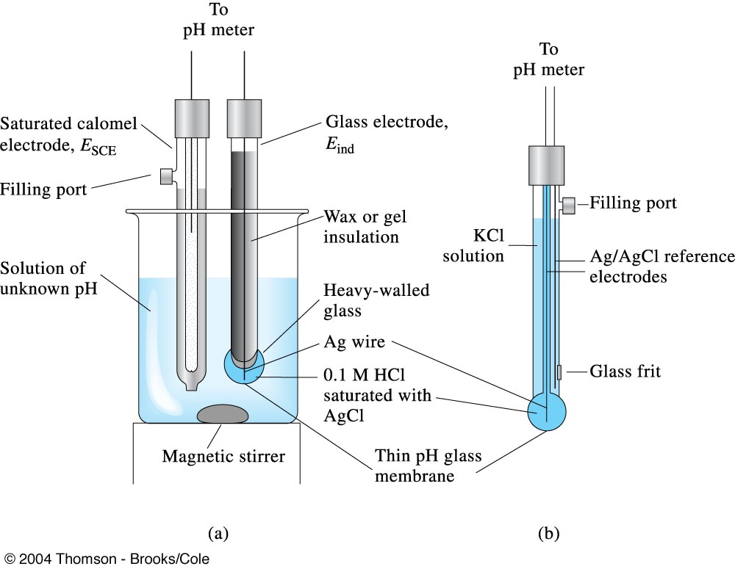
Glass membrane Electrode
Glass electrodes were the first ion-selective electrodes to become known. For more than 60 years, they have been widely used for pH determinations in solutions, both in industry and in scientific research, particularly in biology and medicine. Usually, the electrodes are blown from glass called Corning 015 having chemical composition 22% Na2O, 6% CaO, and 72% SiO2, in the form of bulbs having a wall thickness of about 0.1mm. Inside the tube are 0.1 M solution of HCl and a saturated solution of silver chloride. A silver wire coated with silver chloride is dipped into this solution to just have electrical contact inside the thin membrane of the electrode. While this is almost the same design as that of the silver–silver chloride reference electrode. See Figure

Slide 24


Glass membrane Electrode
The potential that develops at the surface of glass electrode is called membrane potential. Since the glass membrane at the tip is thin, a potential develops due to the difference in the concentration of the hydrogen ions on opposite sides of the membrane that causes the potential—the membrane potential—to develop. There is no half-cell reaction involved.
Ag(s) | AgCl[sat’d], Cl–(inside), H⁺(inside) | glass membrane | H⁺(outside)
The Nernst Equation
E = Eº – (0.05916/1) log [Cl–] + (0.05916/1) log ([H⁺(outside)]/[H⁺(inside)])
E = Q + (0.05916/1) log [H⁺(outside)]
or, since the internal [H⁺] is a constant, it can be combined with E_{o}, which is also a constant, giving a modified E_{o}, E*, and eliminating [H⁺](internal)
In addition, we can recognize that pH = –log [H⁺] and substitute this into the above equation

Slide 25
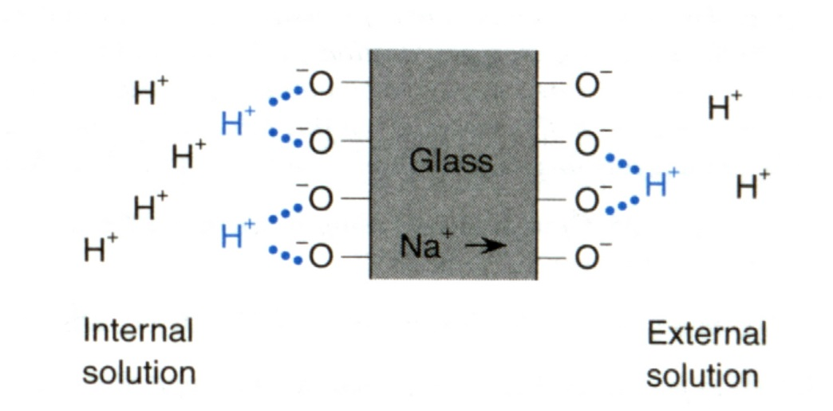
Mechanism of conduction
The conductivity of glass at room temperature is very low. It arises from the slight mobility of sodium ions in the glass. In its usual form, glass does not contain hydrogen ions. However, during the leaching of glass in aqueous solutions its surface layer is altered to a certain depth; water molecules enter, and hydration processes and some swelling occur. Part of the sodium ions in the surface layer are leached out and are replaced by hydrogen ions from the solution. Equilibrium is established between the hydrogen ions in the surface layer and those in solution; hence, an equilibrium potential difference between the phases arises. The special feature of this surface layer is its exceptionally high selectivity toward hydrogen ions (relative to sodium ions or other cations). For this reason, the two sides of the membrane act as good hydrogen electrodes. As we know internal membrane of glass electrode containing known number of hydrogen ions (a = 0.IM of H⁺) while the external membrane containing different. So due to difference in number of hydrogen ions across the both sides of the glass membrane cause a positive charge imbalance which is responsible for membrane potential.
SiO─ Na⁺ _{(solid)} + H⁺ _{(solution)} ↔ SiO─H⁺ _{(solid)} + Na⁺ _{(solution)}
The protons are free to move and exchange with other ions.
Potential is determined by external [H⁺]

Slide 26
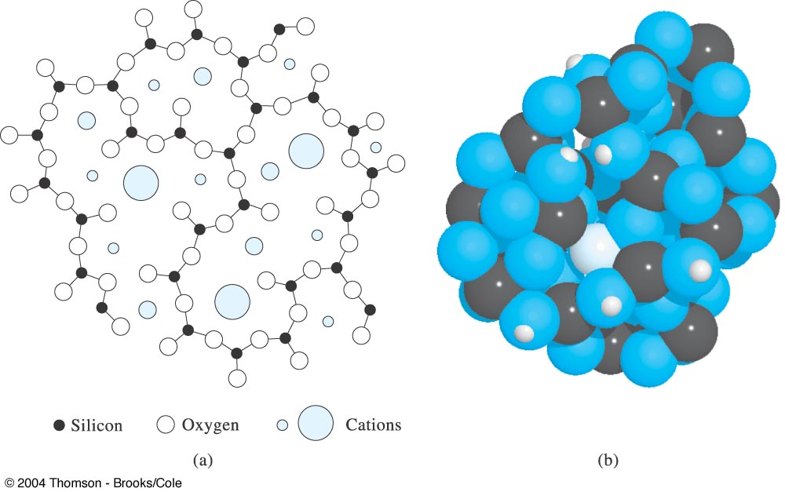
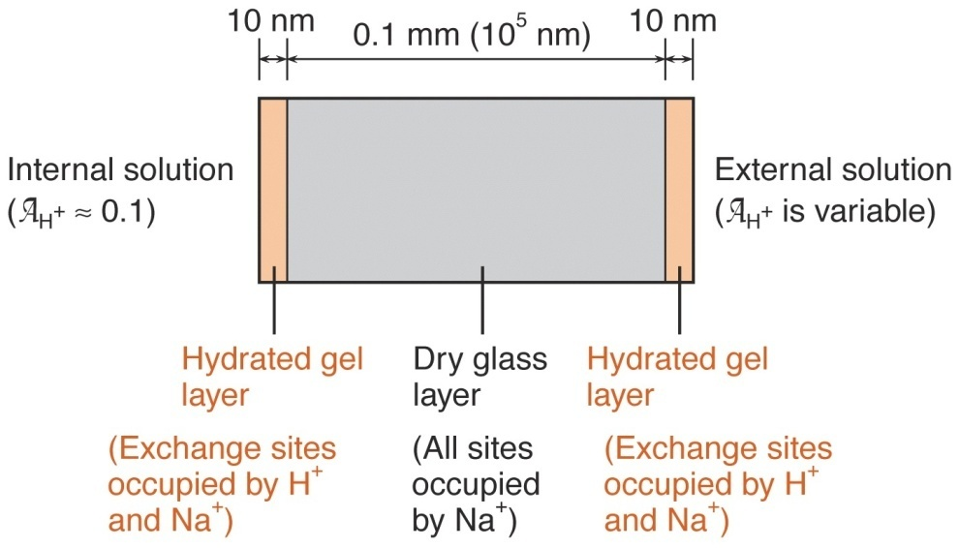
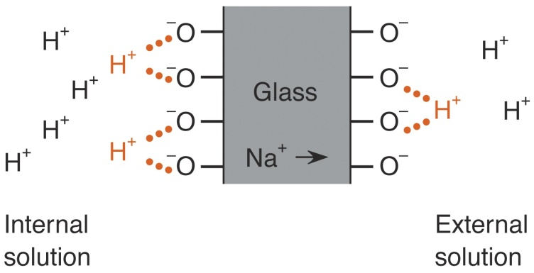
Composition of glass membranes
70% SiO₂
30% CaO, BaO, Li₂O, Na₂O,
and/or Al₂O₃
Ion exchange process at glass membrane-solution interface:
Gl– + H⁺ = H⁺Gl–
(a) Cross-sectional view of a silicate glass structure. In addition to the three Si│O bonds shown, each silicon is bonded to an additional oxygen atom, either above or below the plane of the paper. (b) Model showing three-dimensional structure of amorphous silica with Na⁺ ion (large dark blue) and several H⁺ ions small dark blue incorporated.

Slide 27
In contrast to other types of ion-selective membranes, the current between the two surface layers is transported across the central part of the glass membrane by different ions, the sodium ions. Doping the glass membrane with different proportions of aluminum oxide and other metal oxides can produce ion-selective glass membrane electrodes selective for other metallic ions such as Li⁺, Na⁺, K⁺, Ag⁺ or NH4⁺.
Calibration or standardization of pH meter
The pH meter is standardized (calibrated) with the use of buffer solutions. Usually, two buffer solutions are used for maximum accuracy. The pH values for these solutions should bracket the pH value expected for the sample. For example, if the pH of a sample to be measured is expected to be 9.0, buffers of pH =7.0 and pH = 10.0 should be used. Buffers with pH values of 4.0, 7.0, and 10.0 are available commercially specifically for pH meter standardization. Alternatively, of course, homemade buffer solutions may be used. In either case, when the pH electrode and reference electrode are immersed in the buffer solution being measured and the electrode leads are connected to the pH meter, the meter reading is electronically adjusted (refer to manufacturer’s literature for specifics) to read the pH of this solution.
The electrodes can then be immersed into the solution being tested and the pH directly determined.

Slide 28
Glass pH electrode
Advantages over other electrodes for pH measurements:
  Its potential is essentially not affected by the presence of oxidizing or reducing agents.
  It operates over a wide pH range.
  It responds fast and functions well in physiological systems.
  Selective for monovalent cations only because polyvalent ions can not penetrate the surface of membrane.

Slide 29
Errors that affect pH measurements with glass electrode
1. The alkaline(sodium) error : low readings at pH values greater than 9
2. The acid error : somewhat high when the pH is less than about 0.5
3. Dehydration may cause erratic electrode performance.
4. Variation in junction potential : ~ 0.01 pH unit
5. Error in the pH of the standard buffer : ± 0.01 pH unit
Cleaning glass electrode :
1. Washing with 6M HCl
2. 20 w/w% aqueous ammonium bifluoride (NH₄HF₂)

Slide 30
LIQUID MEMBRANE ELECTRODE
Liquid membrane is a type of ISE based on water- immiscible liquid substances produced in a polymeric membrane used for direct potentiometric measurement.
Used for direct measurement of several polyvalent cations (Ca ion) as well as a certain anions.
Inner compartment of electrode contains reference electrode & aqueous reference solution.
Outer compartment – organic liquid ion exchanger

Slide 31
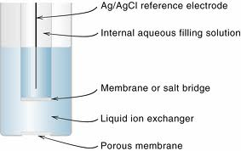
•The polymeric membrane made of PVC to separate the test solution from its inner compartment which contains standard solution of the target ion.
•The filling solution contains a chloride salt for establishing the potential of the internal Ag/AgCl wire electrode.

Slide 32
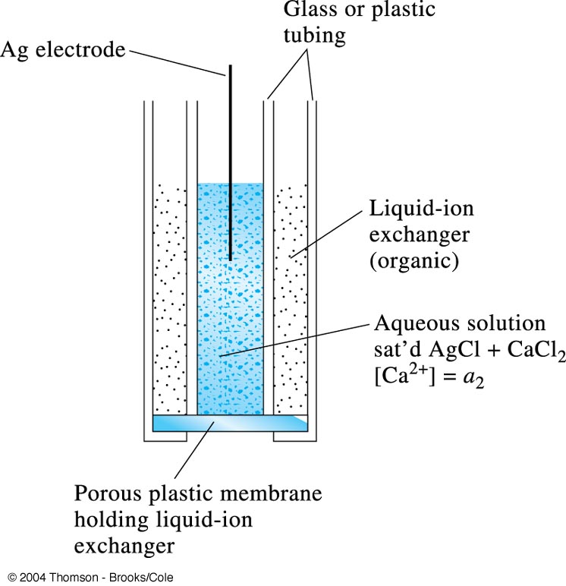
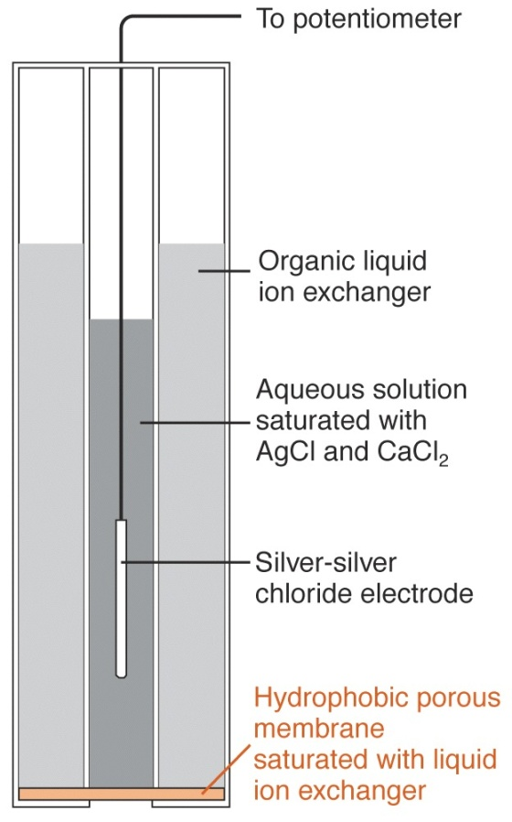
Liquid ISE
Ca ISE
Calcium didecylphosphate dissolved in dioctylphenylphosphonate
[(CH₃(CH₃)₈CH₂O)₂PO₂]₂Ca ↔ 2[(CH₃(CH₃)₈CH₂O)₂PO₂]– + Ca²⁺
Diagram of a liquid-membrane electrode for Ca²⁺.

Slide 33
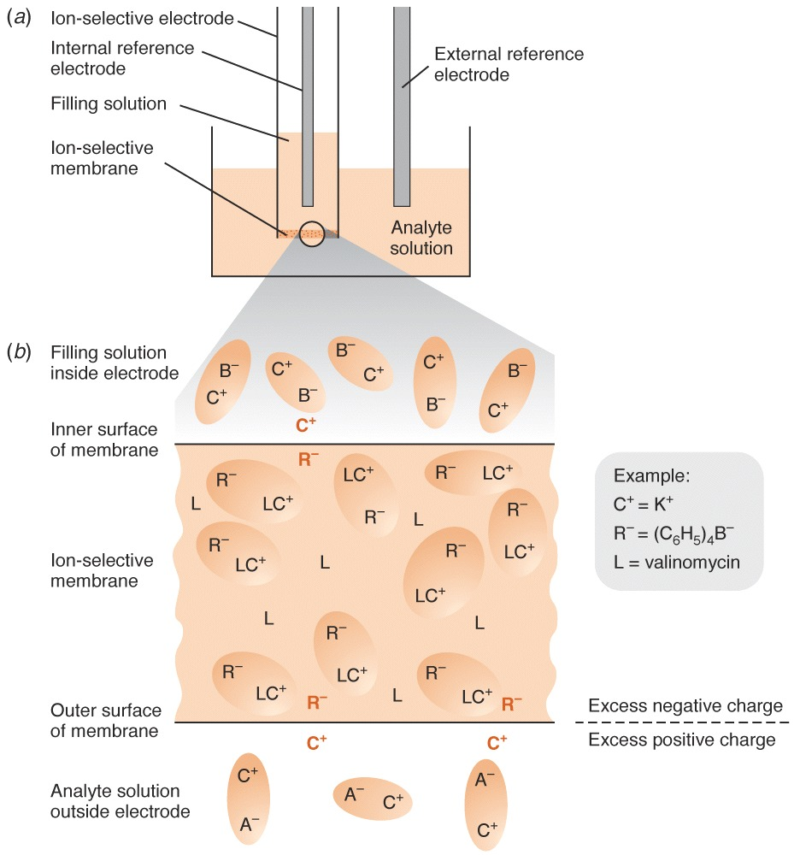

Slide 34
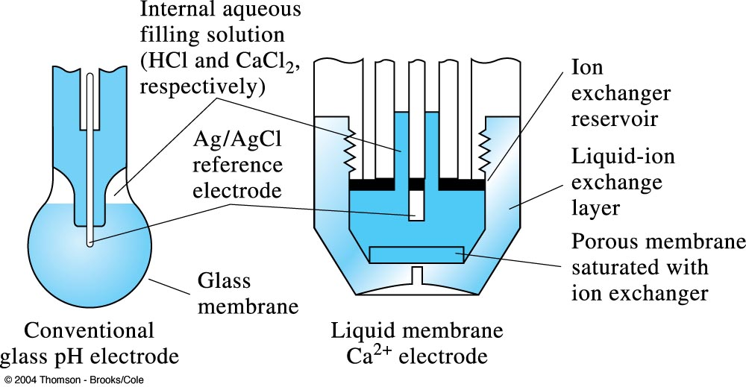
Comparison of a liquid-membrane calcium ion electrode with a glass pH electrode.

Slide 35
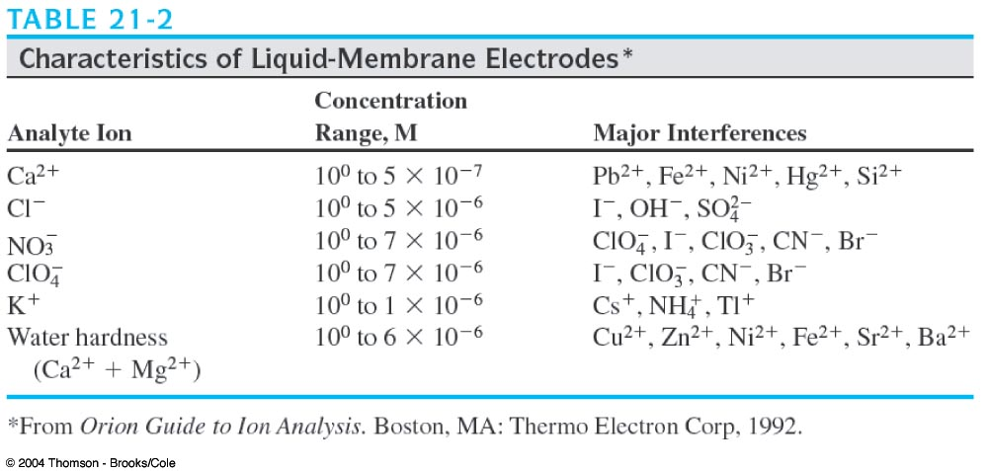
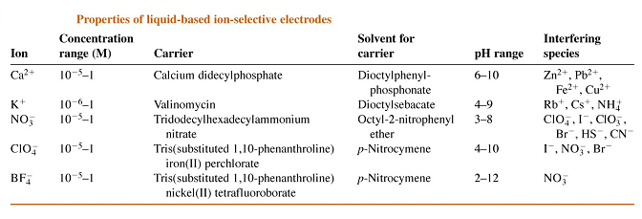

Slide 36
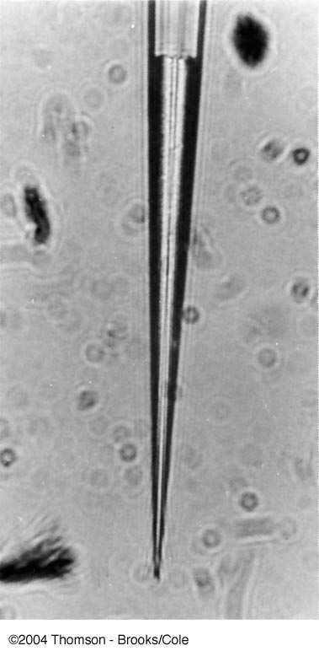
Photograph of a potassium liquid-ion exchanger microelectrode with 125 m of ion exchanger inside the tip. The magnification of the original photo was 400×.

Slide 37
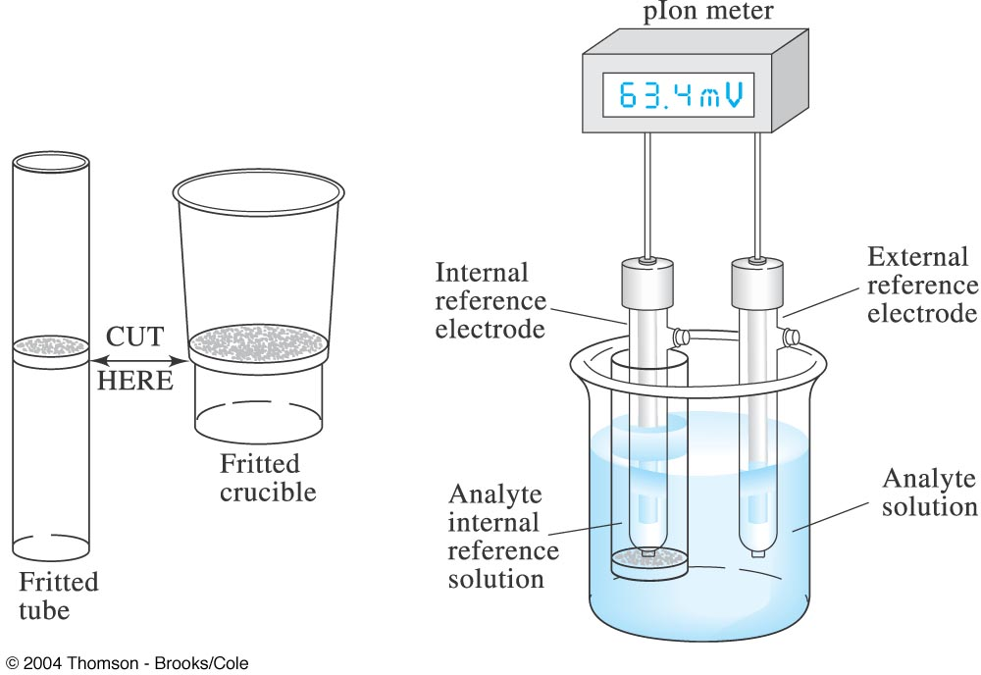
A homemade liquid-membrane electrode.

Slide 38
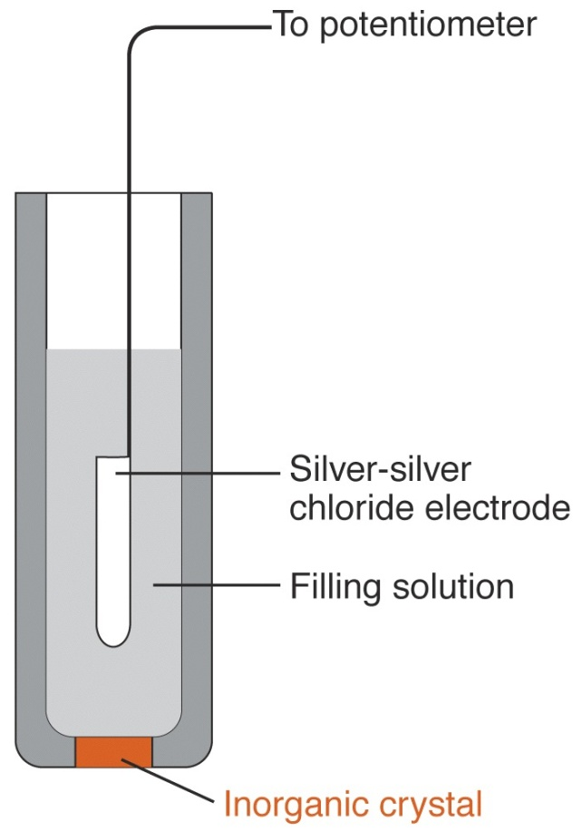
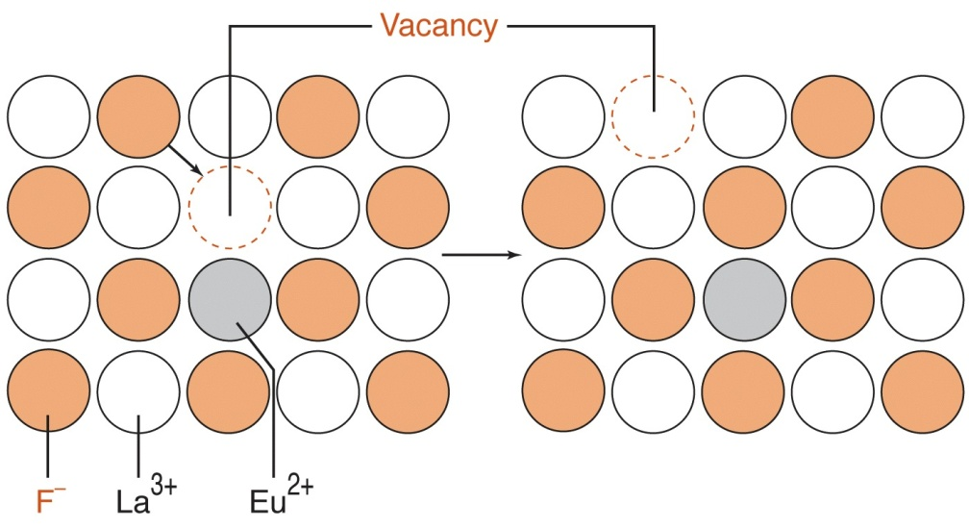
Solid state crystalline membrane electrode
Migration of F– through LaF₃ doped with EuF₂.

Slide 39
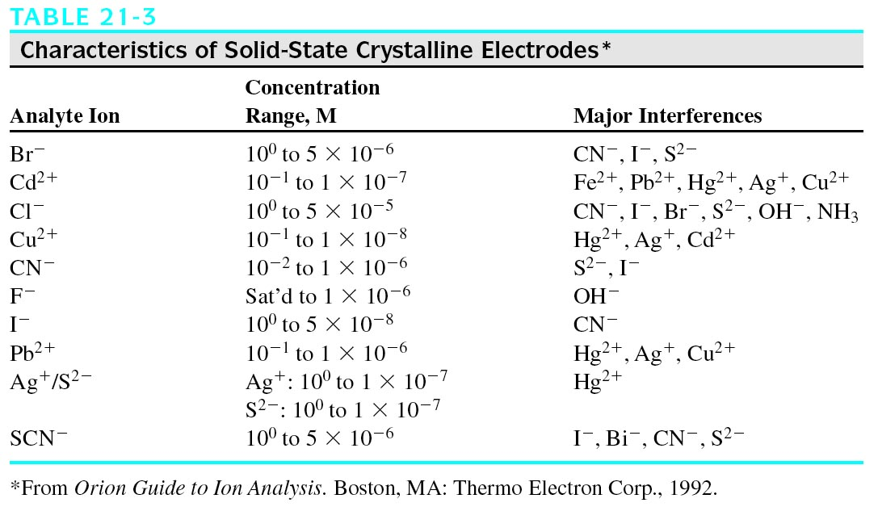
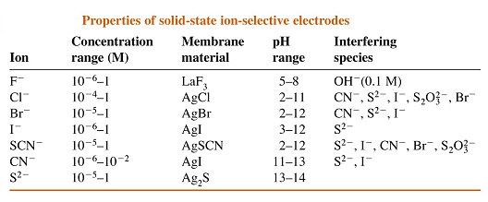

Slide 40
Example: Fluoride (F⁻) electrode
Internal ref electrode
Ag/AgCl
Filling soln.
Aqueous NaCl + NaF
Membrane
LaF₃ crystal disc
Applications
Electroplating industry, water treatment (fluoridation), toothpaste

Slide 41
GAS SENSING ELECTRODE
Available for the measurement of ammonia, carbon dioxide and nitrogen oxide.
This type of electrode consist of permeable membrane and an internal buffer solution.
The pH of the buffer changes as the gas react with it.
The change is detected by a combination pH sensor.
This type of electrode does not require an external reference electrode.

Slide 42
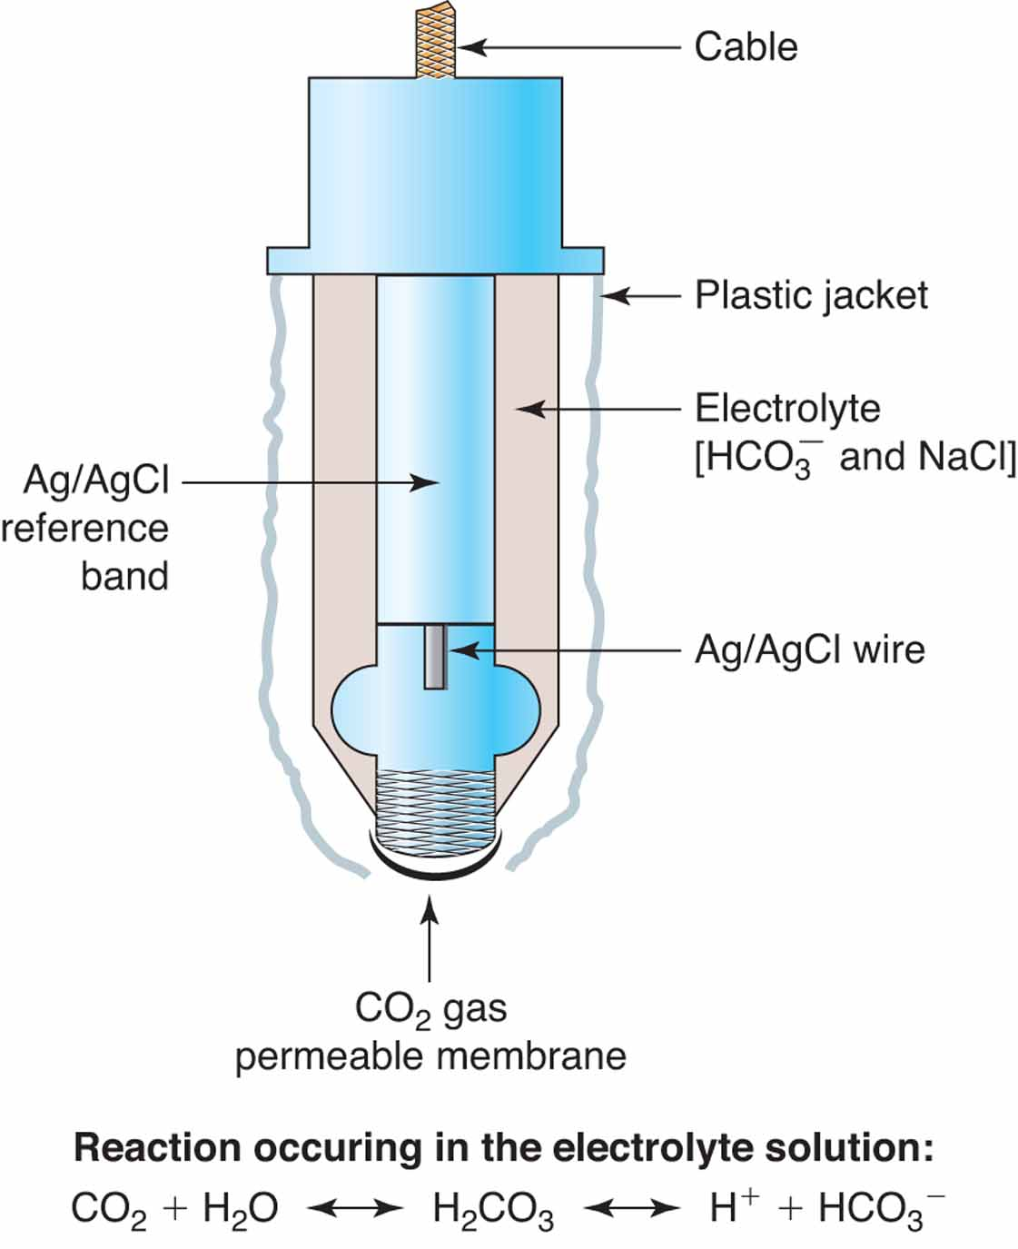
pco2 electrode
  Measurement of PCO₂ in routine blood gases
  A modified pH electrode with a CO₂ permeable membrane covering the glass membrane surface
  A bicarbonate buffer separates the membranes
  Change in pH is proportional to the concentration of dissolved CO₂ in the blood

Slide 43
Applications of ion selective electrodes
Ion-selective electrodes are used in a wide variety of applications for determining the concentrations of various ions in aqueous solutions. The following is a list of some of the main areas in which ISEs have been used.
Pollution Monitoring: CN, F, S, Cl, NO₃ etc., in effluents, and natural waters.
Agriculture: NO₃, Cl, NH₄, K, Ca, I, CN in soils, plant material, fertilisers and feedstuffs.
Food Processing: NO₃, NO₂ in meat preservatives.
Salt content of meat, fish, dairy products, fruit juices, brewing solutions.
F in drinking water and other drinks.
Ca in dairy products and beer.
K in fruit juices and wine making.
Corrosive effect of NO₃ in canned foods.
Detergent Manufacture: Ca, Ba, F for studying effects on water quality.
Paper Manufacture: S and Cl in pulping and recovery-cycle liquors.
Explosives: F, Cl, NO₃ in explosive materials and combustion products.
Electroplating: F and Cl in etching baths; S in anodising baths.
Biomedical Laboratories: Ca, K, Cl in body fluids (blood, plasma, serum, sweat).
F in skeletal and dental studies.
Education and Research: Wide range of applications.

Slide 44
Application of Potentiometric Measurement
Clinical Chemistry
  Ion-selective electrodes are important sensors for clinical samples because of their selectivity for analytes.
  The most common analytes are electrolytes, such as Na⁺, K⁺, Ca²⁺,H⁺, and Cl⁻, and dissolved gases such as CO₂.
Environmental Chemistry
  For the analysis of of CN⁻, F⁻, NH₃, and NO₃⁻ in water and wastewater.

Slide 45
Potentiometric Titrations
  pH electrode used to monitor the change in pH during the titration.
  For determining the equivalence point of an acid–base titration.
  Possible for acid–base, redox, and precipitation titrations, as well as for titrations in aqueous and nonaqueous solvents.
Agriculture
  NO₃, NH₄, Cl, K, Ca, I, CN in soils, plant material, fertilizers.
Detergent Manufacture
  Ca, Ba, F for studying effects on water quality

Slide 46
Food Processing
  NO₃, NO₂ in meat preservatives
  Salt content of meat, fish, dairy products, fruit juices, brewing solutions.
  F in drinking water and other drinks.
  Ca in dairy products and beer.
  K in fruit juices and wine making.
  Corrosive effect of NO₃ in canned foods.

Slide 47
advantages
Relatively inexpensive and simple to use and have an extremely wide range of applications and wide concentration range.
Under the most favourable conditions, when measuring ions in relatively dilute aqueous solutions and where interfering ions are not a problem, they can be used very rapidly and easily.
ISEs can measure both positive and negative ions.
They are unaffected by sample colour or turbidity.

Slide 48
Non-destructive: no consumption of analyte.
Non-contaminating.
Short response time: in sec. or min. useful in industrial applications.

Slide 49
LIMITATION
Precision is rarely better than 1%.
• Electrodes can be affected by proteins or other organic solutes.
• Interference by other ions.
• Electrodes are fragile and have limited shelf life.

Slide 50
Voltammetry

Slide 51

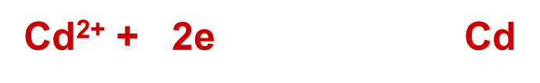
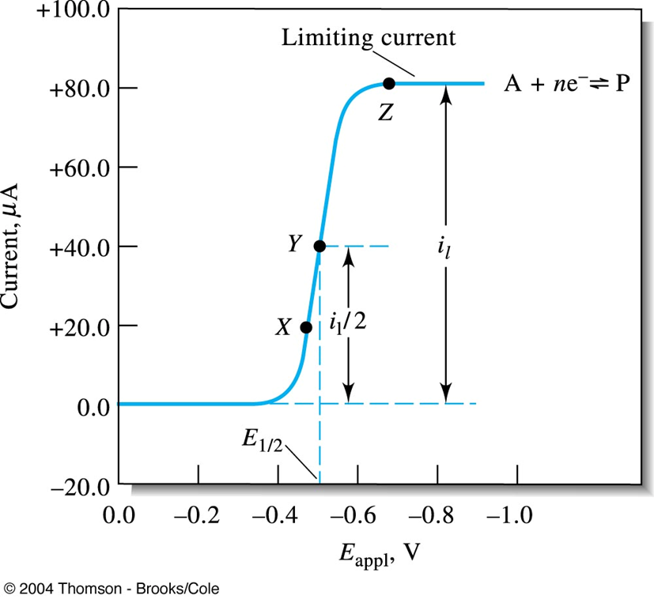
Voltammetry
General Principles of Voltammetry
In voltammetry diffusion current (I) is measured as a function of changing potential (E)
  As potential is applied, electrolysis of analyte begins and current rises until it reaches a limiting current
  The magnitude of this current is directly proportional to the activity or concentration of analyte i.e I = kC
  Where I= current, k = constant, C = concentration of analyte
E_{1/2} = half wave potential (characteristic of every redox reaction) used for identification purposes
Plot of I vs. E is called a voltammogram

Slide 52
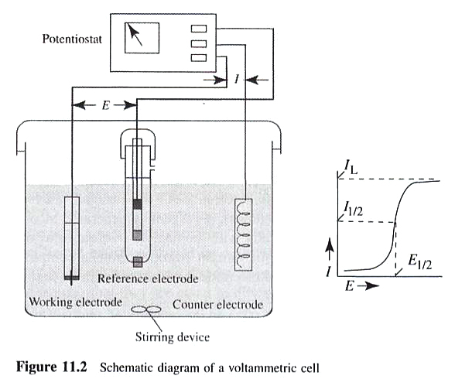
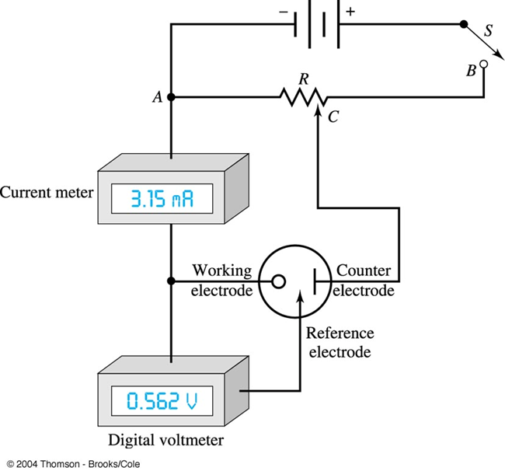
Voltametric Cell
Electrolytic cell consisting of 3 electrodes:
  Micro indicator electrode like Hg, Pt, Au, Ag, C or others
  Reference electrode like SCE or Ag/ AgCl
  Auxillary counter electrode like Pt wire

Slide 53
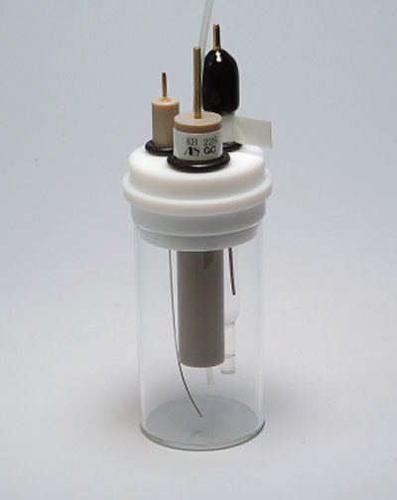
Typical 3-electrode
Voltammetry cell
Reference electrode
Counter
electrode
Working electrode
O
O
Reduction at electrode
Causes current flow in
External circuit
e⁻
Mass transport
R
R
End of Working electrode
Bulk solution

Slide 54
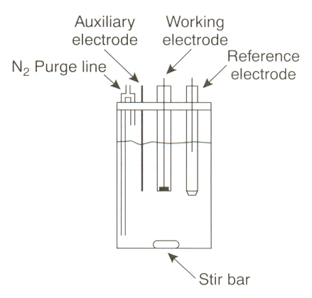
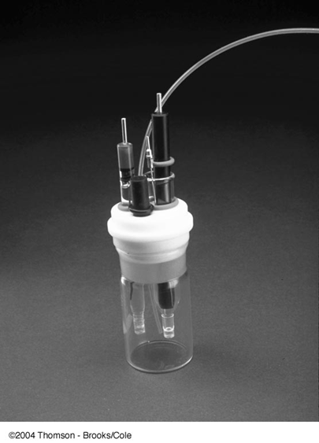
Voltametric Cell
Changing potential (E) is applied on indicator electrode (working electrode) to drive a nonspontaneous redox reaction
Counter electrode serves to conduct electricity between the two electrodes
Reference electrode has a constant potential throughout
A supporting electrolyte is a salt added in excess to the analyte solution. Most commonly, it is an alkali metal salt that does not react at the working electrode at the potentials being used. The salt reduces the effects of migration and lowers the resistance of the solution.

Slide 55
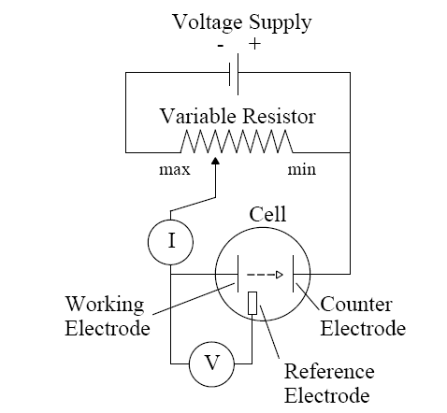
Three electrode cell:
Working
Reference
Counter/auxilliar
current flows between working and counter electrodes.
Potential controlled by potentiostat between working and reference electrodes.

Slide 56
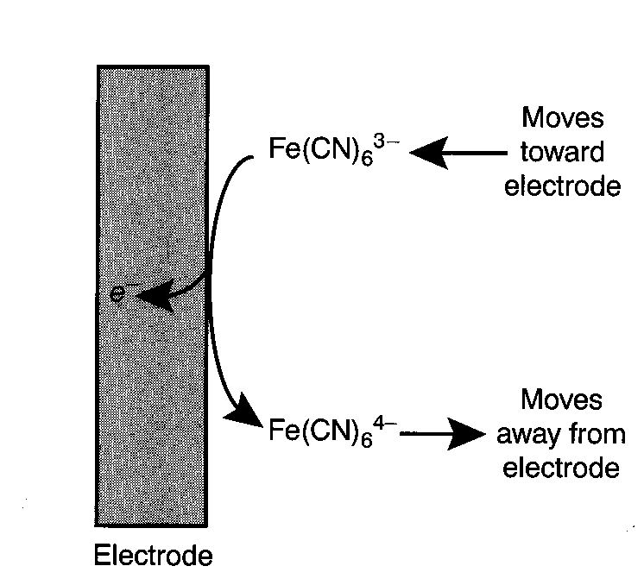
Influence of applied potential on the faradaic current
When the potential applied to the working electrode reaches to the reduction potential of the electroactive species, a reduction will take place at the electrode surface
Thus, electroactive species diffuses from the bulk solution to the electrode surface and the reduction products diffuse from the electrode surface towards the bulk solution. This creates what is called the faradaic current.

Slide 57
0.001 M Cd²⁺ in 0.1 M KNO₃ supporting electrolyte
Electrode become more and more reducing and capable of reducing Cd²⁺
Cd²⁺ + 2e⁻ Cd
Current starts to be registered at the electrode
All Cd²⁺ around the electrode has already been reduced. Current at the electrode becomes limited by the diffusion rate of Cd²⁺ from the bulk solution to the electrode. Thus, current stops rising and levels off at a plateau
i (μA)
Working electrode is no yet capable of reducing Cd²⁺ ⇒ only small residual current flow through the electrode
E_{½}
i_{d}
Current at the working electrode continue to rise as the electrode become more reducing and more Cd²⁺ around the electrode are being reduced. Diffusion of Cd²⁺ does not limit the current yet
Base line of residual current
-0.2
-0.4
-0.6
-0.8
-1.0
-1.2
-1.4
V vs SCE

Slide 58
Current in Voltammetry
When an analyte is oxidized at the working electrode, a current passes electrons through the external electric circuitry to the auxiliary electrode.
This current flows from the auxiliary to the working electrode, where reduc­tion of the solvent or other components of the solution matrix occurs .
The current resulting from redox reactions at the working and auxiliary electrodes is called a faradaic current.
Sign Conventions A current due to the analyte's reduction is called a cathodic current and, by convention, is considered positive. Anodic currents are due to oxidation reactions and carry a negative value.

Slide 59
The magnitude of the faradaic current is determined by the rate of the resulting oxidation or reduction reaction at the electrode surface.
Two factors contribute to the rate of the electrochemical reaction:
  the rate at which the reactants and products are transported to and from the surface of the electrode (mass transport)
  and the rate at which electrons pass between the electrode and the reactants and products in the solution. (kinetics of electron transfer at the electrode surface)

Slide 60
Influence of Mass Transport on the Faradaic Current
There are three modes of mass transport to and from the electrode surface: diffusion, migration, and convection.
Diffusion from a region of high concentration to a region of low concentration occurs whenever the concentration of an ion or molecule at the surface of the electrode is different from that in bulk solution.
Convection occurs when a mechanical means is used to carry reactants toward the electrode and to remove products from the electrode.
  The most common means of convection is to stir the solution using a stir bar. Other methods include rotating the electrode and incorporating the electrode into a flow cell.
Migration occurs when charged particles in solution are attracted or repelled from an electrode that has a positive or negative surface charge.
  Unlike diffusion and convection, migration only affects the mass transport of charged particles

Slide 61
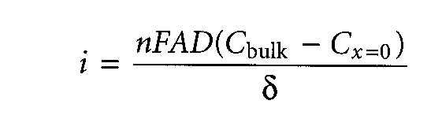
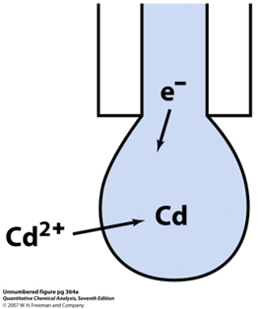
diffusion is the only significant means for the mass transport of the reactants and products, the current in a voltammetric cell is given by
where n is the number of electrons transferred in the redox reaction, F is Faraday's constant, A is the area of the electrode, D is the diffusion coefficient for the reactant or product, C_{buIk} and C_{x=o} are the concentration of the analyte in bulk solution and at the electrode surface, and δ is the thickness of the diffusion layer.
Diffusion current : I_{d} is directly proportional to the concentration of the analyte.
I_{d} = limiting current – residual current ∝ [C]_{o}
Ilkovic equation

Slide 62
Influence of the Kinetics of Electron Transfer on the Faradaic Current
When electron transfer kinetics at the electrode surface are fast, the redox reaction is at equilibrium, and the concentrations of reactants and products at the electrode are those specified by the Nernst equation.
Such systems are considered electrochemically reversible.
In other systems, when electron transfer kinetics are sufficiently slow, the concentration of reactants and products at the electrode surface, and thus the current, differ from that predicted by the Nernst equation. In this case the system is electrochemically irreversible.

Slide 63
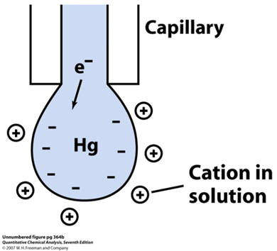
Non faradic Currents
Currents other than faradaic may also exist in an electrochemical cell that are unrelated to any redox reaction.
These currents are called nonfaradaic currents
The most important example of a nonfaradaic current occurs whenever the electrode's potential is changed.
When mass transport takes place by migration negatively charged particles in solution migrate toward a positively charged electrode, and positively charged particles move away from the same electrode.
When an inert electrolyte is responsible for migration, the result is a structured electrode‑surface interface called the electrical double layer, or EDL,
The movement of charged particles in solution, gives rise to a short‑lived, nonfaradaic charging current.
Changing the potential of an electrode
causes a change in the structure of
the EDL, producing a small charging current.

Slide 64
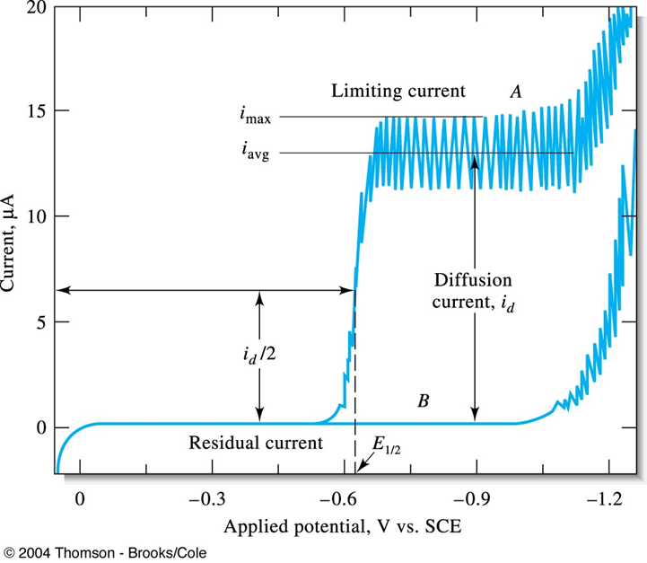
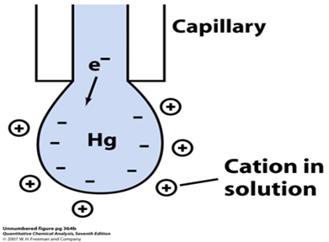
Residual Current
Even in the absence of analyte, a small current flows through an electrochemical cell.
This current, which is called the residual current, consists of two components:
  a faradaic current due to the oxidation or reduction of trace impurities,
  a charging current. it is the current needed to charge or discharge the capacitor formed by the electrode surface‑solution interface. This is called the condenser current or charging current.
  It is present in all voltammetric
  and polarographic experiments,
  regardless of the purity of reagents.

Slide 65
Types of Voltammetry
Different kinds of Voltammetry
Polarography
Linear sweep and Cyclic Voltammetry
Hydrodynamic Voltammetry
Pulsed methods
Stripping Voltammetry
AC Voltammetry

Slide 66
Polarography
Jaroslav Heyrovský was the inventor of the polarographic method, and the father of electroanalytical chemistry, for which he was the recipient of the Nobel Prize. His contribution to electroanalytical chemistry can not be overestimated. All modern voltammetric methods used now in electroanalytical chemistry originate from polarography.
In polarography the working electrode is a dropping mercury electrode (DME) or a mercury droplet suspended from a bottom of a glass capillary tube.
Analyte is either reduced (most of the cases) or oxidized at the surface of the mercury drop.
The current –carrier auxiliary electrode is a platinum wire.
SCE or Ag/AgCl reference electrode is used.
The potential of the mercury drop is measured with respect to the reference electrode.

Slide 67
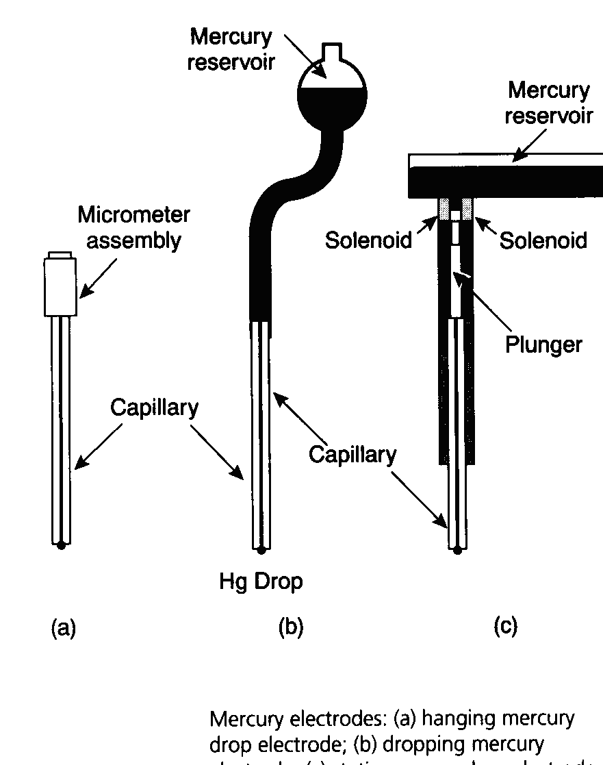
The DME is referred to as the working or indicator electrode, it is made up of mercury reservoir
connected to a capillary tube. The capillary tube deliver mercury size of about 1mm in diameter
(micro-electrode), the mercury drops detach after every two seconds and as such a fresh surface of mercury is encountered such that the reaction at any point in time does not depend on the past history of
the electrode. This therefore, makes the electrode reaction perfectly reproducible. Also since it is
a micro electrode, the amount of current carried is very low (0-15UA).

Slide 68
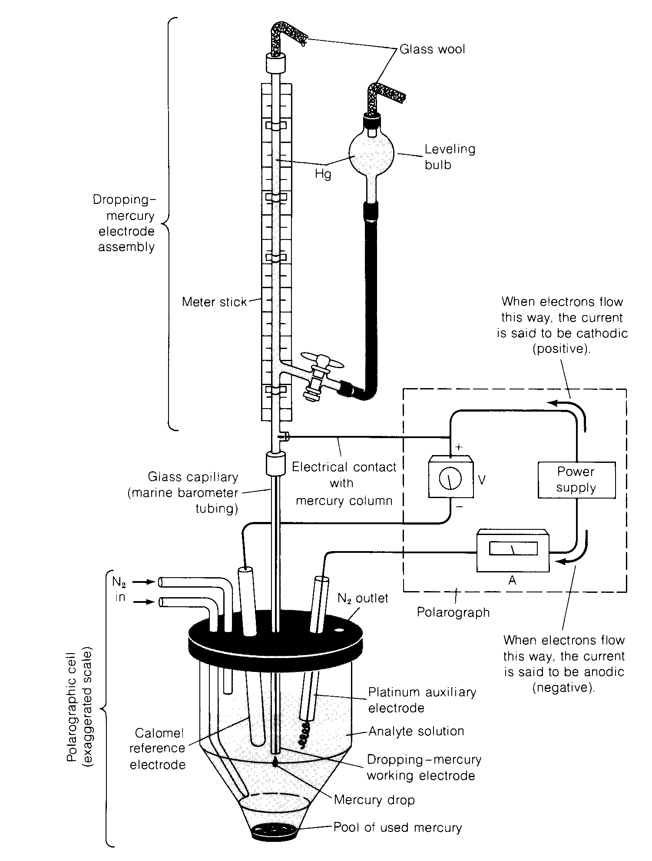
Typical electrochemical cell used in polarography

Slide 69
Advantages and Disadvantages of the Dropping Mercury Electrode
Some of the advantages of dropping mercury electrode(DME) are as follows:
Mercury form amalgam with most metals.
Mercury has a high hydrogen overvoltage.
It provides a smooth, fresh surface for the reaction.
Each drop remains unaffected and does not become contaminated by the deposited metal.
Diffusion equilibrium is readily established at mercury-solution interface.
Some of the disadvantages of dropping mercury electrode(DME) are as follows:
It is poisonous so care should be taken in its handling.
Surface area of a drop of mercury is never constant.
Applied voltage produces changes in surface tension and hence change in drop size.
Mercury has limited applications in analysis of more positive potential range.
Following care must be taken while using dropping mercury electrode:
Pure and triple distilled mercury should be used in DME
Tip of DME should be always immersed in water when not in use.
Tip of DME should be cleaned by dipping in nitric acid.
The DME assembly should be mounted vertical on a heavy stand to be free from vibrations.
It is essential to use clean and dust free tubing while setting the DME.
There should be sufficient mercury in reservoir so that the pressure changes are negligible.

Slide 70
One serious limitation of the dropping electrode is the ease with which mercury is oxidized: this property severely limits the use of the electrode as an anode. At potentials greater than about + 0.4 V, formation of mercury(I) gives a wave that masks the curves of other oxidizable species.
In the presence of ions that form precipitates or complexes with mercury(I), this behavior occurs at even lower potentials. For example, in the Figure, the beginning of an anodic wave can be seen at 0 V due to the reaction
2Hg + 2CI⁻ < === > Hg₂CI₂(s) + 2e⁻
Incidentally, this anodic wave can be used for the determination of chloride ion.

Slide 71


Slide 72
Another important disadvantage of the dropping mercury electrode is the nonfaradaic residual or charging current, which limits the sensitivity of the classical method to concentrations of about 10⁻⁵ M.
At lower concentrations, the residual current is likely to be greater than the diffusion current, a situation that prohibits accurate measurement of the latter.
Finally, the dropping mercury electrode is cumbersome to use and tends to malfunction as a result of clogging.

Slide 73

Polarography uses mercury droplet electrode that is regularly renewed during analysis.
Applications:
  Metal ions (especially heavy metal pollutants) - high sensitivity.
  Organic species able to be oxidized or reduced at electrodes: quinones, reducing sugars and derivatives, thiol and disulphide compounds, oxidation cofactors (coenzymes etc), vitamins, pharmaceuticals.
  Alternative when spectroscopic methods fail.

Slide 74

SHAPE OF THE POLAROGRAM
A graph of current versus potential in a polarographic experiment is called a polarogram.
Cd²⁺ + 2e Cd

Slide 75
Features of the Polarogram
residual current – the small current before the potential at which the analyte reacts, caused by reactive species in the matrix and by the mercury drop behaving like a capacitor
limiting current – the maximum current reached
diffusion current – the difference between the limiting and residual, and proportional to the concentration of analyte
half-wave potential – the potential half-way up the polarographic wave, which is similar to the reduction/oxidation potential, and characteristic of the species;
current oscillations – caused by the mercury drop which repeatedly falls off and is replenished from the capillary

Slide 76
Polarographic Mechanism
When the potential is only slightly negative with respect to the calomel electrode, essentially no reduction of Cd²⁺ occurs. Only a small residual current flows.
At a sufficiently negative potential, reduction of Cd²⁺ commences and the current increases. The reduced Cd dissolves in the Hg to form an amalgam.
After a steep increase in current, concentration polarization sets in: The rate of electron transfer becomes limited by the rate at which Cd²⁺ can diffuse from bulk solution to the surface of the electrode.
The magnitude of this diffusion current I_{d} is proportional to Cd²⁺ concentration and is used for quantitative analysis. The upper trace in the Figure above is called a polarographic wave.
The oscillating current in the Figure above is due to the growth and fall of the Hg drops.
As the drop grows, its area increases, more solute can reach the surface in a given time, and more current flows.
The current increases as the drop grows until, finally, the drop falls off and the current decreases sharply.

Slide 77
Current or rate of diffusion α [C]_{o} - [C]_{s}
The [C]_{o} and [C]_{s} are the concentrations in the bulk solution and at the electrode surface.
The greater the difference in concentrations the more rapid will be the diffusion.
At a sufficiently negative potential, the reduction is so fast that the [C]_{s} << [C]_{o} and equation above reduces to the form
Limiting current = diffusion current α [C]_{o}
The ratio of the diffusion current to the bulk solute concentration is the basis for the use of voltammetry in analytical chemistry

Slide 78
The magnitude of the diffusion current, is given by the Ilkovic equation:
l_{d} = (7.08 x 10⁴)nCD^{1/2} m ^{2/3} t ^{1/6}
where I_{d} = diffusion current, measured at the top of the oscillations in the Figure above with the units µA
n = number of electrons per molecule involved in the oxidation or reduction of the electroactive species.
C = concentration of electroactive species, with the units mmol/L
D = diffusion coefficient of electroactive species, with the units M²/s
m =rate of flow of Hg, in mg/s
t = drop interval, in s
The number 7.08 x 10⁴ is a combination of several constants whose dimensions are such that l_{d} will be given in , µA

Slide 79
Thus, i_{d} is proportional to the concentration of a certain species under specific conditions and the above equation may be expressed as follows:
i_{d} = kc
where k is constant under the specific conditions.
If k is constant for a series of standard solutions of various concentrations and an unknown, a calibration plot can be constructed and the unknown concentration can be determined.
Clearly, the magnitude of the diffusion current depends on several factors in addition to analyte concentration.
In quantitative polarography, it is important to control the temperature within a few tenths of a degree.
The transport of solute to the electrode should be made to occur only by diffusion (no stirring).

Slide 80
Half-wave Potential, E_{1/2}
Half wave potential, E_{1/2} is an important feature can be derived from the plarogram.
It is the potential corresponding to one half the limiting current i.e. i_{d}/2.
E_{l/2} is a characteristic for each element and thus used for qualitative analysis.

Slide 81
Supporting electrolyte
Current flow due to electrostatic attraction (or repulsion) of analyte ions by the electrode is reduced to a negligible level by the presence of a high concentration of supporting electrolyte (1 M HCl in the Figure above).
Increasing concentrations of electrolyte reduces the net current, since the rate of arrival of cationic analyte at the negative Hg surface is decreased.
Typically, a supporting electrolyte concentration 50‑100 times greater than the analyte
concentration will reduce electrostatic transport of the analyte to a negligible level.

Slide 82
Effect of Dissolved Oxygen
Oxygen dissolved in the solution will be reduced at the DME leading to two well defined waves which were attributed to the following reactions:
O₂(g) + 2H⁺ + 2e⁻ < ==== > H₂O₂; E_{1/2} = - 0.1V
H₂O₂ + 2H⁺ +2e⁻ < ==== > 2H₂O; E_{1/2} = - 0.9V
E_{1/2} values for these reductions in acid solution correspond to -0.05V and -0.8V versus SCE.
This indicates that dissolved oxygen interferes in the determination of most metal ions.
Therefore, dissolved O₂ has to be removed by bubbling nitrogen free oxygen into the solution before recording the polarogram.

Slide 83

Current maxima
A distortion of the polarographic wave appears to be due to absorption phenomena at the surface of the mercury drop.
The maxima may be removed by the addition of surface active agent (maxima suppressors) such as gelatine, methyl cellulose or Triton X-100.

Slide 84

Types of PolarograpicTechniques
Linear Sweep polarography or Direct Current (DC) polarography
The earliest voltammetric experiment was normal polarography at a dropping mercury electrode. In normal polarography the potential is linearly scanned, producing Polarogram. In LSV the major source of noise at low concentration is the capacitive current resulting from charging of electrical double layer at the electrode which limit the application of this technique to 10⁻⁵ M

Slide 85
Pulse polarography
By using pulse or differential pulse polarography, most of the capacitive current can be eliminated with a resultant of increase in the S/N ratio of about 100.
In pulse and differential pulse polarography advantage is taken of the relatively rapid decrease in the capacitive current as compared with faradic current after application of a potential to an electrode.
In pulse polarography a potential pulse is applied to the mercury drop about 57ms prior to the drops fall from the capillary.
The capacitive current exponential decays to nearly zero during the first 40ms of the pulse and the remaining faradic current is measured during the last 17ms of the pulse.
A drop knocker is used to control time and to permit application of the pulse just before the drop is knocked from the capillary.
It increase the sensitivity and the detection limits that are about 10 times lower then with low current.

Slide 86
Differential Pulse Polarography
In differential pulse polarography, the current is typically measured during the 17ms prior to the application of the pulse and during the last 17ms of application of the pulse and after decay of the capacitive current. The polarogram is a plot of the difference between the two currents as a function of the linearly increasing voltage.
The drop is then mechanically dislodged.
The current is not measured continuously. Rather, it is measured once before the pulse and again for the last 17 ms of the pulse.
The polarograph subtracts the first current from the second and plots this difference versus the applied potential (measured just before the voltage pulse).
The resulting differential pulse polarogram is nearly the derivative of a direct current polarogram, as shown in the Figure
Again we have decreased the charging current and increased the faradaic current. Generally, detection limits with differential pulse polarography are two to three orders of magnitude lower than those for classical polarography and lies in the range of 10⁻⁷ to 10⁻⁸ M.

Slide 87



Polarogram for a differential pulse polarography experiment. Here Δi = i_{s2} – i_{s1}. The peak potential, E_{peak}, is colsely related to the polarographic half-wave potential.

Slide 88
Square-wave polarography.
This is the same as the differential pulse method except we do not have a continuous ramp of voltage but instead the potential is stepped as in the picture.
The size of the pulses is such that the material reduced in the forward pulse is oxidized in the reverse pulse. So we have little net consumption of analyte. The detection limit for square-wave polarography is about the same as for differential pulse – about 10⁻⁷ to 10⁻⁸ M.
The advantage of the square-wave approach is the speed of the measurement. With steps in the microseconds, an entire polarogram can be obtained in 10 msec. The entire scan can be performed in the last few msecs of the life of a single drop of mercury, when the charging current is essential zero.
The speed of the measurement also permits increase in precision by signal averaging data from a number of polarographic scans.

Slide 89


Square wave polarography
Square wave polarography is more sensitive and much faster than differential pulse polarography. The square wave is also better at rejecting background signals such as those generated by reduction of oxygen.
Waveform for square wave polarography.

Slide 90

Square Wave Voltammetry
advantage of square wave voltammetry is that the entire scan can be performed on a single mercury drop in about 10 seconds, as opposed to about 5 minutes for the techniques described previously. SWV saves time, reduces the amount of mercury used per scan by a factor of 100. If used with a pre-reduction step, detection limits of 1-10 ppb can be achieved, which rivals graphite furnace AA in sensitivity.
data for SWV similar to DPP
height and width of the wave depends on the exact combination of experimental parameters (i.e. scan rate and pulse height

Slide 91
Square-Wave Voltammetry
Reversible System
- The peak-shaped Polarogram is symmetric about the
half-wave potential
- Peak current is proportional to the concentration
- The net current is larger than the forward or reverse currents

Slide 92


Generation of a square-wave voltammetry excitation signal. The staircase signal in (a) is added to the pulse train in (b) to give the square-wave excitation signal in (c ).
Current response for a reversible reaction to excitation signal.

Slide 93
Square-Wave Voltammetry
- Higher sensitivity than differential-pulse in which
reverse current is not used
(currents 4 times higher for reversible systems)
(currents are 3.3 times higher for irreversible systems)
- Low detection limits up to 10⁻⁸ M
- Reduced analysis time due to higher scan rates
(few seconds compared to ~3 minutes for differential pulse)
Entire Polarogram is recorded on a single mercury drop
- Effective Scan Rate = f∆E_{s}
f = square-wave frequency
∆E_{s} = step height
- May be used for kinetic studies

Slide 94
Cyclic Voltammetry (CV)
Cyclic voltammetry (CV) is an electrolytic method that uses microelectrodes and an unstirred solution so that the measured current is limited by analyte diffusion at the electrode surface. The electrode potential is ramped linearly to a more negative potential, and then ramped in reverse back to the starting voltage. The forward scan produces a current peak for any analytes that can be reduced through the range of the potential scan. The current will increase as the potential reaches the reduction potential of the analyte, but then falls off as the concentration of the analyte is depleted close to the electrode surface. As the applied potential is reversed, it will reach a potential that will reoxidize the product formed in the first reduction reaction, and produce a current of reverse polarity from the forward scan. This oxidation peak will usually have a similar shape to the reduction peak. The peak current, i_{p}, is described by the Randles-Sevcik equation:
i_{p} = (2.69x10⁵) n^{3/2} A C D^{1/2} v^{1/2}
where n is the number of moles of electrons transferred in the reaction, A is the area of the electrode, C is the analyte concentration (in moles/cm³), D is
The potential difference between the reduction and oxidation peaks is theoretically 59 mV for a reversible reaction. In practice, the difference is typically 70-100 mV. Larger differences, or nonsymmetric reduction and oxidation peaks are an indication of a nonreversible reaction. These parameters of cyclic voltammograms make CV most suitable for characterization and mechanistic studies of redox reactions at electrodes.

Slide 95


Cyclic voltammetry
In cyclic voltammetry, a periodic, triangular wave form is applied to the working electrode. The portion between times t_{o} and t₁ is a linear voltage ramp. In CV, the time is on the order of seconds. The ramp is then reversed to bring the potential back to its initial value at time t₂.
Cyclic voltammetry is used principally to characterize the redox properties of compounds and to study the mechanisms of redox reactions.
Waveform used in cyclic voltammetry.
Cyclic voltammetric excitation signal.

Slide 96

Cyclic Voltammetry
t₀ → t₁ : cathodic wave
  Instead of leaving off at the top of the wave, current decreases at more negative potential
  ← diffusion is too slow to replenish analyte near the electrode
t₁ → t₂ : anodic wave
  The potential is reversed and, reduced product near the electrode is oxidized
Cyclic voltammograms are recorded either with an osciloscope or with a fast X-Y recorder.
The current decreases after the cathodic peak because of concentration polarization.
For a reversible reaction, half-wave potential lies midway between the cathodic and anodic peaks.
Notes:
96

Slide 97


Potential vs time waveform and
cyclic voltammogram for a solution that is 6.0 mM in K₃Fe(CN)₆ and 1.0M in KNO₃.

Slide 98





Fe(C₅H₅)₂
5.375mM (left) and 0.5375 (right) mM Ferrocene in Acetonitrile

Slide 99
Hydrodynamic Voltammetry
In hydrodynamic voltammetry the solution is stirred by rotating the electrode.
Current is measured as a function of the potential applied to a solid working electrode.
The same potential profiles used for polarography, such as a linear scan or a differential pulse, are used in hydrodynamic voltammetry.
The resulting voltammograms are identical to those for polarography, except for the lack of current oscillations resulting from the growth of the mercury drops.
Because hydrodynamic voltammetry is not limited to Hg electrodes, it is useful for the analysis of analytes that are reduced or oxidized at more positive potentials.

Slide 100
Stripping Ansalysis
Stripping analysis is an analytical technique that involves
Preconcentration of a metal phase onto a solid electrode surface or into Hg (liquid) at negative potentials and selective oxidation of each metal phase species during an anodic potential sweep.
The analyte from a dilute solution is first concentrated in a single drop of Hg (or any micro-electorde) by electroreduction or electro-oxidation.
The electroactive species is then stripped from the electrode by reversing the direction of the voltage sweep.
The potential becomes more positive, oxidizing the species back into solution (anodic stripping voltammetry) or more negative reducing the species back into solution (cathodic stripping voltammetry)
The current measured during the oxidation or reduction is related to the quantity of analyte
The polarographic signal is recorded during the oxidation or reduction process.
The deposition step amounts to an electrochemical preconcentration of the analyte; that is, the concentration of the analyte in the surface of the microelectrode is far greater than it is in the bulk solution.

Slide 101


Slide 102
Stripping Ansalysis
Very sensitive and reproducible (RSD<5%) method for
trace metal ion analysis in aqueous media.
Concentration limits of detection for many metals are in
the low ppb to high ppt
range (S/N=3) and this compares
favorably with AAS or ICP analysis.
Field deployable instrumentation that is inexpensive.
Approximately 12-15 metal ions can be analyzed for by
this method.
The stripping peak currents and peak widths are a
function of the size, coverage and distribution of the
metal phase on the electrode surface (Hg or alternate)

Slide 103
Excitation signal for stripping determination of Cd²⁺ and Cu²⁺
Voltamrnograrn.

Slide 104
Electrogravimetry

Slide 105
Electrogravimetry
In an electrogravimetric analysis, the analyte is quantitatively deposited as a solid on the cathode or anode.
  The increase in the mass of the electrode directly measures the amount of analyte.
  Not always practical because numerous materials can be reduced or oxidized and still not plated out on an electrode.
Electrogravimetry can be conducted with or
without a controlled potential
When No control
  A fixed potential is set and the electrodeposition
  is carried out
  The starting potential must be initially high to
  ensure complete deposition
  The deposition will slow down as the reaction
  proceeds

Slide 106


Slide 107
In practice, there may be other electroactive species that interfere by codeposition with the desired analyte.
Even the solvent (water) is electroactive, since it decomposes to H₂ + 1/2O₂ at a sufficiently high voltage.
Although these gases are liberated from the solution, their presence at the electrode surface interferes with deposition of solids.
Because of these complications, control of the electrode potential is an important feature of a successful electrogravimetric analysis.

Slide 108
Examples on electrogravimetry
Cu: is deposited from acidic solution using a Pt cathode
Ni : is deposited from a basic solution
Zn: is deposited from acidic citrate solution
Some metals can be deposited as metal complexes e.g., Ag, Cd, Au
Some metals are deposited as oxides on the anode e.g.,
Pb²⁺ as PbO₂ and Mn²⁺ as MnO₂

Slide 109
Coulometry

Slide 110
Coulometric Methods of Analysis
Coulometric methods of analysis are based on the measurement of quantity of electrical charge that passes through a solution during an electrochemical reaction. The principle of coulometric method of analysis is governed by Faraday’s laws of electrolysis.
Faraday’s First laws of electrolysis
According to the first law, the mass of a substance liberated at the electrodes during electrolysis is directly proportional to the quantity of electrical charge (Q) that passed through the electrolyte. m ∝ Q
Total charge, Q, in coulombs, passed during an electrolysis is related to the amount of analyte by Faraday’s law
Q= N· F.n
Where Q is the amount of charge its unit is coulomb is equivalent to an A•s ; thus for a constant current, I, the charge, Q, is given as, Q= I · t
coulombs = amperes · seconds
The charge on an electron is 1.6022 × 10^{–19} coulombs.
where F is Faraday constant charge carried by one mole of electrons, F=6.023x10²³ x 1.6022 × 10^{–19} = 96,487 C/mol and N is number of mole of analyte
 N = Q / n.F = I · t / n.F, as N=m/M.mass, so
where m is mass of analyte, M is molar mass, n, number of electron involved during reaction and I is the amount of current and t is the time in second
M
n
•
i .t
96487
m =

Slide 111
Special Features of coulometric methods
Coulometric methods give more accurate and precise results than classical methods since the electrical currents can be controlled and measured with utmost precision.
These methods are suited for both routine as well as rare analyses which involve electrolytic method of determination.
Coulometric titrations are more popular and have the special advantage in the sense that the tedious steps of preparation, storage and handling of standard titrants are avoided.
Titrations which cannot be performed by conventional methods can be easily performed coulometrically. Titrations of high hazardous materials, titrations involving unstable or difficulty prepared titrants such as bromine, tin(II), titanium(III), chromium(II), silver(II) etc. and titrations in molten salts can be performed.
In situ generation of titrants, for example electrolytic generation of iodine used to estimate hydroquinone, ascorbic acid, antimony(III), electrolytically generated bromine used to estimate organic substances like oxine have been found to be the most satisfactory intermediates for the estimation of several organic compounds.
Constant current coulometry has widely been used than the controlled potential coulometry since the former is faster and requires simpler instrumentation and less expensive.
Controlled potential coulometry is a quite sensitive method and has selectivity.

Slide 112
Types of Coulometry
Controlled potential coulometry: constant potential is applied to electrochemical cell
Controlled current coulometry: constant current is passed through the electrochemical cell
Faraday’s law:
Total charge, Q, in coulombs passed during electrolysis is related to the absolute amount of analyte:
Q = nFN
n = #moles of electrons transferred per mole of analyte
F = Faradays constant = 96487 C mol⁻¹
N = number of moles of analyte
Coulomb = C = Ampere X sec = A.s

Slide 113
For a constant current, i:
Q = it_{e} ; ⁽t_{e} = electrolysis time)
For controlled potential coulometry: the current varies with time:
Q =
What do we measure in coulometry?
Current and time. Q & N are then calculated according
to one of the above equations
Coulometry requires 100% current efficiency. What does this mean?
  All the current must result in the analyte’s oxidation or reduction

Slide 114
Controlled potential coulometry
(Amperometry)
The working electrode will be kept at constant potential that allows for the analyt’s reduction or oxidation without simultaneously reducing or oxidizing other species in the solution
The current flowing through the cell is proportional to the analyt’s concnetration
With time the analyte’s concentration as well as the current will decrease
The quantity of electricity is measured with an electronic integrator.

Slide 115

Controlled potential coulometry

Slide 116

Controlled potential coulometry
Instrumentation
The instrumentation for potentiostatic coulometry consists of a potentiostat (to
maintain a constant potential), an electrolysis cell, a chemical coulometer or an
integrating device for determining the number of coulombs and placed in series withthe working electrode. The chemical coulometer such as hydrogen-oxygen
coulometer/silver coulometer can be used to measure the number of coulombs
(quantity of electricity).
Cell Assembly
The cell assembly consists of a platinum gauze working electrode, a platinum wire
counter electrode and a saturated calomel electrode as the reference electrode. The counter electrode is separated from the test solution by a porous tube containing the same supporting electrolyte

Slide 117

Controlled potential coulometry
Instrumentation
Sometimes a mercury cathode is used instead of a platinum gauze electrode. This cathode is useful for separating the easily reducible elements during an analysis. For example, copper, nickel, cobalt, silver and cadmium are easily separated from ions such as aluminium, titanium, alkali metals and phosphates. The precipitated elements dissolve in mercury and form amalgams.
Potentiostat
A potentiostat is an electronic device which maintains the potential of the working
electrode at a constant level relative to a reference electrode.

Slide 118

Controlled potential coulometry
Instrumentation
Integrators
Most of the modern apparatus for potentiostatic coulometry employ integrators to
determine the number of coulombs required to complete an electrolysis.
Efficient stirring is important for controlled potential electrolysis, since all analyte
species must be swept up to the electrode surface, so that the electrochemical reaction is completed. Besides stirring, the ratio of the electrode surface to solution volume is another requirement of the experiment. This ratio plays a role in determining the time needed for complete electrolysis, since the electrical current will be directly proportional to electrode area, A and also directly proportional to the concentration, c, of the analyte.

Slide 119
Controlled potential coulometry
Applications
i) Inorganic Analysis
Controlled potential coulometric methods have widespread use in the determination of
several metal ions. As many as 55 elements of the periodic table can be determined by
the cathodic reduction of metal ions to metallic state. Most of the metals (about two
dozen element) can form amalgams with mercury, and hence controlled potential
coulometry with mercury cathode is usually preferred.
ii) Analysis of radioactive materials
The technique is widely adopted for the determination of uranium and pluotinum and
thus finds extensive use in the nuclear energy field. Reduction of UO + 2
2 to U4+ can be carried out in H2SO4 medium with a mercury pool cathode (− 0.6 V vs. SCE). Samples containing 7 – 75 mg of uranium have been analysed with an accuracy of ± 0.l %.
iii) Micro analysis
Controlled potential coulometry is more popular than the electrogravimetric methods
since it avoids the final step of weighing the product. The tedious process of drying
and weighing the electrode after each elecltrolysis is avoided. This technique is
especially useful for the determination of small amounts of analyte (0.01 – l mg) with
an accuracy of (± 0.5 %).

Slide 120

Controlled potential coulometry
Applications
iv) Multistep controlled potential electrolysis
Determination of several metal ions in the same solution is possible with controlled potential electrolysis using mercury pool cathode. A sample solution containing several metal ions such as Cu2+, Bi3+,Pb2+,and Zn2+ can be analysed by controlled potential analysis. When the cathode potential is controlled at about + 0.008 vs. SCE, Cu2+ is reduced to Cu0. When the current decays to zero, then the potential can be controlled so that Bi3+ can be reduced to Bi0. Subsequently by controlling the potentials, Pb2+ can be determined as Pb0
and Zn2+ as Zn. A sample of brass/bronze which contains Cu2+, Zn2+, and Pb2+ can be analysed by this technique.
v) Continuous monitoring of gas streams
Determination of trace level concentration of oxygen in a gas stream can be done by controlled potential analysis. The cell consists of a porous silver cathode and a cadmium anode. The reactions are
The porous silver cathode serves to break up the incoming gas into small bubbles, wherein the reduction of oxygen takes place quantitatively within the pores. The hydroxyl ions formed during reduction reacts with the cadmium anode and forms a Cd(OH)2(s) product.

Slide 121

Controlled potential coulometry
Applications
vi) Electrolytic determination of organic compounds:
Controlled potential coulometry offers a new step for the electrolytic determination of organic compounds. Trichloroacetic acid and picric acid are quantitatively reduced at a mercury cathode. Coulometric methods permit the analysis of these compounds with an accuracy of 0.1%.
vii) Elctrolytic synthesis of new organic compounds :
Synthesis of new species and novel chemical compounds are possible. No chemical reagents are required since electron itself is the reagent for carrying out these reactions. No contamination of the products takes place.
viii) Determination of n-values of the reaction:
Controlled potential coulometry can be used to determine n values of the reactions. Determination of n values offers a route to deduce the kinetics and mechanism of the
overall reactions. Picric acid is reduced at a mercury pool cathode, in which n value of
the reaction was found to be, l8. The reaction product is identified to be
triaminophenol.

Slide 122

Coulometric Titration (Controlled-Current Coulometry)
Coulometric titrations need an electrolytically generated titrant that reacts stoichiometrically with the analyte to be determined. As in controlled-current coulometry, 100% current efﬁciency is required. The current is accurately ﬁxed at a constant value and the quantity of electricity can be calculated by the product of the current (in amperes) and the time (in seconds) i.e. Q=I x t using endpoint detection.
In principle, any endpoint detection system that ﬁts chemically can be used; for example, chemical indicators (color change), and potentiometric, amperometric or conductometric procedures.
For example the determination the amount of Arsenic oxide by titatration with Iodine. In this titration to determine the concentration of a As₂O₃(aq) solution, I₂ is formed from KI at generator electrode by an oxidation half reaction . The I₂ then reacts with the As₂O₃(aq).

Slide 123
The moles of I₂ formed is readily determined by measuring the current and the time and recalling that one mole of electrons equals 96485 coulombs (amp seconds). One particular advantage of this method is that I₂ is formed only as needed and hence all the disadvantages of trying to store an I₂ solution are circumvented. The purpose of this experiment is to determine the concentration of an unknown solution of As₂O₃(aq).
Controlled-current coulometry maintains a constant current throughout the reaction period. Here, an excess of a redox buffer substance must be added in such a way that the potential does not cause any undesirable reaction. That means the product of the electrolysis of the redox buffer must react quantitatively with the unknown substance to be determined.

Slide 124

Maintaining Current Efficiency
To maintain a constant current the cell potential must change until another oxidation or reduction reaction can occur at the working electrode.
Unless the system is carefully designed, these secondary reactions will produce a current efficiency of less than 100%.
let's consider the coulometric analysis for Fe²⁺ based on its oxidation to Fe³⁺ at a Pt working electrode in 1 M H₂S0₄.
Fe²+(aq) = Fe³⁺(aq) + e ‑
The diagram for this system is shown. Initially the potential of the working electrode remains nearly constant at a level near the standard‑state potential for the Fe ³⁺/Fe ²⁺ redox couple.
As the concentration of Fe ²⁺ decreases, the potential of the working electrode shifts toward more positive values until another oxidation reaction can provide the necessary current.
Thus, in this case the potential eventually increases to a level at which the oxidation of H₂O occurs.
6H2O(l) ➔ O₂(g) + 4H₃O⁺(aq) + 4e

Slide 125
Since the current due to the oxidation of H₂O does not contribute to the oxidation of Fe²⁺, the current efficiency of the analysis is less than 100%.
To maintain a 100% current efficiency the products of any competing oxidation reactions must react both rapidly and quantitatively with the remaining Fe²⁺.
This may be accomplished, for example, by adding an excess of Ce³⁺ to the analytical solution.
When the potential of the working electrode shifts to a more positive potential, the first species to be oxidized is Ce³⁺.
Ce³⁺(aq) = Ce⁴⁺(aq) + e‑
The Ce⁴⁺ produced at the working electrode rapidly mixes with the solution, where it reacts with any available Fe²⁺.

Slide 126
Ce⁴⁺(aq) + Fe²⁺(aq) = Fe ³⁺(aq) + Ce³⁺(aq)
Combining these reactions gives the desired overall reaction
Fe ²⁺(aq) = Fe³⁺(aq) + e⁻
Thus, a current efficiency of 100% is maintained.
Since the concentration of Ce³⁺ remains at its initial level, the potential of the working electrode remains constant as long as any Fe ²⁺ is present.
This prevents other oxidation reactions, such as that for H₂O, from interfering with the analysis.
A species, such as Ce³⁺ which is used to maintain 100% current efficiency is called a Mediator.

Slide 127
End Point Determination
Adding a mediator solves the problem of maintaining 100% current efficiency, but does not solve the problem of determining when the analyte’s electrolysis is complete. Using the same example, once all the Fe²⁺ has been oxidized current continues to flow as a result of the oxidation of Ce³⁺ and, eventually, the oxidation of H₂O. What is needed is a means of indicating when the oxidation of Fe²⁺ is complete.
Thus, the same end points that are used in redox titrimetry such as visual indicators, and potentiometric and conductometric measurements, may be used to signal the end point of a controlled-current coulometric analysis. For example, ferroin may be used to provide a visual end point for the Ce³⁺ mediated coulometric analysis for Fe²⁺.

Slide 128
Instrumentation
Controlled‑current coulometry normally is carried out using a galvanostat and an electrochemical cell consisting of a working electrode and a counter electrode.
The working electrode is constructed from Pt, is also called the generator electrode since it is where the mediator reacts to generate the species reacting with the analyte.
The counter electrode is isolated from the analytical solution by a salt bridge or porous frit to prevent its electrolysis products from reacting with the analyte.
Alternatively, oxidizing or reducing the mediator can be carried out externally, and the appropriate products flushed into the analytical solution.

Slide 129

Coulometric Titration Instrumentation
For coulometric titrations the instrumentation consists of a titrator (constant-current source, integrator) and a cell. As the constant-current source, an electronically controlled amperostat is preferably used. The integrator measures the product of current and time (i.e., the number of coulombs). The electrolysis cell, ﬁlled with the solution from which the titrant will be generated electrolytically and the solution to be titrated (analyzed), is schematically shown in Figure.
The generator electrode, at which the reagent is formed, possesses a large surface area (e.g., a rectangular strip of
platinum). The auxiliary electrode (e.g., a platinum wire) is in contact with an appropriate electrolyte of higher concentration than the solution to be titrated. It is isolated from the analyte by a sintered disk or some other porous media. This is required to avoid the interference of additional products generated at the second electrode. To circumvent these limitations of internal generation, an external generator cell is often used.

Slide 130

Method for the external generation of oxidizing and reducing
agents in coulomtric titration

Slide 131
The other necessary instrumental component for controlled‑current coulometry is an accurate clock for measuring the electrolysis time, t_{e}, and a switch for starting and stopping the electrolysis.
Analog clocks can read time to the nearest ±0.01 s, but the need to frequently stop and start the electrolysis near the end point leads to a net uncertainty of ±0.1 s.
Digital clocks provide a more accurate measurement of time, with errors of ±1 ms being possible.
The switch must control the flow of current and the clock, so that an accurate determination of the electrolysis time is possible.

Slide 132
Coulometric Titration Applications
2.) Applications
a) Can be used for Acid-Base Titrations
- Acid titration
2H₂O + 2e⁻ » 2OH⁻ + H₂ titrant generation reaction
⁻ Base titration
H₂O » 2H⁺ + ½ O₂ + 2e⁻ titrant generation reaction
b.) Can be used for Complexation Titrations (EDTA)
HgNH₃Y²⁻ + NH₄⁺ + 2e- » Hg + 2NH₃ +HY³⁻
HY³⁻ » H⁺ + Y⁴⁻
c.) Can be used for Redox Titrations
Ce³⁺ » Ce⁴⁺ + e⁻
Ce⁴⁺ + Fe²⁺ » Ce³⁺ + Fe³⁺

Slide 133
3.) Comparison of Coulometric and Volumetric Titration
a) Both Have Observable Endpoint
- Current (e⁻ generation)
serves same function as a standard titrant solution
- Time
serves same function as volume delivered
- amount of analyte determined by combining capacity
- reactions must be rapid, essentially complete and free of side reactions
b.) Advantages of Coulometry
- Both time and current easy to measure to a high accuracy
- Don’t have to worry about titrant stability
- easier and more accurate for small quantities of reagent
< small volumes of dilute solutions → problem with volumetric
- used for precipitation, complex formation oxidation/reduction or neutralization reactions
- readily automated
c) Sources of Error
- variation of current during electrolysis
- departure from 100% current efficiency
- error in measurement of current
- error in measurement of time
- titration error (difference in equivalence point and end point)

Slide 134
Advantages of Coulometric Titration
Coulometric titrations possess some practical advantages:
no standard solutions are required and unstable reagents can be generated or consumed immediately,
small amounts of titrants can be electrically quantiﬁed with high accuracy, pretitration is possible, and the method can be readily adapted to automatic remote control. Thus, with respect to controlled-potential coulometry a wider ﬁeld of practical applicaions exists. Often, automatic titrators for multipurpose and single analysis employ potentiometric endpoint detection. Examples are sulfur dioxide monitors and water titrators (Karl Fischer).

Slide 135
Controlled‑current coulometry, has two advantages over controlled‑potential coulometry.
  First, using a constant current leads to more rapid analysis since the current does not decrease over time. Thus, a typical analysis time for controlled current coulometry is less than 10 min, as opposed to approximately 30‑60 min for controlled‑potential coulometry.
  Second, with a constant current the total charge is simply the product of current and time. A method for integrating the current‑time curve, therefore, is not necessary.

Slide 136
Conductometry

Slide 137
Conductometry
Conductometry is a kind of electroanalytical techniques based on measuring electrolytic conductance.
Conductance
It is a measure of the ease with which current flows through a conductor. The conductance G is defined as the reciprocal of the resistance
and is expressed in Siemens [S], that is in ohms⁻¹ [Ω⁻¹] or mhos. The conductance of a homogeneous body of uniform cross section area is proportional to the cross section area A and inversely proportional to the length l :
where κ is the conductivity or the specific conductivity expressed in S·cm⁻¹ or in Ω⁻¹·cm⁻¹

Slide 138

Conductivity or Specific conductance
Specific conductance or conductivity. It may be defined as the conductance of a solution of 1 cm length and having 1 sq. cm as the area of cross-section. In other words, specific conductance is the conductance of
one centimetre cube of a
solution of an electrolyte.
constant has been found, conductivity can be calculated from the experimental resistance by using equation
Specific conductance is defined by the number of the ions and the their velocity. The more ion’s concentration and more their velocity the more will be more conductance.
Therefore there are some factors that influence on the value of κ: the nature of solvent and solute, the concentration of electrolyte’s solution, temperature.

Slide 139
Resistance; It measures the obstruction to the flow of current. The resistance of a conductor is proportional to the length (l) and inversely proportional to the area of cross-section.
where ^{ρ (rho)} is the constant of proportionality and is called specific resistance or resistivity. The resistance depends upon the nature of the material. Its units are ohm (^{Ω} )
R= ^{ρ ,} if l =1 cm, a=1 cm²
In other words, specific resistance is the resistance between opposite faces of one centimetre cube of the conductor.

Slide 140
Conductometry
Water itself is a very poor conductor of electricity, the presence of ionic species in solution increases the conductance considerably. The conductance of such electrolytic solutions depends on the concentration of the ions and also on the nature of the ions present ( through their charges and mobilities ).
Conductance behaviour as a function of concentration is different for strong and weak electrolytes.
Electrolytic solutions obey Ohm’s law just as metallic conductors do. Thus the current i passing through a given body of solution is proportional to the potential difference U, and
where R is the resistance of the body of solution in ohms Ω .

Slide 141
Molar Conductance
The conductivity of a solution depends on the concentrations and mobilities of the ions present. It is convenient to define a new quantity, the molar conductance Λ, by
where c is the molar concentration, that is expressed in mol·dm⁻³. 1000 is the factor arising from the fact that 1 dm³=1000 cm³. Thus, the molar conductance is expressed in S·cm²·mol⁻¹. The molar conductance is sometimes described as the actual conductance of that volume of solution which contains one mol of solute when placed between parallel electrodes 1 cm apart with a uniform electric field between them.

Slide 142

Equivalent conductance
It is defined as the conducting power of all the ions produced by dissolving one gram equivalent of an electrolyte in solution.
It is denoted by the symbol (lambda).

Slide 143
Equivalent Conductance:
It is the conductance of one gram equivalent of solute contained between two electrodes spaced one centimetre apart.
Equivalent conductance C = concentration in
So as: the equivalent wt of the substances ↑
their equivalent conductances (λ) ↓
e.g. The λ of HCl (eq.wt. 36.5) is higher than NaCl (eq.wt. 58.5)
Equivalent conductance is used to express the ability of individual substance to conduct electric current.
gram equivalent / liter.
Notes:
Notice that as the concentration of ions increases the equivalent conductance decreases but the total conductivity of the solution increases.

Slide 144
From the previous equation it is clear that the equivalent conductance increases as the concentration decreases until it reaches a constant value at infinite dilution which is known as:
Equivalent conductance at infinite dilution or
Limiting equivalent conductance, or
Mobility (λ∞). Which is the conductance of the equivalent weight of the substance at infinite dilution.
It is characteristic for the solutes.

Slide 145
Equivalent ionic conductance:
At infinite dilution, interionic attractions become nil; the overall conductance of the solution consists of the sum of the individual equivalent ionic conductance.
Overall conductance = λ∞⁺ + λ∞⁻
λ∞⁺ is the equivalent ionic conductance of the cation at infinite dilution.
λ∞⁻ is the equivalent ionic conductance of the anion at infinite dilution.
Equivalent ionic conductance differ according to the nature of ions (i.e. Charge, size, hydration).

Slide 146
Cations λ∞ anions λ∞
H⁺ 350 OH⁻ 198
Na⁺ 42.6 Cl⁻ 76
K⁺ 74 NO₃⁻ 71
NH₄⁺ 73 CH₃COO⁻ 41
Ag⁺ 62 propionate 36
½ Ba²⁺ 64 ½ SO₄²⁻ 80

Slide 147
The conductance of electrolytic solutions depends on:
1- Nature of ions:
The velocity by which ions move towards the electrodes carrying the electric current varies according to their nature (i.e. size, molecular weight, number of charge the ion carries).
Velocity of ions α charge
α 1 / size
α 1 / molecular weight
α 1 / hydration

Slide 148
2- Temperature:
Conductance is increased by increase of temperature as:
Energy of ions is increased &
viscosity and hydration are decreased.
An increase of temperature by 1⁰C is accompanied by 2% increase in conductance.
for this reason the measurement must be carried out at constant temperature using thermostatically controlled conditions.

Slide 149
3- Concentration of ions:
The electrical conductance of a solution is a summation of contribution from all ions present.
It depends on the number of ions/unit volume of solution and their nature i.e. each ion represents itself independently.
As the number of ions increases the conductance of the solution increases.
The linear relationship between conductance and c is valid only for diluted solutions. In highly conc solu, there is interionic attraction forces which decreases conductance.
Notes:
A strong electrolyte is a solute that completely, or almost completely, ionizes or dissociates in a solution. These ions are good conductors of electric current in the solution.
Originally, a "strong electrolyte" was defined as a chemical that, when in aqueous solution, is a good conductor of electricity. With greater understanding of the properties of ions in solution its definition was gradually changed to the present one.
Examples of Strong Electrolytes
Strong Acid: Perchloric acid HClO₄, Hydriodic acid HI, Hydrobromic acid HBr, Hydrochloric acid HCl, Sulfuric acid H₂SO₄, Nitric acid HNO₃, Chloric acid HClO₃, Bromic acid HBrO₃, Perbromic acid HBrO₄, Periodic acid HIO₄, Fluoroantimonic acid HSbF₆, Magic acid FSO₃HSbF₅, Carborane superacid H(CHB₁₁Cl₁₁), Fluorosulfuric acid FSO₃H, Triflic acid CF₃SO₃H, Citric Acid
Strong Base: Potassium hydroxide KOH, Barium hydroxide Ba(OH)₂, Caesium hydroxide CsOH, Sodium hydroxide NaOH, Strontium hydroxide Sr(OH)₂, Calcium hydroxide Ca(OH)₂, Rubidium hydroxide RbOH, Magnesium hydroxide Mg(OH)₂, Lithium diisopropylamide (LDA) C₆H₁₄LiN, Lithium diethylamide (LDEA), Sodium amide NaNH₂, Sodium hydride NaH, Lithium bis(trimethylsilyl)amide ((CH₃)₃Si)₂NLi
Ionization is the physical process of converting an atom or molecule into an ion by adding or removing charged particles such as electrons or other ions. This is often confused with dissociation.
Strictly speaking, yes. Dissociation refers to the breaking of a chemical bond without reference to whether the products are ions or neutral fragments. Ionization (ionisation, alternate spelling) refers to breaking of chemical bonds into charged species. The terms are sometimes both used when referring to the ionization reaction HA -----> H(+) + A(-).
Dissociation of a molecule can either produce ions or neutral molecules. If it produces ions, then the dissociation is also an ionization.
so HCl ---> H+ + Cl- is a dissociation reaction and also an ionization reaction. However, H2 ----> 2H is just a dissociation reaction.
However, ionization is a general term which refers to the formation of ions, and not necessarily from dissociation. You can form an ion by removing an electron from it (a cation) or adding an electron (forming an anion, as in F + e ---> F-). If you want to think of cation formation as a dissociation reaction, fine- but the latter is clearly not a dissociation.
The term ionization also has a second meaning when used in discussions of solutions. The way substances behave electrically in water solution is often very different from the way they behave as solids or gases. As an example, let us consider the compound known as acetic acid which is a liquid that does not conduct an electric current. Yet, when acetic acid is added to water, the solution that is formed does conduct an electric current.
In order for a solution to conduct an electric current, ions must be present. Pure acetic acid is made of molecules. It contains no ions. If we pass an electric current into acetic acid, nothing will happen because no ions are present. An important change takes place, however, when acetic acid is added to water. Water molecules have the ability to tear acetic acid molecules apart, breaking them down into hydrogen ions and acetate ions. Now that ions are present, the water solution of acetic acid can conduct an electric current. This process is known as ionization because ions are produced from a substance (acetic acid in this case) that did not contain them originally.
A similar story about the conductivity and nonconductivity of sodium chloride could be told. If the two ends of a battery are attached to a large crystal of sodium chloride, no electric current will flow. One might guess that this result indicates that no ions are present in sodium chloride. However, that is not the case. Indeed, a crystal of sodium chloride is made up entirely of ions, positively charged sodium ions and negatively charged chloride ions. The problem is, however, that these ions are held together very tightly by electrical forces. Sodium ions are bound tightly to chloride ions, and vice versa.
The situation changes, however, when sodium chloride is added to water. Water molecules are able to tear apart sodium ions and chloride ions in much the same way they tear apart acetic acid molecules. Once the sodium ions and chloride ions are no longer bound tightly to each other, they are free to roam through the salt/water solution. The name given to this change is dissociation. The term means that ions already existed in the sodium chloride crystal before it was put into water. Water did not create the ions, it only set them free. It is this difference between creating ions and setting them free that distinguishes ionization from dissociation.
activity (symbol a) is a measure of the “effective concentration” of a species in a mixture
Under Creative Commons License: Attribution No Derivatives

Slide 150
But at infinite dilution, interionic attraction is negligible and each ion represents itself independently.
At infinite dilution activity (a) equals concentration (c) and activity coefficient a/c = 1, outside the infinite dilution a/c < 1
So conductometric determination must be carried out on dilute solution

Slide 151
4‑ The size of the electrodes:
Conductometric measurements are usually carried out in a conductance cell, which consists of two parallel sheets of platinum (pt.) as inert electrodes.
The pt. electrodes must be platinized, i.e. Covered by pt.black this will give large surface area which will absorb tiny quantities of electrode reaction products produced during passage of current.
The conductance (G) is directly proportional to the surface area (A) and inversely proportional to the distance between the two electrodes (L ).

Slide 152
G α A, G α 1/L, G α A/L
G= K A/L
K is known as specific conductance or conductivity
it is the conductance when L is unity (1cm) and A is unity (1cm²). OR it is the conductance of a one cubic cm of liquid (1cm³).
K = G L/A (where L/A is known as cell constant)
The dimension of K is 1 / ohm.cm or ohm^{‑1}cm^{‑1} or seimen/cm.
K, is a constant value for a specific solution. But it changes with (is affected by) concentration, temperature and change in cell constant.
N.B. For solution with high conductance(G) we use cells with low A/L or high cell constant (L/A) and vice versa.
Notes:
Concentration:
* The specific conductance (κ) increases with increase in concentration of solution as the number of ions per unit volume increases.
Whereas, both the equivale
nt conductivity and molar conductance increase with decrease in concentration (i.e. upon dilution) since the extent of ionization increases.
Explanation: Since the concentration decreases, one can expect decrease in equivalent conductivity due to decrease in available number of ions per unit volume. However the increase in volume (V) factor more than compensates this effect. The volume must be increased in order to get one equivalent of electrolyte since the concentration is decreased. Hence the net effect is increase in equivalent conductivity

Slide 153

INSTRUMENT USED IN CONDUCTOMETRIC DETERMINATION
To carry out a conductometric measurement it is necessary to measure the resistance (R) of the solution and the conductance G= l/R
The instrument consists of two parts:
1‑ Conductance cell: A conductance
measuring cell consists of two inert electrodes
that face each other and immerse
in measuring solution. The inert electrode
is generally platinum or stainless steel.
The cross-sectional area corresponds
to the surface of electrodes and l is the
distance between them. .
2‑ Conductivity bridge (Kohlrausch bridge): A mean to measure the resistance and then converts it to conductivity unit and It is formed of:
a‑ Wheatstone bridge.
b‑ An oscillator (to produce A.C. From D.C.).

Slide 154

The bridge is formed of:
A standard constant resistance R1.
Unknown resistance (conductance cell) R_{x}.
R₂ and R₃ are formed of a uniform cross section wire (AB) which is divided to 100 equal parts it is intersected by the sliding contact C which by changing its position will change both R₂ and R₃ (AC and CB).
G is a galvanometer which acts as a current detector.
Rx
G
A
B
C
N.B: The bridge is supplied by high voltage attached to an oscillator which change the direct current (DC) to alternative current (AC).
WHY ?
to prevent electrolysis in the cell and polarization of the electrodes.
Notes:
Electrolysis التحليل الكهربائيis the passage of a direct electric current through an ionic substance that is either molten or dissolved in a suitable solvent, resulting in chemical reactions at the electrodes and separation of materials.
Polarization: some kind of layer or film on anode to make anode to inactive

Slide 155
Now upon using the bridge:
the unknown cell is attached, the position of C will be changed rapidly and automatically till the balance point , where no current is detected.
At balance OR
OR
SO
Rx
G
A
B
C
AB =100 part
AC = X
CB = 100 – x
Notes:
A Wheatstone bridge is an electrical circuit used to measure an unknown electrical resistance by balancing two legs of a bridge circuit, one leg of which includes the unknown component.
A galvanometer is a type of ammeter: an instrument for detecting and measuring electric current.

Slide 156


Slide 157

Application of Conductometry
1- Direct or Absolute Measurements:
This is used in industry for checking the purity of distilled water or other chemicals.
Determination of physical constant such as ionization constant.
Determination of unknown concentration of pure substance: where, a series of standard solutions of exact known concentrations is prepared from pure grade of the substance to be determined.
The conductance of the solutions
is measured and a calibration
curve is plotted representing the
conductance against the concentration.
A solution of exact known
concentration of the substance to
be determined is prepared and
checked from the curve.
Conductance
Concentration

Slide 158
2- Indirect Conductometry (Conductometric Titrations):
A conductometric titration involves measurements of the conductance after successive addition of the titrant.
The end point is obtained from a plot of the conductance against ml of titrant.
The most important advantages of this method are that it can be used for determination of:
1-Turbid and highly colored solutions.
2-very dilute solutions
3-Reactions which are not complete and where is no suitable indicator e.g. reaction between weak acid and weak base.

Slide 159
Precautions to be Considered in Conductomertic Titrations
1‑ Upon carrying out the titration; the titrant used must be at least 10 times concentrated as the solution to be determined.
e.g. on determination of solution 0.01 N HCl, the titrant NaOH should be at least 0.1 N.
By this way, we can minimize decrease in conductance due to dilution.
However a correction factor must be used to compensate for this dilution.
Correction factor = V_{i} + V_{t} / V_{i}
V_{i} = initial volume of the solution.
V_{t} = titrant volume added.

Slide 160
2‑ Avoid the presence of external ions which will not enter the reaction (such as the presence of buffer or concentrated acids). These ions will change the initial conductance during the titration and can not be accurately observed.
3‑ The method is suitable for detection of end point in neutralization and precipitation reactions but not for redox reactions as there is no electron transfer at the electrode surface.

Slide 161

I‑ Titration of Strong Acid with Strong Base: e.g. HCl ≠ NaOH
HCl + NaOH → NaCl + H₂O
H⁺ + Cl⁻ + Na⁺ + OH⁻ → Na⁺ + Cl⁻ + H₂O
Before titration the conductance is high which is due to HCl → H⁺ + Cl⁻ mobility of H⁺ is 350 and that of Cl⁻ ion is 73.
Upon addition of NaOH the H⁺ ion reacts with OH⁻ ion to form the very weakly ionized water molecule.
This means that the H⁺ ion is removed from the medium and replaced by Na⁺ ion which has a mobility of 43; thus a
continuous abrupt decrease in conductance
occurs during the titration till the end point.
Beyond the end point there is excess Na⁺
and OH⁻ ions with 43 and 198 mobility due to
continuous addition of NaOH
So there is continuous increase in conductance
and the curve will have a V shape , the end
point is the minimum of the curve.
H⁺
+ Na⁺
+ OH⁻
+ Na⁺
E.p.

Slide 162

2- Titration of weak acid with strong base
e.g. CH3COOH ≠ NaOH
CH₃COOH + Na⁺ + OH⁻ → CH₃COO⁻ + Na⁺ + H₂O
Before titration low initial conductance is observed due to low H⁺ obtained during dissociation of weak CH₃COOH.
During titration we can observe slight decrease of conductance due to consumption of H⁺ .
During progress of titration we can
observe slight increase in conductance
due to the presence of CH₃COO⁻ (41) &
Na⁺ (43) and nearly constant H⁺ due to the
buffer action of the produced
CH₃COONa and the remaining
CH₃COOH.
After end point excess NaOH will lead to
increase in conductance due to increasing
of Na⁺ (43) and OH⁻ (198)
+ OH⁻
+ Na⁺
+ CH₃COO⁻
+ Na⁺
E.p.

Slide 163

3- Mixture of strong acid and weak acid aganist strong base.e.g. HCl/CH3COOH mix ≠NaOH
The initial conductivity is high it is due to HCl which by common ion effect suppress the ionization of CH₃COOH.
Upon titration; decrease in conductivity occurs due to replacement of H⁺ ion with mobility 350
by Na⁺ ion with mobility 43 , till all the H⁺
ions from HCl are neutralized.
CH₃COOH will thus ionize and
react with NaOH.
The change in conductivity will take
place in similar way as described above.
for acetic acid.
HCl e.p.

Slide 164
4- Precepitation Titrations
It is important to choose the suitable titrant which gives sharp change at the equivalence point.
Titrant must have mobility that varies greatly from the sample because the products are weakly ionizable leading to decrease in conductance during titration till the endpoint.

Slide 165

e.g. Titration of NaCl ≠ AgNO₃
NaCl + AgNO₃ → AgCl + NaNO₃
Na⁺ + Cl‑ + Ag⁺ + NO₃‑ → AgCl + NO₃⁻ + Na⁺
During titration of NaCl against AgNO₃, Ag⁺ precipitate Cl⁻ as AgCl and NO₃⁻ replace Cl⁻ in the medium.
As mobility of NO₃⁻ (71.5) is nearly equal that of Cl⁻ (76.3) we observe nearly no change in conductance during titration.
After complete precipitation of Cl⁻ ,
exx Ag⁺ (61.9) and NO₃⁻ (71.5) will
increase conductance of solution.
+ Ag⁺
+ NO₃⁻
- Cl⁻
+ NO₃⁻

Slide 166

e.g. Titration of BaCl₂ ≠ Na₂SO₄
BaCl₂ + Na₂SO₄ ➔BaSO₄ +2 NaCl
Ba²⁺ + 2Cl‑ + 2Na⁺ + SO₄^{2‑} ➔ BaSO₄ +2Cl‑ + 2Na⁺
During titration of BaCl₂ against Na₂SO₄ , SO₄²⁻ precipitate Ba²⁺ as BaSO₄ i.e1/2 Ba²⁺ (mobility 63.6 ) is replaced by Na⁺ (mobility 43), therefore conductance is decreased during titration.
After complete reaction conductance is
increased due to addition of exx
Na⁺ (43) and SO₄²⁻ (mobility of ½ SO₄²⁻ 80)
after the end point.
The curve is V shape its minimum is the
end point . It is obtained by extrapolation
of the two arms of the curve.
+ SO₄²⁻
+ Na⁺
- Ba²⁺
+ Na⁺

Slide 167
Thank you

