Slide 1
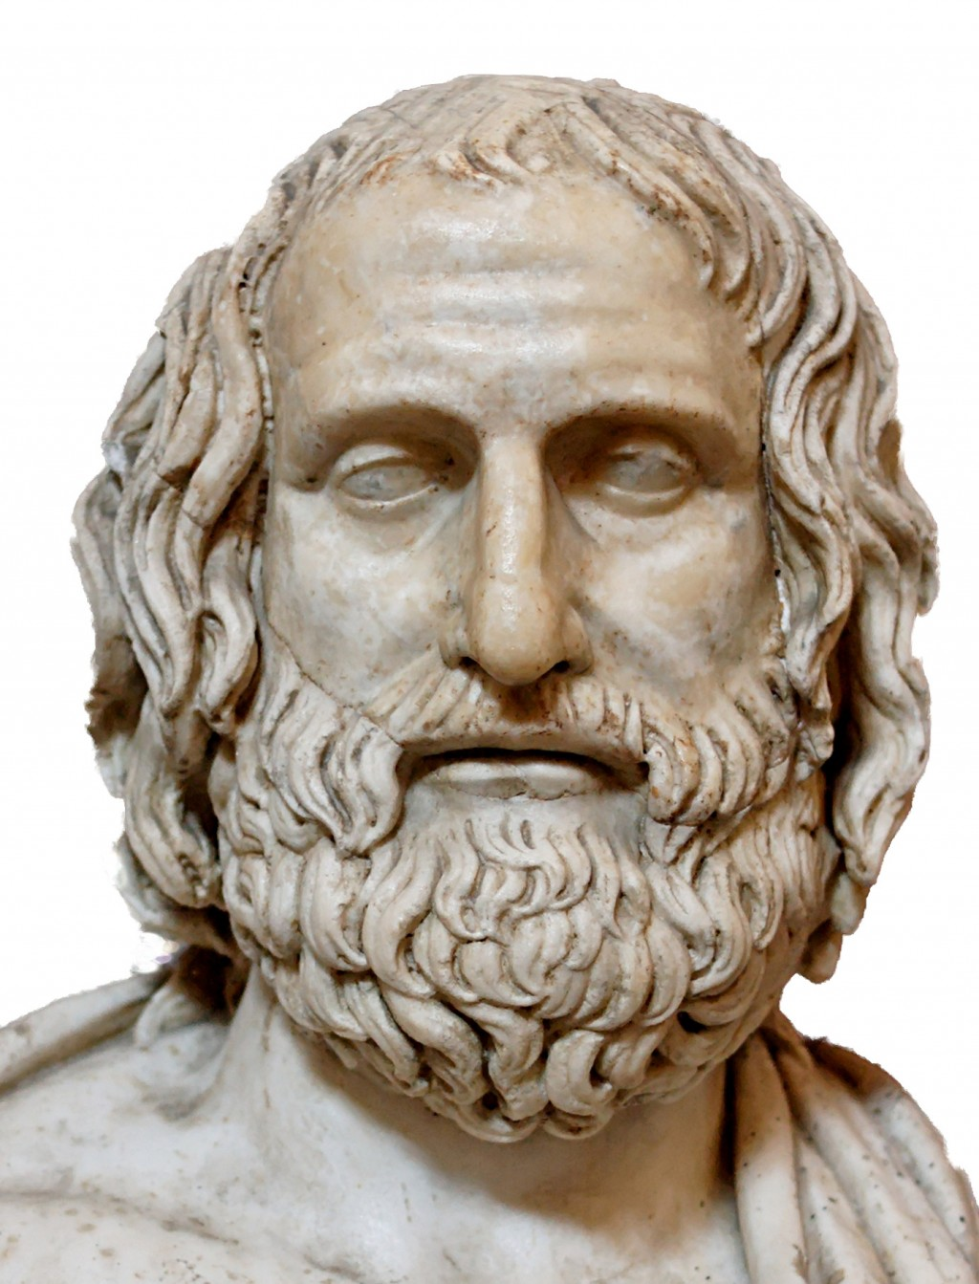
MEDEA
Euripides ( 480-406 BC )
Mr : J. B. Khot
MA SET
Department of English
Kisan Veer Mahavidyalaya, Wai (Satara)

Slide 2
About the Playwright
Along with Aeschylus and Sophocles, he is one of the three ancient Greek tragedians.
Some ancient scholars attributed ninety-five plays to him.
Of these, eighteen or nineteen have survived more or less complete.

Slide 3
Medea: An Introduction
Medea is a remarkable study of injustice and ruthless revenge.
Performed in 431 BCE.
The Colchian princess Medea has married the hero Jason.
They have lived happily for some years at Corinth and have produced two sons.
Jason decides to cast off Medea and to marry the daughter of Creon, king of Corinth.
Medea determines that she will punish Jason by murdering not only her own sons but also the Corinthian princess.
She carries out the murders and escapes in the chariot of her grandfather, the sun-god Helios.

Slide 4
Characters
Medea:
Princess of Colchis and wife of Jason----Barbarian, sorceress, woman of passion, rage, clever, powerful, and ruthless---
Jason:
Son of Aeson--- Hero of the Golden Fleece---an opportunistic and unscrupulous man---He condescends to his wife, although she is in every way superior to him.
Creon
King of Corinth and new father-in-law to Jason---Creon exiles Medea, fearing that the dangerous witch will seek vengeance against his family.
Aegeus
King of Athens and Friend of Medea---Kindly and trusting ruler.

Slide 5
Nurse
Servant to Medea and Medea's children---loyal to Medea and disapproves of Jason's decisions---an outside commentator on the events of the play.
Tutor
Another slave of Medea's household.
Messenger
Brings the news of the deaths of Creon and the Corinthian princess.
Chorus of Corinthian Women
The women of Corinth---They watch the horrific events unfold, but do not interfere---

Slide 6
Background
Medea is a powerful sorceress, princess of Colchis, and a granddaughter of the sun god Helias.
Jason, a great Greek hero and captain of the Argonauts, led his crew to Colchis in search of the Golden Fleece (a magical artifact with powerful healing abilities).
King Aeetes, lord of Colchis and Medea’s father, has kept the Fleece under guard.
Jason's voyage with the Argonauts predates the Trojan War, and represents the first naval assault by the Greeks against an Eastern people.
By Medea's aid, Jason overcomes obstacles.
Medea herself kills the giant serpent that guarded the Fleece.
To buy time during their escape, Medea kills her own brother and tosses the pieces of his corpse behind the Argo as they sail for Greece.

Slide 7
Her father has to slow his pursuit of the Argo so he can collect the pieces of his son’s body for burial.
Medea and Jason return to his hereditary kingdom of Iolcus.
After his fathers death, his uncle Pelias has become king.
Medea, to help Jason, convinces Pelias’ daughters that she knows a way to restore the old king's youth by cutting his body into small pieces.
But the sorceress then explains that she cant really bring Pelias back to life.
Rather than win Jason his throne, this move forces Jason, Medea, and their children into exile.
Finally, they settle in Corinth, where Jason eventually take a new bride.

Slide 8
Summary
Medea's in dire straights.
Because her husband, Jason, has married another woman, Glauke, daughter of Creon the King of Corinth.
Creon banishes Medea and her two sons from Corinth.
She swears bloody revenge and swiftly sets about finding a way to kill them all.
She convinces Creon to let her stay one more day in Corinth. He allows her.
She snookers Jason into believing that she's now cool with his new marriage.
Medea tells Aegeus, king of Athens, of her problems, and asks for safe haven in Athens.

Slide 9
Aegeus is childless whom she offers to help him to have child.
She has thorough knowledge of drugs and medicines.
Medea makes the old king vow by all the gods that If she can reach Athens, he will protect her.
She begs Jason to allow the children to stay in Corinth. She also has the children bring gifts to the Corinthian princess.
Jason is pleased by this change of heart.
The poisoned dress and diadem have worked: the princess is dead.
When Creon saw his daughter's corpse, he embraced her body.
Medea now prepares to kill her children.
Children's screams from inside the house.

Slide 10
Jason has come to take the children under guard.
Jason is informed that his children are dead. Now he wants to take his revenge against his wife for these atrocities.
Medea appears above the palace, in a chariot drawn by dragons.
She has the children's corpses with her. She refuses to give him the bodies.
Jason can do nothing ; with the aid of her chariot, Medea will escape to Athens.

Slide 11
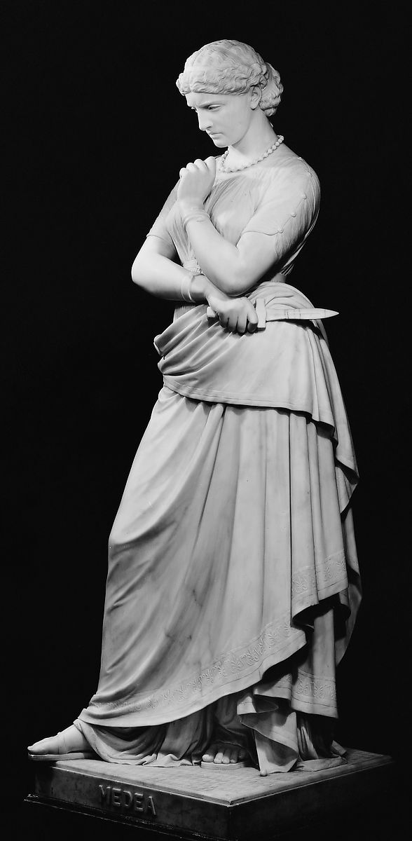
Themes
Passion and Rage
Revenge
Greatness and pride
The position of women
The Other
Exile
Cleverness
Manipulation

Slide 12
Episodewise
Summary

Slide 13
Episode I
Medea finally gets on stage. She says that Jason has deserted her.
She observes that women are treated like the lowest form of life on Earth.
She's a foreigner in a strange land and has no one to whom she can turn.
She begs the Chorus to not stand in the way of her revenge.
Medea observes that
Creon enters.
The King orders Medea to take her sons and get out of Corinth.
Medea has a reputation as a sorceress and Creon thinks she's plotting to use those skills for revenge.

Slide 14
She begs him to let her stay just for the day. There are travel arrangements to be made, and she has to prepare her sons.
Creon takes a little pity on the sons, and tells Medea that she has until tomorrow to get out of town.
Medea has got a little something in mind for Jason and his young princess.
Medea declares that she's going to kill Creon, his daughter, and Jason.
She decides poison is the way to go.
She decides she'd better postpone her revenge until she has some guaranteed shelter.

Slide 15
Episode II
Jason enters and lectures Medea that it's all her fault that she and the children got banished. Because she cursed Creon and his daughter.
She tells him just how ungrateful he is, pointing out that she saved his life.
She chastises him more, saying that she deserted her father and bore him two sons, yet still Jason betrayed her.
Medea's husband tells her that he's only marrying the princess out of devotion to his family.
Jason only wants to provide his family with a more stable life by marrying in to royalty.
Medea tells Jason he should've tried to convince her of some of these points, before he snuck off and took a second wife.
Medea curses him.

Slide 16
Episode III
Aegeus enters. Greets Medea.
He's just come from the oracle at Delphi, where he went to ask Apollo why he can't have children.
She tells him all her woes, and begs him to let her come and stay with him in Athens, promising that she'll use her expertise to help him have children.
Medea says that he must swear an oath to protect her when she gets to Athens.
Aegeus agrees and swears on the Earth and the Sun that he'll never drive her from his land.
She lays out her plans.
Medea declares that no man will ever think she's weak.

Slide 17
Episode IV
Jason enters, with the Nurse asks Medea what she wants.
She tells him that she was ungrateful to him. Now she is ready to aceept his second wife.
She calls for the children and urges them to hug their father. All the strife is over.
She begs him to talk his new wife and Creon into letting the boys stay in Corinth.
Medea tells him she'll help out by sending his new wife a gossamer gown and a golden diadem.
Medea tells her children to take the gifts to their stepmother.
She tells them to make sure that the new wife touches the items with her own hands.

Slide 18
Episode V
The Tutor enters with the boys and tells Medea the good news: the princess has agreed to let the boys stay in Corinth.
Medea emits a wail of pain.
She hugs the boys close to her and laments the fact that she won't see them grow up.
Finally decides that murdering her sons is necessary.

Slide 19
Episode VI
A Messenger runs in.
Panicked, he tells Medea to run. The Princess and Creon are both dead.
Medea is tickled pink and asks the Messenger to tell her every grisly detail.
The Princess was all about the gifts. She put the gown and diadem on and pranced around the palace looking at herself in the mirror.
Her skin changed color, her eyeballs bulged, and she started foaming at the mouth.
The diadem caught fire and the gossamer gown ate away her flesh.
The King was stricken with grief and grabbed his daughter's flaming body. He caught fire too, and, before you knew it, his flesh was also bubbling from his bones.

Slide 20
Now Medea says that it's time to kill her sons.
Media pushes down her feelings of motherly love and enters the house to murder them.

Slide 21
Episode VII
The boys are heard desperately shouting for their lives inside the house.
They go silent.
Jason says he's worried what Medea might do to their sons.
Medea appears in the sky with the boys' corpses beside her.
She's in a chariot drawn by dragons.
Jason heaps curses on Medea.
Jason yells that she's hurt herself, too, by killing her own sons.
She tells Jason that the whole thing is his fault, because he married another woman.
Jason begs her to leave him the boys' bodies so that he can bury them.

Slide 22
Nope, says Medea, I'm going to place their bodies in a temple to Hera, where no one will violate the bodies.
Medea adds that she's going to start a festival in Corinth in honor of the boys.
Jason pleads to touch his children's flesh one last time.
Medea refuses and flies away.

Slide 23
Thank
you!

