Slide 1
Evolution

Slide 3
Oparin & Haldane

Slide 6
Lamark 1774-1829

Slide 7
Evolution of giraffe lamarkism

Slide 8
Weismann1892

Slide 10
Darwin Natural selection

Slide 12
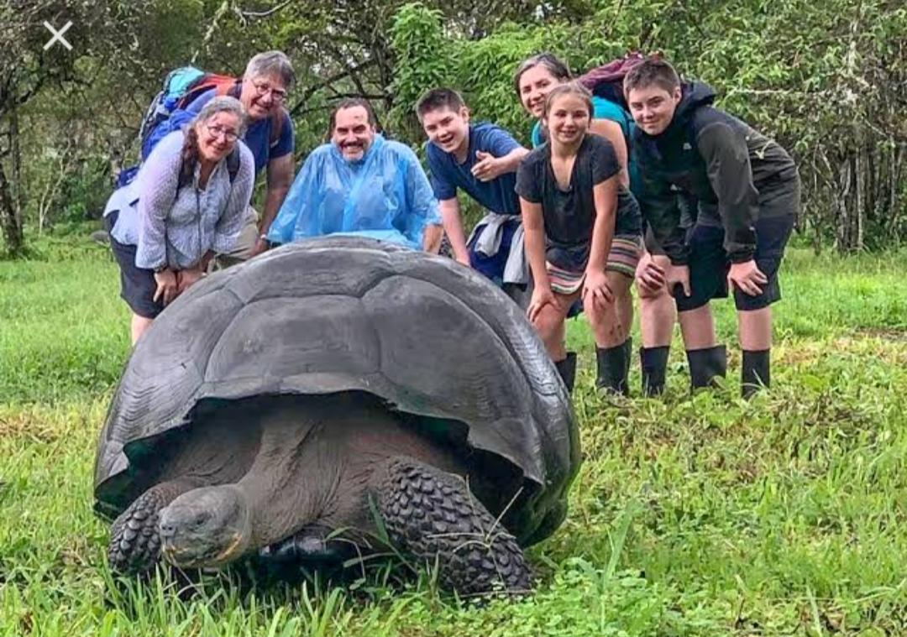
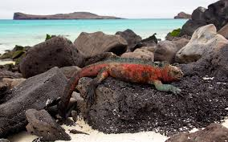
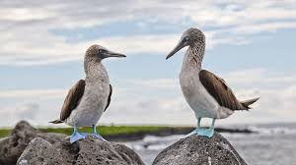

Slide 13
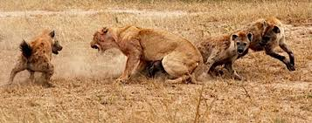
Intra. And interspecific compitition

Slide 15
Selective breeding

Slide 16
Genetic variation

Slide 28
Archaeopteryx 1860 Germany

Slide 33
Petrified fossil of plant

Slide 34
Starfish

Slide 42
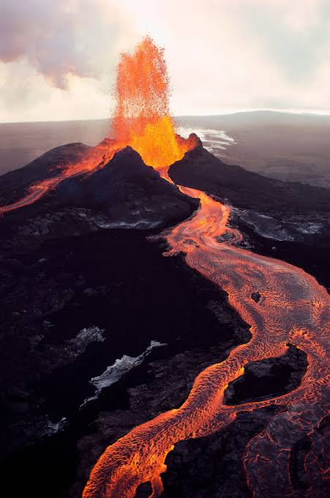

Slide 46
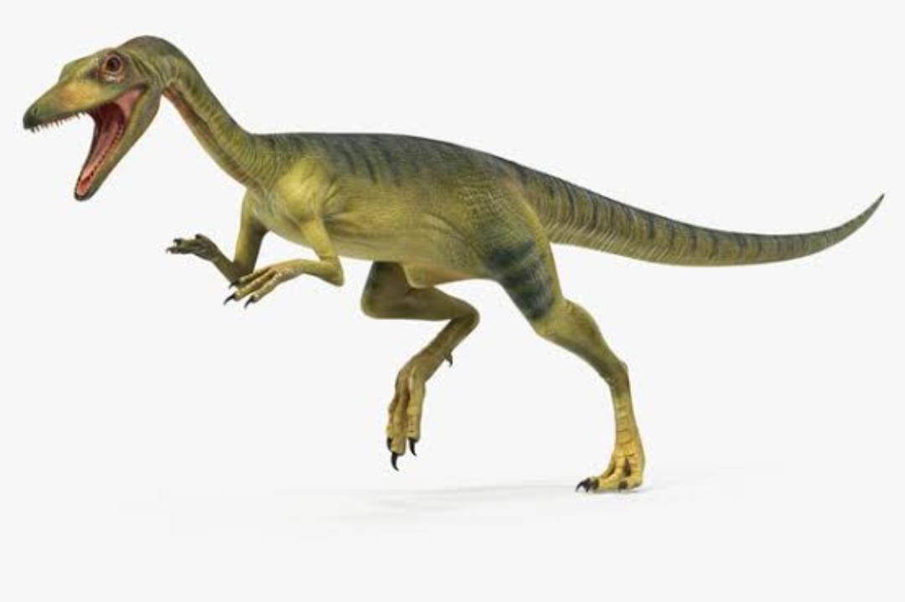
Compsognathus

Slide 47
Giganthosaurus

Slide 48
Barapasaurs

Slide 49
Jainosaurus

Slide 50
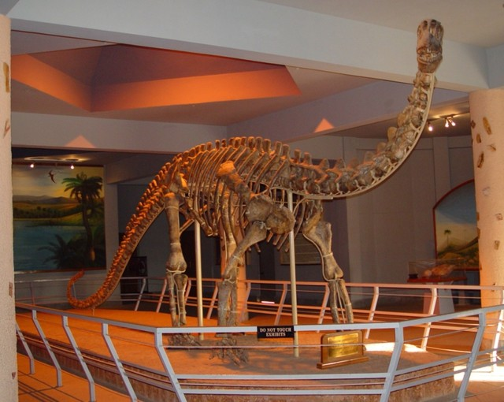
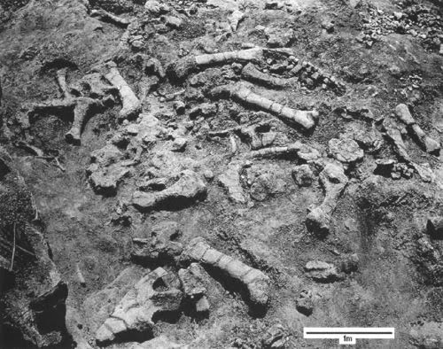
Kotasaurus Telangana india

Slide 51
Pradhania

Slide 52
Nambalia

