Slide 1
SUSTAINABLE ENERGY

Slide 2
WELCOME
WE ARE VERY GLAD TO PRESENT OUR POWERPOINT PRESENTATION AND OUR TOPIC IS : SUSTAINABLE ENERGY
MADE BY :
1) SURAJ MULLA
2) ROHAN DESHMUKH
3) SAURABH RAJE

Slide 3
INTRODUCTION
Major Renewable Energy Sources
Solar Energy
Geothermal Energy
Wind Energy
Tidal Energy
Wave Energy
Hydroelectricity Energy
Biomass

Slide 4
Renewable Energy- “any sustainable energy sources that comes from natural environment.”
Some Aspects of Renewable Energy
It exists perpetually and in abundant in the environment
Ready to be harnessed, inexhaustible
It is a clean alternative to fossil fuels
“energy that is derived from natural process are replenished constantly”– defined by the RENEWABLE ENERGY WORKING PARTY of the INTERNATIONAL ENERGY AGENCY

Slide 5
Sustainable energy is the sustainable provision of energy that meets the needs of the present without compromising the ability of future generations to meet their needs. Technologies that promotes sustainable energy include renewable energy sources, such as hydroelectricity, solar energy, wind energy, wave power, geothermal energy, and tidal power and also technologies designed to improve energy efficiency.
“Energy which is the renewed within a human lifetime and causes no long term damage to the environment.”

Slide 6
The Importance of Sustainable Energy
Sustainable energy is important because of the benefits it provides. The key benefits are:
Environmental : Sustainable energy can avoid and reduce air emission as well as water consumption, waste, noise and adverse land-use impacts.
Energy for Future Generations : Renewable avoid the rapid depletion of fossil fuel reserves and will empower future generations to deal with the environmental impact of over-dependence on fossil fuels.
Energy Security : Lessens our dependence on fossil and imported fuels.

Slide 7
Renewable energy is energy which comes from natural resources such a sunlight, wind, rain, tides and geothermal heat.

Slide 8
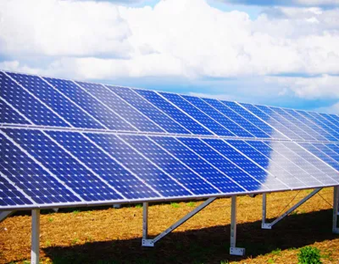
Solar Energy-
Solar Energy is the energy received by the earth from the sun. This energy is in the form of solar radiation, which makes the production of solar electricity possible.

Slide 9
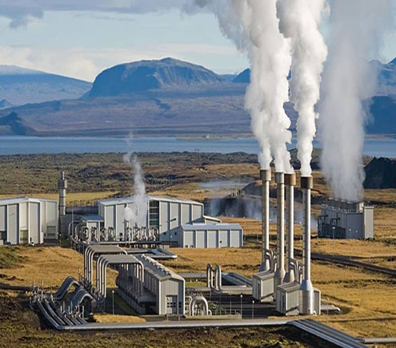
GEOTHERMAL POWER
Power generated using steam produced by heat emanating from the molten core of the earth.
Geothermal power is the considered to be sustainable because the heat extraction is small compared with the Earth’s heat content. The emission intensity of existing geothermal electric plants is on average 122 kg of CO2 per megawatt-hour (MHh) of electricity ,about one-eighth of a conventional coal-fired plant.

Slide 10
WIND ENERGY
Wind Energy-
Form of energy conversion in which turbines convert the Kinetic Energy of wind into mechanical or electric energy that can be used for power. Since wind does not require the use of fossil fuels, it is consider renewable energy source.
The Advantage of Wind Turbines
They are pollution free
Using wind energy means that less fossil fuel (coal & oil) needs to be burned to make electricity.
The Disadvantage of Wind Turbines
Spoil the look of the natural environment
Wind turbines make noise.

Slide 11
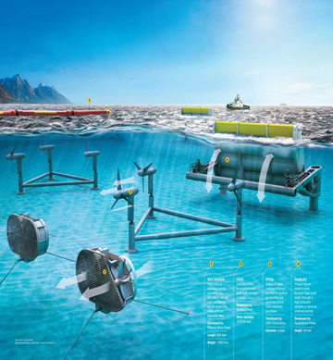
Tidal Power
Tidal power, also called Tidal Energy, is a form of hydropower that converts the energy of tides into useful forms of power- mainly electricity.
Advantage of Tidal Energy-
It is an inexhaustible source of energy.
Tidal Energy is environment friendly energy & doesn’t produce
greenhouse gases.
Disadvantage of Tidal Energy-
Cost of construction Tidal Power plant is high.
There are very few ideal locations for construction of
plant and they too are localized to coastal regions only.

Slide 12
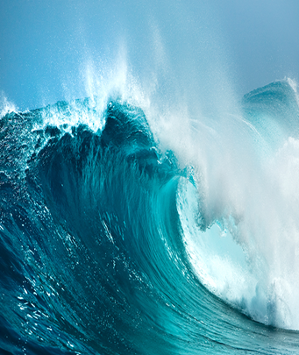
WAVE POWER
Wave power is the transport of energy by Ocean surface wave, and the capture of that energy to do useful work.
Advantage of Wave Power-
Capable of high efficiency (60-80%) in ideal conditions.
Renewable energy source obtained by wind
via the suns heating at our atmosphere.
Disadvantage of Wave Power-
Improperly placed wave power plants can
damage the Marine Ecosystem.
Efficiency drops significantly in rough weather
due to safety mechanism.

Slide 13
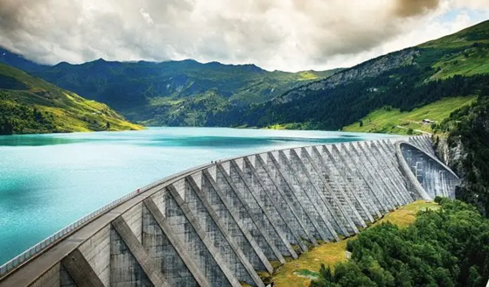
HYDROELECTRICITY
Hydroelectricity is the form of electricity which is produced by water power e.g. DAMS….
Advantage-
Once a dam is constructed, can be
produced at constant rate.
The Lakes water can be used for the
Irrigation purposes.
Disadvantages –
Dams are extremely expensive to build an must be built to very high standard.
The Flooding of large areas of Land means that the natural environment is destroyed.

Slide 14
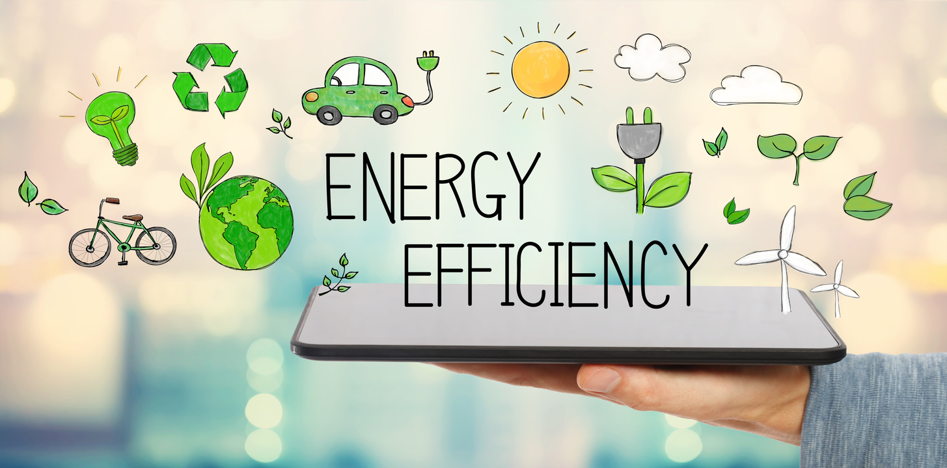
ENERGY EFFICIENCY
Moving toward energy sustainability will require changes not only in the way energy is supplied, but in the way it is used, and reducing the amount of energy required to deliver various goods or services is essential.

