Slide 1
Host Parasite Interaction

Slide 3
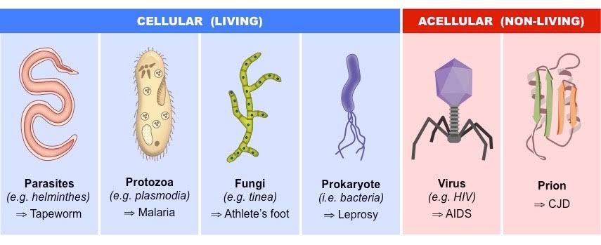

Slide 5
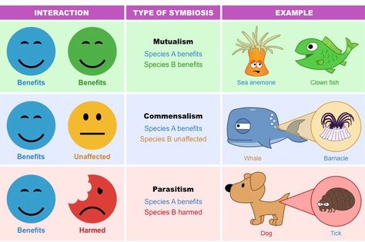

Slide 9
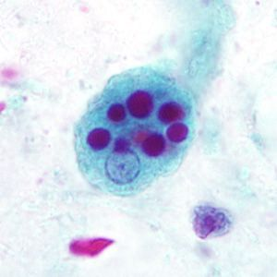
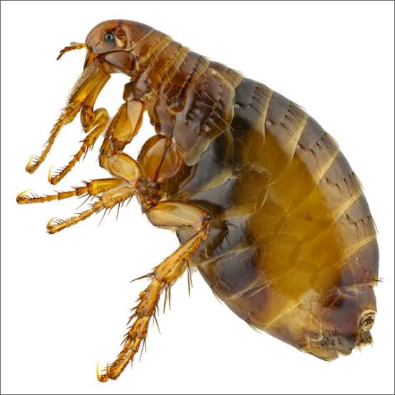
Entamoeba histolytica

Slide 10
Ectoparasite :Flea

Slide 11
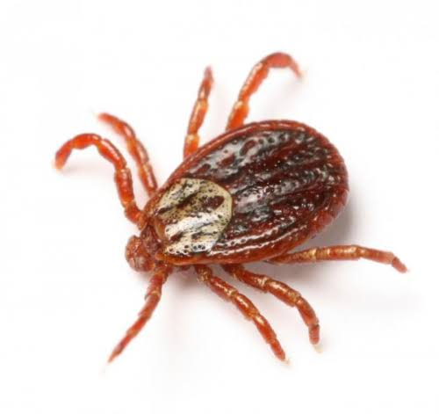
Ectoparasite: Tick

Slide 12
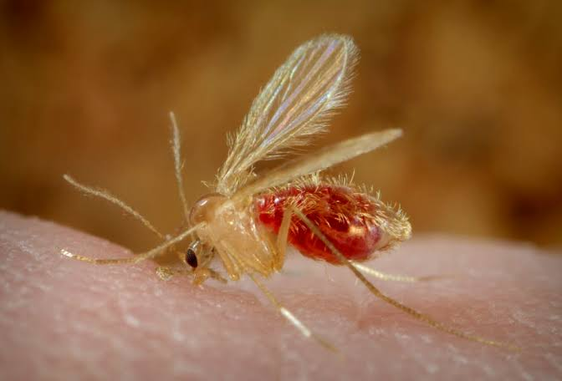
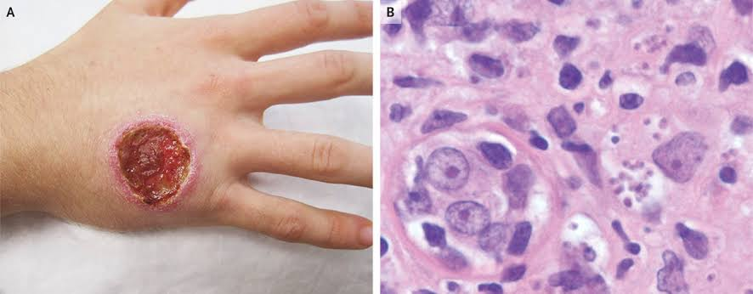
Tse Tse Fly cause Leishmaniasis

Slide 13
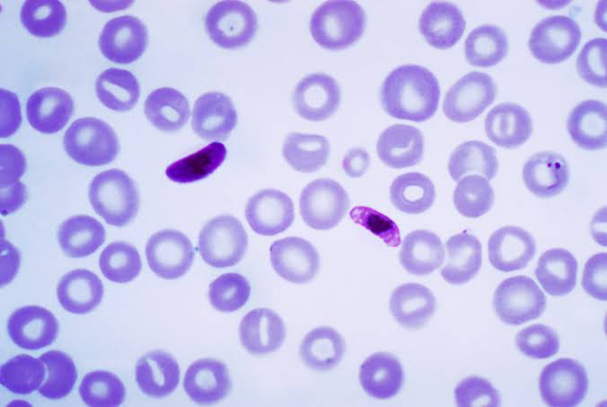
Plasmodium cause Malaria

Slide 14
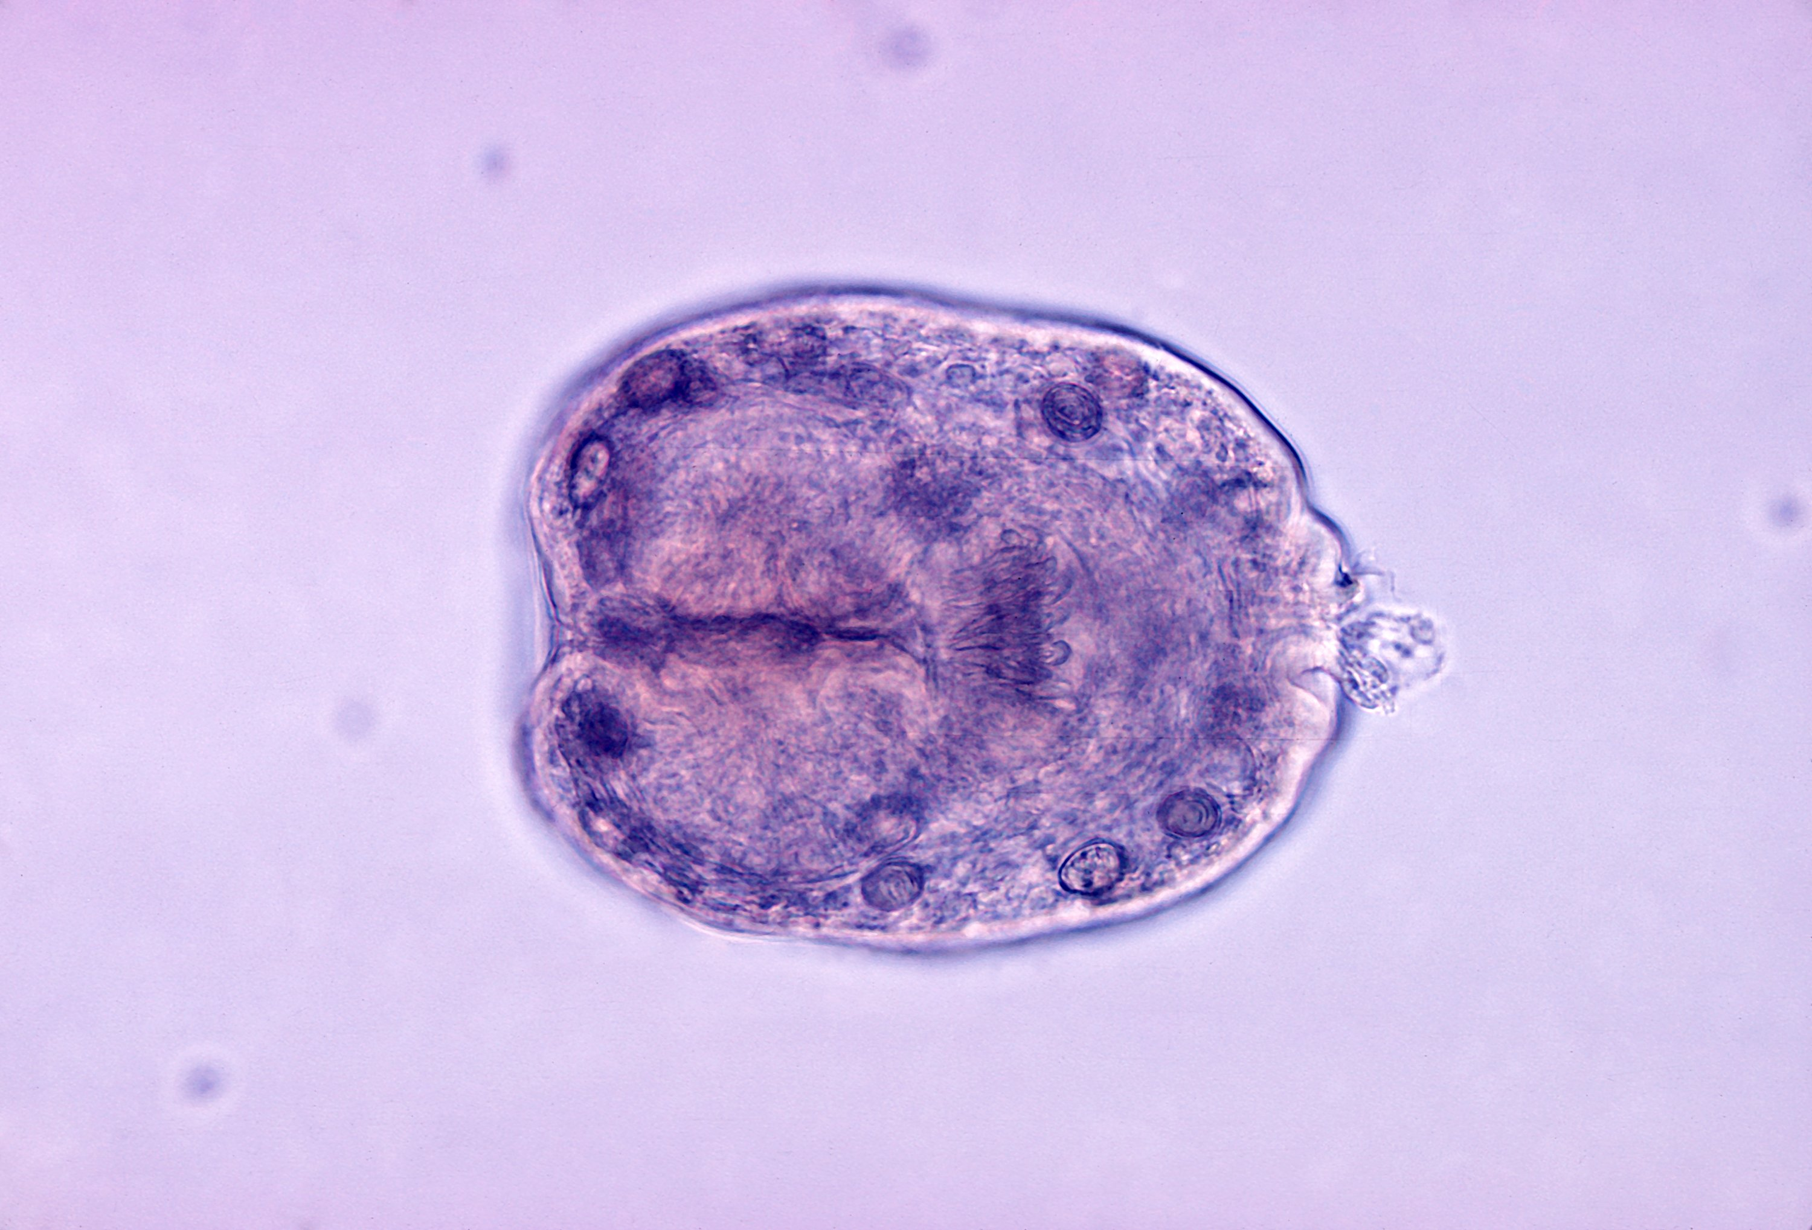
Echinococcus granulosis

Slide 16
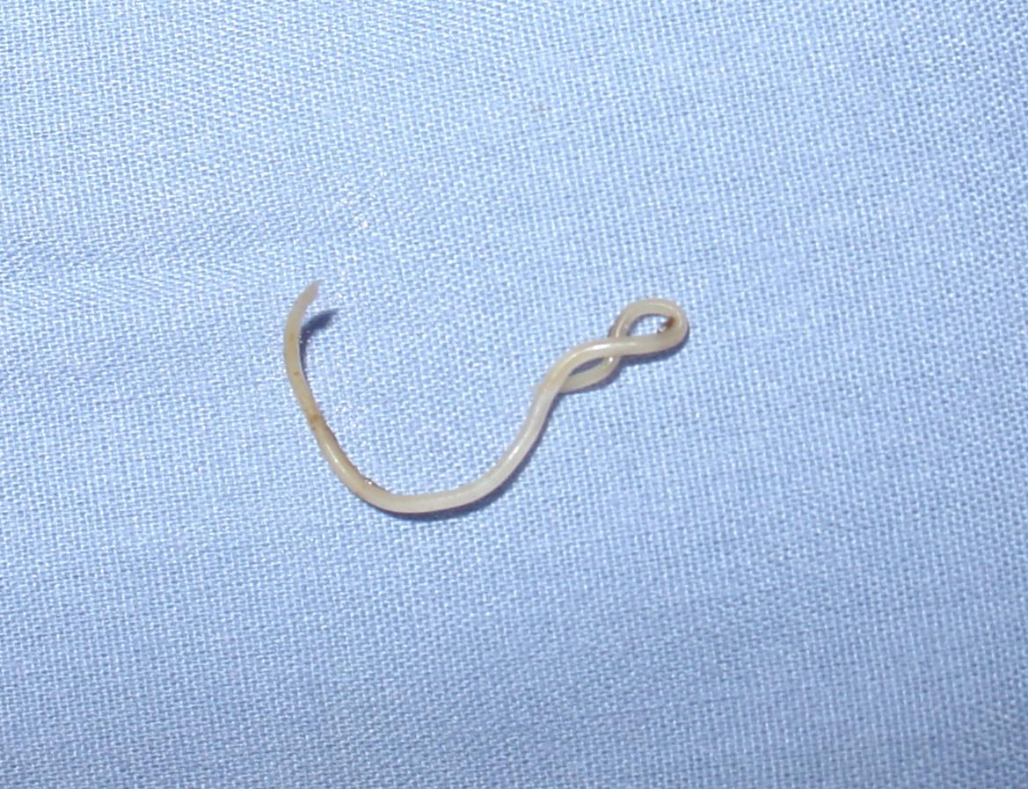
Toxocara or dog roundwarm

Slide 22
Thank you

