Slide 1
Introduction to Elasticity
Elasticity is a fundamental concept in engineering that describes the ability of materials to deform under stress and then return to their original shape and size when the stress is removed. Understanding elasticity is crucial for designing structures, devices, and materials that can withstand various loads and forces.

Slide 2
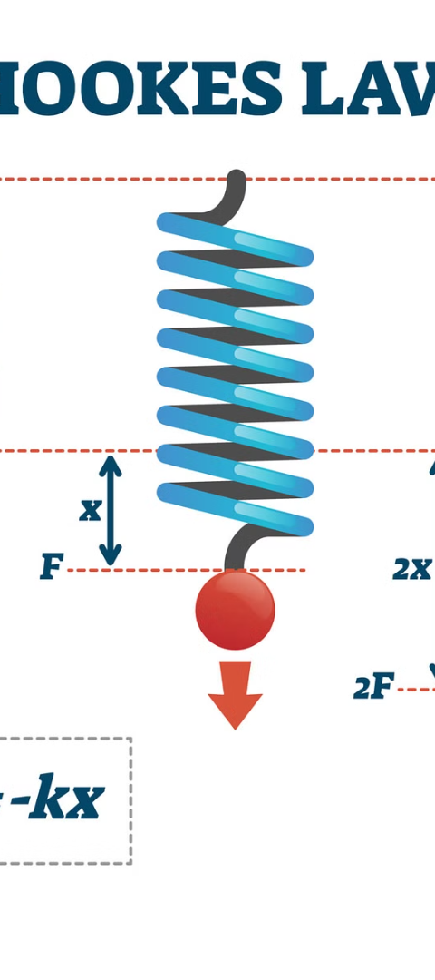
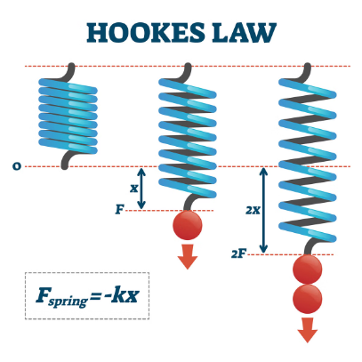
Revision of Hooke's Law
1
Proportionality
Hooke's law states that the force required to stretch or compress a material is proportional to the distance of the stretch or compression, up to the elastic limit.
2
Linear Relationship
The relationship between stress and strain is linear, meaning that the ratio of stress to strain remains constant within the elastic limit.
3
Elastic Limit
Beyond the elastic limit, the material will not return to its original shape and size, and permanent deformation will occur.

Slide 3
Stress-Strain Diagram
Elastic Region
Plastic Region
Yield Strength
In the elastic region, the material deforms proportionally to the applied stress, and it returns to its original shape and size when the stress is removed.
In the plastic region, the material undergoes permanent deformation, and it will not return to its original shape and size even after the stress is removed.
The yield strength is the point at which the material transitions from the elastic to the plastic region, and it is an important design parameter.

Slide 4
Definitions of Elastic Constants
1
Young's Modulus
2
Poisson's Ratio
The ratio of stress to strain within the elastic limit, which measures a material's stiffness.
The ratio of transverse strain to longitudinal strain, which describes a material's tendency to expand in one direction and contract in another when stretched.
3
Bulk Modulus
4
Shear Modulus
The ratio of the infinitesimal pressure increase to the resulting relative decrease of the volume, which measures a material's resistance to uniform compression.
The ratio of shear stress to the corresponding shear strain, which measures a material's resistance to angular deformation.

Slide 5
Bending of Beams
Beam Theory
Strain and Stress
Neutral Axis
The bending of beams is governed by the principles of beam theory, which relates the applied loads, beam geometry, and material properties to the resulting stresses and deformations.
When a beam is bent, the outer fibers of the beam are subjected to tensile stress, while the inner fibers are subjected to compressive stress. The distribution of these stresses is linear across the beam's cross-section.
The neutral axis is the plane within the beam where the stresses are zero, and it is located at the centroid of the beam's cross-section.

Slide 6
Bending Moment
Applied Load
When a load is applied to a beam, it creates a bending moment that causes the beam to bend.
Internal Stresses
The internal stresses in the beam are proportional to the bending moment and are distributed linearly across the cross-section.
Deflection
The bending of the beam results in a deflection, which is the displacement of the beam from its original position.

Slide 7
Cantilever Beams
Definition
Moment Distribution
A cantilever beam is a structural element that is fixed at one end and free at the other. It is commonly used in bridges, balconies, and cranes.
The bending moment in a cantilever beam is maximum at the fixed end and decreases linearly towards the free end.
Deflection
Applications
The deflection of a cantilever beam is greatest at the free end and decreases towards the fixed end.
Cantilever beams are used in various engineering applications, such as supporting balconies, overhanging roofs, and crane arms, due to their efficient load-bearing capabilities.

Slide 8
Conclusion
Elasticity is a fundamental concept in engineering that underpins the design and analysis of a wide range of structures, devices, and materials. By understanding the principles of elasticity, such as Hooke's law, stress-strain relationships, and the behavior of beams under bending, engineers can create robust and efficient designs that meet the demands of modern engineering challenges.

Slide 9
Elasticity of Beams
Beams exhibit elastic behavior when subjected to loads, undergoing deformation and stress. Understanding the principles of beam elasticity is crucial for designing robust and reliable structures.

Slide 10
Beam Supported at Both Ends
Reactions
Deflection
Stress Distribution
When a beam is supported at both ends, it experiences vertical reactions at the supports, which must be calculated to ensure structural integrity.
The beam will undergo deflection, or bending, due to the applied loads. Analyzing the beam's deflection is essential for determining its maximum stress and stability.
The distribution of stresses within the beam, including compressive and tensile stresses, must be carefully evaluated to prevent failure.

Slide 11
Torsional Oscillation
Initiation
1
Torsional oscillation in beams is initiated by the application of a twisting moment or torque.
2
Resonance
The beam's natural frequency of torsional oscillation can lead to resonance, which can cause excessive vibrations and potentially damage the structure.
Damping
3
Incorporating damping mechanisms, such as viscous or structural damping, can help mitigate the effects of torsional oscillation and maintain the beam's stability.

Slide 12
Torsional Couple per Unit Twist
Torsional Rigidity
Cross-Sectional Shape
The torsional couple per unit twist, also known as the torsional rigidity, is a measure of a beam's resistance to twisting.
The shape of the beam's cross-section, such as circular or rectangular, affects its torsional rigidity and overall torsional behavior.
Material Properties
The material's shear modulus is a key factor in determining the torsional couple per unit twist and the beam's torsional response.

Slide 13
Factors Affecting Torsional Behavior
1
Cross-Section Geometry
2
Material Properties
The shape and dimensions of the beam's cross-section significantly influence its torsional response.
The shear modulus and other material characteristics affect the beam's resistance to torsional deformation.
3
Loading Conditions
4
Boundary Conditions
The magnitude, location, and distribution of applied torsional loads impact the beam's torsional behavior.
The way the beam is supported at its ends, such as fixed or simply supported, affects its torsional response.

Slide 14
Analytical Approaches
Closed-Form Solutions
Analytical techniques, such as the use of torsion formulas, can provide closed-form solutions for the torsional response of beams.
Numerical Methods
Finite element analysis and other numerical techniques are useful for analyzing the torsional behavior of complex beam geometries and loading conditions.
Energy Methods
Approaches based on energy principles, such as the principle of virtual work, can be employed to derive the torsional response of beams.

Slide 15
Practical Applications
Bridge Design
Crane Structures
Building Frames
Torsional analysis is crucial in the design of bridges, where beams may be subjected to significant twisting loads.
Torsional behavior must be considered in the design of crane booms and other structures that experience torsional loading.
Torsional effects can be significant in high-rise buildings and must be accounted for in the design of structural frames.

Slide 16
Conclusion and Key Takeaways
Elastic Behavior
Beams exhibit elastic deformation and stress when subjected to loads.
Torsional Response
Torsional oscillation, torsional couple per unit twist, and various factors affect the torsional behavior of beams.
Analytical Approaches
Closed-form solutions, numerical methods, and energy-based techniques can be used to analyze beam torsion.
Practical Applications
Torsional analysis is crucial in the design of bridges, cranes, and building frames.

Slide 17
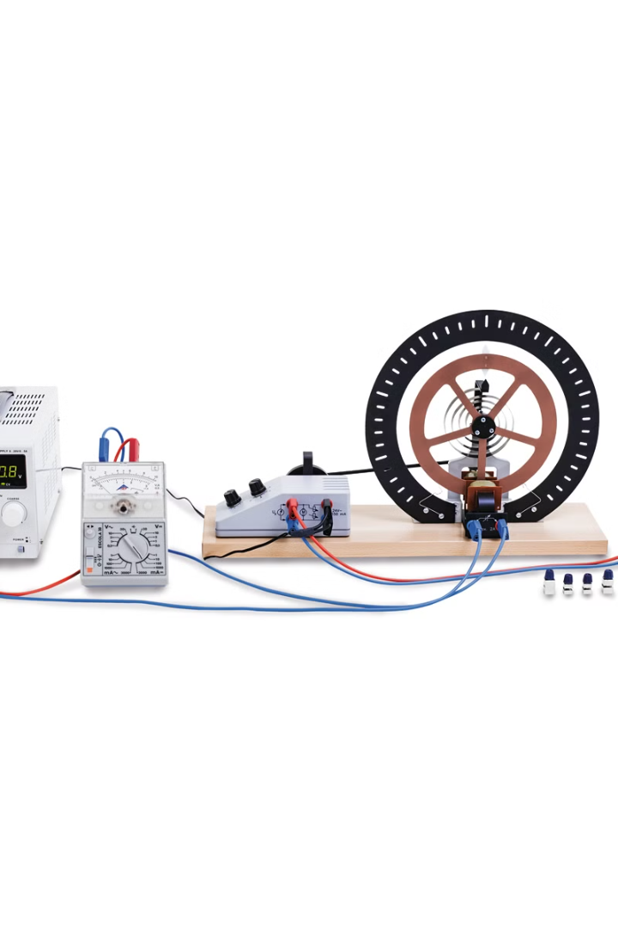
Introduction to Torsional Pendulum Experiment
The torsional pendulum is a valuable tool for studying the properties of materials and exploring the fundamental principles of physics. This experiment will guide you through the process of determining the rigidity modulus and moment of inertia of a wire, laying the foundation for understanding elastic constants.
Pa

Slide 18
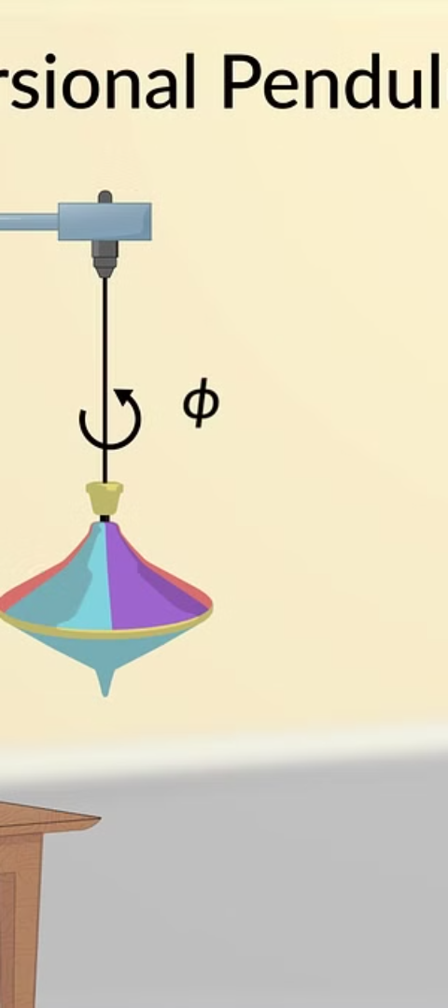
Theoretical Background: Torsional Pendulum and Its Applications
1
Oscillation Principles
The torsional pendulum utilizes the principle of oscillation, where a wire or rod is twisted and allowed to twist back and forth.
2
Measuring Material Properties
By analyzing the oscillation period and other parameters, we can determine the rigidity modulus and moment of inertia of the wire.
3
Wide-ranging Applications
Torsional pendulums have applications in materials science, engineering, and even the study of fundamental physics.

Slide 19
Determination of Rigidity Modulus
Hooke's Law
Rigidity Modulus
Experimental Approach
The torsional pendulum experiment relies on Hooke's law, which describes the relationship between the applied torque and the resulting angular displacement.
The rigidity modulus, also known as the shear modulus, is a fundamental material property that describes a material's resistance to shear stress.
By measuring the period of oscillation and the geometric parameters of the wire, we can calculate the rigidity modulus.

Slide 20
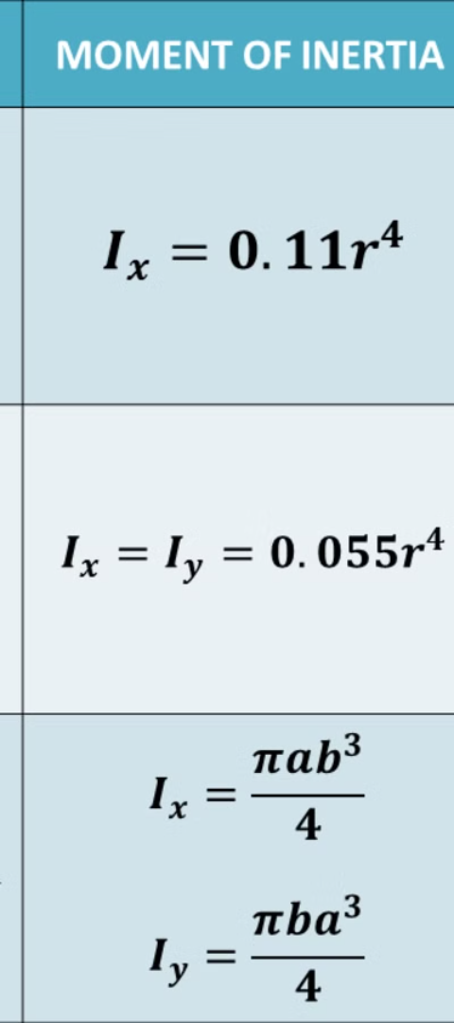
Determination of Moment of Inertia
1
Moment of Inertia
2
Importance in Torsional Pendulum
The moment of inertia is a measure of an object's resistance to changes in its rotational motion.
Determining the moment of inertia of the wire is crucial for understanding the dynamics of the torsional pendulum.
3
Experimental Determination
The moment of inertia can be calculated using the wire's dimensions and the period of oscillation.

Slide 21
Experimental Setup and Procedure
Torsional Pendulum Apparatus
Experimental Procedure
The setup includes a wire or rod, a rotational platform, and a means to measure the period of oscillation.
The wire is twisted and released, and the resulting oscillation period is measured using a stopwatch or other timing device.
Repeatability and Accuracy
Multiple measurements should be taken to ensure the reliability and reproducibility of the results.

Slide 22
Data Analysis and Calculations
Gathering Data
Record the period of oscillation and the wire's dimensions, such as length and diameter.
Calculating Rigidity Modulus
Use the formula for the rigidity modulus to determine the material property from the experimental data.
Calculating Moment of Inertia
Apply the formula for moment of inertia to determine the rotational inertia of the system.

Slide 23
Determination of Elastic Constants
Elastic Constant
Definition
Relationship to Rigidity Modulus
Young's Modulus
Measure of a material's resistance to axial stress
Depends on the rigidity modulus and Poisson's ratio
Poisson's Ratio
Ratio of transverse to axial strain
Relates to the rigidity modulus and Young's modulus
Bulk Modulus
Measure of a material's resistance to uniform compression
Depends on the rigidity modulus and Poisson's ratio

Slide 24
Conclusion and Key Takeaways
Rigidity Modulus
Moment of Inertia
Elastic Constants
Deeper Insight
Determined the rigidity modulus of the wire using the torsional pendulum experiment.
Calculated the moment of inertia of the system, a crucial parameter for understanding the dynamics.
Explored the relationships between the measured properties and other important elastic constants.
Gained a deeper understanding of the fundamental principles behind torsional pendulum experiments.

