Slide 1
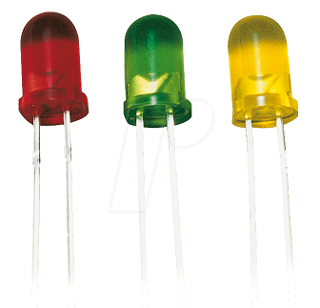
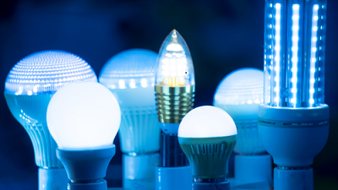
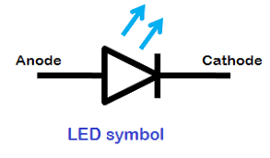
LED [Light Emitting Diode] – A light emitting diode (LED) is a semiconductor light source that emits light when current flows through it. It is a p-n junction diode which emits visible light when the junction is in forward bias. When electron from N-side recombines with holes on P-side, then charge carrier recombination takes place.

Slide 2
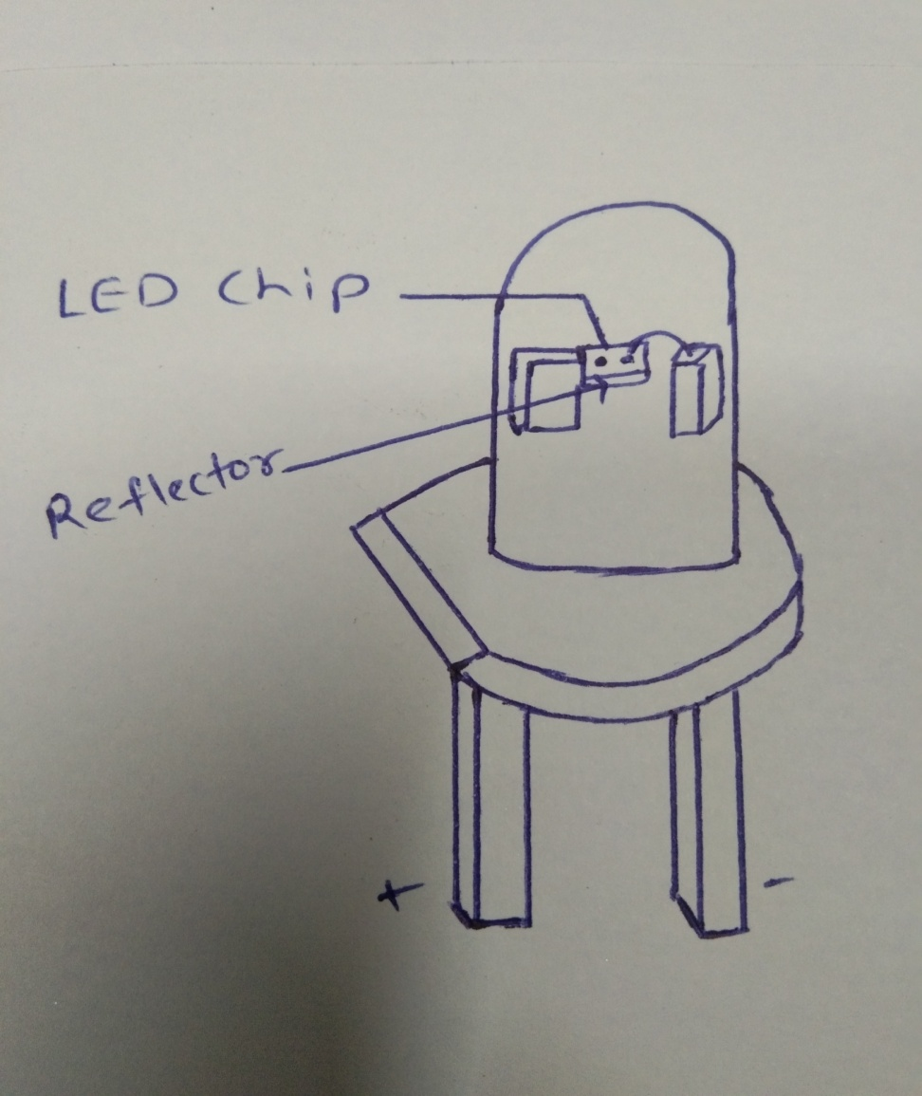
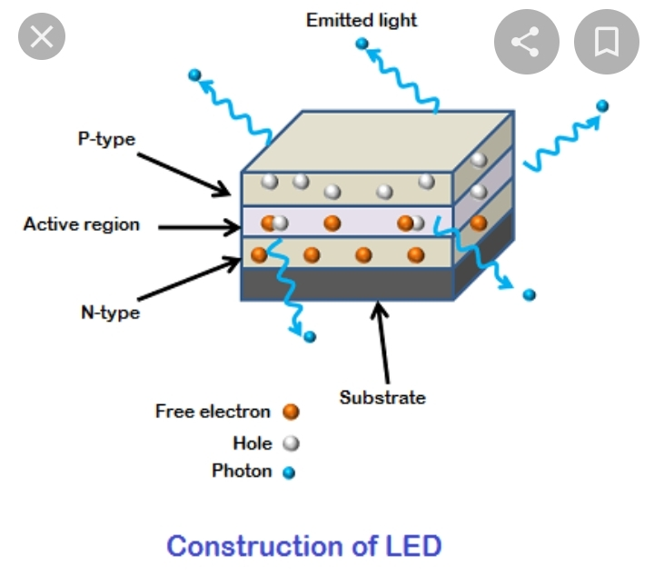
Construction of LED –

Slide 3
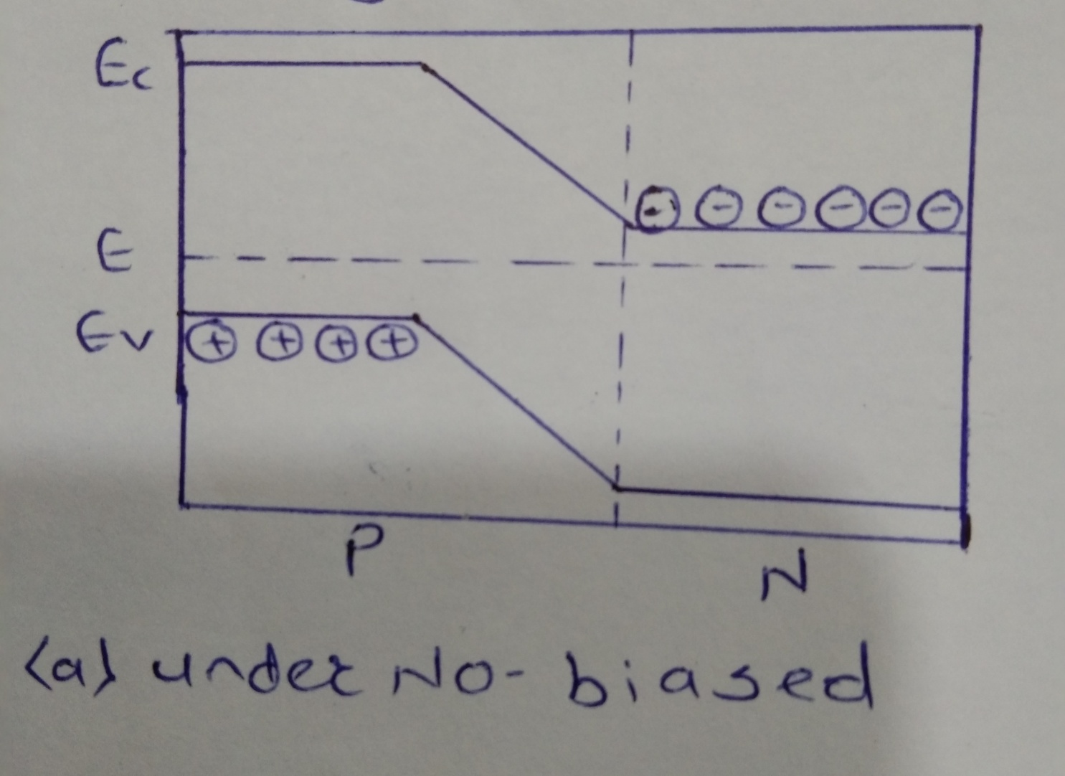
Working:

Slide 4
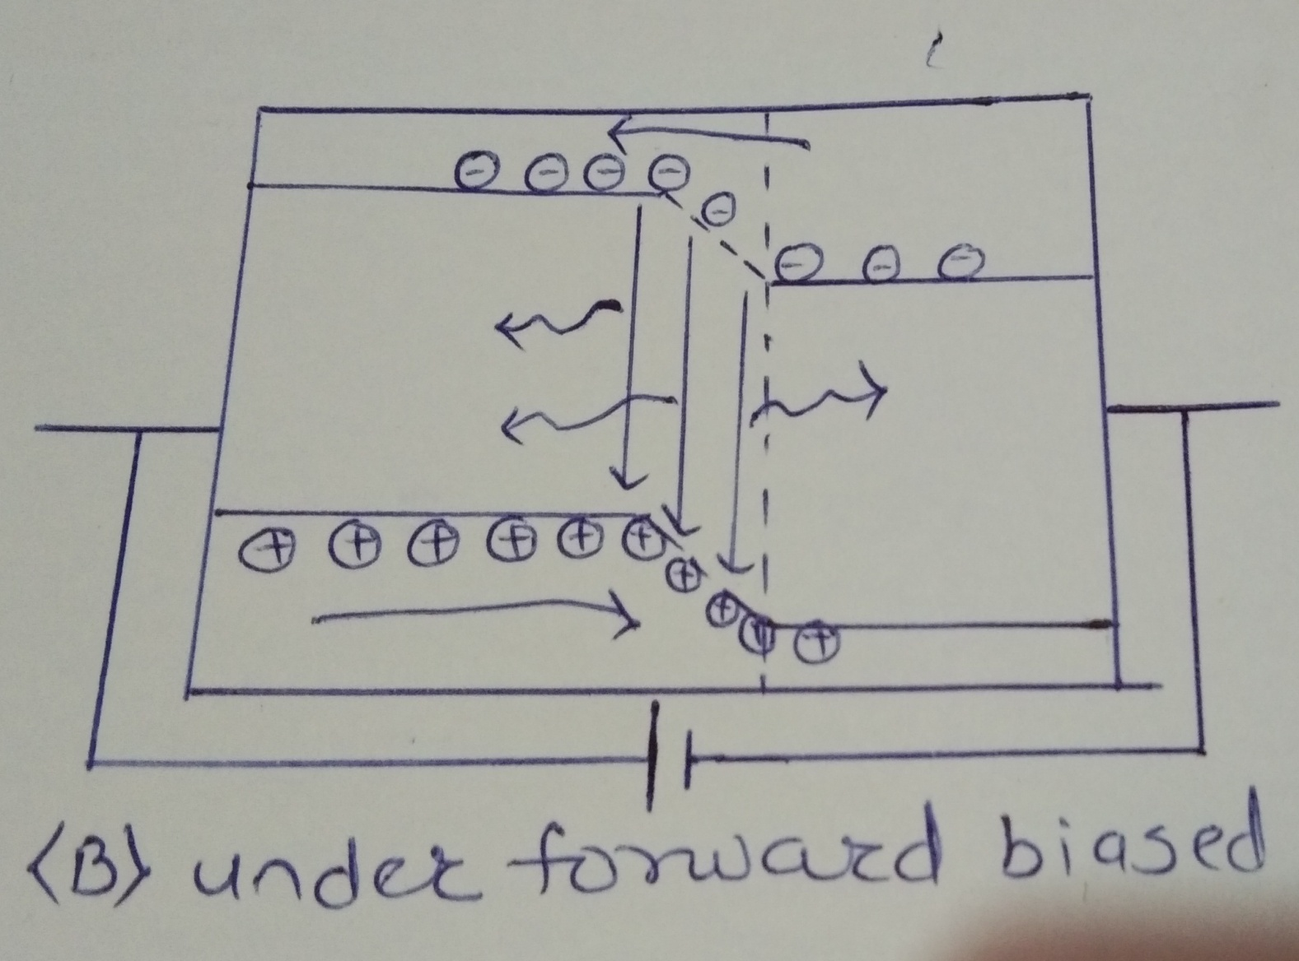

Slide 5
LED Efficiency: It is defined as light output devided by the electrical input power. It is denoted by eta. Applications: 1) Burglar alarm system 2) T.V. , F.M. , Computers, etc.

