Slide 1
MOLECULAR SPECTRA

Slide 2
INTRODUCTION: The molecular spectra may be broadly divided into three types.
MOLECULER SPECTRA
Pure rotational
Electronic spectra
Vibrational-rotational

Slide 3
1)Molecular bond: Molecule is a stable system where in two or more atoms are bound together . A system can be stable if it possesses minimum energy.
2)Co-valent bond: A bond formed by sharing electron is called covalent bond .
Eg.H₂ molecule
3)Ionic bond: If one or more electrons from one atom are transferred to other atom,then positive and negative ions are formed which strongly attract each other to form a stable system i.e.molecule.The bonding so formed is called ionic bond.

Slide 4
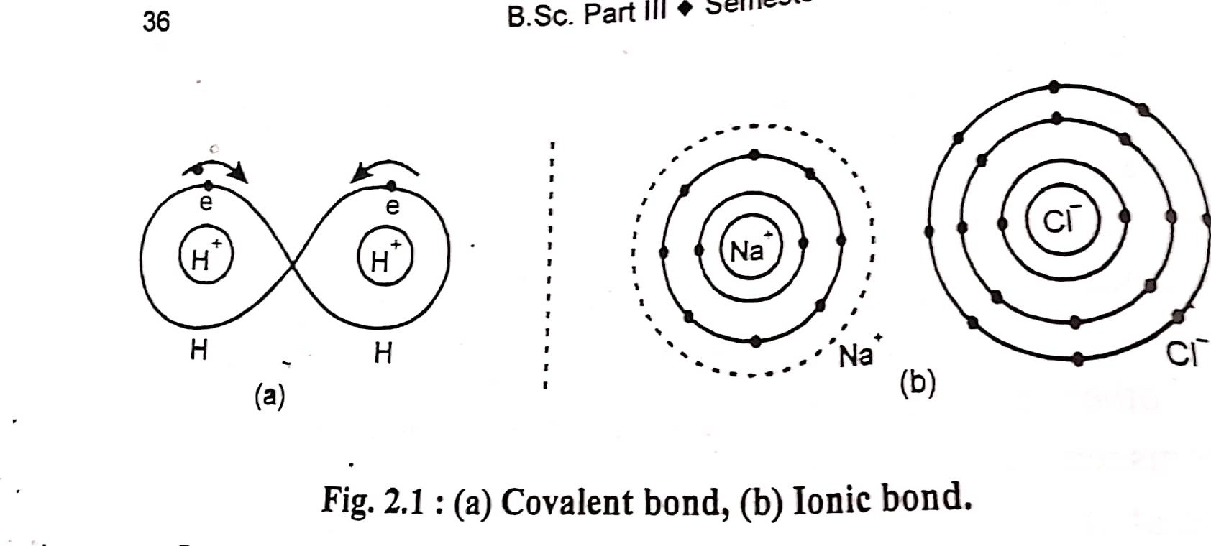
Electron sharing
The simplest molecule H₂ in which two proton share an electron.
Two protons form two boxes with wall in between them.

Slide 5
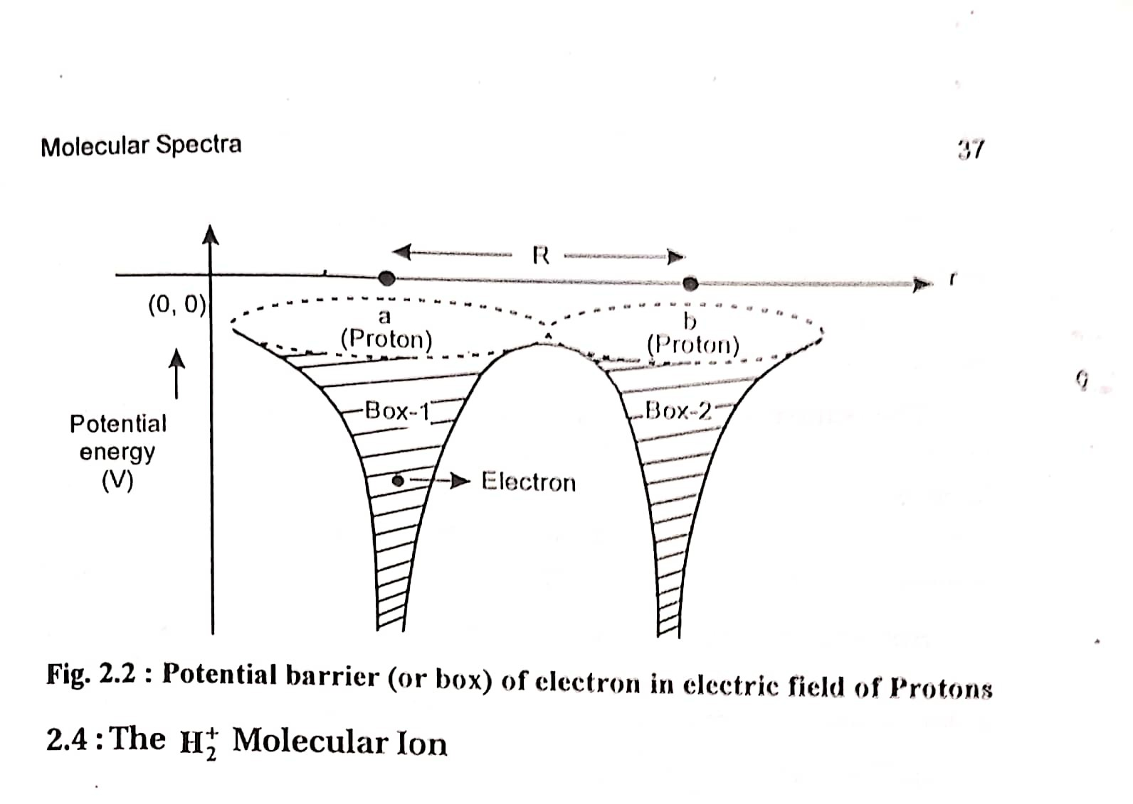
Potential barrier of electron in electric field of protons
The probability of tunnelling decrease with increase in distance between the two protons

Slide 6
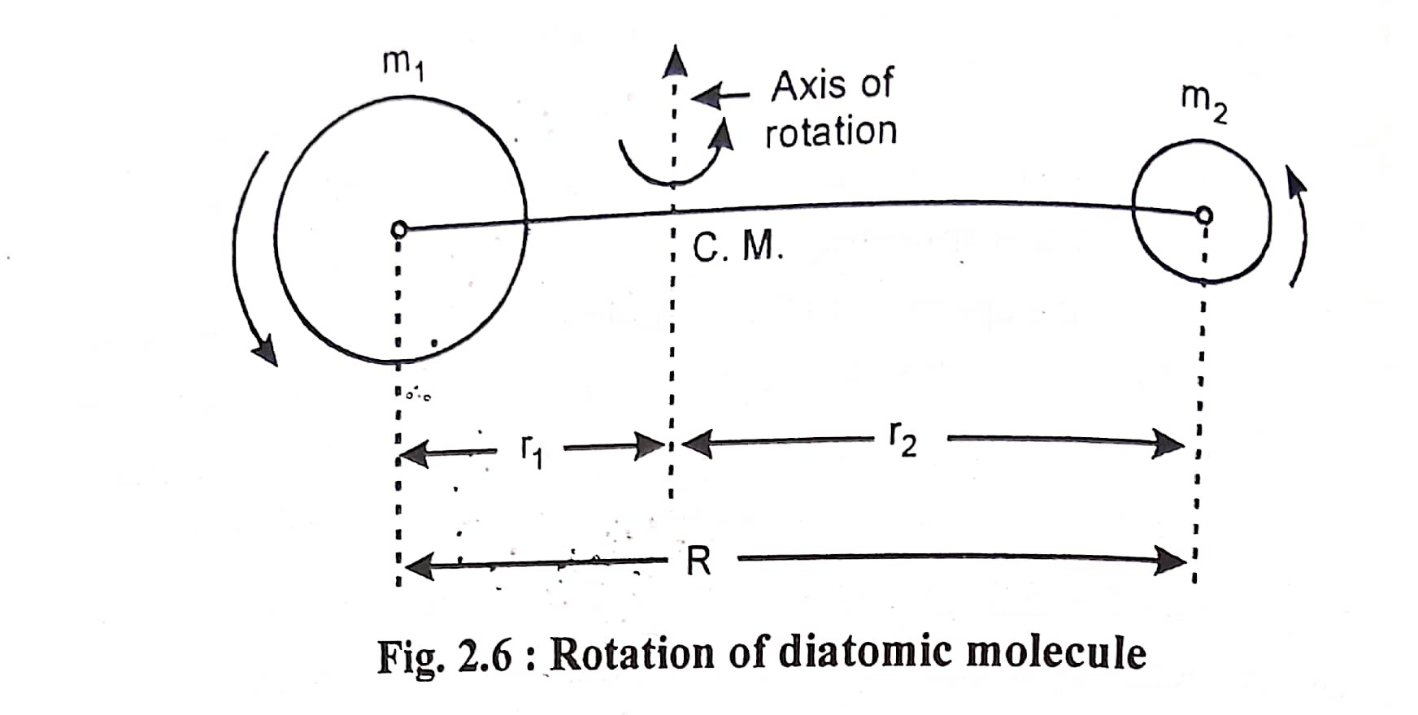
The rotation about the axis of symmetry involves energy about a few ev, which is of the order of bond energy.

Slide 7
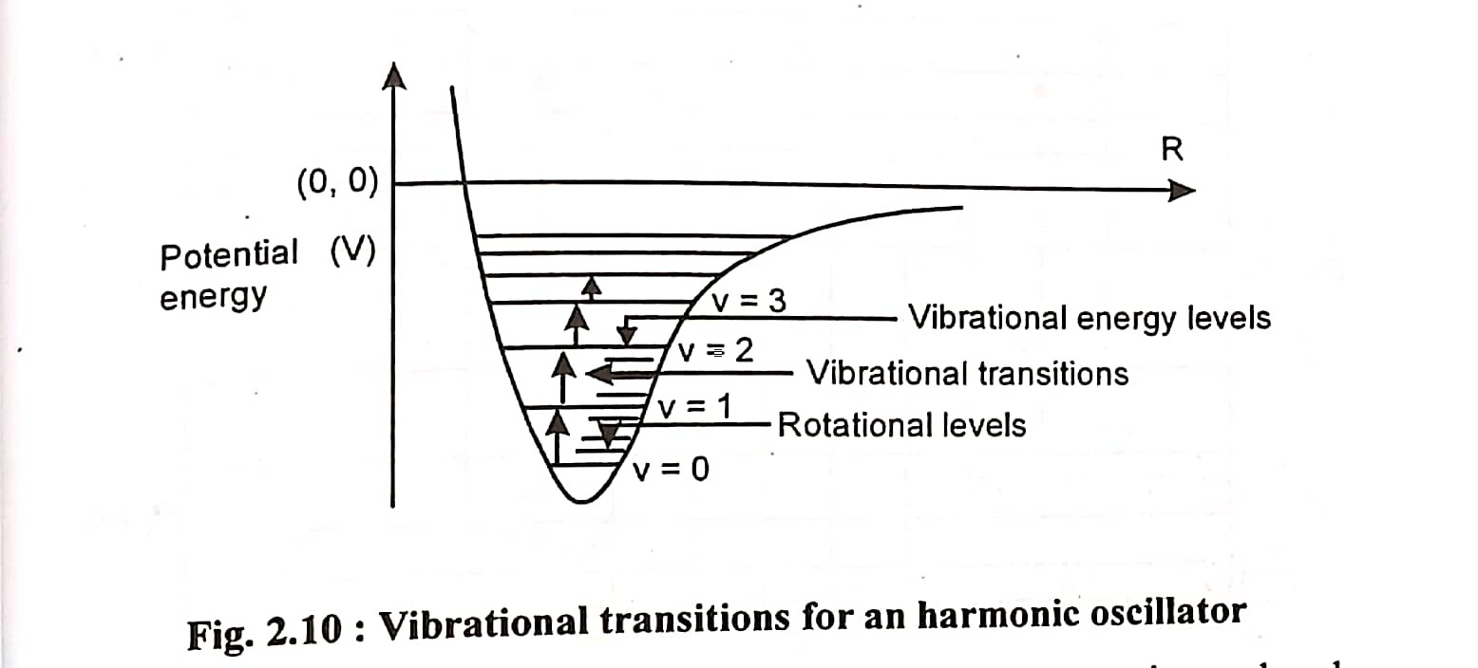
Vibrational spectra
Vibrational energy levels are equispaced .
E_{v} ∝(v+1/2)
Pure vibrational spectra are observed only in liquid.

Slide 8
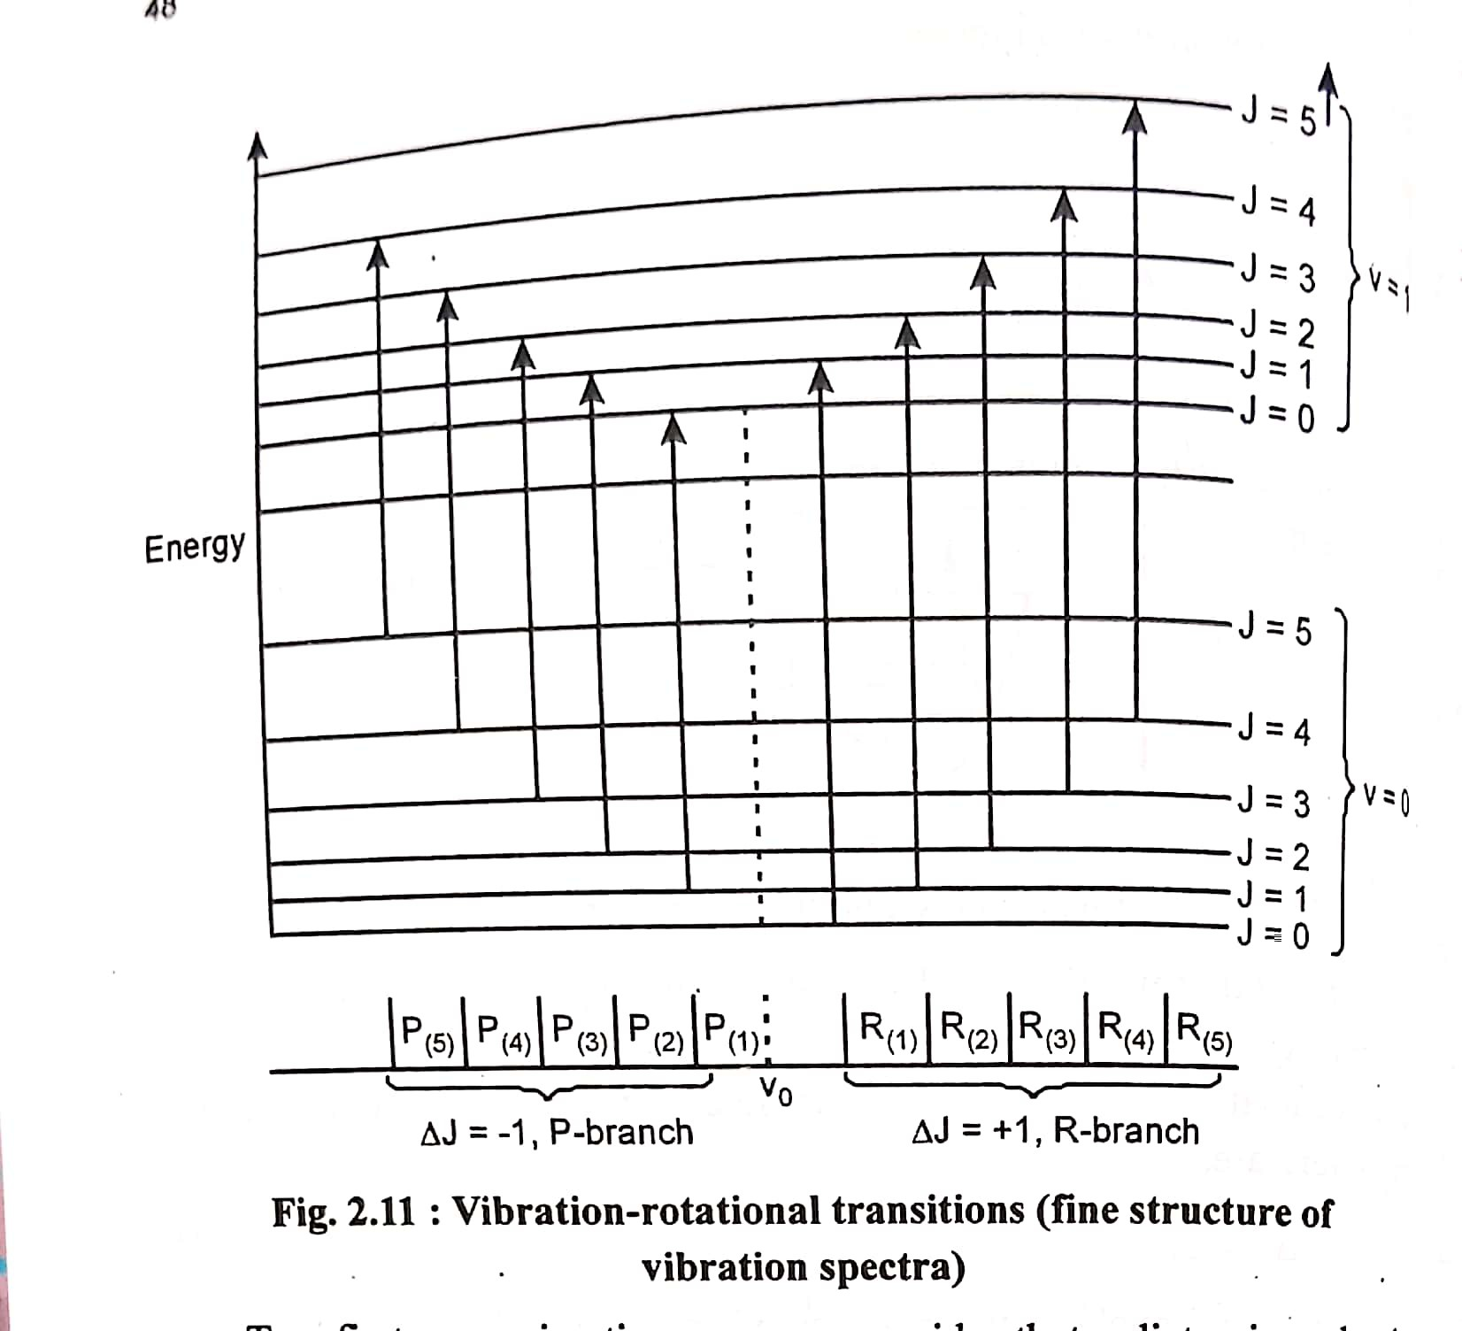
Vibration-Rotation spectra
The spectra obtained by a low resolving power spectrometer will appear as a broad band called vibration-rotation band.

Slide 9
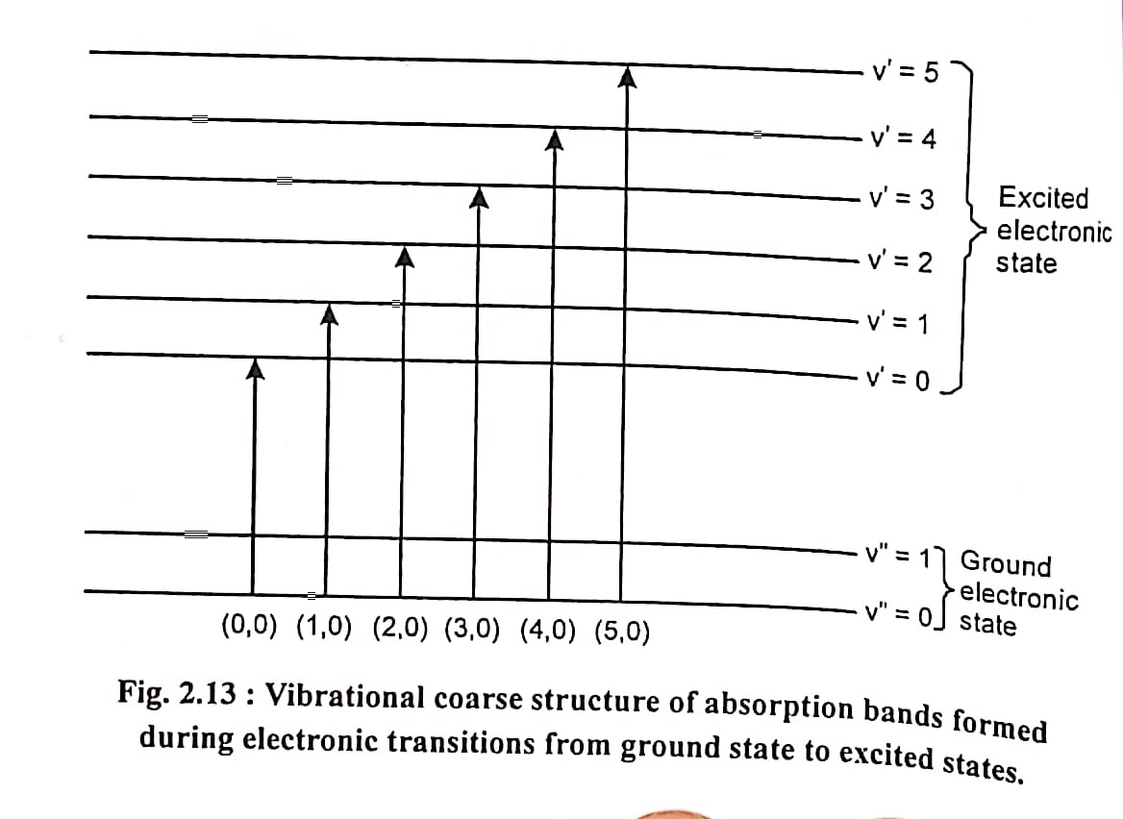
If a group of bands corresponds to same electronic transition,then they are called a system of bands.
(i)If △V=(V’-V”) is a constant,then a series of such band is called a sequence.
(ii)A set of bands corresponding to same v’ and different values of v” or same value of v” and different values of v’ is called a progression.

Slide 10
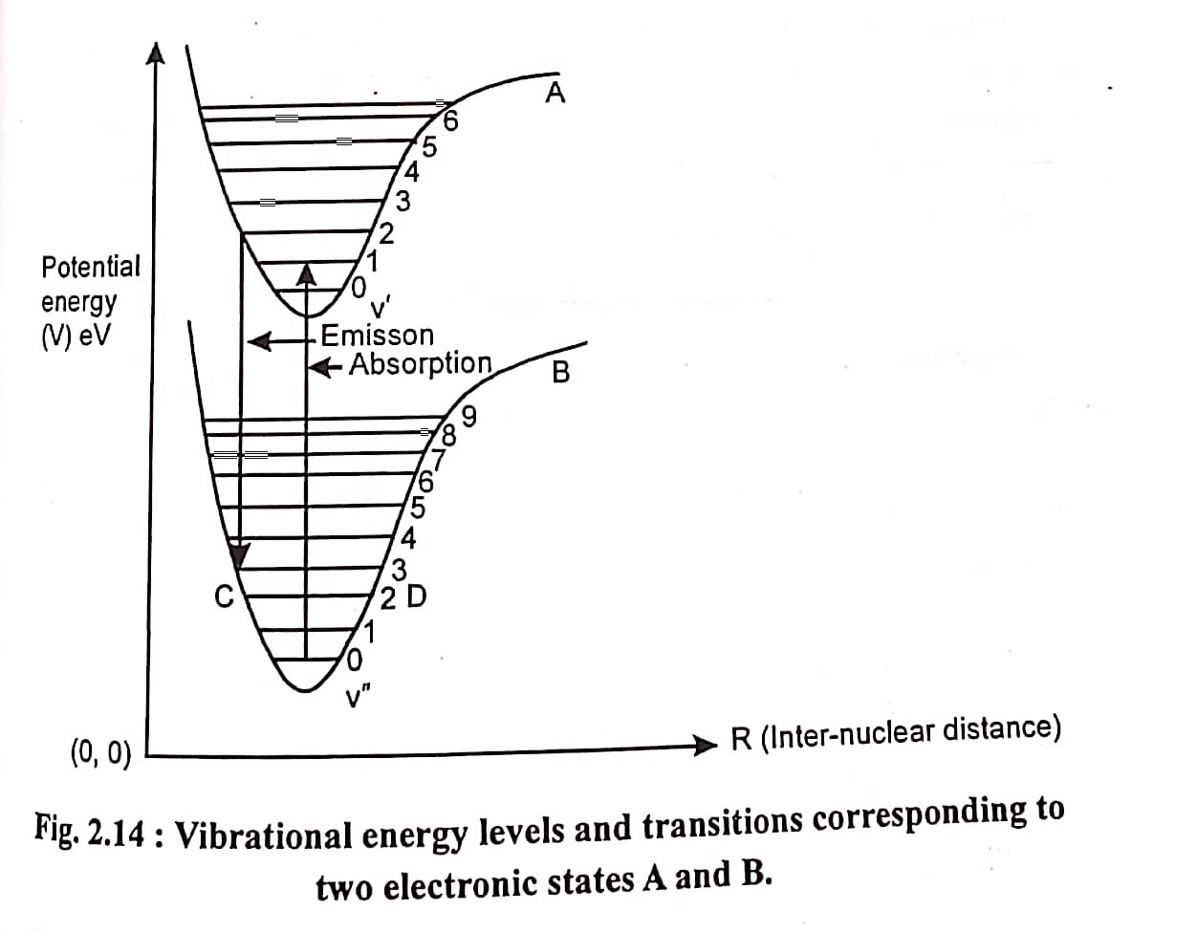
Frank-Condon principle and intensity of band spectra
(i)The transitions should be represented by vertical lines
(ii)The observed transitions should start from extreme positions of vibrational levels.

Slide 11
THANK YOU!

