Slide 1
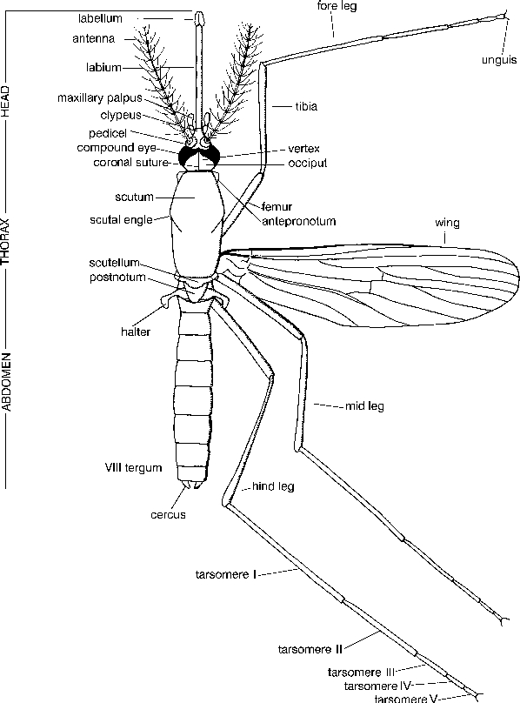
Vector: Phylum: Arthropoda
Class Insecta Head
Thorax
Abdomen

Slide 2
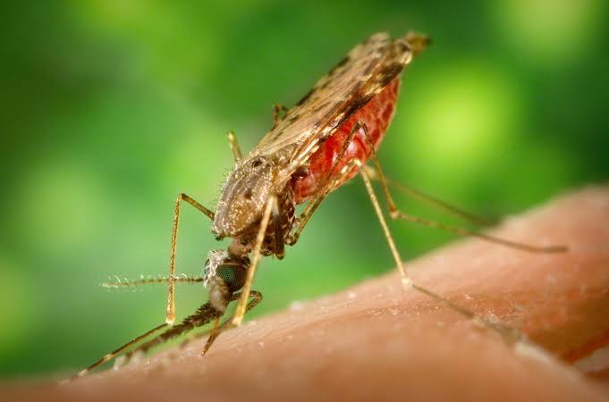
Anopleles. Mosquito

Slide 3
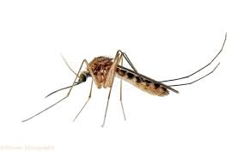
Culex

Slide 4
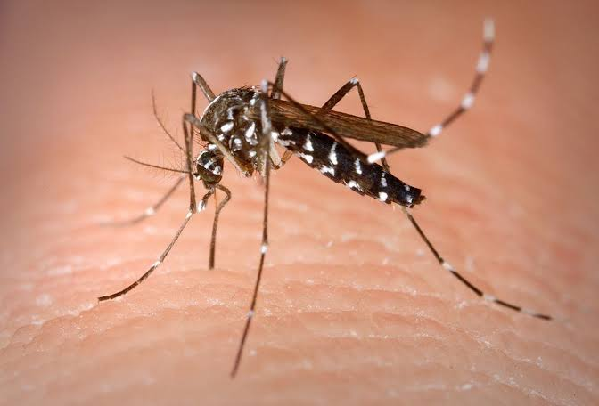
Aedes

Slide 5
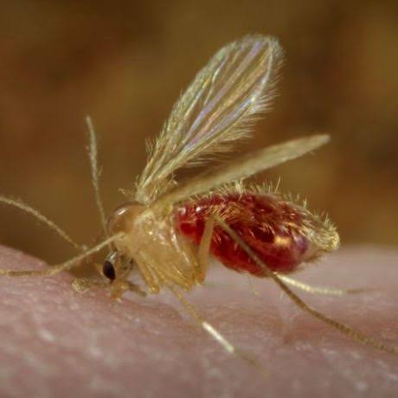
Sand fly

Slide 6
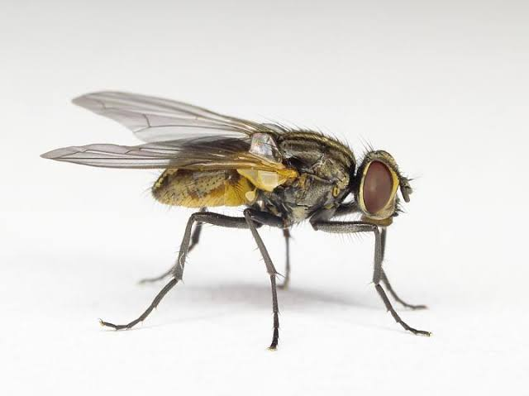
House fly

Slide 7
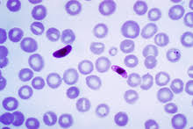
Plasmodium: malaria

Slide 8
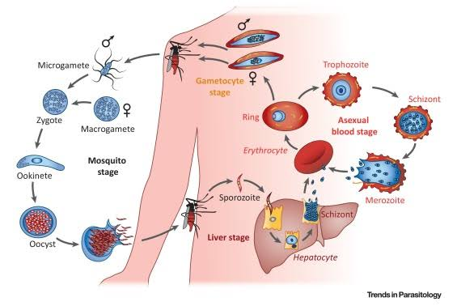
Malaria Life cycle

Slide 9
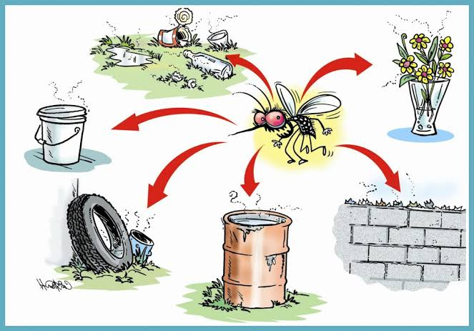
Prevention

Slide 10
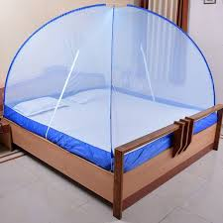

Slide 11
