Slide 1

Mughal Architecture
Presented By:
Dr. B.M. Birajdar,
Assist. Prof.in History,
Kisan Veer Mahavidyalaya, Wai.

Slide 2
Mughal Empire
An empire in the Indian subcontinent
1526-1540
1555-1857
Founded by Babar in 1526
Established and ruled by Muslim dynasty
Dynasty
  Ethnically Chaghatai Turco-Mongol Origin
  But Persianate in terms of culture
Religion
  Islam (1526–1857)
  Din-e Ilahi (1582–1605)

Slide 3
Mughal Empire
Empire
  Extended over large parts of the Indian subcontinent and Afghanistan
  Spanning 4 million square kilometers at its zenith
  Second largest empire after Maurya Empire
Language
  Chagatai Turkic (only initially)
  Persian (official and court language)
  Urdu (spoken)
Ended in 1857 with the start of British Raj in sub- continent

Slide 4

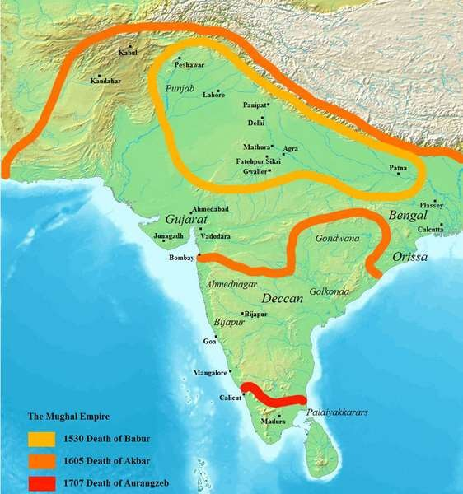
Mughal Empire at its greatest extent in, 1707

Slide 5
Mughal Emperors
Were Central Asian Turco-Mongols
Babar
  1526-1530
  The Founder of Mughal Empire
Humayun
  The successor of Babur
  1530-1540, 1555-1556
  Interruption by the Sur Empire (1540-1554)
Akbar the Great
  1556-1605
  ‘Classic Period’ of Mughal Empire

Slide 6
Mughal Emperors
Shah Jahan; The fifth emperor
  1628–1658
  The golden age of Mughal architecture
Aurangzeb
  1658-1707
  Empire reached the zenith of its territorial expanse
Bahadur Shah Zafar II
  1837-1857
  The last Ruler of Mughal Empire

Slide 7
Salient Features of Mughal Architecture
Building style from mid 16th – late 17th Century
Amalgam of Islamic, Persian, Turkic and Indian architecture
Revival of Islamic architecture in northern India
Costly decorations & Delicate Ornamentation of Buildings
Buildings had a uniform pattern of structure and character
  Large bulbous domes
  Slender minarets at the corners
  Massive halls
  Large vaulted gateways
Building Material
  Red Sandstone
  White Marble

Slide 8
Akbar The Great
Mughal Architecture begins with Akbar
Planned & constructed splendid edifices
During his reign, Mughal Architecture took new form
Construction of Buildings for civilian Purposes
Architecture
  Elegant and graceful by its rich decorative work
  Reflects many traditional Hindu elements
  Made free use of Hindu & Persian styles
  Use of red sandstone with white marble
  Painted designs on walls and ceilings
Agra Fort, Lahore Palace, Fatehpur Sikri, Buland Darwaza, Allabad Fort, Humayun’s Tomb

Slide 9

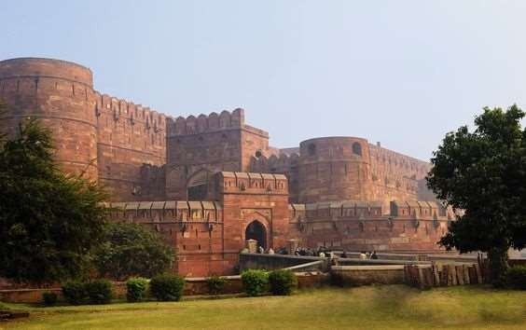
Fortress of Agra

Slide 10

Fortress Of Agra
Former imperial residence of the Mughal Dynasty located in Agra, India
Walled City; most accurate Description
Historical Importance
Layout:
  Area 380,000-square-metre (94-acre)
  A semi-circular plan, Parallel to the river
  Five hundred buildings in the beautiful designs of Bengal and
Gujarat were built in the fort
  Walls 70 feet high
  Double ramparts with massive circular bastions at intervals
  With battlements, embrasures, machicolations and string
courses
  Four gates provided on its four sides
Delhi Gate & Lahore Gate are the most notable gates

Slide 11

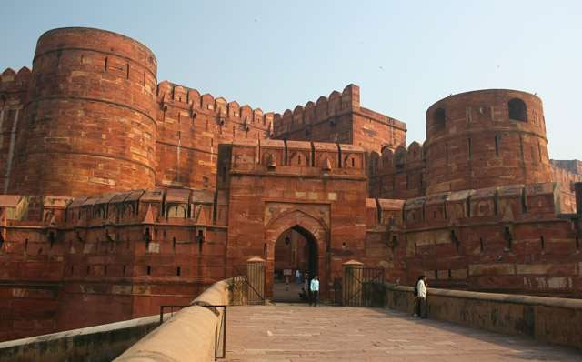
Amar Singh Gate

Slide 12

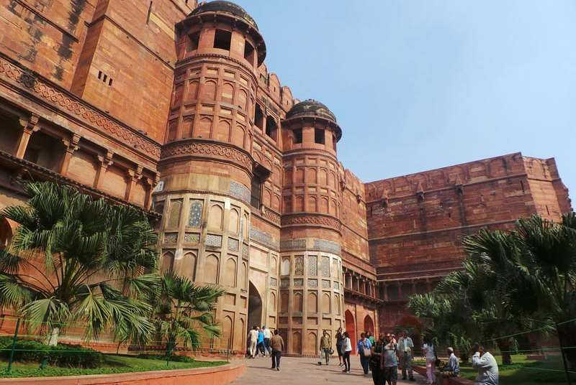
Delhi Gate

Slide 13

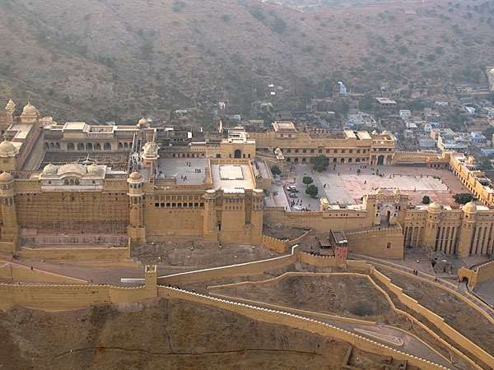
Aerial View Of Agra Fort

Slide 14
Sites & Structures In Agra Fort
Anguri Bagh
Diwan-i-Am & Diwan-i-Khas
Golden Pavilions
Jehangiri Mahal
Macchi Bhawan (Fish Enclosure)
Mina Masjid & Moti Masjid
Nagina Masjid
Naubat Khana (Drum House)
Rang Mahal
Shahi Burj
Shah Jahani Mahal
Sheesh Mahal (Glass Palace) or Shish Mahal

Slide 15
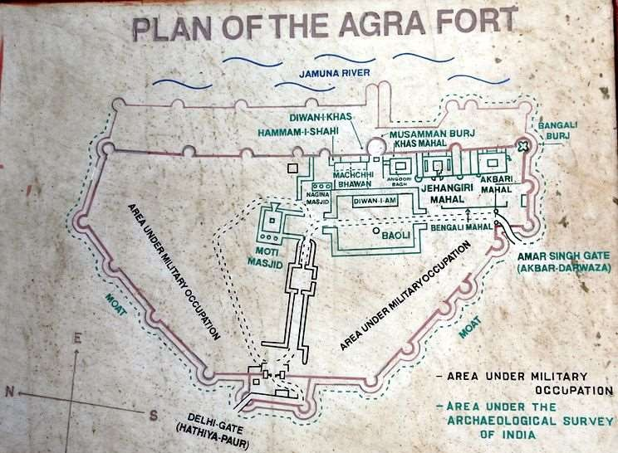

Slide 16
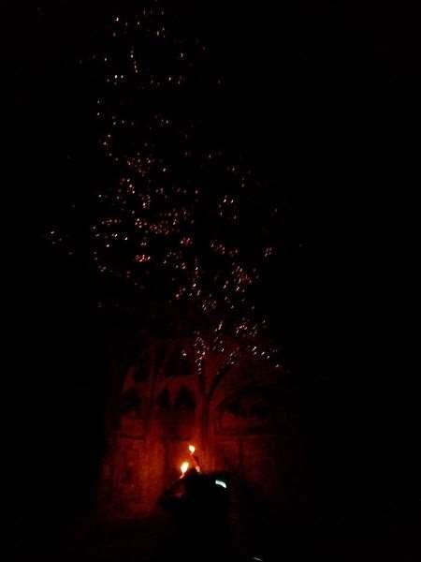
Effect of Lightning in Sheesh Mahal, Agra Fort

Slide 17
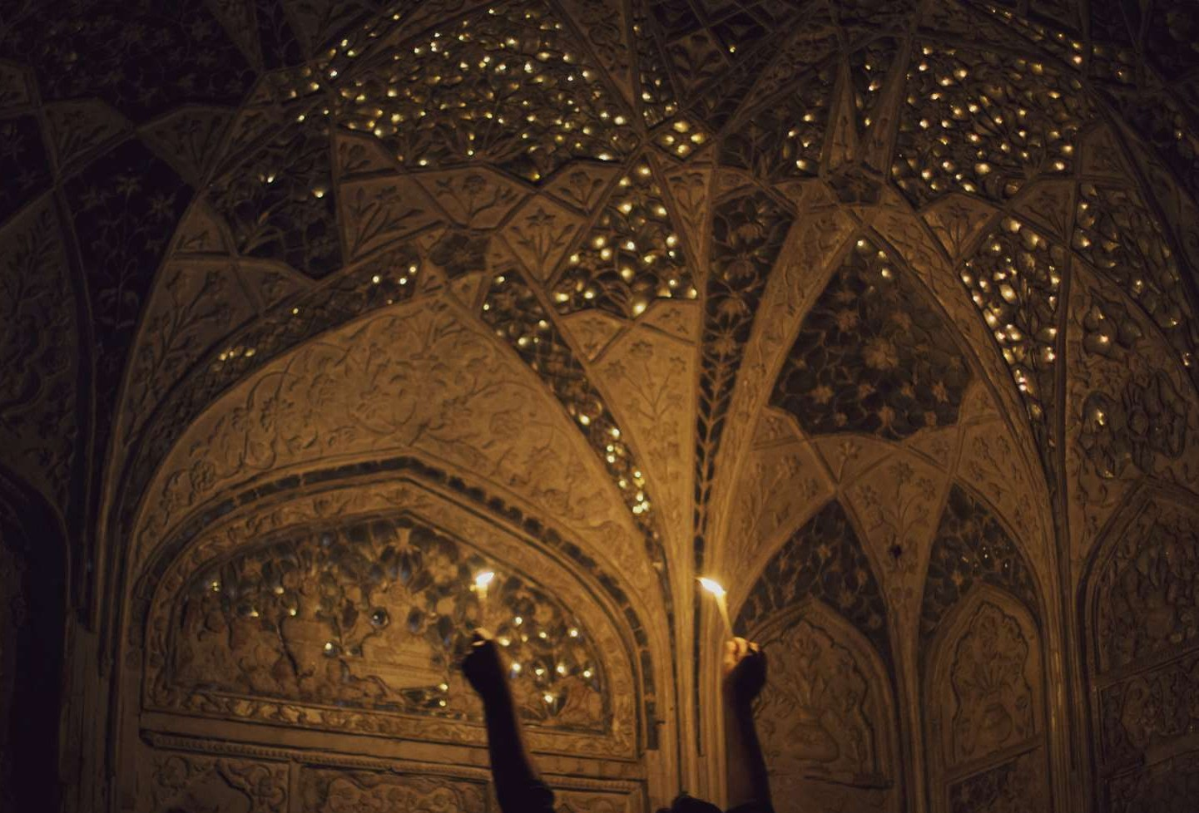

Slide 18
Shah Jahan
Built elegant monuments
Spacious elegance and well-balanced proportion of parts
Mostly made use of marble in place of red stone
Delicate elegance and refinement of detail, illustrated in the palaces erected during his reign at Agra, Delhi and Lahore
  Taj Mahal at Agra
  Jamia Masjid at Delhi
  The Moti Masjid in Lahore Fort
Built sections of the Sheesh Mahal, and Naulakha pavilion
Other Important Works;
  Shahjahan Mosque in Thatta
  Red Fort in Delhi
  Wazir Khan Mosque in Lahore

Slide 19

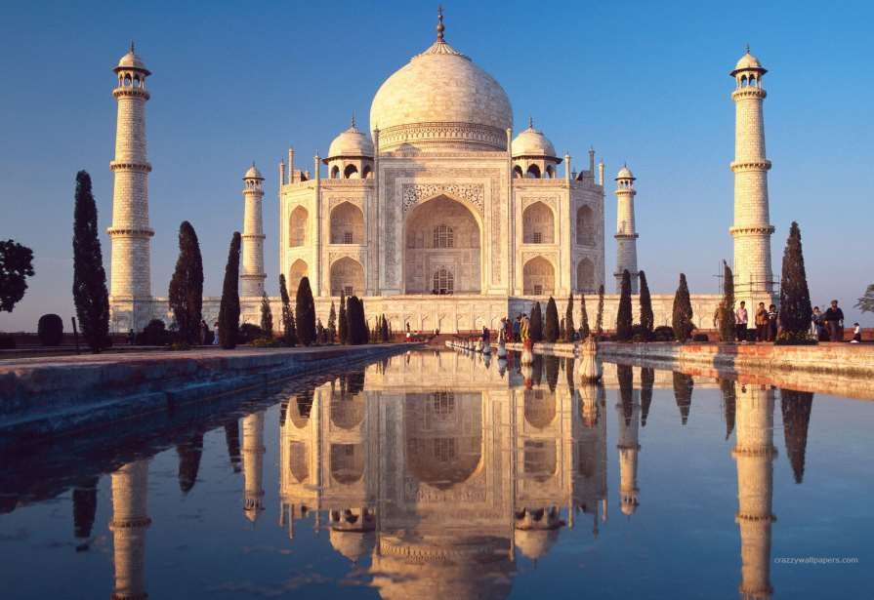
Taj Mahal

Slide 20

Taj Mahal: Crown of the Palace
Located on the south bank of the river Jumna in Agra, India
Built by the Mughal emperor Shah Jahan, to house the tomb of his favorite wife Mumtaz Mahal
Construction
  Began in 1632 AD
  Substantially complete by 1648 AD
An extensive complex of buildings and gardens that extends over 22.44 hectares (55.5 acres)

Slide 21

Estimated cost 52.8 Billion Rupees
Includes
  Subsidiary tombs
  Waterworks infrastructure
  The small town of 'Taj Ganji' to the south
  A 'moonlight garden' to the north of the river
Domed marble mausoleum complex
  An ivory-white marble mausoleum
  Most familiar part of the monument
  Complex has boundary wall on 3 sides
  Outside the boundary are other Tombs

Slide 22
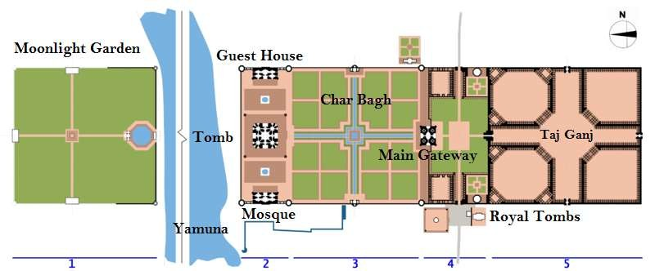
Taj Mahal Site Plan
The Taj Mahal complex; divided into 5 sections:
The 'moonlight garden' to the north of the river Yamuna.
The riverfront terrace, containing the Mausoleum, Mosque and Jawab.
The Charbagh garden containing pavilions.
The jilaukhana containing accommodation for the tomb attendants and two
subsidiary tombs.
The Taj Ganji, originally a bazaar and caravanserai only traces of which are still preserved. The great gate lies between the jilaukhana and the garden.
Levels gradually descend in steps from the Taj Ganji towards the river.

Slide 23
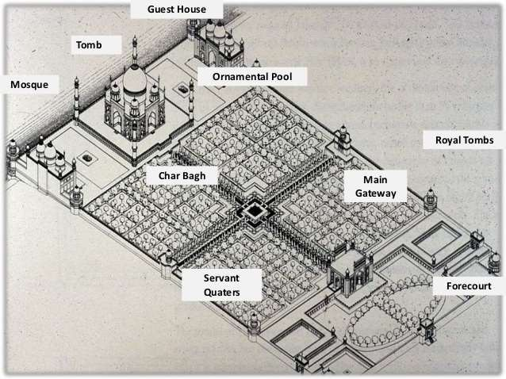

Slide 24

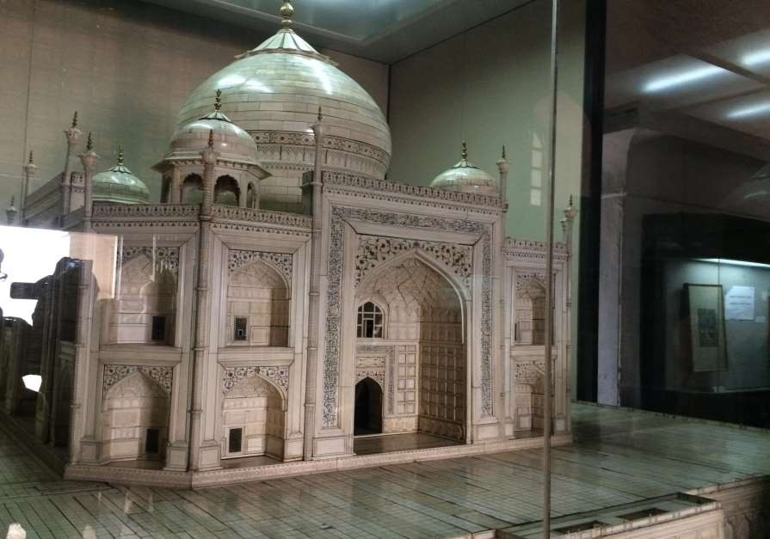
A model of Taj Mahal In the Gallery at Shahi Qila Lahore

Slide 25

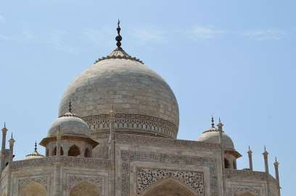


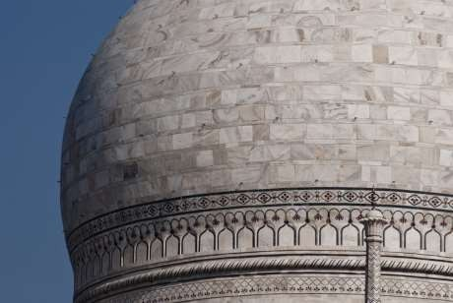
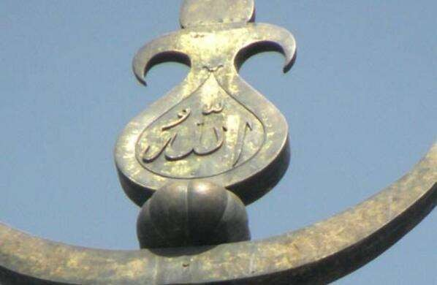
The Dome
Most remarkable part of the tomb
Enormous White Onion shaped dome crowning the tomb
Main dome is flanked by 4 smaller ones on its 4 corners
The Drum is intricately designed with superb inlay work
Islamic Inscription on the gold gilded
finial

Slide 26
Exterior Decorations
The finest in Mughal architecture
Islamic Architecture
  Calligraphy
Created in 1609
By calligrapher named Abdul Haq
Passages from the Qur'an throughout the complex
Composed of florid thuluth script made of jasper or black marble inlaid in white marble panels
Higher panels are written in slightly larger script
Islimi (Yellow marble & Jasper)
Carving
  On White Marble, using chisel and hammer
  Carvings leveled & Polished to Surface
On the lower walls of the tomb are white
marble dados sculpted with realistic bas relief depictions of flowers and vines

Slide 27

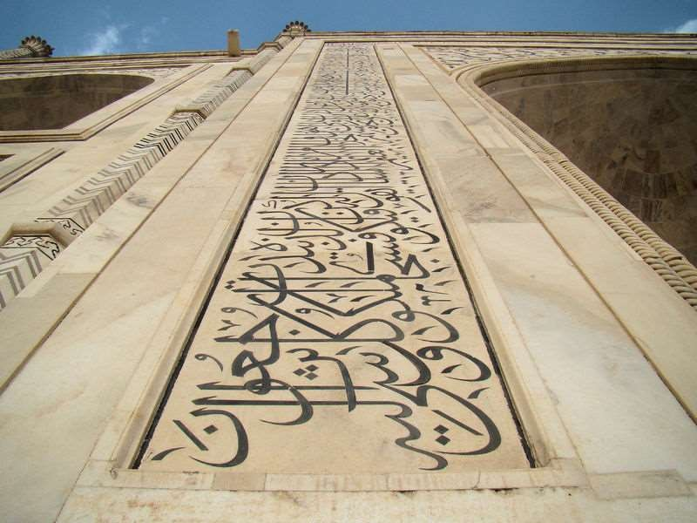
Calligraphy on Walls

Slide 28


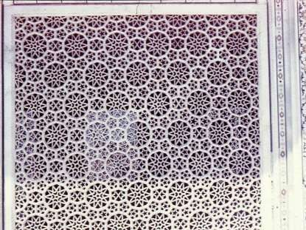
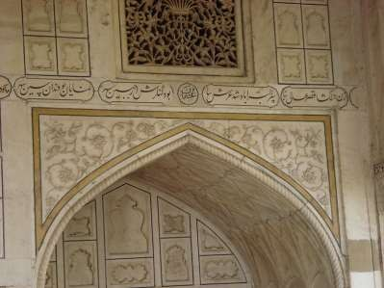


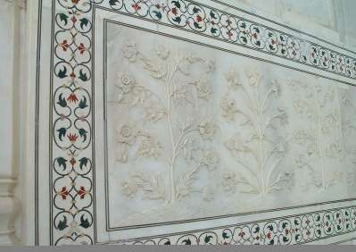
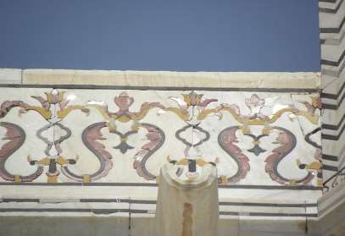
Marble Jail Lattice
Calligraphy of Persian Poems
Plant Motifs
Reflective Tiles

Slide 29
Interior Decorations
Traditional decorative elements
The inlay work is not pietra dura but a lapidary of precious and semiprecious gemstones
Octagon with entrance from each side
The four central upper arches form balconies with jali cut from marble
Efficient daylight
  from balconies
  Through roof openings covered by chattris at the corners
Sarcophagi of false grave of Mumtaz Mahal & Shah Jahan

Slide 30


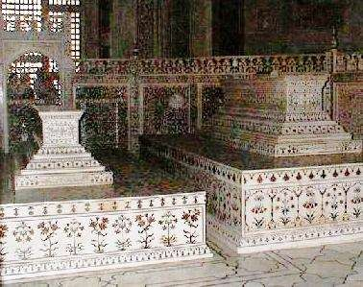
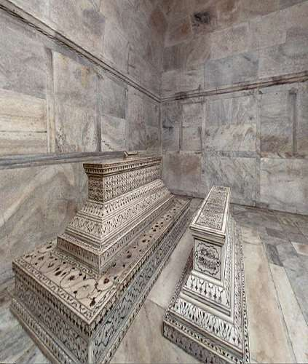
The main chamber houses the false sarcophagi of Mumtaz Mahal
and Shah Jahan; the actual graves are at a lower level
False Sarcophagi of Mumtaz Mahal & Shah Jahan In main Chamber
Actual Graves of Mumtaz Mahal & Shah Jahan in the Lower level

Slide 31


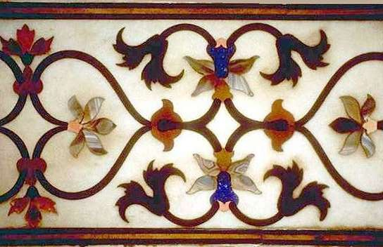
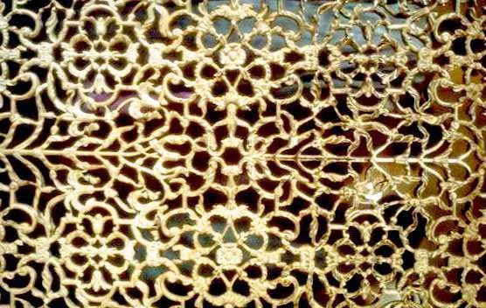


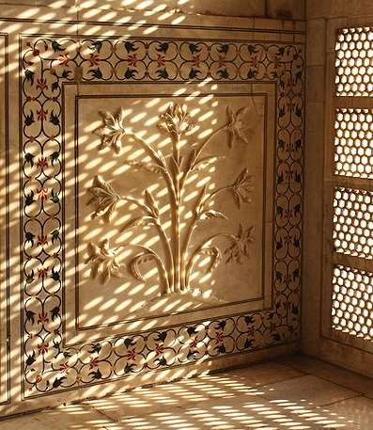
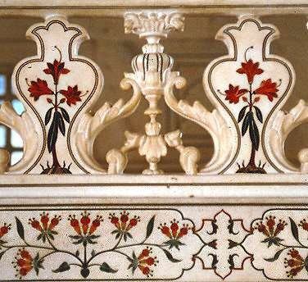
Delicacy of intricate pierce work
Details of Pietra Dura Jali inlay
Flowers Carved in Marble
Detail of Jali

Slide 32

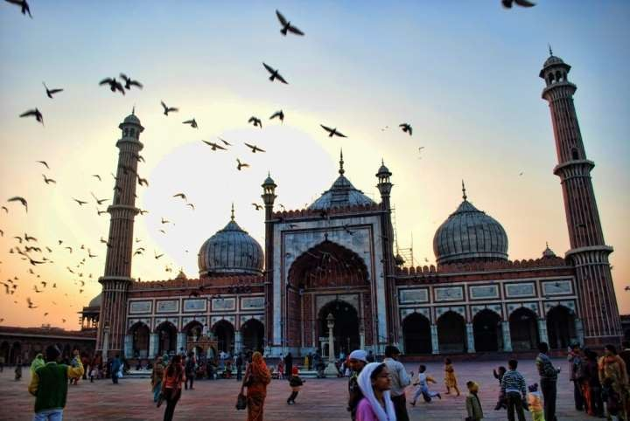
Jamia Masjid Delhi, India

Slide 33

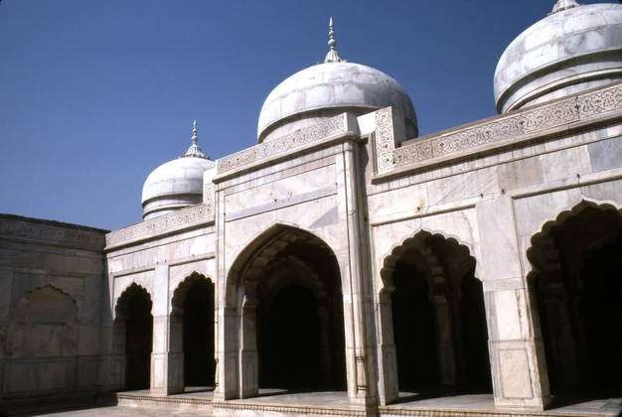
Moti Masjid, Lahore

Slide 34

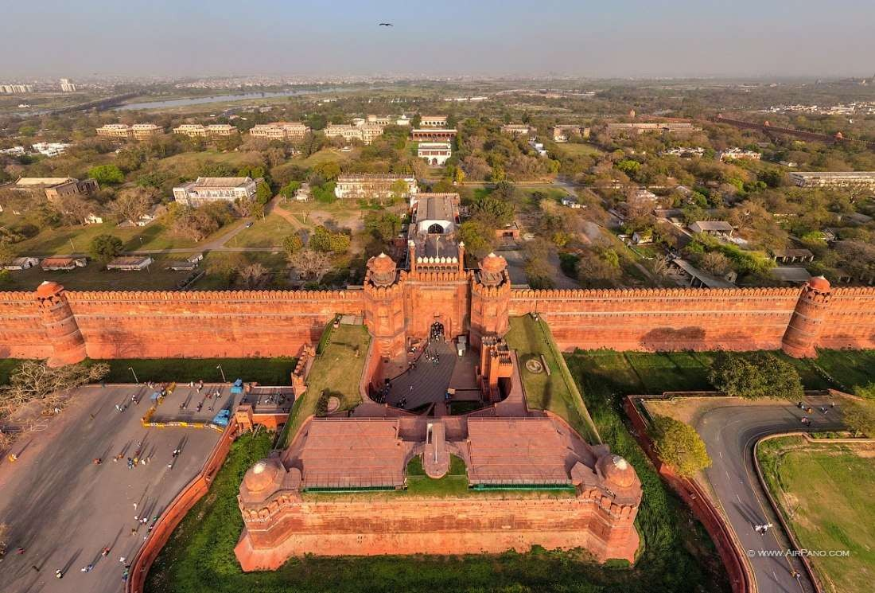
Red Fort New Delhi

Slide 35
Aurangzeb & Later Mughal Archi.
In Aurangzeb's reign (1658–1707) squared stone and marble was replaced by brick or rubble
with stucco ornament
He made additions to the Lahore Fort and also built Alamgir gate
Badshahi Mosque in Lahore, Pakistan
Zinat al-Masjid in Daryaganj built by Aurangzeb's second daughter Zinat-al-Nissa
Tomb of Roshanara Begum in Delhi, India
Bibi Ka Maqbra in Aurangabad, Mahrashtra
Lalbagh Fort in Dhaka, Bangladesh

Slide 36

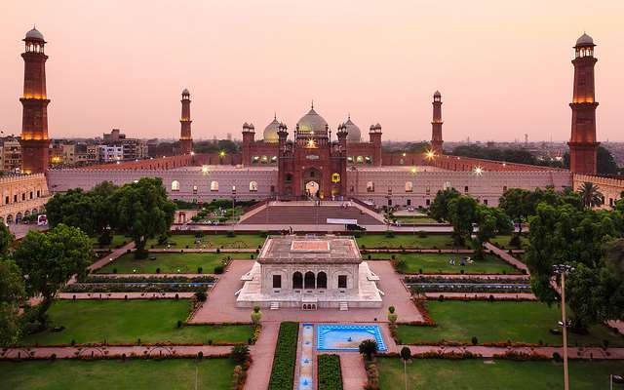
Badshahi Mosque in Lahore, Pakistan

Slide 37

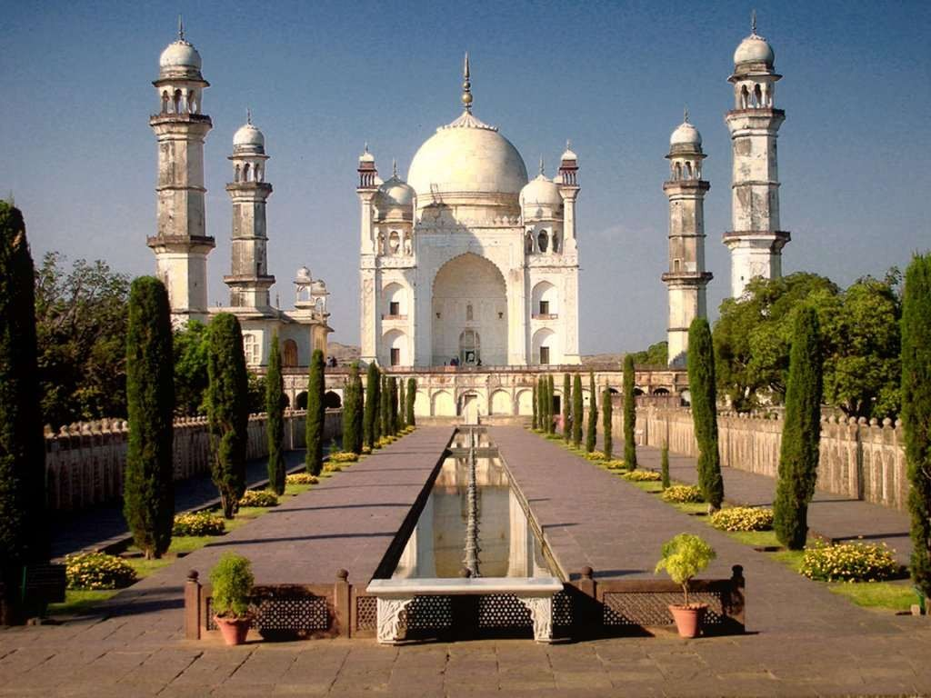
Bibi ka Maqbara, Aurangabad India

Slide 38
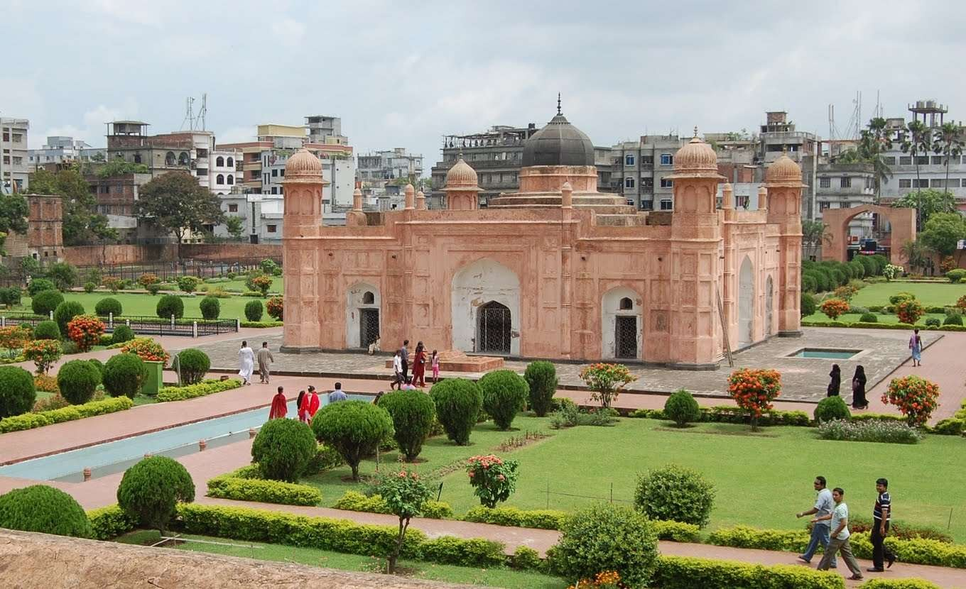
LalBaagh Fort in Dhaka, Bangladesh

Slide 39
Mughal Gardens
Built by Mughals
Islamic style of Architecture
Influenced by Persian Gardens & Timurid Gardens
Significant use of rectilinear layouts within the walled enclosures
Typical features include pools, fountains and canals inside the
gardens
Famous gardens
  The Char Bagh gardens at Taj Mahal
  Shalimar Gardens of Lahore, Delhi and Kashmir
  Pinjore Garden in Haryana

Slide 40
History
Babur introduced ‘Charbagh’ a Persian style garden layout as his Favorite type of Garden
The quadrilateral garden is divided by walkways or flowing water into four smaller parts
This word developed a new meaning in India as India lacked Fast Flowing streams required for the Central Asian Charbagh
The Agra Garden, now known as Ram Bagh is thought to be First Charbagh
India Pakistan and Bangladesh have number of gardens which differ from their central Asian Predecessors with respect to ‘the highly disciplined geometry’

Slide 41
Classification
Mughal Gardens are Generally divided in 4 Sections;
Rectangular Pearl Garden
Long butterfly Garden
Circular Garden
Terraced Garden

Slide 42

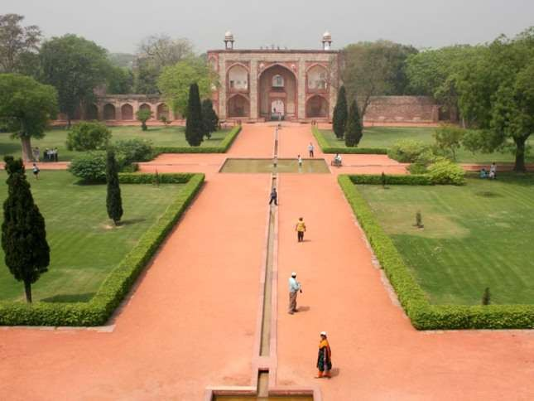
Mughal Garden at Humayun’s Tomb

Slide 43

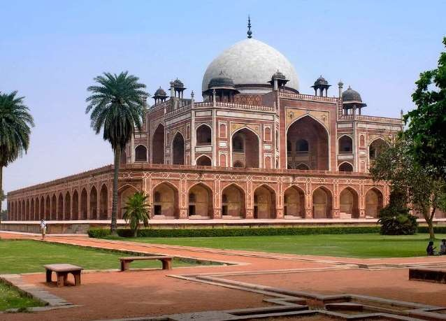

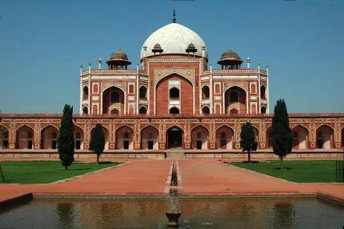
Meeting point of all the Channels
Fountain at the Central Axis

Slide 44

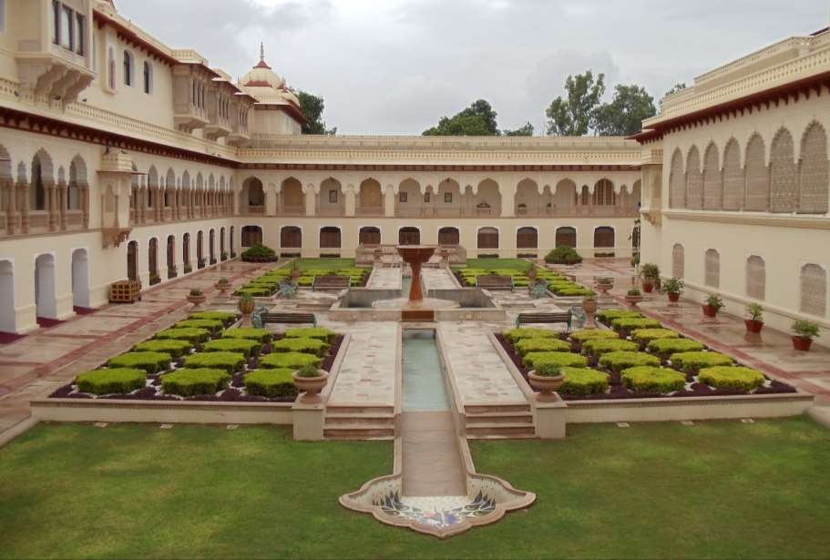
Ram Bagh in Agra, India (originally built by the Mughal Emperor Babur in 1528)

