Slide 1
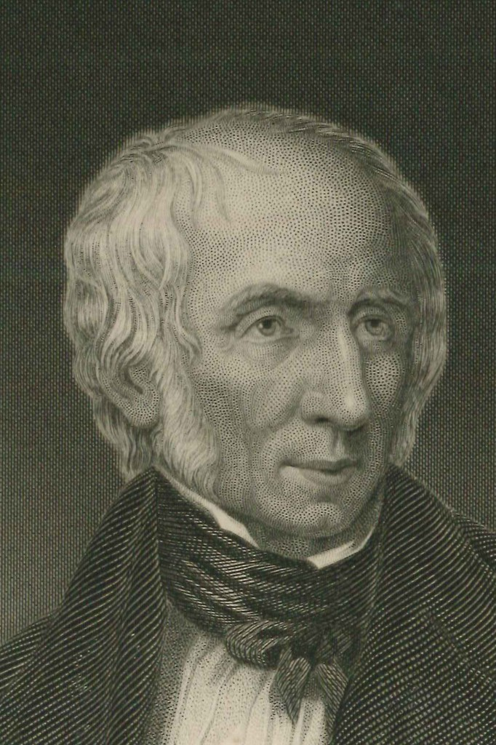
MY HEART LEAPS UP
William Wordsworth (1770-1850)
Mr: J.B.Khot
Assistant Professor
Kisan Veer Mahavidyalaya, Wai
Dist: Satara MAHARASHTRA

Slide 2
About the Poet
Wordsworth was born in the Lake District of northern England
With Samuel Taylor Coleridge, Wordsworth helped to launch the Romantic Age in English literature with their joint publication Lyrical Ballads (1798).
Wordsworth was Poet Laureate from 1843 until his death.
NOTABLE WORKS
“The Solitary Reaper”
“The Prelude”
“Lyrical Ballads”
“The World Is Too Much with Us”
“Ode: Intimations of Immortality”
“Michael”
“Peter Bell”
“Lines Composed a Few Miles Above Tintern Abbey”
“The Recluse”
“The Ruined Cottage”

Slide 3
About the Poem
“My Heart Leaps Up”is also known as “The Rainbow”.
It describes the joy that the poet feels when he sees a rainbow .
He concludes the poem by noting how his childhood has shaped his current views and stating that "the child is father of the man“
The last three lines from "My Heart Leaps Up" are used as an epigraph to "Intimations of Immortality".

Slide 4
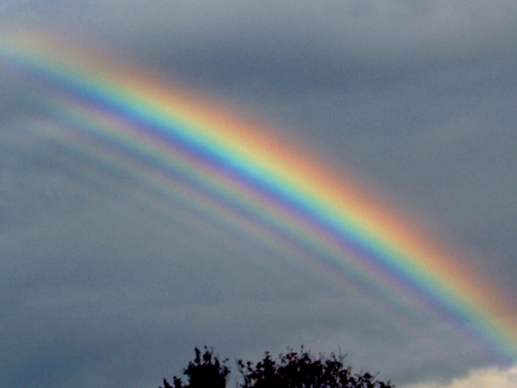
The Poem
My heart leaps up when I behold A rainbow in the sky: So was it when my life began; So is it now I am a man; So be it when I shall grow old, Or let me die! The Child is father of the Man; And I could wish my days to be Bound each to each by natural piety.

Slide 5
Thank
You

