Slide 1
Prof. Dr. Dnyandev. N. Zambare (M. Sc. Ph. D)
Department of chemistry
Kisan Veer Mahavidyalaya, Wai.
Dist- Satara pin- 412803
Mob. no.-9890891947

Slide 2
(B)Non-Aqueous Solvent
Contents …
Non-aqueous solvents 7L
Classification of solvents,
Characteristics of solvents,
Types of reactions in solvents,
Physical and chemical properties of the non-aqueous solvents such as (i) Liquid ammonia, (ii)Sulphur dioxide, (iii)Dinitrogen tetroxide, anhydrous sulphuric acid and molten salts.

Slide 3
Classification of solvents :
Table 1.3: Types of Solvents
Solvent Type | Protonic Characters | Examples
1. Protonic/protic (a) Acidic/ Protogenic | Tendency to release proton | HF, H₂SO₄, HCN CH₃COOH, C₆H₅OH
(b) Basic/ Protophilic | Tendency to accept proton. | NH₃, N₂H₄, amines.
2. Aprotic/ Non-protonic | Tendency neither to release proton nor to accept proton. | C₆H₆, CHCl₃, CCl₄, SO₂
3. Amphiprotic | Tendency either to release protons depending upon the nature of reacting species. | Water and lower alcohols.

Slide 4
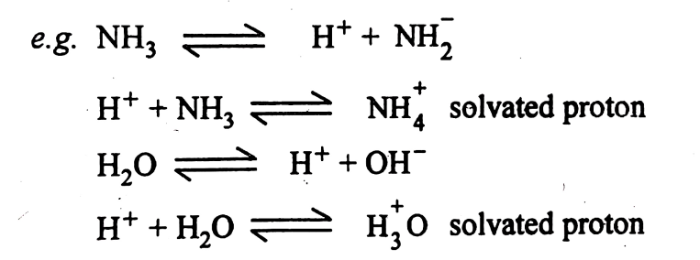
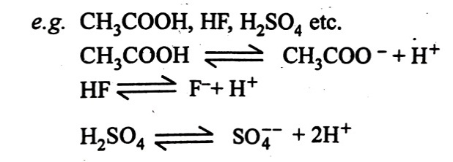
The solvents may be classified as :
(A). Protonic solvents and Aprotic solvents or Non-protonic
1.Protonic solvents :
These are the solvents which can donate or accept the protons. For example, H₂O, HCl, HF, H₂SO₄, CH₃COOH, HCN, etc. These are further classified in three types :
Further protonic solvents are classified as (i)Acidic solvents (ii)Basic solvents,, (iii) Amphiprotic or amphoteric solvents
(i)Acidic solvents . have tendency to donate the protons.

Slide 5
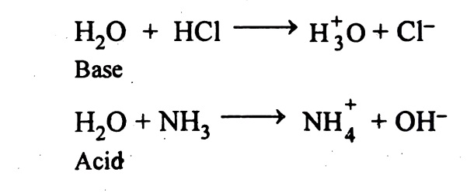
(ii)Basic solvents like liquid NH₃, liq .ethylene diamine C₆H₅NH₂ which have tendency to accept the protons are known as basic solvents.
NH₃ + H⁺ ----→ ${NH}_{4}^{+}$
(iii)Amphiprotic or amphoteric solvents which can either accept or donate the protons which depend on the nature of reaction. e.g. water, acetic acid etc.
2. Aprotic solvents or Non-protonic :
They do not ionize like protonic solvents. They do not have any tendency to accept or to loose the protons. For example, CCl₄, CH₃CN, C₆H₆, DMF (dimethyl formamide), DMSO (dimethyl sulphoxide) etc. There are three broad classes of these aprotic solvents.
(i) Non-polar or non-dissociated liquids: which do not solvate strongly. e.g. CCl₄ and hydrocarbons. They have low polarity and low dielectric constant, poor donor power, no self-ionising capacity. They do not take part in chemical reactions with solute.

Slide 6
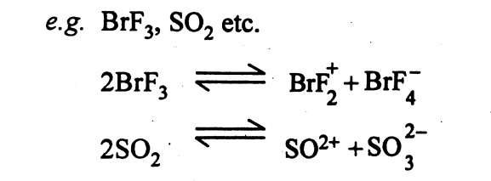
(ii) Non-ionized (non-dissociated) but strongly solvating solvents e.g. CH₃CN, DMF, DMSO and SO₂. They are mainly aprotic and have no self-ionizing capacity, but have tendency to solvate the ions. Some of these solvents like DMSO have high dielectric constants and some have low dielectric constants. These solvents solvate cations best by using negatively charged oxygen atoms.
(iii) Highly polar, autoionizing solvents : They have high dielectric constants and dipole moment val­ues. These solvents are highly reactive. They are extremely sensitive to the moisture. These solvents can undergo autoionization. e.g. H₂O, BrF₃, IF₅ etc
(B) Ionising and non- Ionising solvent :
This classification is based on the polar and non-polar nature of the solvents.
1. Ionising solvents: They undergo autoionisation and bring about ionisation of the solutes. Thease are polar in nature and have high dipole moment and dielectric constant. They are good solvents for ionic solutes.e.g.Water, liquid hydrogen fluoride, NH₃ etc.
2. Non-ionising solvents: They undergo autoionisation and do not bring about ionisation solute. Thease are non-polar and have low dipole moment. They are suitable for covalent compounds.

Slide 7
Characteristics properties of solvents :
Some characteristics of physical and chemical properties of solvents which are given below:
1.Melting point and boiling point:
The melting point and boiling point of solvents indicate the range of temperature over which it can exist in the liquid state under atmospheric pressure. The melting and boiling point of various solvents along with their critical temperature and critical pressure are given in Table 1.
because of the above values file exist as liquid at ordinary temperature and pressure, ammonia, sulphur dioxide and dinitrogen tetroxide exist as gases under these conditions. This gaseous therefore acts as solvent only at low temperature.

Slide 8
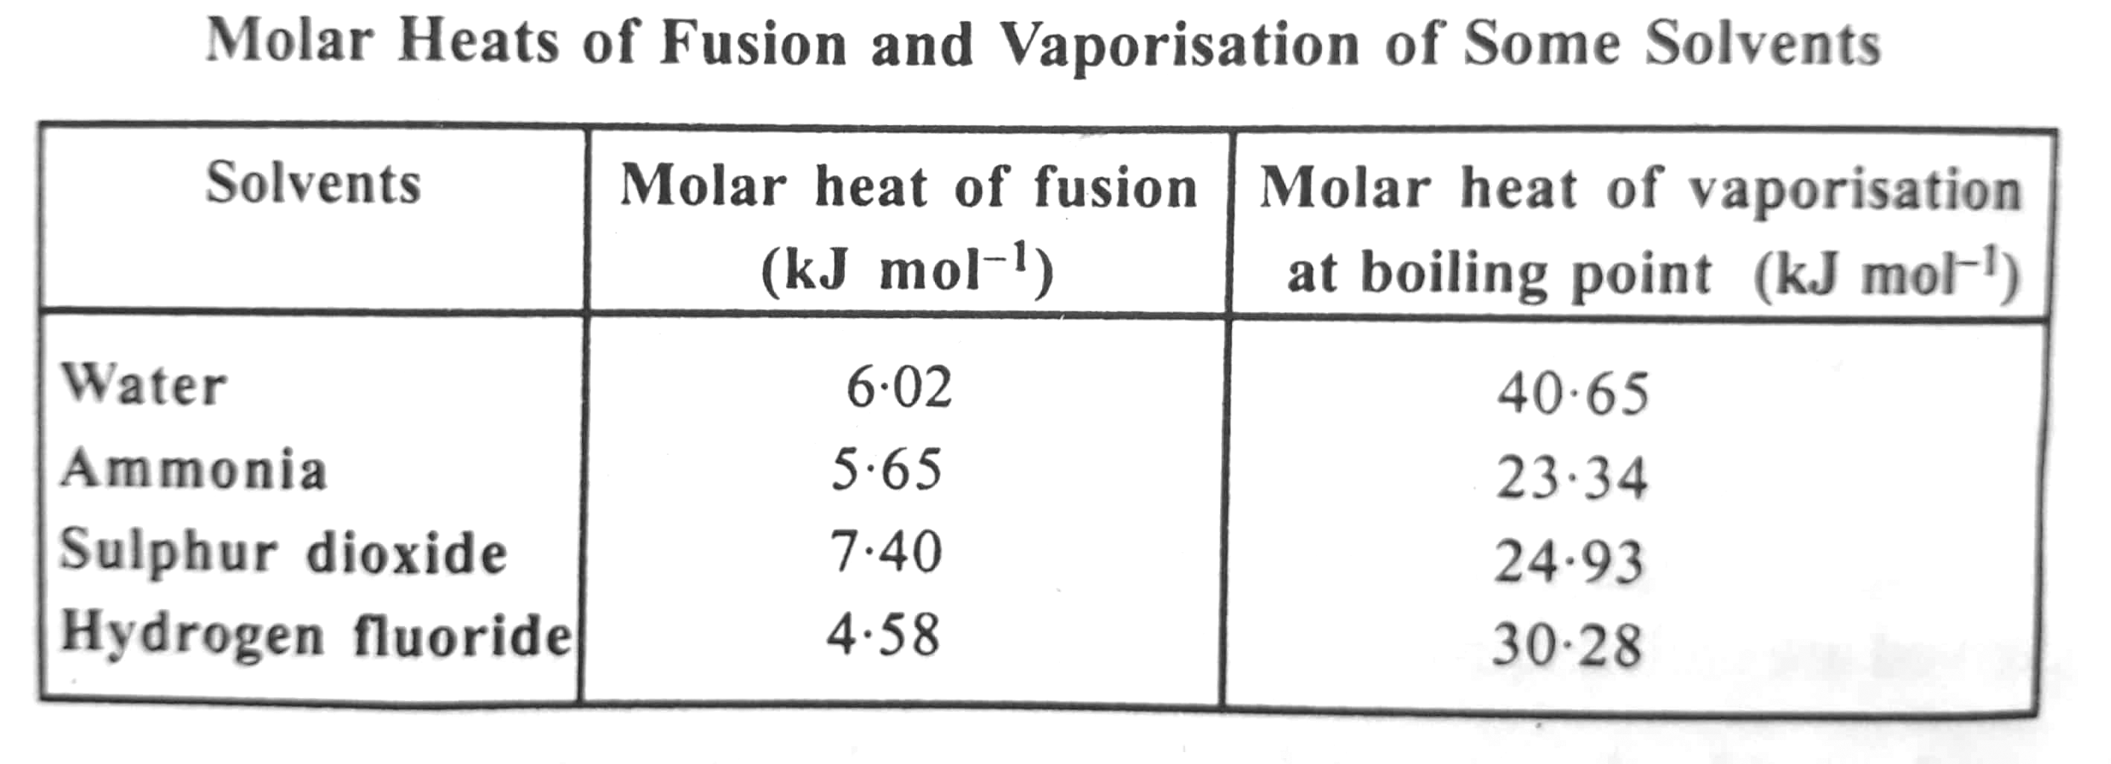
2. Heat of fusion and vaporization:
The heat absorbed by one mole of substance to change from solid to liquid state is called its molar heat of fusion. Likewise, the heat absorbed by one mole of substance to change from liquid to Vapour state is called its molar heat of vaporization. These constants for water, ammonia, Sulphur dioxide and hydrogen fluoride are given in table 2.
It is evident from table.2 that heat of fusion for water and ammonia are very nearly the same. This indicates that the forces which hold molecules together in water and ammonia are of the same magnitude. The heat of fusion of Sulphur dioxide is comparatively high while that of hydrogen fluoride is comparatively is comparatively low indicating that while the force holding SO₂ molecules together is stronger, the force holding HF molecules is weaker.

Slide 9
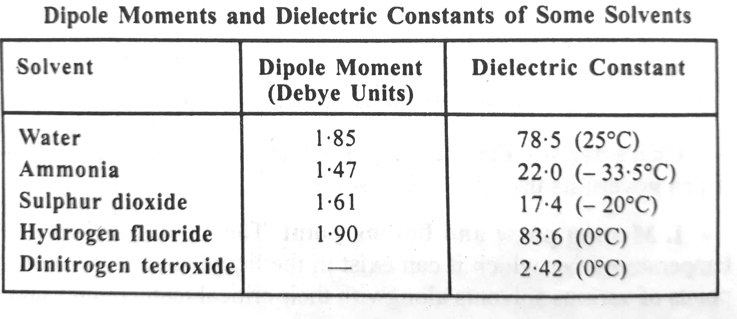
3. Dielectric constant:
The ability of a solvent to dissolve solute depends mainly on its dielectric constant. Dielectric constant can be defined as the capacity of a solvent to weaken the force of attraction between the electrical charges of cations and anions suspended in that solvent. According to Coulomb's law, the force of attraction between two charged bodies is given by the expression,
F =$\frac{q^{+ } q^{−}}{4πer^{2}}$
where, q⁺ and q⁻ =Charges on two species
r= Distance between centres of the charged species
e = Constant known as dielectric constant.
Thus, dielectric constant in general determines the ability of solvent to dissolve ionic compounds. For example solvents such as anhydrous hydrogen fluoride which have high dielectric constant are the best solvents for ionic and polar compounds. On the other hand solvents like liquid Ammonia and liquid sulphur dioxide with low dielectric constants show decreased ability to dissolve ionic compounds is especially those containing multi-charged ions. Thus carbonates, sulphates and phosphates are practically insoluble in liquid ammonia and liquid sulphur dioxide.

Slide 10
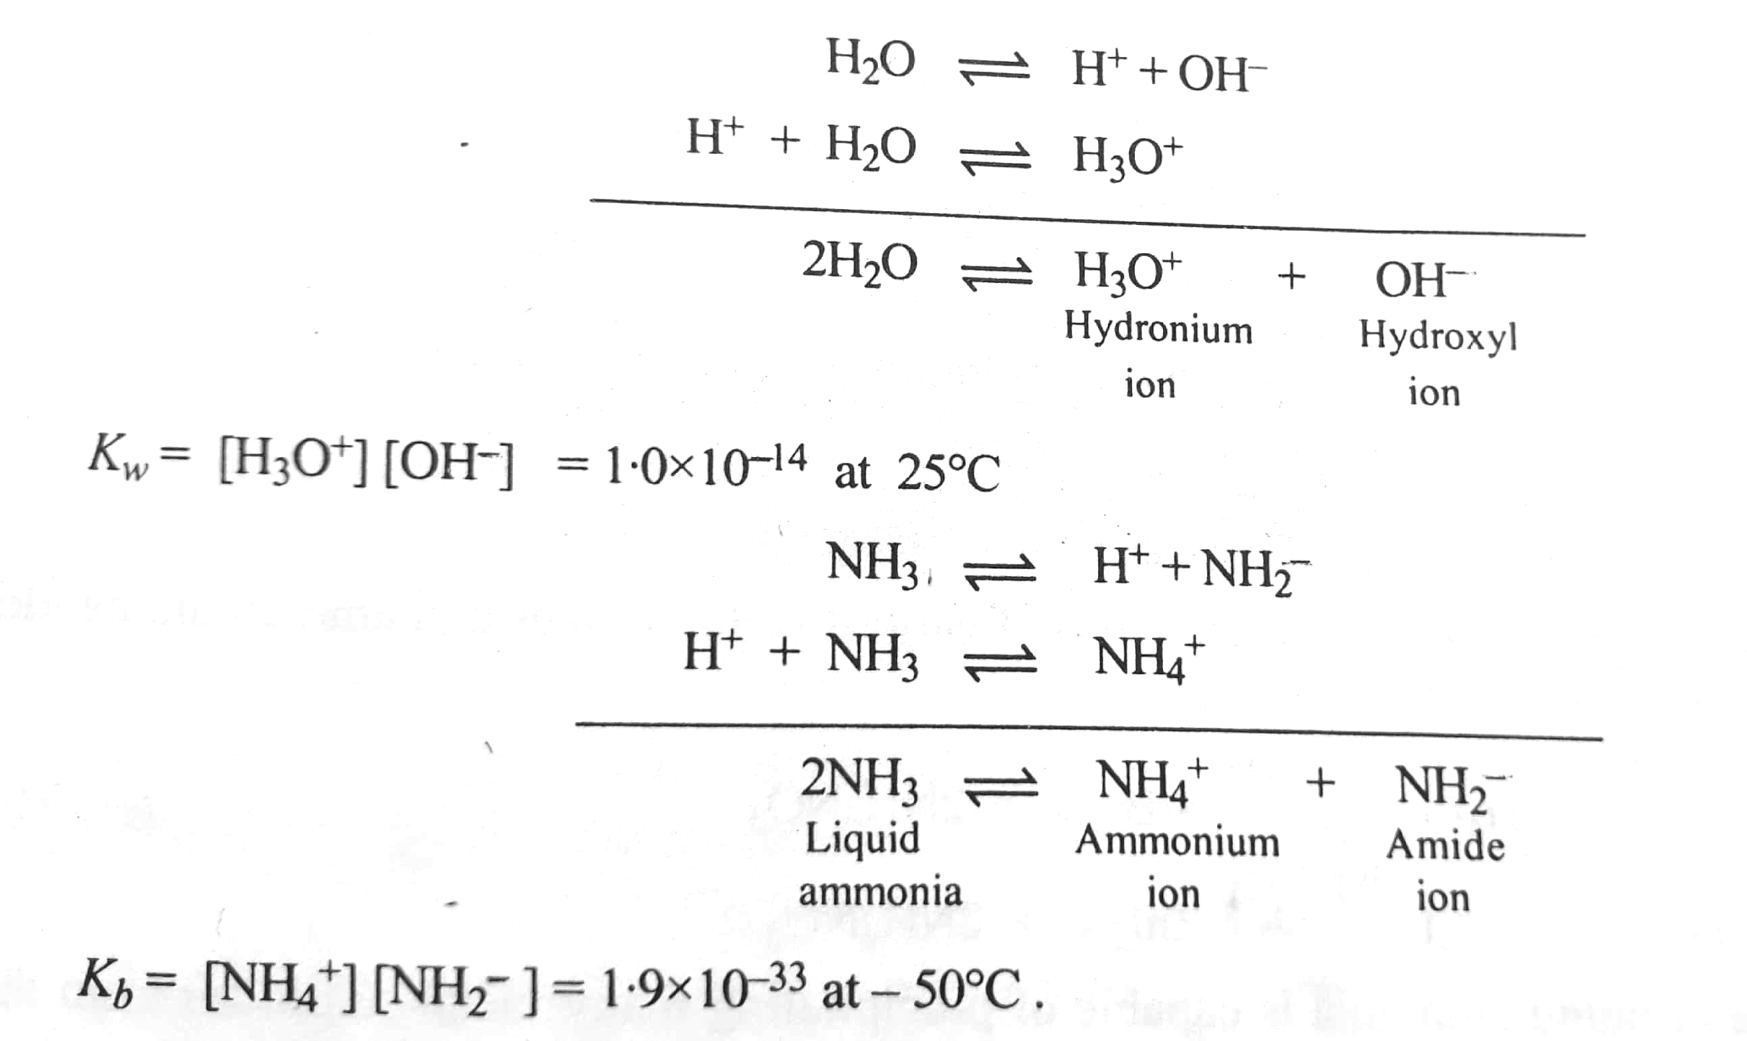
Some important non aqueous solvents are described below:
Liquid ammonia
Liquid ammonia is one of the most extensively studied non aqueous solvents. It is a protonic solvent and its water like properties have made it is highly useful solvent The freezing and boiling points of liquid ammonia are lower than those of water. Another similarity with water is the polarity of the ammonia molecule. It has a pyramidal structure which makes it polar. A third similarity is autoionisation of liquid ammonia. similar to the autoionization of water. Both liquid ammonia and water show comparable autoionization, represented as below:
However the extent of autoionization of liquid ammonia is much less than that of water ( compare the values of K_{W} and K_{B})

Slide 11
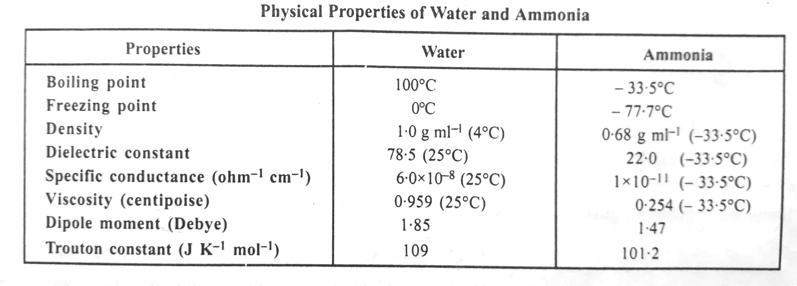
The physical properties of water and liquid ammonia are given in Table 4

Slide 12
Chemical reactions in liquid ammonia:
As mentioned above, liquid Ammonia has water like properties and hence the reactions which takes place in liquid ammonia are of the following types
1. Precipitation reaction:
The precipitation reactions normally involve double decomposition. The solubility of various substances in liquid Ammonia and water are different and hence many reactions which are normally possible in water have been reported to occur liquid ammonia. Some of these reactions are discussed below

Slide 13
b. Iodides and bromides get precipitated when solutions of various metal nitrates and ammonium halides in liquid ammonia are mixed together
2. Acid base reactions in liquid ammonia
There is an interesting comparison between neutralization reaction in aqueous solution and in liquid ammonia solution. Hydrochloric acid gas dissolves in liquid ammonia giving NH₄⁺ ions Cl⁻ ions.

Slide 14
In aqueous solution the process of neutralization of strong acid by strong base involves the combination of H₃O⁺ and OH⁻ ions to form practically un-ionized H₂O the anion of the acid and the cations of the base remaining unchanged. For instance, the neutralization of hydrochloric acid with potassium hydroxide may be represented as,
Similar thing Happens in the case of liquid ammonia solution. The process of neutralisation involves combination of NH₄⁺ and NH₂⁻ ions to from un-ionized NH₃ for instance ,the neutralization of ammonium Chloride with potassium amide may be represented as,

Slide 15
Thus NH₄Cl may be regarded as strong acid and KNH₂ as strong base in liquid ammonia solution. They are termed as ammono acid and ammono bases, respectively. Some typical reactions of ammono acids and bases are given below.
a. Reactions of amino acids
Ammino acids is a substance which in liquid ammonia furnishes NH₄⁺ ion the following reactions show their behaviour to be similar to that of aqua acid
1.Neutralization: This has already been discussed above
2.Replacement of Proyon by reactive metals. Acids give out hydrogen with metals in aqueous solutions. likewise the solutions of ammonium salts in liquid ammonia react with alkali and other metals to give hydrogen.
Ammonium salt decolourises blue solutions of alkali metals in liquid ammonia.

Slide 16
3.Protolysis:
Certain compounds like urea, acetamide, sulphamide, etc., which are incapable of donating protons to water, can readily undergo protolysis in liquid ammonia, i.e., they can donate protons to NH₃ in liquid ammonia. Hence organic amides acts as acids in liquid ammonia. as illustrated by the following reactions:
However, it acts as monobasic acid in aqueous solution. This is because NH₂ group cannot donate a Proton to water.

Slide 17
b.Reactions of ammono bases :
Ammono basis is a substance which in liquid ammonia uses furnishes NH₂ ion. Consequently, amides (-NH₂), imides =NH and nitrides (≡N) behave as bases in liquid ammonia, as shown below:
Since in all the above reactions, the NH₂⁻ is released, the amide, imide and nitride all behave as ammono basis.
Several species that are considered as strong bases in water, behave as weak bases in liquid ammonia. Extremely strong bases such as H⁻ and O²⁻ are lavelled to NH₂⁻ ion in liquid ammonia.
Since alkaline earth amides and lithium and sodium amides have very low solubility, potassium amide KNH₂ which is much more soluble, is usually employed as an ammono base. Thus, salts of metals in liquid ammonia are precipitated as amides,imides and nitrides by the addition of a solution of KNH₂

Slide 18
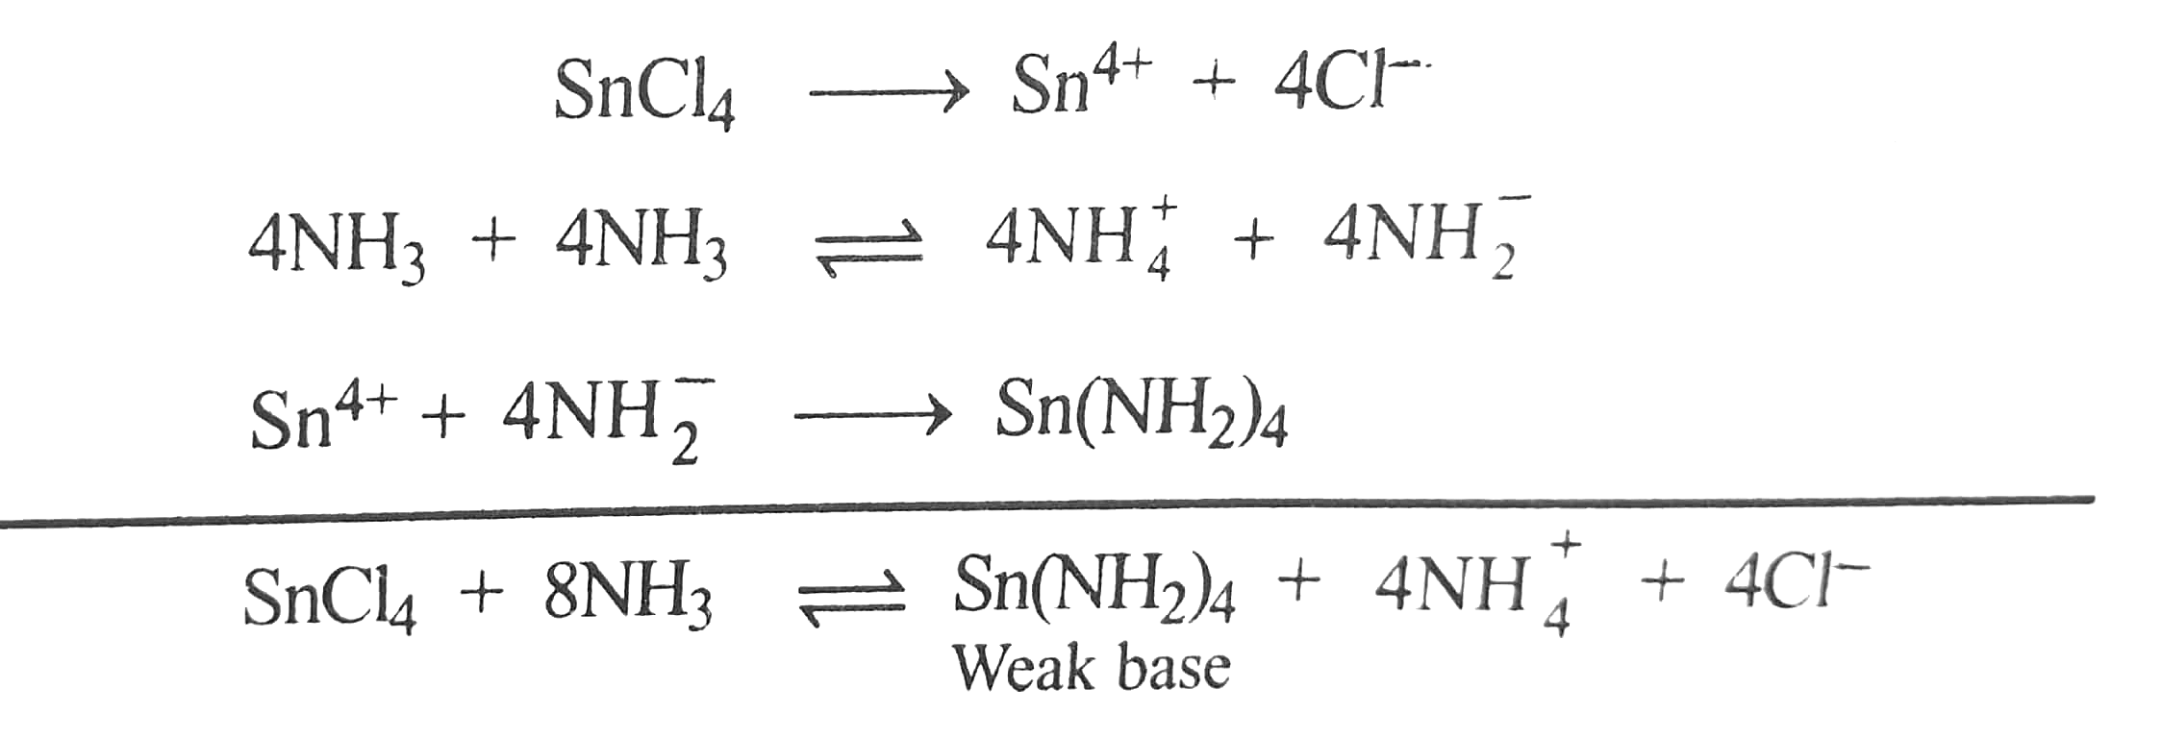
3. Amphoterisim
A compound that dissolves both in acid and bases is said to be amphoteric in character. In aqueous medium, zinc and Aluminium Hydroxide amphoteric. In liquid ammonia, zinc amide shows amphoteric behavior. This is illustrated by the following reaction:
4. Ammonolysis:
Ammonolysis in liquid ammonia is similar to hydrolysis in aqueous medium. Just as in hydrolysis the concentration of H⁺ OR OH⁻ ions increases due to interaction of cations or anions of a salt with H⁺ or OH⁻ ions furnished by autoionization of H₂O, in ammonolysis, the concentration of NH₄⁺ or NH₂⁻ ions increases due to interaction of cation or anion of the salt with NH₄⁺ or NH₂⁻ furnished by autoionisation of NH₃. Consider the hydrolysis of CUSO₄ and ammonolysis of SnCl₄

Slide 19
In ammonolysis, the atom or ion from the compound undergoing ammonolysis is replaced by amides (-NH₂), imides =NH and nitrides (≡N) group. For example, in excess of liquid ammonia, the ammonolysis of TiCl₄ takes place in steps as follow:
In the case of organic halides which undergo slow ammonolysis at the boiling point of liquid ammonia. Mixture of Primary, secondary and tertiary amines as are formed.
5. Ammonation and formation of ammoniates:
Ammonation is a type of solvation reaction in which liquid ammonia is used as a solvent and in which one or more ammonia molecules are attached to a solute species (a cation an anion or neutral molecule) by chemical bond. The products of solvation are called solvats and in the case of ammonation they are known as ammoniates. Solvation in water is called hydration and the products are known as hydrates.
Formation of typical ammoniates is shown below:

Slide 20
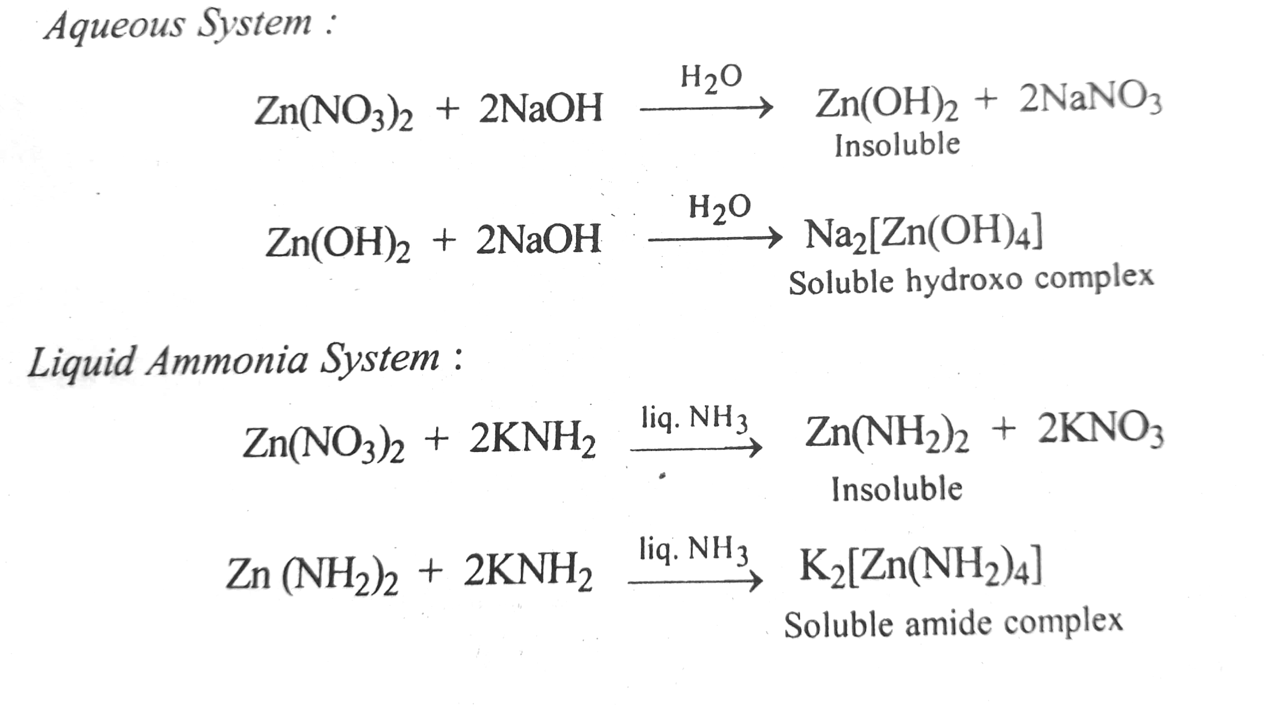
6. Complex formation reaction:
Several complex formation reactions in liquid ammonia are known. These are similar to reactions of occuring in aqueous system. The following reactions are given for illustration:

Slide 21
7. Reduction reaction:
Liquid ammonia serves as and excellent medium for reduction reactions involving inorganic species. For instance, alkali metals dissolve in liquid ammonia giving blue coloured solutions which are strong reducing agents as they can readily supply electrons for reduction process. Sodium metal in liquid ammonia for instance reduces CuI to Cu.
8. Oxidation reaction
Oxidising action of various oxidizing agents is weaker in liquid ammonia than in aqueous solution for instance, HNO₃ in liquid ammonia does not acts as an oxidizing agent. Similarly KMnO₄ in liquid ammonia acts as a very weak oxidizing agent. KMnO₄ is reduced by solution of potassium in liquid ammonia to K₂MnO₄ and finally to Mn.O
9.Solubility of substances in liquid ammonia
As expected from its very low dielectric constant, liquid ammonia is a poor solvent for ionic substances. Amongst the inorganic compounds, nitrates, thiocyanate, perchlorate and most of the cyanides are soluble in liquid ammonia. Oxides and hydroxides, carbonates, phospates, sulphates and most of the sulphide are insoluble. Most of the iodides are soluble and bromides are less soluble. Fluorides and chlorides (except be Be²⁺ and Na⁺ chloride) are practically insoluble. Most of the ammonium salts such as NH₄NO_{3,} NH₄SCN, CH₃COONH₄ are soluble in liquid ammonia. Most of the metal amides, except of those alkali metals, are insoluble.

Slide 22
Solutions of alkali metals in liquid ammonia:
The ability to dissolve alkali metal is one of the striking features of liquid ammonia as a solvent. The alkali metal solutions in liquid ammonia are blue in colour. The blue solution is characterized by
Its colour which is independent of the metal involved.
Its density which is similar to that of pure liquid ammonia.
Its conductivity which is in the range of conductivities of electrolytes dissolved in liquid ammonia
It's paramagnetism (i.e. these solutions when placed in magnetic field are attached into the field) which indicates the presence of large number of unpaired electrons.
The alkali metal solutions dissociate to form alkali metal cations and ammoniated electrons.
The dissociation into cation and ammoniated electrons account for the electrolytic conductivity of the the blue coloured dilute solutions. As the concentration of the solution is increased, M⁺ and e⁻ species associate resulting in a decrease of conductivity.
Very dilute solution of alkali metals in liquid ammonia are metastable and when catalyzed they undergo decomposition.

Slide 23
As the concentration of metal increases, the blue colour changes to bronze and finally the colour disappears altogether. On evaporating the alkali metal ammonia solutions, the alkali metal can be recovered.
The blue colour of dilute metal-ammonia solutions is attributed to the presence of ammoniated cations as well as ammoniated electron.
Advantages liquid Ammonia as solvent:
1. Dissolution of alkali metals in liquid ammonia without chemical reaction is the greatest advantage of using liquid ammonia as a solvent. The dissolved alkali metals can be recovered from the solution by evaporation.
2. The alkali metal solutions in liquid ammonia are strong reducing agents, even stronger than hydrogen.
3. Ammonium salts dissolved in liquid ammonia find applications in preperative chemistry.They can be used to precipitate sulphides,halides, sulphate and alcoholates.
4. The tendency for solvolysis is less in liquid ammonia than in water

Slide 24
Limitations of liquid ammonia solvent :
Low temperature or high temperature pressure is necessary while working with liquid ammonia. This is because the liquid range for liquid ammonia is from - 33.5⁰C to -77.7⁰C
2. Liquid ammonia is the hygroscopic in nature. Hence all the reactions are to be carried out in seal tubes.
3. The use of liquid ammonia as a solvent and as a reaction medium requires special technique as it has an offensive odour.

Slide 25
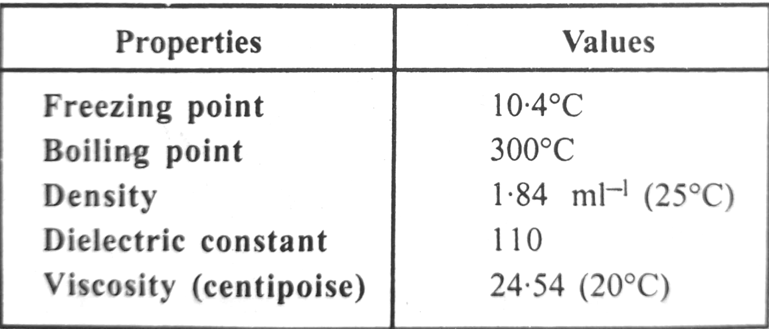
(ii) Anhydrous sulphuric acid:
The characteristic physical properties of non-aqueous sulphuric acid are given in table 6
Viscosity of anhydrous H₂SO₄ is about 25 times higher than that of water. Therefore, solutes dissolve very slowly in sulphuric acid and are also difficult to crystallise from H₂SO₄
Chemical reactions of anhydrous sulphuric acid
1. Autoionisation
Anhydrous sulfuric acid autoionizes to give H₃SO₄⁺ and HSO⁻₄ ions:
Therefore, any chemical species producing HSO⁻₄ ions will acts as base and any chemical species producing H₃SO₄⁺ ions acts as an acid in H₂SO_{4 .}

Slide 26
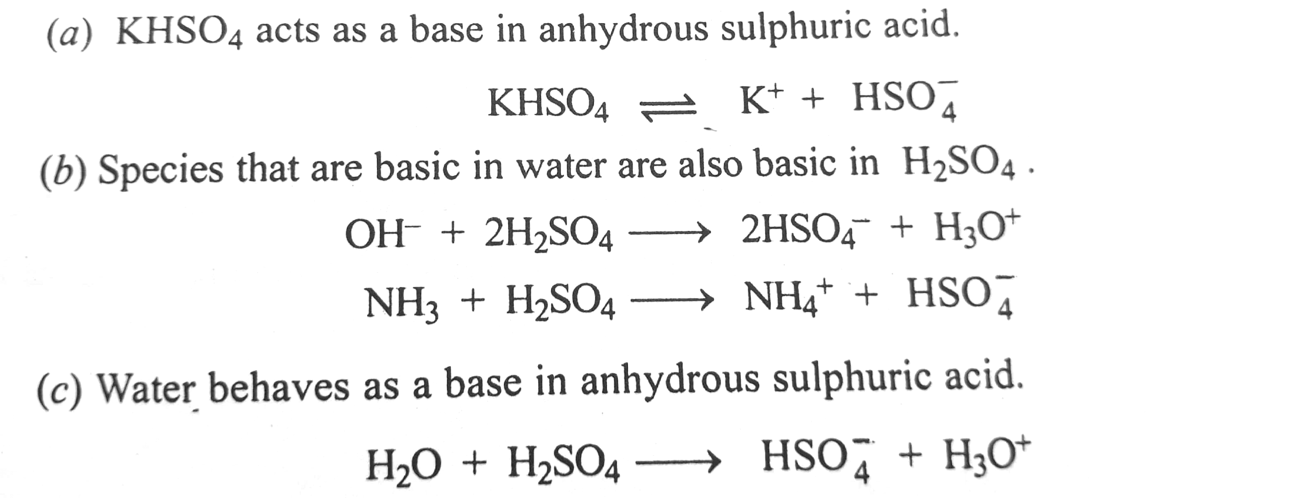
2.Acid base reactions : Some typical acid-base reactions of anhydrous H₂SO₄ are given below:
(d) Species that containing lone pair of electrons easily accept a proton from H₂SO₄ and acts as basis. Thus amides ( like urea etc.) which acts as acids in liquid NH₃, are neutral in water and behaves as bases in anhydrous H₂SO_{4.}

Slide 27
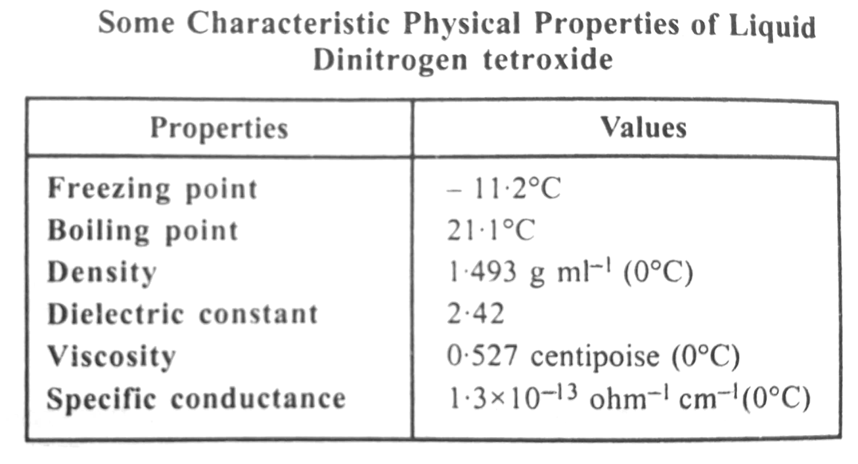
3.Dehydrating action:
H₂SO₄ acts as strong dehydrating agent and extracts water even from chemical compounds. Thus,
4.Super acids : The acids which behave as strong acid, in strong acid solvent are termed as super acids for example [HB(HSO₄)_{4,} hydrogen whose solution can be prepared in sulphuric acid, behaves as an exceptionally strong acid.
The super acids [HB(HSO₄)₄ has not been isolated as such. Only its solution can be prepared. The other super acids are[H₂Sn(HSO₄)₄ and [H₂Pb(HSO₄)₄ in H₂SO₄
Liquid hydrogen tetroxide
Dinitrogen tetroxide N₂O₄ has been studied extensively as non protonic non aqueous solvent the physical properties of the solvent are given in table
Much of the chemistry in this solvent can be rationalised in terms of autionization equilibrium of the type.

Slide 28
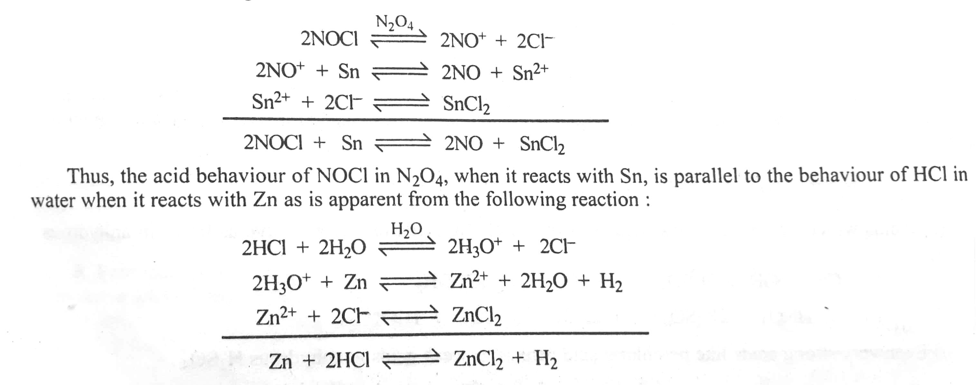
Although there is no Physical evidence for the above type of autoionization occurring in N₂O_{4.} It has been found that the electrical conductance of N₂O₄ increases on adding a donor or a polar solvent to it. This may perhaps be due to increased stabilization of cations and anions (NO⁺ and NO₃⁻) of N₂O₄ as a result of the ion-dipole interaction of these ions with the molecules of the added donor or polar solvent.
Thus assuming that N₂O₄ undergoes auto ionisation as mentioned above, it can be said that any chemical species which gives the cation NO⁺ in the solvent will behave as an acid and any chemical species which gives the anion NO₃⁻ in this solvent will behave as a base. Thus, NOCl behaves as an acid in N₂O_{4 ,}as is evident from the following reaction:

Slide 29
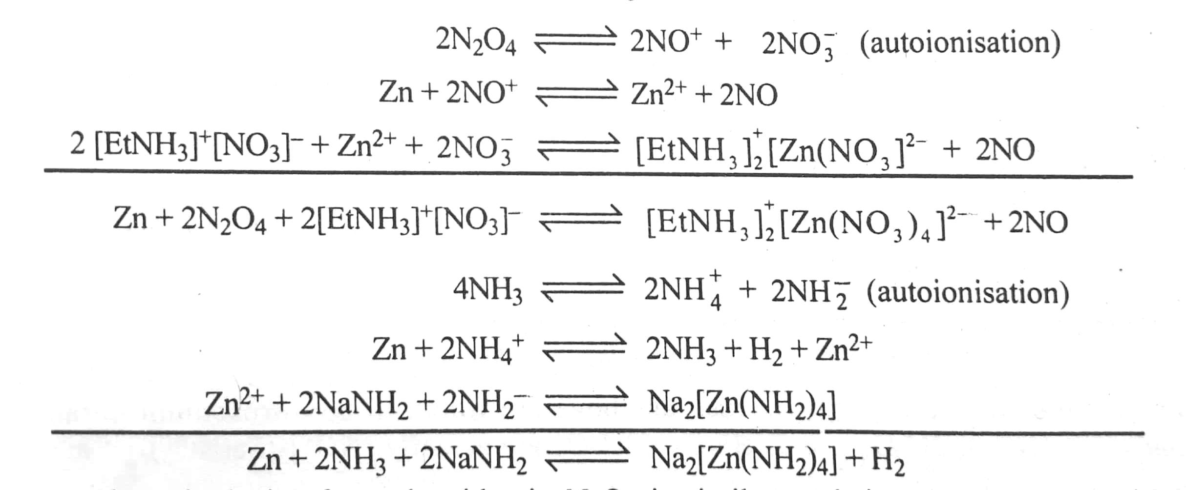
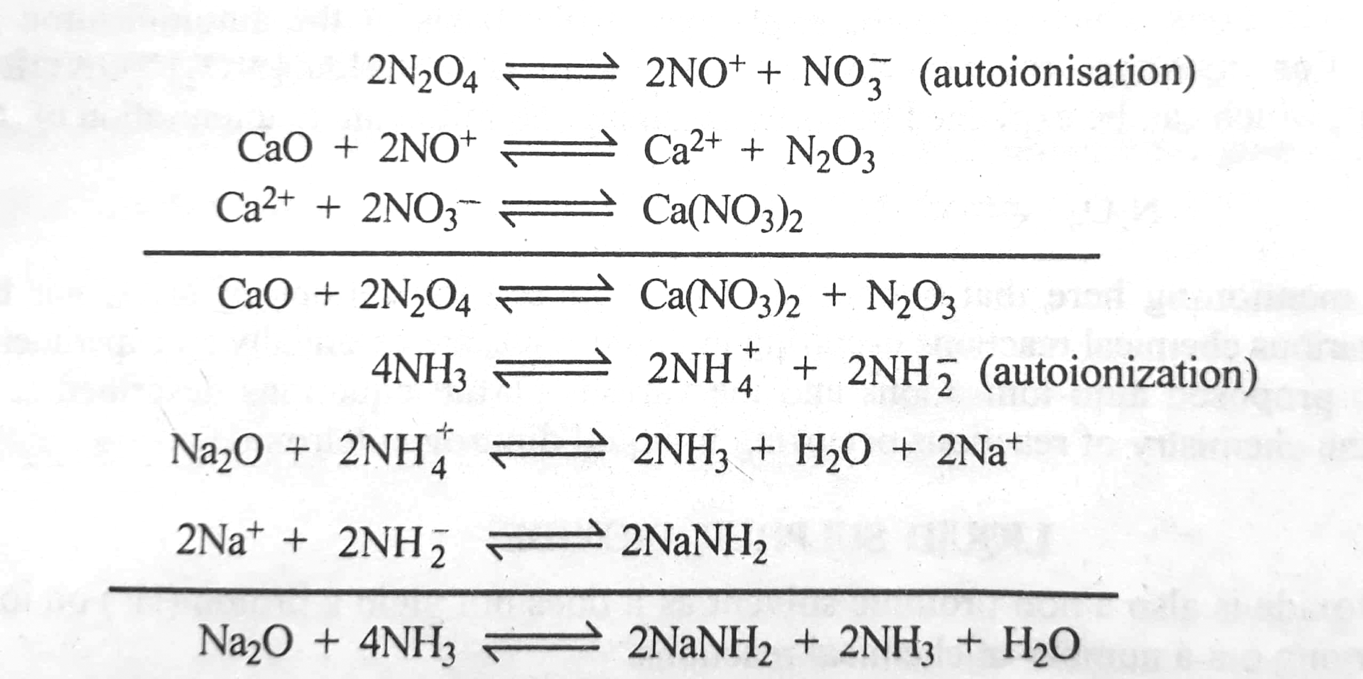
The compounds [EtNH₃]⁺[NO₃]⁻ releases NO₃⁻ anion in N₂O_{4.} It, therefore acts as a base in N₂O_{4.} A typical reaction of [EtNH₃]⁺[NO₃]⁻ with zinc metal in N₂O₄ is similar to the reaction of znic with NaNH₂ in liquid ammonia, as is evident from the following reactions;
The solvolysis of metal oxide in N₂O₄ is similar to their solvolysis in liquid ammonia, as shown below:

Slide 30
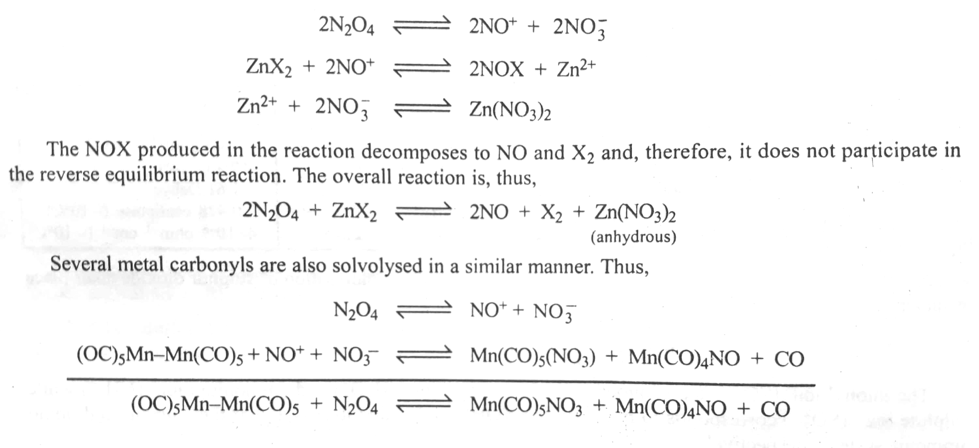
In fact, solvolysis of the halides of metals in N₂O₄ provides an excellent method for preparing anhydrous metal nitrates which are otherwise extremely difficult to prepare. Thus,

Slide 31
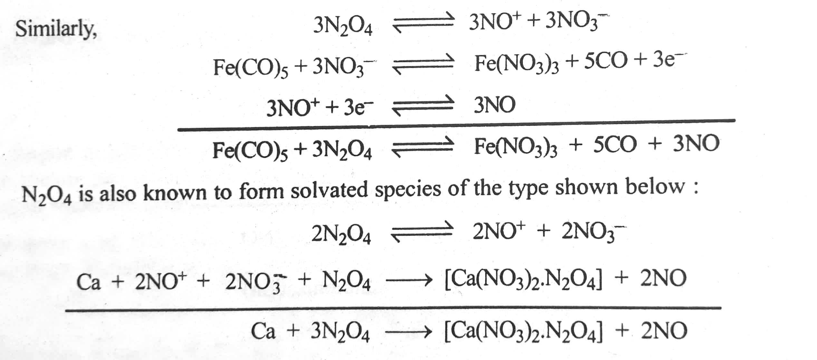
Quit often ,however,the solvated species form as above are found to be nitrosonium nitrates compound for example, Sc(NO₃)₃.2N₂O₄ and 2Fe(NO₃)₃.3N₂O₄ are actually Sc(NO₃)₃.2N₂O₄ , respectively
There are certain reactions which cannot be explained on the basis of the autoionization of N₂O₄ proposal as above. For instance the reaction of N₂O₄ with BF₃ yields [NO₂]⁺[ONOBF₃]⁻ and [NO₂]⁺[F₃BONOBF₃]⁻, which can be explain better by assuming the following autonisation of N₂O₄:

Slide 32
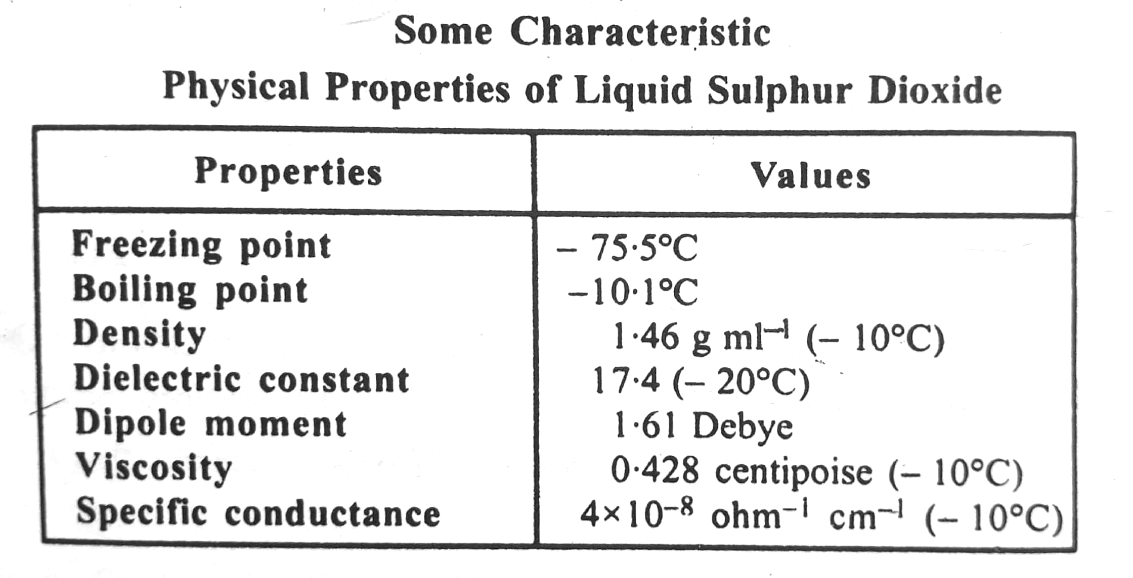
(iii) Liquid sulphur dioxide
liquid sulphur dioxide is also non protonic solvent as it does not yield a Proton H⁺ on ionization. It is widely used for carrying out a number of chemical reactions.
Under normal temperature and pressure, sulphur dioxide is a gas but it cannot be readily liquefied. It has a wide range( -10⁰C to -75.5⁰C) and hence can serve as a good solvent. It is used as a non aqueous solvent is rapidly increasing due to its low cost and is of it's handling. It's dielectric constant is small (17.4 at -20.0⁰C) which makes it a good solvent for covalent compounds but a poor solvent for electrovalent compounds. The characteristics physical properties of liquid sulphur dioxide are given in table 8

Slide 33
Autoionization
By analogy with water and liquid ammonia, autoionization of Sulphur dioxide takes place as under:
The thionyl ion (SO²⁺) is analogous to the hydronium ion (H₃O⁺) and ammonium ion (NH₄⁺) while sulfite ion(SO₃²⁻) corresponding to hydroxyl ion (OH⁻) and amide ion(NH₂⁻) of the aqueous and liquid ammonia system, respectively.
Sulphur Dioxide solutions are not as a good electrical conductors as are liquid ammonia solution or aqueous solutions.
Solubility of substances in liquid sulphur dioxide
Amongst inorganic compounds iodide and thiocyanates are the most soluble. Metal sulphate, sulphides, oxides and hydroxides are practically insoluble. Many of the ammonium, thallium and mercuric salts soluble. Liquid sulphur dioxide is an excellent solvent for covalent compounds. Substances like IBr, PBr_{3,} CCl₄, SiCl₄ ,SnCl₄ are soluble in it. Metals are insoluble in liquid sulphur dioxide.
Amongst the organic compounds benzene and alkenes dissolved in it freely . pyridine, quinoline, ether, halogen derivatives and acid chlorides are also dissolve in liquid sulphur dioxide. Alkanes are insoluble.

Slide 34
Reactions in liquid sulphur dioxide
Chemical reactions that occur in liquid sulphur dioxide are of the following types:
1.Acid base neutralization reaction :
Comparing the autoionization of liquid sulphur dioxide with that of water, it can be seen that thionyl ion(SO²⁺) is analogous to hydronium ion(H₃O⁺) and sulphate ion(SO₃²⁻) is analogous to hydroxyl ion(OH⁻) . Hence all compounds containing for making available SO₃²⁻ ions in liquid sulphur dioxide will acts as bases in this medium. Similarly all compounds which make available SO²⁺ ions in liquid sulphur dioxide will acts as a typical acid in liquid sulphur dioxide.
Typical acid- base or neutralization reactions in liquid sulphur dioxide are given below:
Reactions between thionyl Chloride and cesium sulphite:

Slide 35
2. Solvolytic Reaction
Only a limited number of salts undergo solvolysis in liquid sulphur dioxide. Some common reactions are given below. Ammonium acetate is solvolysed in liquid sulphur dioxide.
The formation of solvates, i.e. the addition compounds with a solvent, is also known. Typical solvates formed are NaI.4SO₂, RbI.4SO₂ KBr.4SO_{2,} CaI₂.4SO₂ SrI₂.4SO₂, NaI.4SO_{2 ,} AlCl₃.2SO₂ etc.

Slide 36
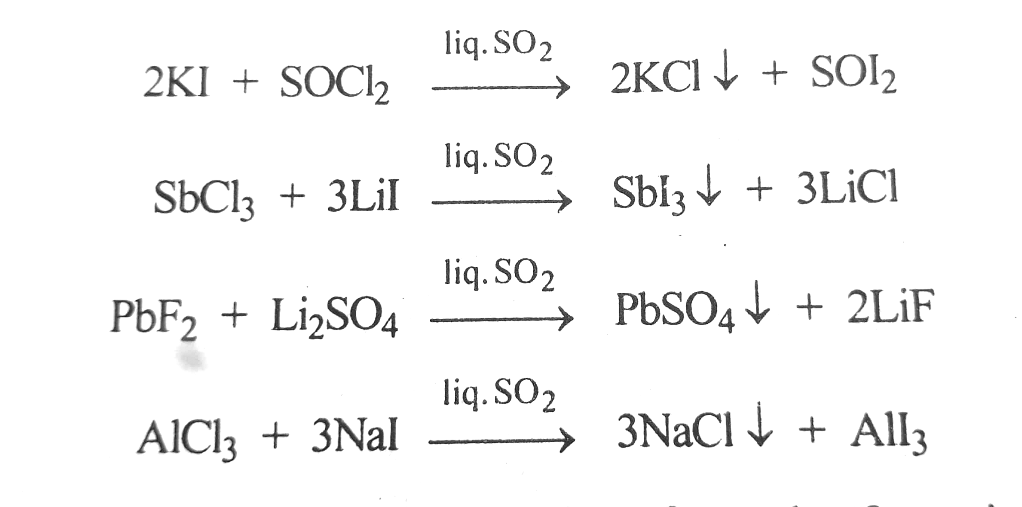
3. precipitation reactions
large amount of precipitation reactions can be carried out in liquid sulphur dioxide due to specificity solubility relationship. Some of these reactions are given below:

Slide 37
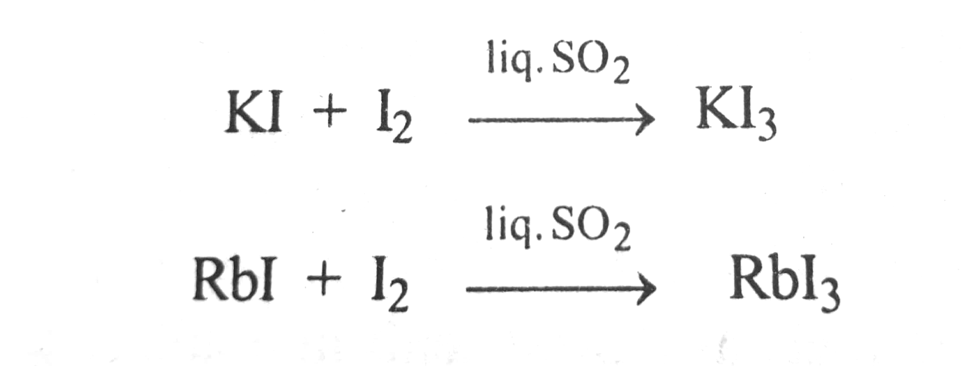
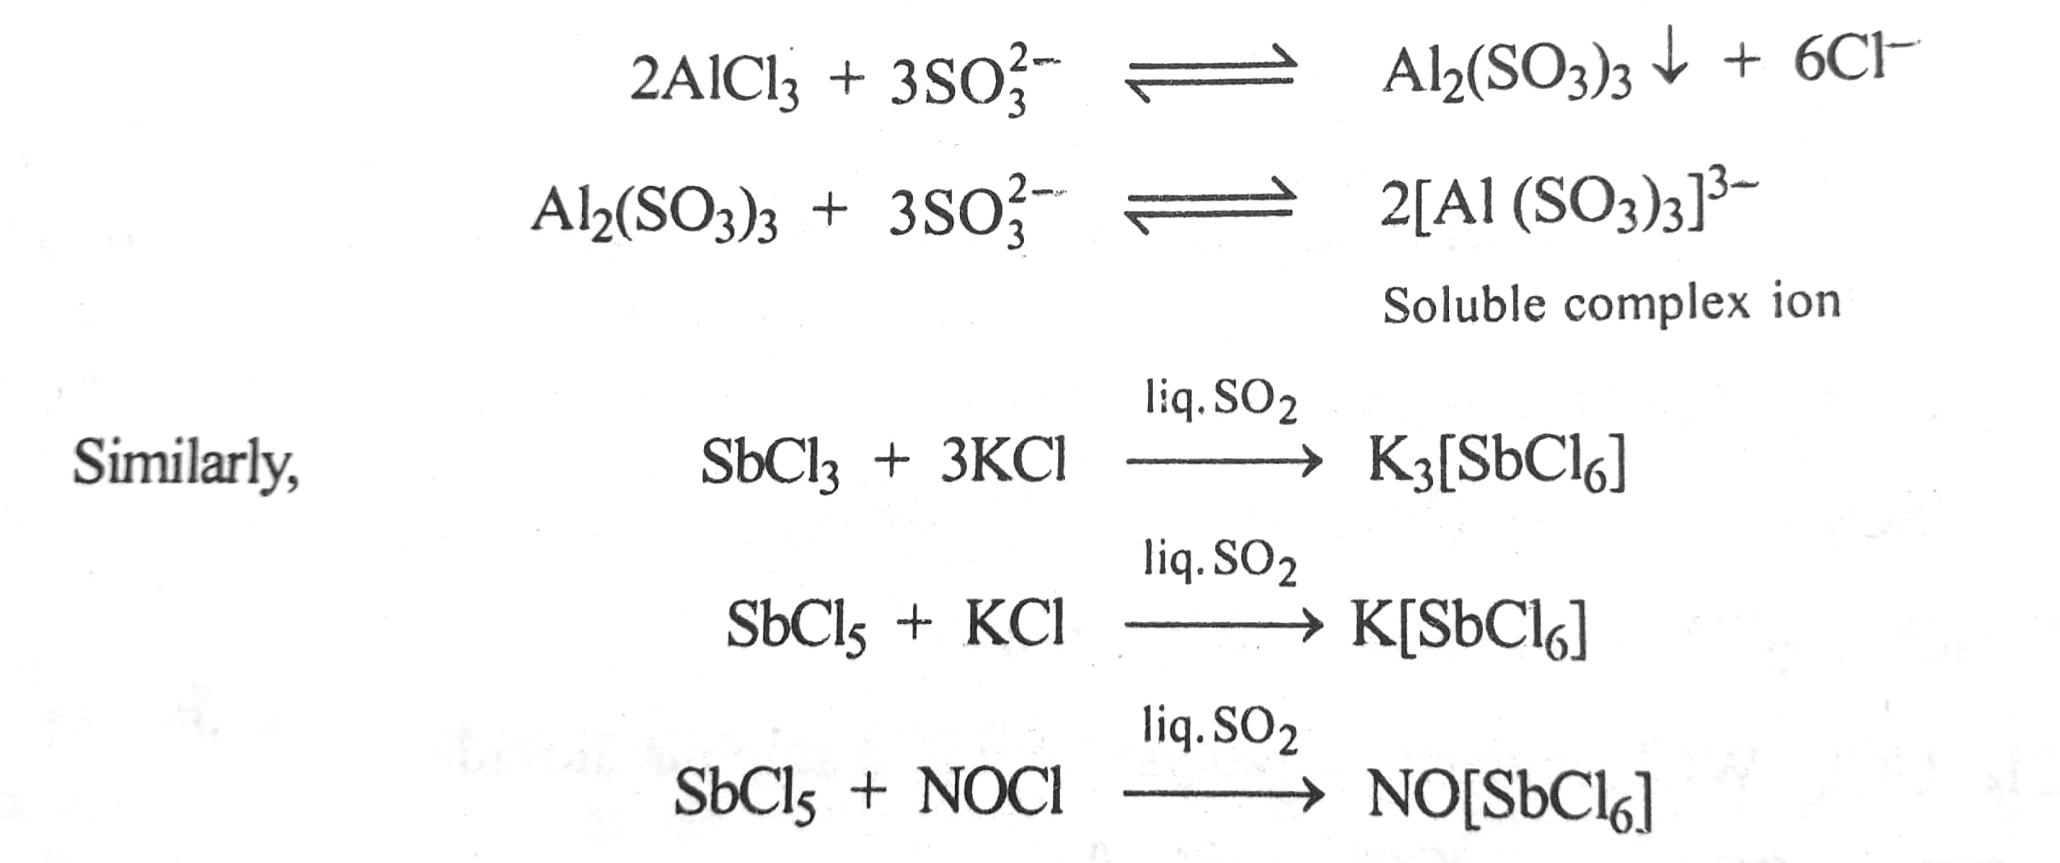
4. Complex formation reaction :
A large number of complex formation reaction of liquid sulphur dioxide have been reported. For instance the solubility of iodine in liquid sulphur dioxide is greatly increased by the addition of potassium rubidium iodide. This is due to the formation of the complex KI₃ or RbI_{3.}
Similarly, the increase in the solubility of cadmium iodide and mercury iodide in liquid sulphur dioxide is attributed to the formation of complexes.
Some other examples of complex formation are as follows:
AlCl₃ react with SO₃²⁻ ions to from a precipitate of Al₂(SO₃)₃ which redissolves in excess of SO₃²⁻ ions forming the complex ion[Al₂(SO₃)₃]³⁻

Slide 38
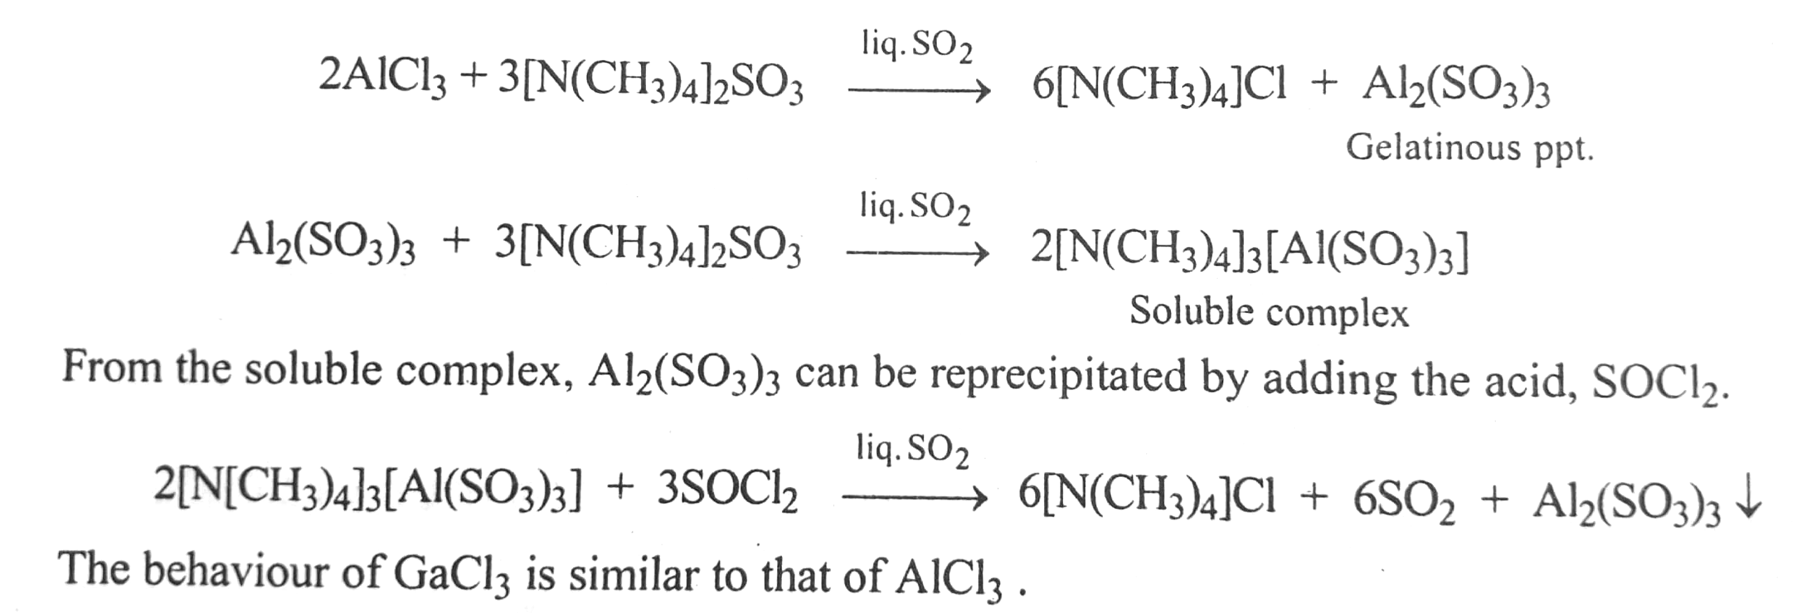
5. Amphoteric behaviour :
Various salts shows amphoteric behaviour in liquid sulphur dioxide. The reaction of AlCl₃ with NaOH in aqueous medium can be compared with the reactions of AlCl₃ with tetramethyl ammonium Sulphite in liquid sulphur dioxide. In aqueous solution, the reaction takes place as follows:
In liquid sulphur dioxide medium, an identical reaction takes place between AlCl₃ and tetramethyl ammonium Sulphite:

Slide 39
6. redox reactions :
Liquid sulphur dioxide does not have any strong oxidizing or reducing properties. It serves only as a medium for redox reactions. For instance, liquid sulphur dioxide cannot reduce iodine. However, a sulphide in liquid sulphur dioxide reduces iodine to iodide, Thus,
Molten salts as non- aqueous solvents:
Molten salts which acts as non aqueous solvent can be divided into two categories like 1. high temperature molten salts 2. room temperature molten salts
high temperature molten salts: This category contains melts of compounds containing mainly ionic bond e.g. alkali halides. The coordination number of the ions drops from 6 in solids to 4 in the melts. The long-range lattice symmetry is destroyed in the molten state of such salts but the short range symmetry around the ions still exist. Ionic compounds can be dissolved in such melts giving rise to highly conducting solutions. The cryoscopic technique can be applied to determine the number of ions of the solute. For example, the number of ions of KF in molten solution of sodium chloride is 2 and BaF₂ is 3. But number of ions of NaF in molten NaCl comes out to be 1 by cryoscopic technique because Na⁺ ion of solute is common with the Na⁺ ion of molten NaCl solvent.

Slide 40
Another type of molten salts are melts of covalently bonded compounds although some autoionisation may occur in such compounds also. The example is the autionization of molten HgX₂ :
room temperature and can be used as a solvent for many ionic compounds. But a serious limitations of such liquid chloroaluminate solvent is that they are highly hygroscopic and hydrolyse radially. The hydrolysed chloro chloroaluminate may further react with the dissolved solids to produce their oxides products.

Slide 41
The low melting point of the product obtained by the above reaction is due to the presence of mixture of salts, Such as in this product the solvent can be easily reduced and can also be easily oxidized.
Therefore the species which are even mild oxidized or mild reducing cannot be studied. In this one for all reactions to be studied in the solvent have to be carried out in the absence.

Slide 42
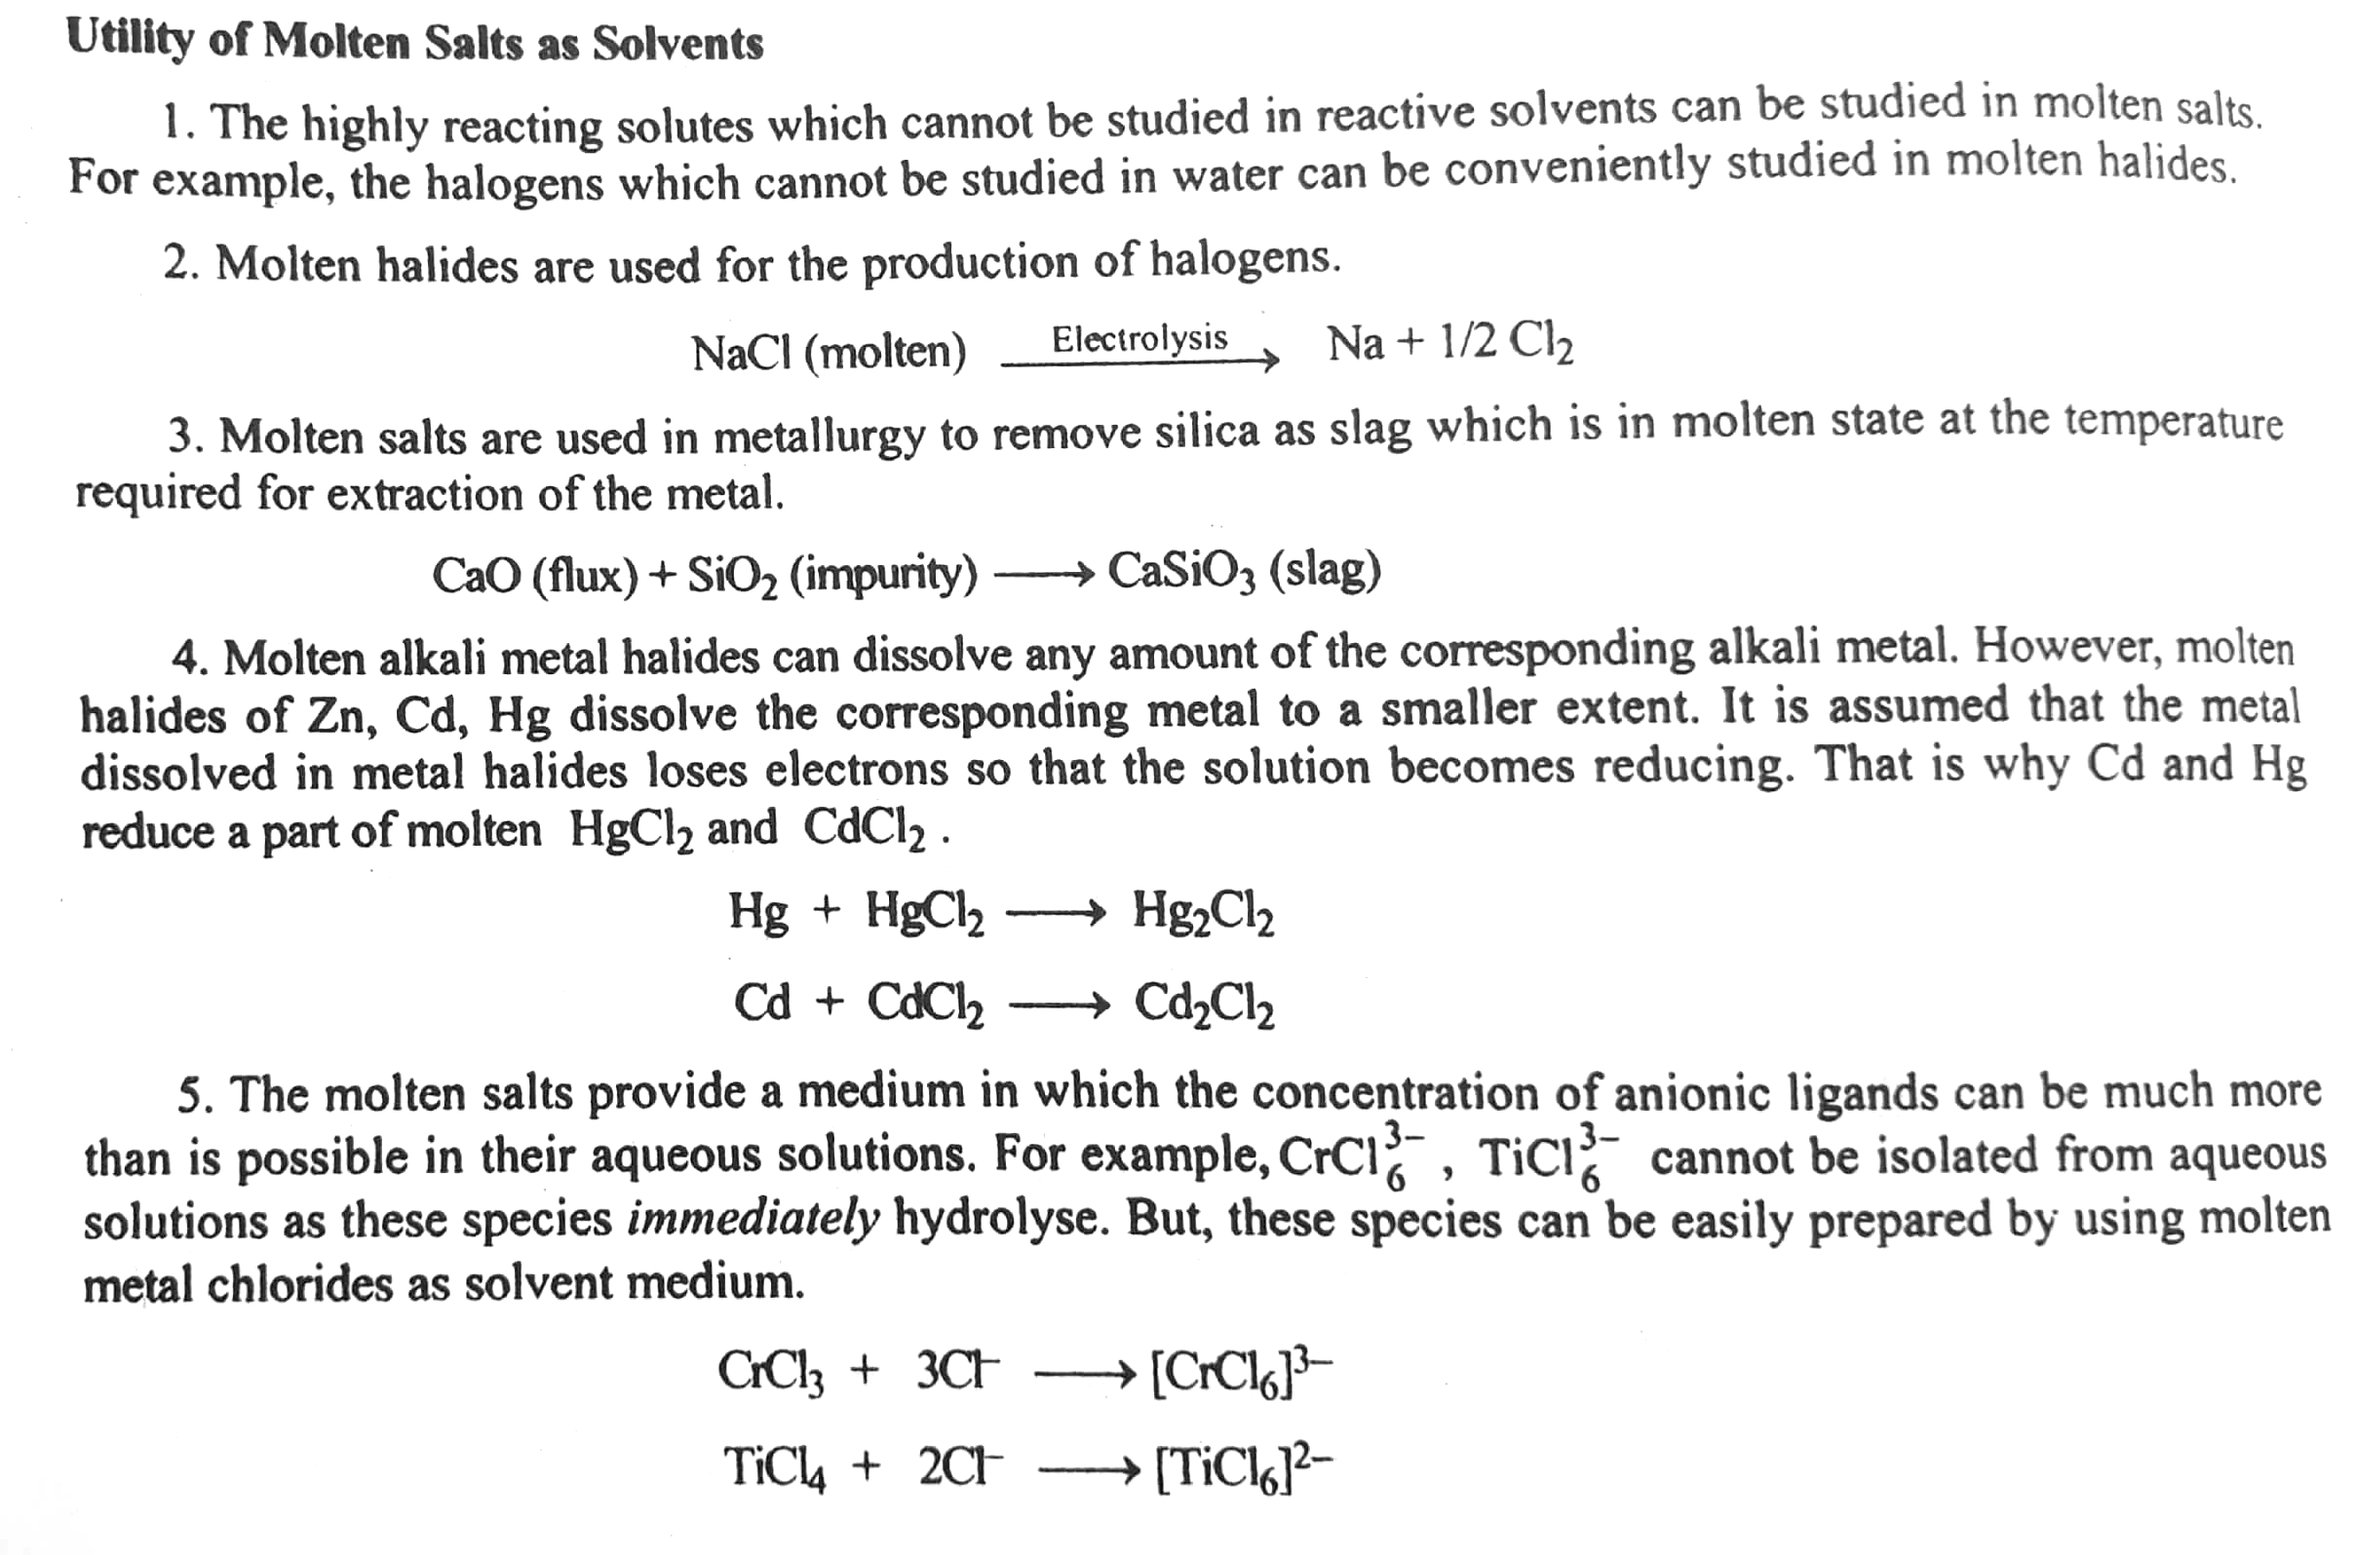

Slide 43
THANK YOU

