Slide 1
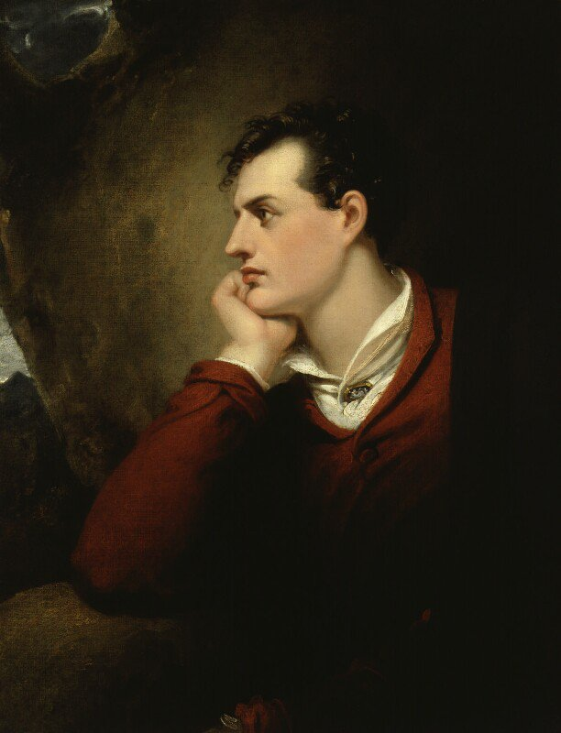
OZYMANDIAS
P. B.Shelley (1792-1822)
Mr: J.B.Khot
Assistant Professor
Kisan Veer Mahavidyalaya, Wai
Dist: Satara MAHARASHTRA

Slide 2
About the Poet
One of the major English Romantic poets.
Widely regarded as one of the greatest lyric and philosophical poets.
A radical in his poetry as well as in his political and social views.
Shelley is best known for classic poems such as "Ozymandias", "Ode to the West Wind", "To a Skylark", "Music, When Soft Voices Die", "The Cloud" and The Masque of Anarchy.

Slide 3
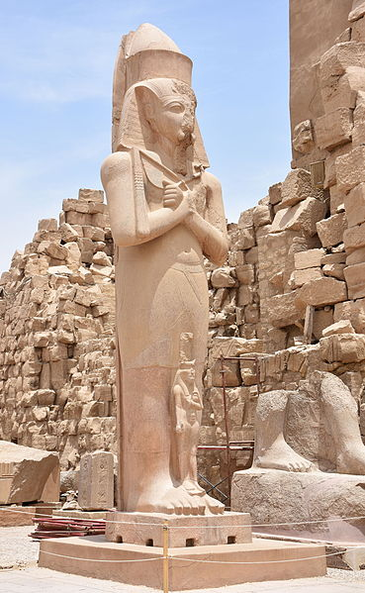
Introduction to the Poem
This poem was published on 11 January 1818.
It was included the following year in Shelley's collection Rosalind and Helen, A Modern Eclogue; with Other Poems
Shelley wrote the poem in friendly competition with his friend and fellow poet Horace Smith (1779–1849), who also wrote a sonnet on the same topic with the same title.
Both poems explore the fate of history and the ravages of time: even the greatest men and the empires they forge are impermanent.
A central theme of the "Ozymandias" poems is the inevitable decline of rulers with their pretensions to greatness.

Slide 4
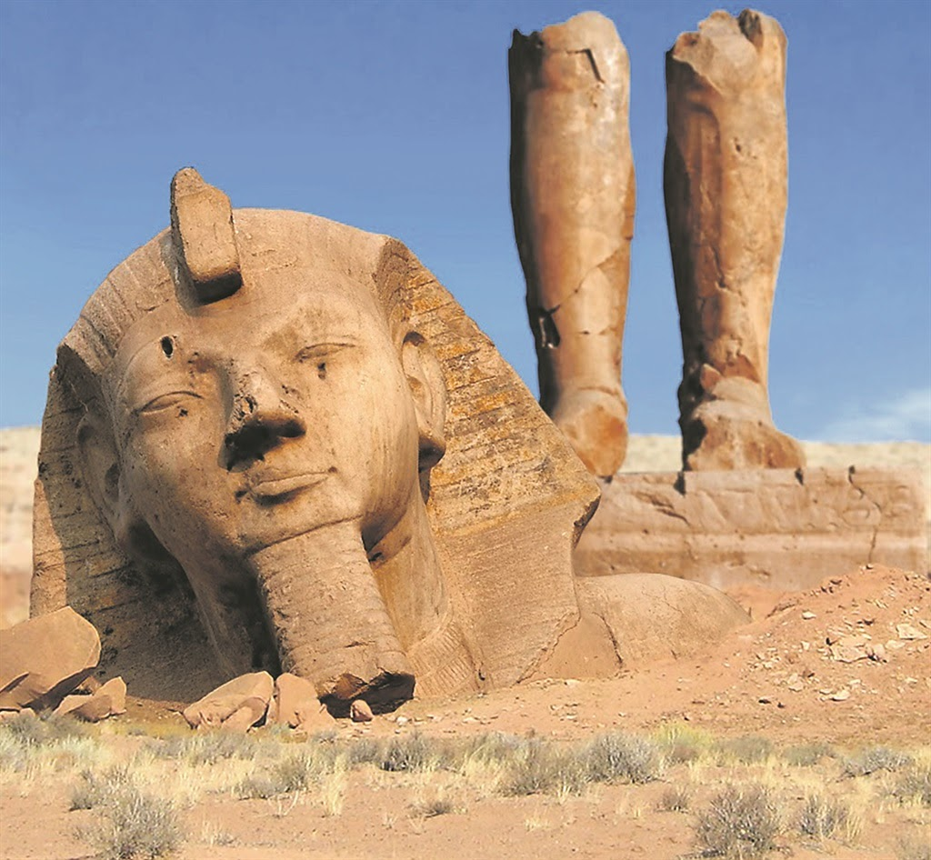
Ozymandias
I met a traveller from an antique land,
Who said—“Two vast and trunkless legs of stone
Stand in the desert. . . . Near them, on the sand,
Half sunk a shattered visage lies, whose frown,
And wrinkled lip, and sneer of cold command,
Tell that its sculptor well those passions read
Which yet survive, stamped on these lifeless things,

Slide 5
The hand that mocked them, and the heart that fed;
And on the pedestal, these words appear:
My name is Ozymandias, King of Kings;
Look on my Works, ye Mighty, and despair!
Nothing beside remains. Round the decay
Of that colossal Wreck, boundless and bare
The lone and level sands stretch far away.”

