Slide 1
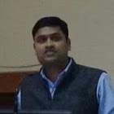
IMPACT OF COVID-19 ON HISTORICAL TOURISM: CHALLENGES & OPPORTUNITIES
Mr. Bhimashankar M. Birajdar
[Assistant Professor (History) &
Coordinator, Travel & Tourism Course],
Kisan Veer Mahavidyalaya, Wai
Dist: Satara (Maharashtra)
E-mail: bmbirajdar@hotmail.com
Twitter: @Bhimashankar83

Slide 2
What Mean by Tourism & Traveler?
Tourism: ‘‘Tourism is a collection of activities, services and industries which deliver a travel experience comprising transportation, accommodation, eating and drinking establishments, retail shops, entertainment businesses and other hospitality services provided for individuals or groups traveling away from home’’ (UNWTO)
Traveler : ‘‘A Person who travel often or who engaged in travelling’’
‘‘A traveler is someone who moves between different geographic locations, for any purpose any duration’’
( Cambridge Dictionary)

Slide 3
Historical/Heritage Tourism
Definition: Historical or Heritage Tourism means traveling with the primary purpose of exploring the history and heritage of a place
Historical & Cultural Background : Tourism term is used for journeys that include visits to cultural resources, regardless of whether it is tangible or intangible. Specifically the historical sites, religious places, art & architecture, religious tradition, fair-festival, rural & ethnic centres cultural tradition, urban lifestyle, food, values, customs and other elements of the people

Slide 4
Travel & Tourism Industry:
International National and State Collaboration- India has rich cultural heritage, this region has Social, Religious and political cultural diversities.
Global to Local Tourism: India attracts the Tourists from various countries across the globe, further inter-states, districts, sub-districts.
Tourists of Global, National, Regional, Local Places: **INCREDIBLE INDIA**

Slide 5
Types of Tourism
Recreational Tourism - This includes people who travel to relax, and have fun.
Cultural Tourism - Cultural Tourism is the subset of tourism concerned with a traveler’s engagement with a country or region’s culture,
Religious Tourism- It is also referred as faith Tourism. It is a type of tourism where people travel individually or in a group for pilgrimage or leisure (fellowship ) purposes
Nature Tourism - This is referred as responsible travel to natural areas, which conserves the environment and improves the welfare of the local people
Pleasure Tourism - Some people travel for their happiness and satisfaction.
Medical Tourism - Medical Tourism refers to people travelling to a country other than their own to obtain medical treatment.
Adventure Tourism -Adventure Tourism is a nice tourism involving exploration of a travel with a certain degree
Eco tourism typically involves travel to destinations where flora, fauna, and cultural heritage are the primary attractions

Slide 6
Types of Tourism
Culinary tourism or food tourism- Is the exploration of food as the purpose of tourism.
Space tourism- is human space travel for recreational purposes
War tourism is recreational travel to active or former war zones for purposes of sightseeing or historical study.
Slum tourism-or ghetto tourism is a type of city tourism that involves visiting impoverished areas
Disaster tourism- has been defined as the practice of visiting locations at which an environmental disaster

Slide 7
Modern Tourism Industry & Its Present Scenario in India
Indian Tourism and Hospitality sectors are the important Service Sector in India
GOI allotted the 1250 Cr. in 2018 started the Swadesh Darshan, Pilgrimage Rejuvenation & Spiritual Augmentation
As per the reports of world tourism could decline by 60-80% in 2020 which caused 21 percent in international tourist coming during the first quarter of 2020.
The Indian tourism and hospitality industry is staring at a potential job loss of around 38 million, which is 70% of the total workforce.

Slide 8
Contd.
Emerging Industry: The Indian tourism and hospitality industry has emerged as one of the key drivers of growth among the services sector in India.
Rich Cultural and Historical Heritage: In Indian rich cultural and historical heritage so government wants to commercialized these assets and attract national and foreign tourists
Government Policy: Govt. has allotted Rs 1,250 core in year2018 for integrated development of tourist circuits under ‘Swadesh Darshan’ and Pilgrimage Rejuvenation and Spiritual Augmentation.
Mr. Bhimashankar Birajdar, KVM, Wai (Maharashtra)

Slide 9
Importance of the Tourism
Unemployment is one of the major problems of Indian Economy.
India has great cultural legacy, potential of agricultural, environmental resources, variety of languages cheap labor availability and transport facility provide the ample opportunity to development of tourism sector
Proper Guidance, Planning , Skill workforce and Propaganda of tourism will be helpful for increase employability
Tourism will play the an important role to overall development of State and country

Slide 10
Importance for Socio-Economic Development
To Reduce the Unemployment of Youth
Economic Crisis: Impact on Industries/Trade & Commerce
Large Scale Migration: Rural to Urban & Vice-Versa
Acquaint tourist of local and region assets to national and international people
Tourism can provide other kinds of employment possibilities available in the regional contexts ( Hotel, Food , Transport, Local Market, Agriculture Market etc.)
Local and regional art, Small-scale industries, Agriculture etc.
It Improves Economy and living standard.

Slide 11
Challenges Before Travel/Tourism Industry:
Impact of COVID-19
Lack of Infrastructure & Transportation
Skilled Human resources
Insufficient Promotion and Marketing
Safety and Security Issues
Government Taxation
The special awareness named "Travel Tomorrow" has become the most regular thread that runs through the ‘World Tourism Organization’
Mr. Bhimashankar Birajdar, KVM, Wai (Maharashtra)

Slide 12
Opportunities in Travel/Tourism Industry:
Medical Tourism:
Ministry of Tourism marketing promotion of medical tourism as new initiatives. Marketing Development Assistance Scheme (MDAS), administered by the ministry, GOI, provides financial support and assistance to tourism service providers.
Tourism Support Services:
Post-COVID 19 Prospects:
Mr. Bhimashankar Birajdar, KVM, Wai (Maharashtra)

Slide 13
Opportunities in Tourism Industry
Travel Agent
Travel consultant
Hotel Industry
Tour Operator
Event & Conference Organizer
Tour Guide
Insurance Agent
P.R. Manager
Cultural Activity Coordinator
Transport Officer
Freelance Journalist
Entrepreneur
Retailer

Slide 14
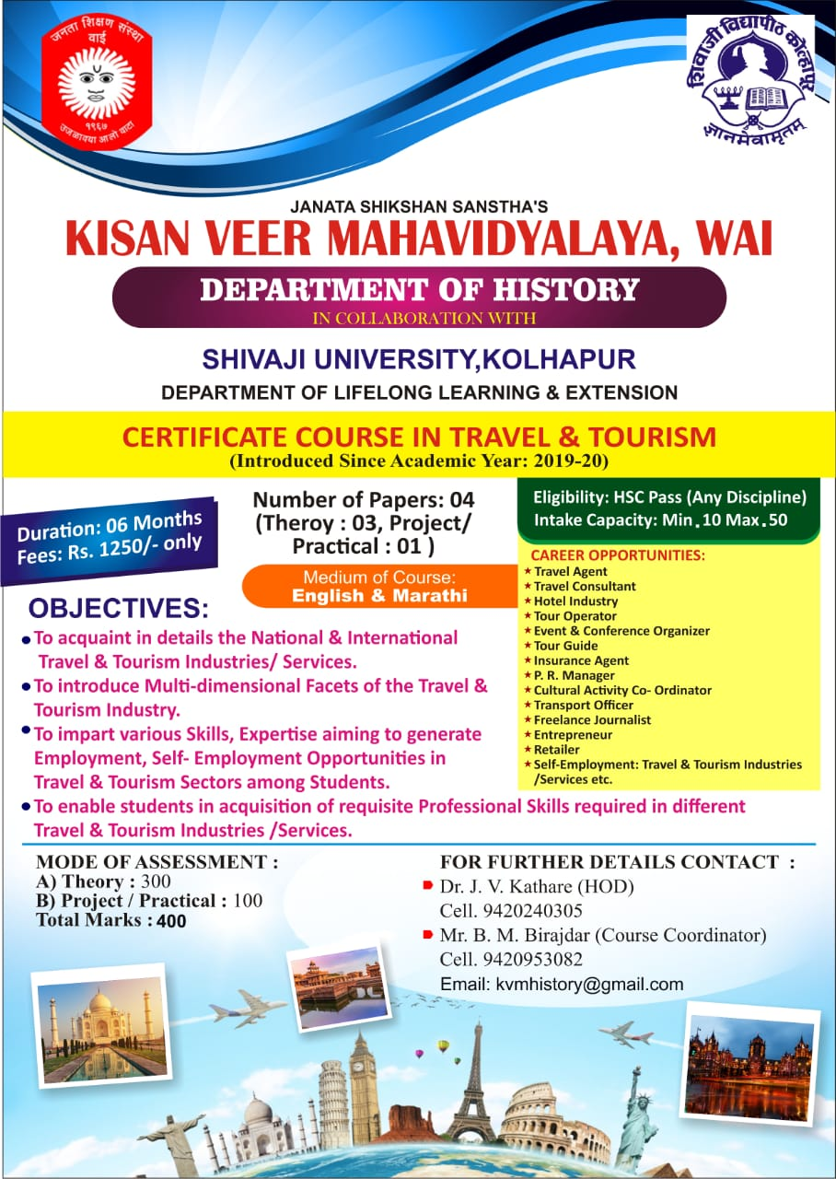

Slide 15
Select Travel/ Tourism Institutes in India:
Centre For Tourism Studies, Pondicherry
Indian Institute of Hotel and Tourism Management , Ghaziabad
Delhi Institute of Heritage Research and Management New Delhi
Department of Tourism and Hospitality, Yenepoya (Deemed to be University), Mangalore
Indian Institute of Tourism Management, Amity Institute of Travel and Tourism.
National Institute of Tourism Hospitality Management.
Al-ameen Institute of Management Studies, Banglore.
Thomas Cook Centre of Learning, N. Delhi
University Of Mysore.
Bharathi Vidyapeeth College of Hotel And Tourism Management, Pune
Centre for Heritage Management, Ahmadabad University (GUJ.)
Vikram University Ujjain (MP) etc.

Slide 16
References & For Extended Reading:
Swain & Mishra (2012): Tourism Principles and Practices
Bhatiya A. K. (2012): Tourism Development: Principles and Practices
Bhatiya A. K. (2012):Tourism in India: History & Development
Burton R. (1995): Travel Geography
Singh L.K. (2008): Ecology, Environment and Tourism
Journal of Tourism & Hospitality (Jan. 2021): The Impact of COVID-19 in the Indian Tourism and Hospitality Industry: Brief Report
https://www.unwto.org/
https://tourism.gov.in/

Slide 17
You May Drop Your Queries/Comments at: E-mail: bmbirajdar@hotmail.com Twitter: @Bhimashankar83 Thank You!
Questions? / Comments (If any)

