Slide 1
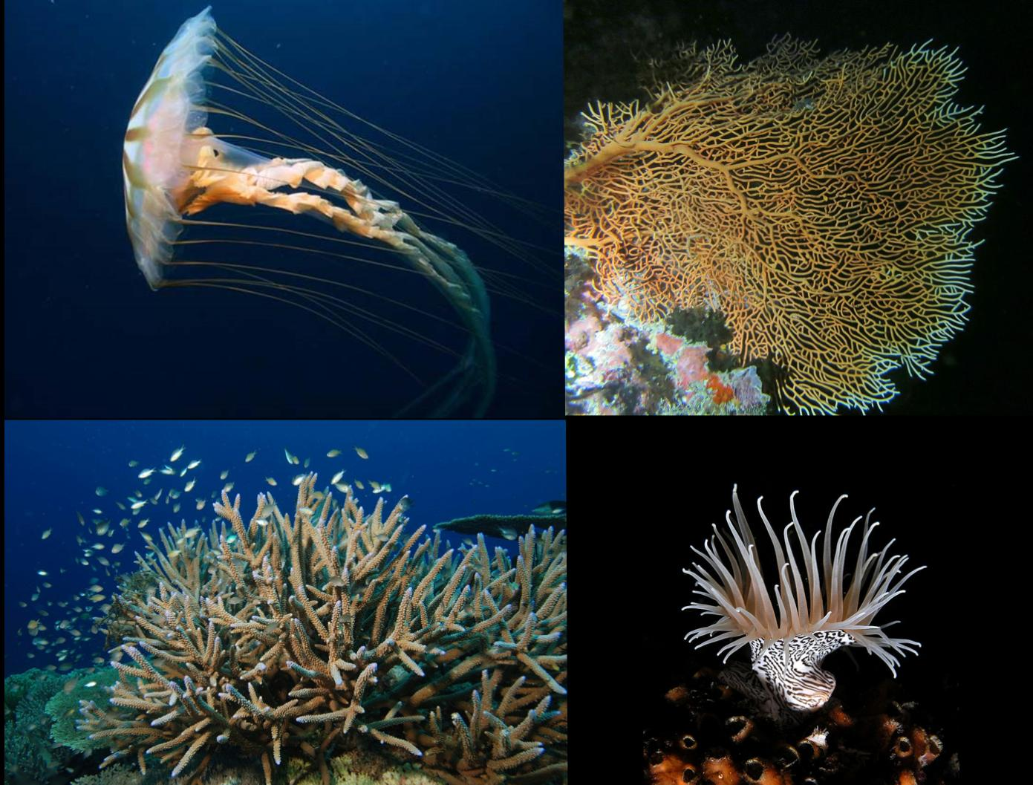
B.Sc. Part I, Semester I Zoology, DSC 15 A, Paper I
Unit I – Study Of Non-Chordates: Part I
Phylum – Cnidaria (General Characters and classification upto classes, polymorphism in Hydrozoa)
Miss Renjar J. K.

Slide 2
General characters
This phylum includes organisms, which possess specialised stinging cells called cnidoblasts.
Animals are strictly aquatic, some are freshwater while some are marine.
The animals may be either solitary or colonial and sedentary or free swimming, and possess a cavity called coelenteron.
The animals are triploblastic and have generally non-cellular mesoglea.
The animals are radially symmetrical.
These animals are found in two different forms. One is the cylindrical, sedentary from called polyp and the other is free swimming, umbrella like form Called medusa
Reproduction is asexual as well as sexual.
Phylum Cnidaria has been divided into following classes.

Slide 3
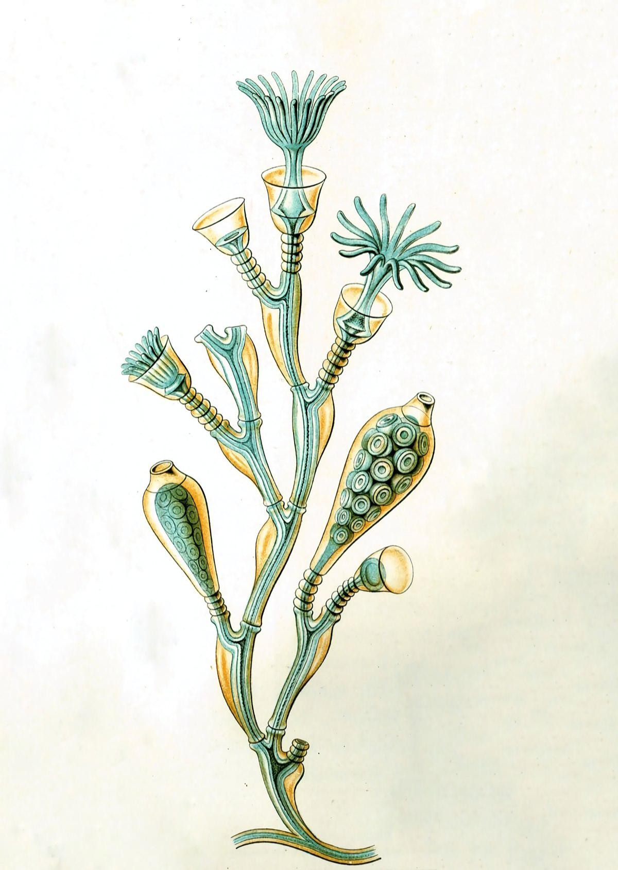
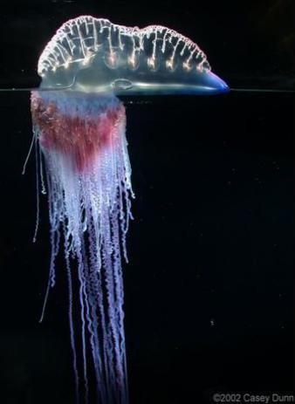
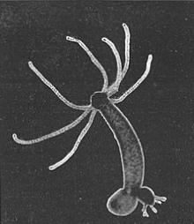
(A) Class - Hydrozoa
These are mostly marine and colonial, few are freshwater and solitary
Between ectoderm and endoderm, there is a presence of a non-cellular mesoglea.
Colonial forms like, Obelia, Physalia, Halistemma etc. Shows polymorphism.
Examples; Obelia, Physalia, Hydra, Halistemma

Slide 4
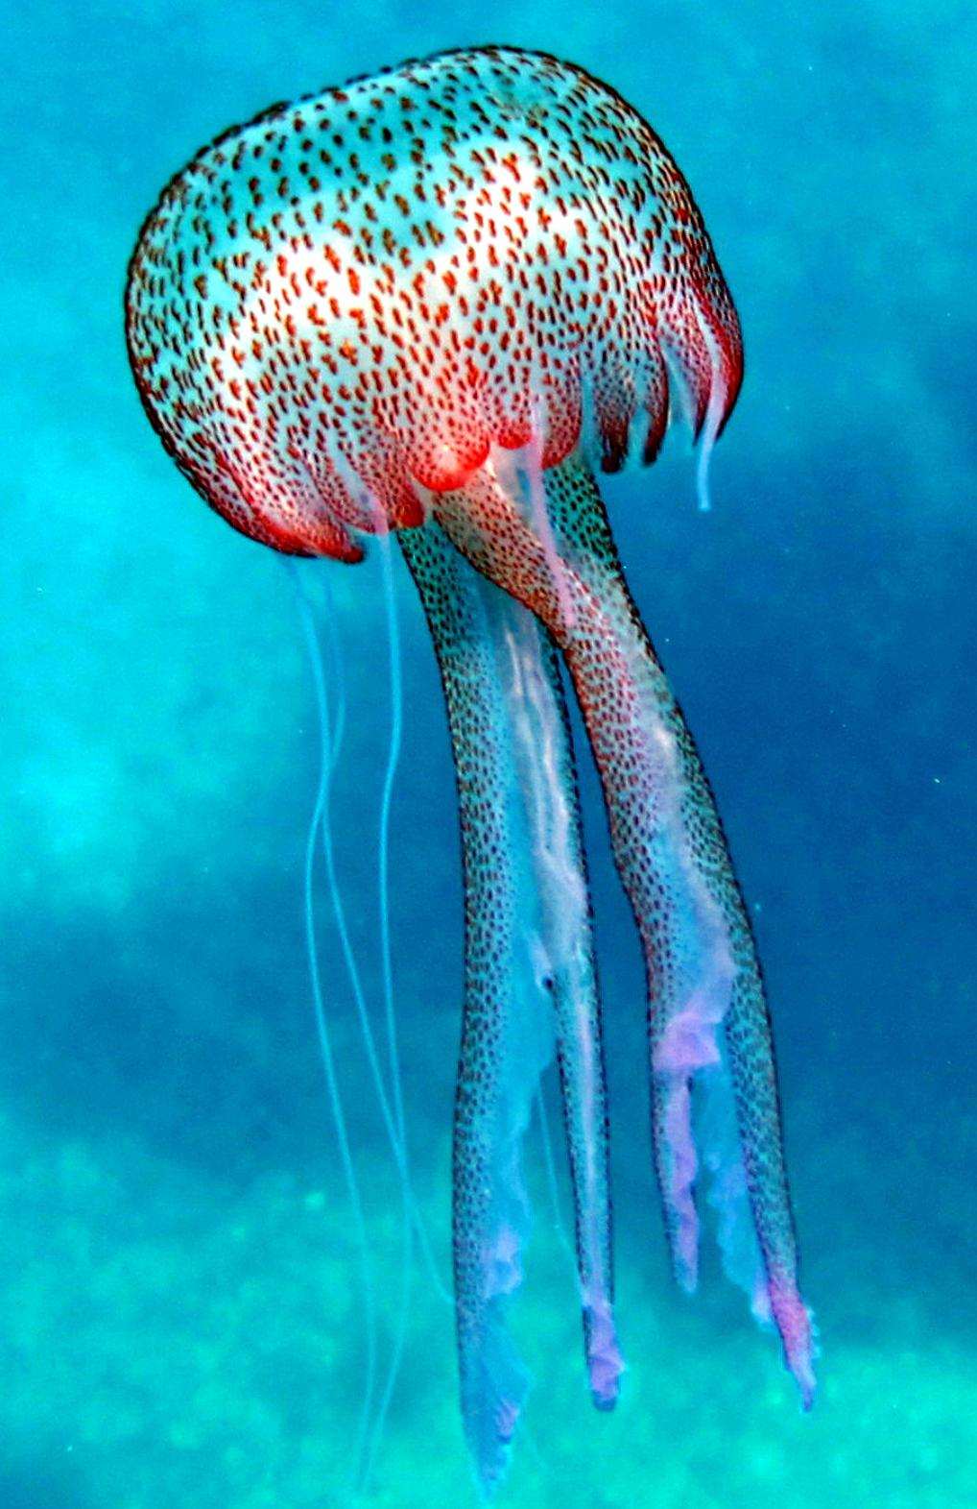
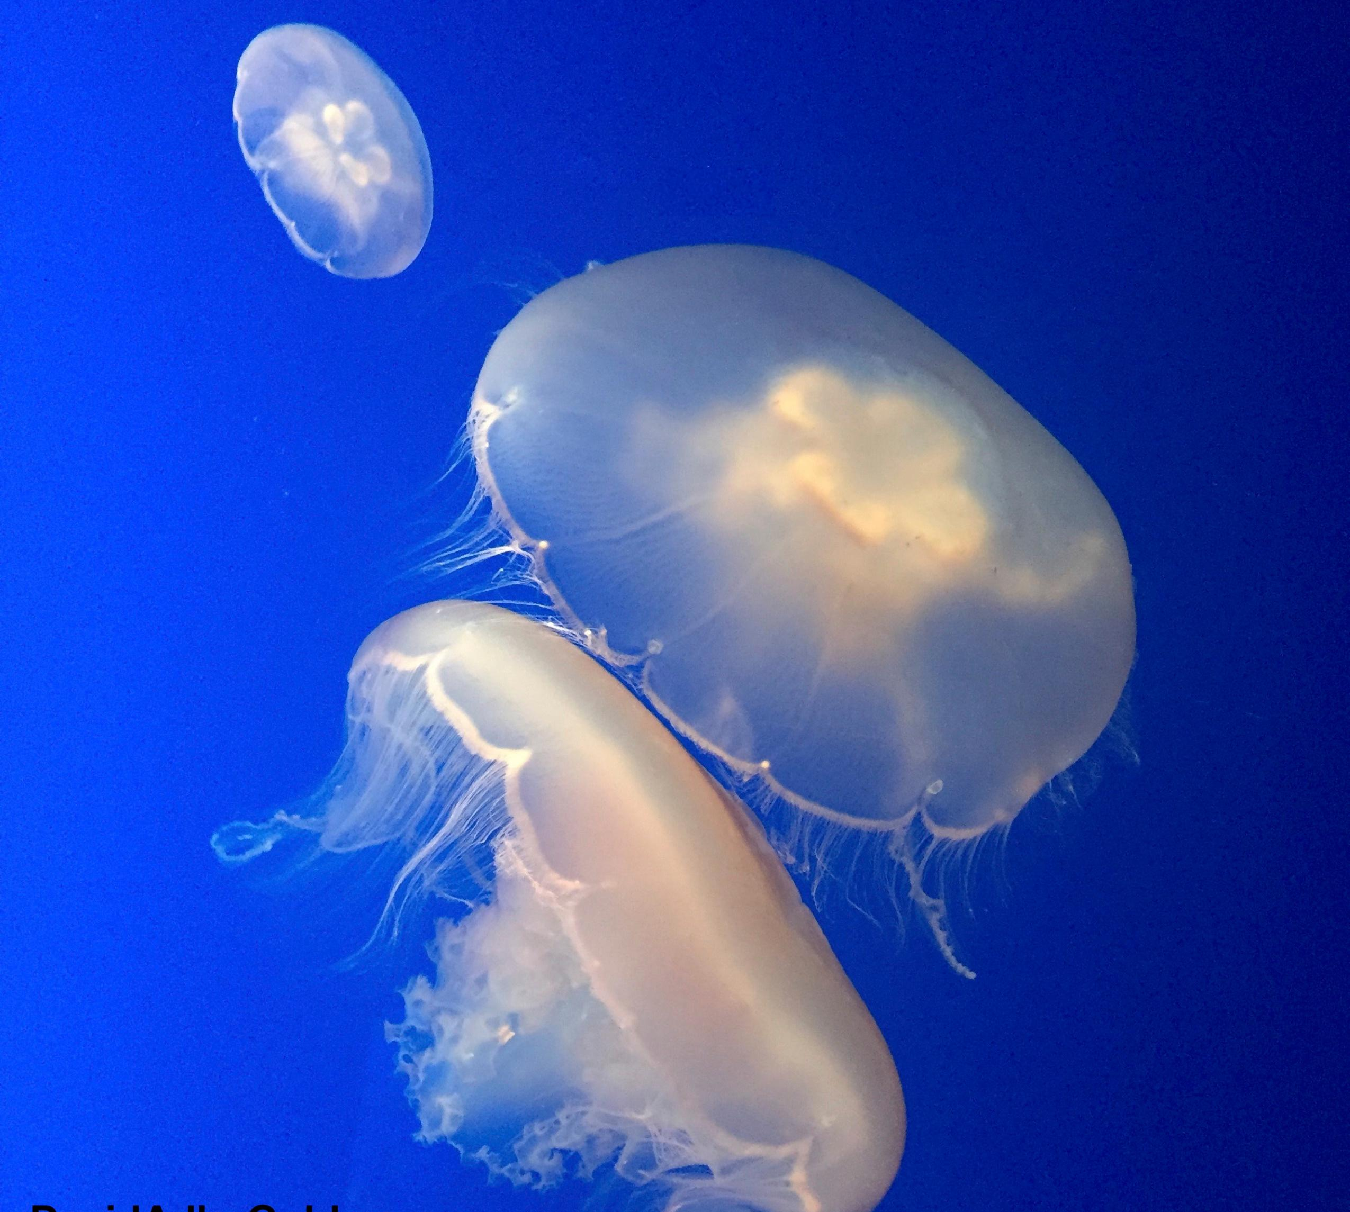
(B) Class - Scyphozoa
Animals are strictly marine and solitary.
These are free swimming; the medusoid phase is prominent.
Mesoglea is thick and it contain cells.
Examples : Jelly fish, Pelagia etc.

Slide 5
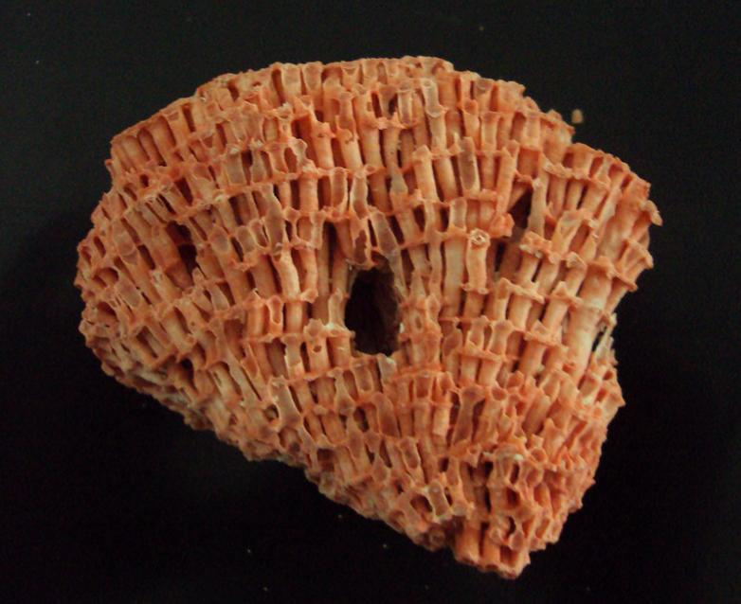
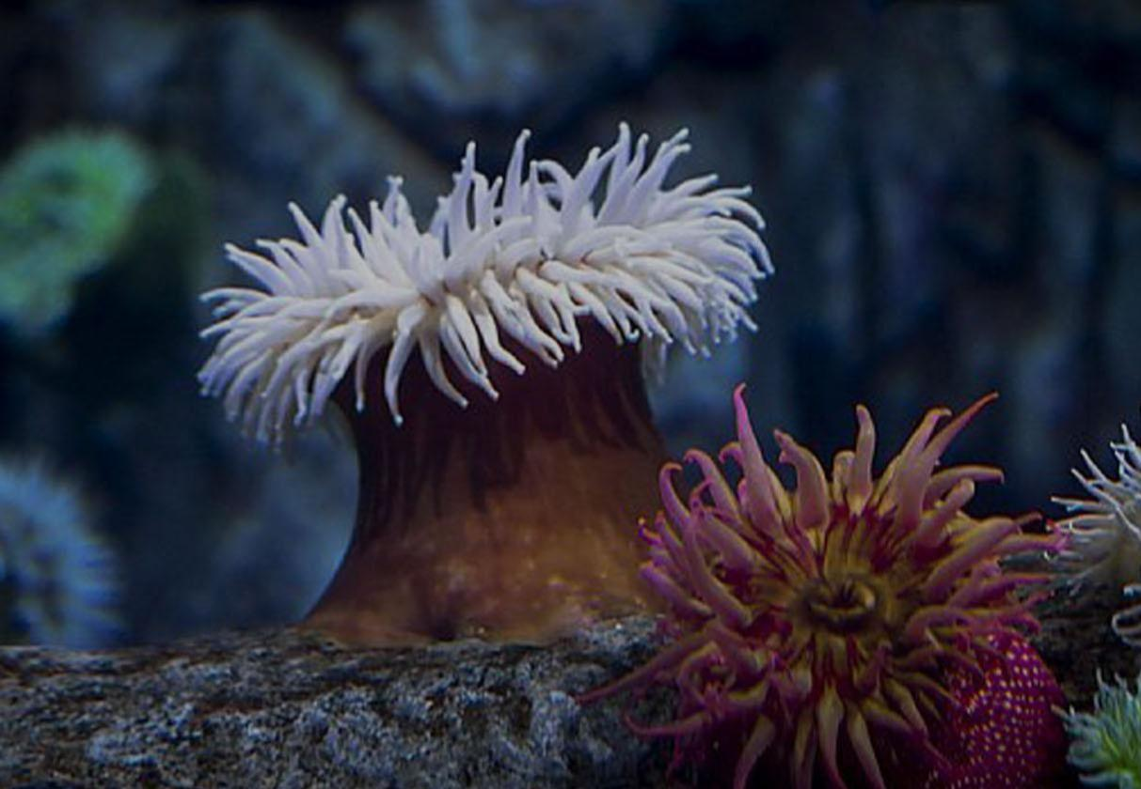
(C) Class - Hydrozoa
Animals are solitary or colonial.
These are strictly marine and are fixed to the substratum.
These are polyps only. The medusoid stage is absent.
Mesoglea contains cells as well as fibers.
Examples : Sea anemone, Tubipora

Slide 6
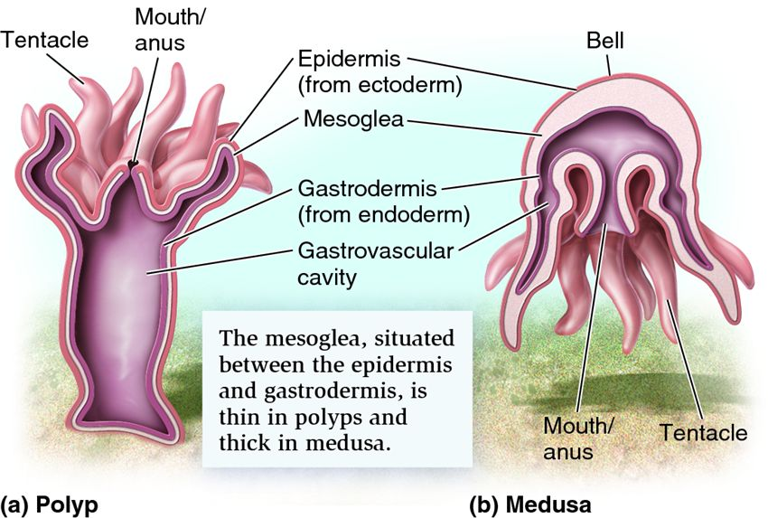
Polymorphism in Hydrozoa
Polymorphism can be defined as a phenomenon, when an organism is a colony of more- than two types of individuals or zooids, which are different in structure and perform diverse functions in a coordinated manner.
In Cnidarians, in general have two basic morphological types of individuals,.
These individuals called zooids.
One zooid is called “ polyp” while other zooid is called “ medusa”.

