Slide 1
WELCOME

Slide 4
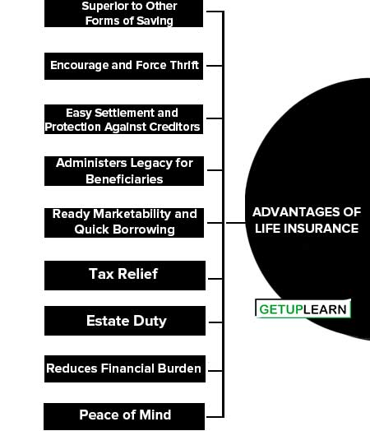

Slide 8
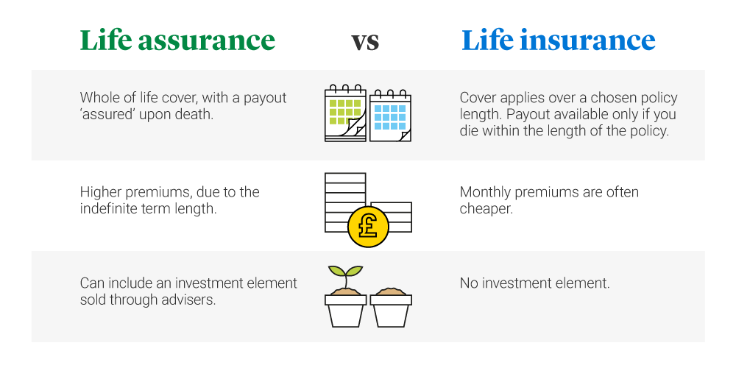

Slide 14
THANK YOU

