Slide 1
JANATA SHIKSHAN SANTHA’S
KISAN VEER MAHAVIDYALAYA, WAI
DEPARTMENT OF CHEMISTRY
TOPIC- ELEMENTARY QUANTUM MECHANICS
BSc III
SEMESTER V
PAPER XI PHYSICAL CHEMISTRY
PRESENTED BY
MISS. RAJESHWARI SHIVAJI KAMATE

Slide 2
Quantum Mechanics : -
Defination –
Quantum mechanics is the science of motion of micro particles.
Importance –
physicochemical properties of atoms and molecules, their structure, spectral behaviour and even reaction may be interpreted in terms of the motion of micro particles like electrons and protons.

Slide 3
Blackbody Radiation And Quantum Theory : -
Radiation –
Radiation is defined as a wave that consist of oscillating electric and magnetic field , it is also called electromagnetic wave. It is characterized by its wavelength λ and frequency ν, which are related as -
c - velocity of light, c = 3 x 10¹⁰ cms⁻¹
λν = c

Slide 4
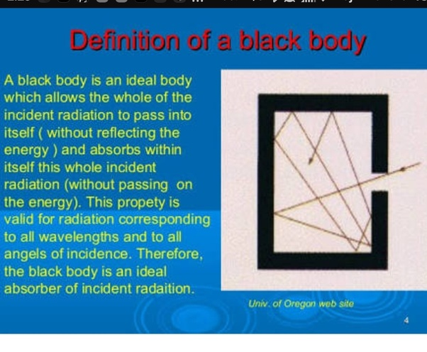
Blackbody Radiation :-
A black body can absorb all the radiation that falls on it.
The radiation emerging from the small hole of such a hollow enclosure is therefore , called “black body radiation.”
The intensity of radiation,i.e. the total radiation emitted per unit surface area, from a black body depends only on temperature(T) and is independent of the nature of the solid.

Slide 5
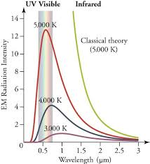
Distribution of Energy in the Blackbody Radiation : -
Radiation emitted by a black body is not confined to a single wavelength,but a spread over a wide spectrum.
This distribution is described in terms of a function 𝛒(𝛎)dν which denotes the density of the radiant energy in the frequency range ν and ν+ dν,i.e, the amount of radiation per unit volume of the black body chamber at a temperature T.
The experimental dependence of the energy density on temperature and wavelength (λ) is shown in fig .1

Slide 6
Lord Rayleigh(1900 )was the first to make an attempt at deriving an equation for distribution of radiation density in terms of classical laws of mechanics.He based his derivation on two theorems :
i) theorem of stationary waves in a hollow space and
ii) theorem of equipartition of energy
If the walls of black body chamber are assumed to be composed of a large number of harmonic oscillator that emit and absorb radiation continuously and are in equilibrium with the radiation field, then the radiation density is given by eqn-1
ρ(ν) ԁν = E n(ν)dν ……….(1)
Where E is average energy of the oscillator and n(ν) is the number of possible vibrations or wave motions per unit volume in the frequency range ν and ν + dν in the black body chamber. Rayleigh first calculated that –
………..(2)

Slide 7

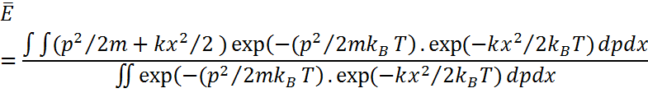
which is independent of the volume,shape and size of the chamber.Now, the energy of single harmonic oscillator a given by,
………….(3)
The average energy of an oscillator is therefore,calculated by taking the average over the Boltzmann distribution as follows:
…………….(4)
where k_{B} is the Boltzmann constant whose value is known to be 1.38 x 10⁻²³ JK⁻¹
And ∂τ = ∂p.∂x. Using eqn 3 for E in eqn.4,
……(5)

Slide 8
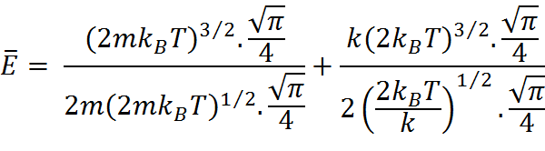



……………..(6)
………………(7)
………………..(8)
Substituting eqn .8 for and eqn .2 for n(ν) in eqn .1,we obtain an equation for density of radiation –
……………….(9)
This is Rayleigh - Jean’s law of radiation.
If we plot ρ(υ) against ν ,it runs to infinity as ν increases without showing any maximum.

Slide 9

Planck’s Law of Radiation -
In October 1900, the German physicist, Max Planck proposed a new emperical formula which agreed remarkably well with the observed energy curves of the black body radiation.The formula could be written as-
………….(10)
Where a and b are numerical constants.
In December,1900 Planck announced the theoretical derivation of his radiation law.

Slide 10


He proposed that a black body chamber was filled not only with radiation but also with molecules of a perfect gas, and dipole oscillators of molecular dimensions constituting the blackbody absorbed energy from the radiation and transferred it partly or wholly to the gas molecules when the latter collided with them.
Planck calculated that the number of oscillator per unit volume was so that the radiation density was given by eqn -11
……….(11)
Planck gaved up the hypothesis of continuous emission of radiation by oscillators and assumed that they emitted energy only when they acquired certain minimum energy E or an integral multiple of it,nE.
Futher ,E was directly proportional to ν, i.e.,
E = hν …………(12)
where the proportionality constant h,was called the Planck’s constant.

Slide 11


In the light of this hypothesis ,Planck calculated the mean energy of the oscillators as follows :
According to Maxwell- Boltzmann distribution law of energy , the probability that an oscillator will have energy E is exp(-E/k_{B}T).Now let N₀,N₁,N₂,…..N_{n}..be the number of oscillators having the energy 0,E,2E,…..nE….etc.,Then ,
N = N₀ +N₁ +N₂ +N₃ +………. + N_{n} + …… …….(13)
E_{T} = E (N₁ +2N₂+3N₃+…….nN_{n}+…….) ………..(14)
where N = total number of oscillators and E_{T} = total energy,
By Boltzmann’s law –
N_{n} = N₀ exp(-nE/k_{B}T) ………(15)
The mean energy of oscillator is-
………….(16)
………..(17)
,

Slide 12




Using Eq.17 for ,the energy density relation Eq.11,becomes –
Since E = hν
………..(18)
Equation .18 is known as the Planck’s radiation law.This has the same form as
equation .10,if a is put equal to and b equal to .

Slide 13
Thank you……

