Slide 1
JANATA SHIKSHAN SANTHA’S KISAN VEER MAHAVIDYALAYA, WAI DEPARTMENT OF CHEMISTRY
TOPIC- ELEMENTARY QUANTUM MECHANICS
BSc III
SEMESTER V
PAPER XI PHYSICAL CHEMISTRY
PRESENTED BY
MISS. RAJESHWARI SHIVAJI KAMATE

Slide 2
Heisenberg’s Uncertainty Principle -
Statement -
To explain the behaviour of electron ,German scientist Werner Heisenberg in 1927 have given a statement called as Heisenberg Uncertainty Principle which is stated as,
“Simultaneous and accurate determination of position and momentum (velocity) of a microscopic particle such as electron is impossible”.

Slide 3
In classical terms, when we think of a particle we think it to have a definite mass and when in motion to have a definite position and momentum at a definite time.
However Werner Heisenberg pointed out that “it was not possible, even in principle to determine both exact position and momentum, simultaneously of a particle like electron; if position is determined accurately the velocity (or momentum) becomes uncertain and vice versa.”
This “uncertainty” is not due to any lack of precision in measurement but due to inherent nature( wave- particle duality) of the particle.
Qualitatively this can be understood as follows.Suppose we want to locate the exact position of an electron.Ordinary light cannot be used for this purpose as its wavelength is many time greater than the size of the electron.
Light of shorter wavelength (ex. X-rays) has to be used.The position of the electron will be revealed by the scattering of the X-ray photon.

Slide 4
But in this process,the electron will suffer a recoil with the photon, and due to Compton effect it will suffer a change in the momentum.
Since there is no mean to determine the change in momentum,it is not possible to know the exact original momentum of the electron.
Thus the accuracy of measurement of position(x) is limited by wavelength(λ) of the photon used, and the minimum uncertainty(Δx) is equal to λ.The smaller the λ, the more accurately will be the position known,but by the equation(1), , greater will be momentum of the photon.
This will result in greater recoil of the electron and greater uncertainty in the determination
of momentum(Δp).
The principle of uncertainty is expressed mathematically as,
………………………..(2)
Δx.Δp_{x} ≈ h

Slide 5
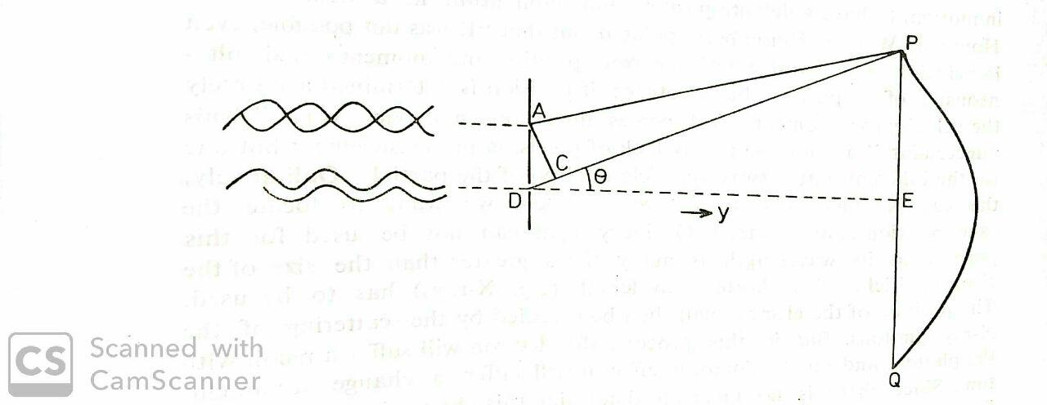
Equation. 2 may be derived in various way. Heisenberg derived it theoretically. Consider however an electron moving along the y axis, let it pass through a slit of width d to fall on a fluorescent screen where its position is recorded by production of a spot.
Fig.1. Diffraction of electron waves

Slide 6
There will be points of minimum and maximum intensity due to destructive
and constructive interferences.
When two waves originate from two points such that their path lengths to the
screen differ by λ/2, they will be out of the phase and the intensity of the
wave will be minimum ( point P and Q on the screen),
and when the path length differ by λ(in phase) the intensity will be
maximum (point E on the screen).
Let two such waves originating from the point A and D in the slit travelling along AP and DP interfere destructively to produce the intensity minimum at P.
Cutting from DP a distance CP is equal to AP gives DP - AP =DC =λ/2.But the
distances AP and DP are so large compared to the size (d) of the slit that the
∟APC≈ 0 or ∟PAC = ∟ACP ≈ 90^{0.}
Then ∟PDE = ∟DAC ≈ 90⁰ - ∟ADC = Ө

Slide 7
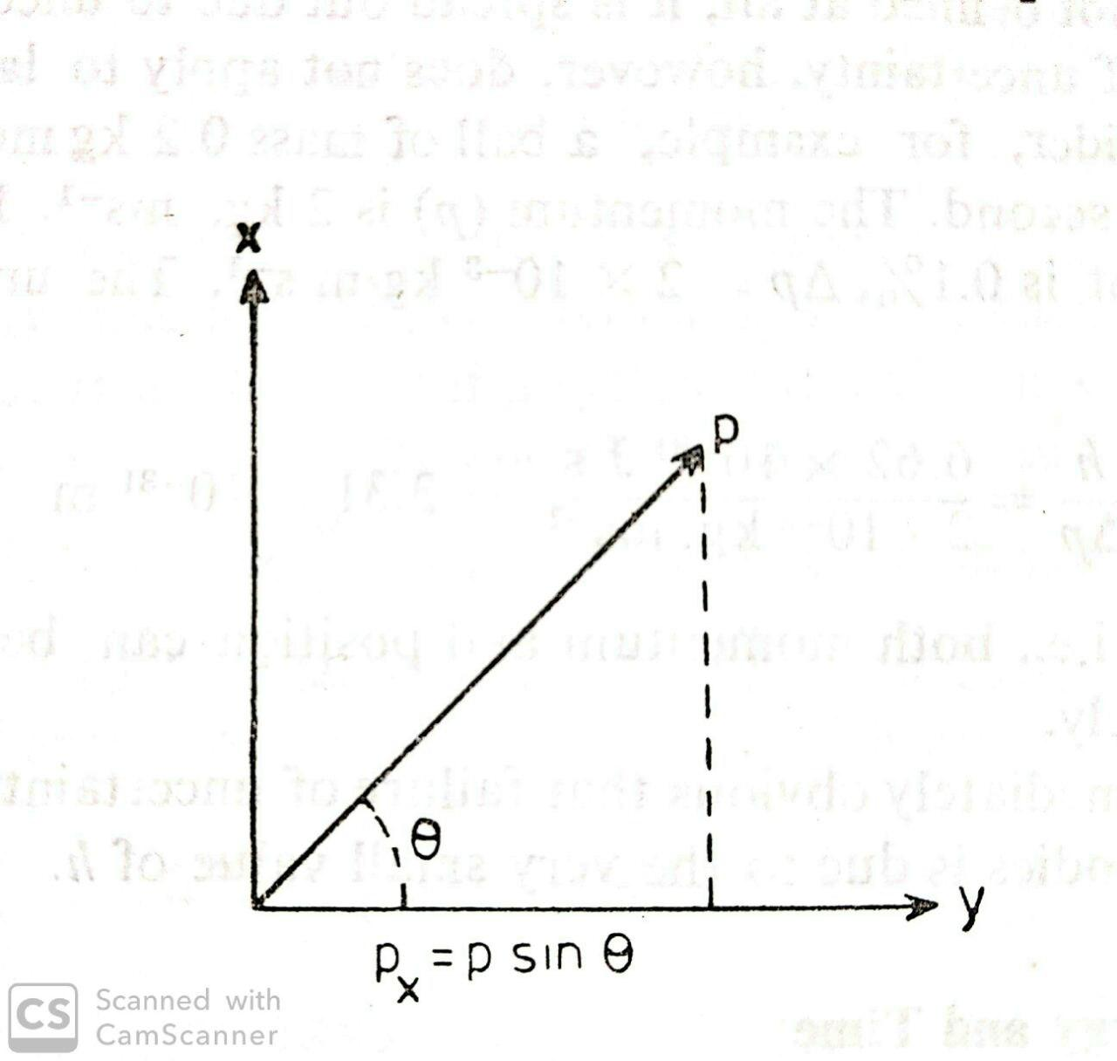
The uncertainty in the x-co-ordinate of the position of a single electron is given by equation 3
………………..(3)
Fig.3. x and y components of
momentum

Slide 8
Near the slit, where the electron is moving along the y-axis,the x-component of p,i.e.,
p_{x} is zero .On diffraction,angular range is 2Ө; but
p_{x} = p sinӨ ……………..(4)
At the point P or Q the value of px is governed by the angle of diffraction Ө,hence the
uncertainty Δp_{x} is p sinӨ - 0 =p sinӨ.Hence,
Which is same as equation .2

Slide 9
One –Dimensional Simple Harmonic Oscillator-
A diatomic vibrating molecule can be represented by a simple model ,the so called simple harmonic oscillator.(S.H.O)
According to Hooke’s law, the force acting on the molecule is given by
The potential energy V(x) of this molecule is given by-
………….(1)
Eqn.(1) is the equation of a parabola.Thus, if we plot potential energy of a particle executing simple harmonic oscillations as a function of displacement from the equilibrium position, we get a curve as shown in Fig .1
f = - kx

Slide 10
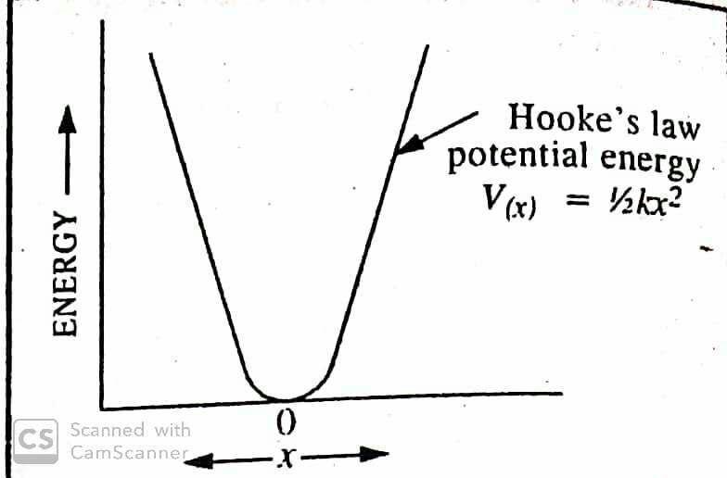
Fig.1.Potential energy diagram for a simple harmonic oscillator
The vibrational frequency of the oscillator of mass m is given by –
………………(2)
It is more accurate to define the vibrational frequency as-
………(3)

Slide 11
Where µ is the reduced mass of the diatomic molecule defined as –
………….(3)
Where m₁ and m₂ are the atomic masses of the two atoms.
Using the potential energy given by eqn.1,for one-dimensional S.H.O.,the Schrödinger equation is represented as-
…………..(4)
Mathematically, Eq.4 may be written as –
……………(5)
Defining α and β as α = and β = , ………………(6)
Eqn.5 becomes ………….(7)
Ψ(x)

Slide 12
Defining a new variable ξ = β^{1/2} x, the above equation becomes
…………(8)
Eq.8 has a solution of the form
………(9)
Using this solution, eqn.8 becomes
……….(10)
Eq.10 is identical in form to a well known second –order differential equation, called the Hermite equation,
The Hermite equation has solutions which depends upon the value of n.These solution are called Hermite polynomials,H_{n}(ξ),i.e., Φ(ξ) ≡ H_{n}(ξ).

Slide 13
The Hermite polynomial of degree n is defined as –
………….(12)
A few Hermite polynomials are given below:
H₀(ξ) = 1 H₃(ξ) = 8ξ³ -12ξ
H₁(ξ) = 2ξ H₄(ξ) = 16ξ⁴-48ξ² +12
H₂(ξ) = 4ξ² -2
The normalized wave functions of the one dimensional S.H.O.are then written as-
…………..(13)
Where n =0,1,2,3,…..

Slide 14
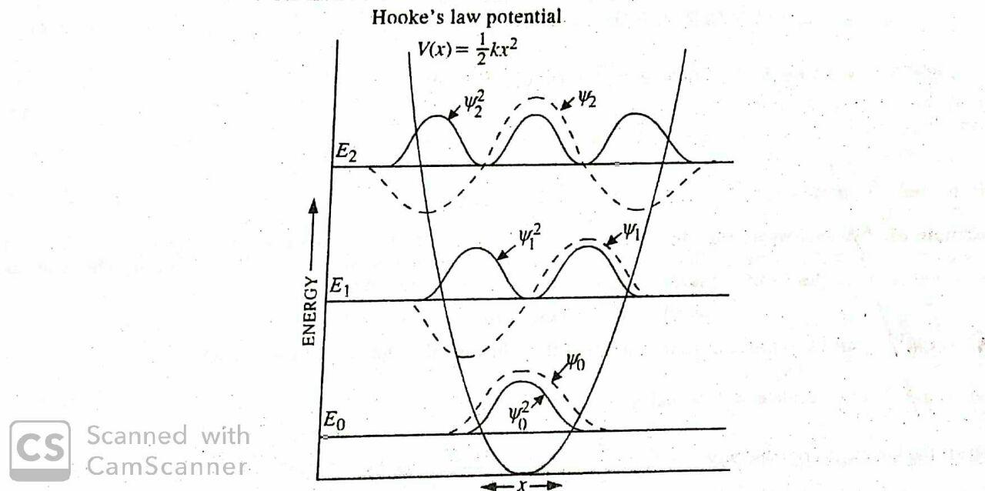
The first three wave functions(with n=0,1,2,3….),the corresponding energy levels and the probability functions Ψ²_{n} for the S.H.O.,are shown in fig.2
Fig.2. The wave function, the probability functions and the energy levels of a simple
harmonic oscillator.

Slide 15
Energy of S.H.O. -
The energy of the S.H.O.is obtained by comparing eqns.10 and 11,hence we find that-
α/β = 2n + 1 ……………(14)
Substituting for α and β from eqn.6,we have
(2mE/ħ²)(mk)^{1/2}/ħ = 2n + 1 ……………(15)
Or ………….(16)
From eqn.2,(k/m)^{1/2} =2πν ………….(17)
Combining eqn .16 and 17,we have

Slide 16
; n =0,1,2,3,4,……(ħ =h/2π) ……….(18)
The energy state with n = 0 is the vibrational ground state with energy
…………(19)
This energy is called the zero point energy of the oscillator.

Slide 17
The Rigid Rotor (or Rotator) -
A diatomic molecule rotating about an axis perpendicular to the internuclear axis and passing through the centre of gravity of the molecule,constitutes an example of a rigid rotor,it being assumed that the internuclear distance does not change during rotation.The kinetic energy(K.E.) of the molecule is given by
…………..(1)
Where ω is the angular velocity and I is the moment of inertia of the rotating molecule.The angular momentum L=Iω.
If no force acts on the rotor,we can set the potential energy V=0.Hence, the Hamiltonian is expressed as-
H = T + V =L²/2I ……………….(2)

Slide 18
The expression for L² in spherical polar coordinate(r,θ,ϕ) is given by-
………….(3)
The Schrödinger equation may be written as
…………(4)
The above equation may be written as-
…………….(5)
Equation .5 contains two angular variables θ and ϕ.It can be solved by the methods of separation of variables,i.e,we look for a solution of form
Ψ(θ,ϕ) = Θ(θ)Ф(ϕ) ……………(6)
Substituting Eq.6 into Eq.5,we obtain
…………..(7)

Slide 19
We can set both sides of eqn.7 equal to a constant ,say m² ,thereby obtaining two differential equations each in one variable.These equation are:
…………..(8)
…………(9)
Where β = 8π²IE/h² Eqn.8 has the solution
Ф(ϕ)=N exp(±imϕ), i=√-1 ……….(10)
This wave function is acceptable provided m is an integer.This condition arises because Ф must be single-valued.Thus,
Ф(ϕ) = Ф(ϕ+2π) ……….(11)
It follows,therefore,that exp(2πmi) = 1 ………(12)
(Euler’s relation) ………..(13)
∴ cos 2πm + isin 2πm = 1 …………(14)

Slide 20
This can be true only if m= 0,±1,±2,±3,……….,etc. Let us now normalize the wave function Ф(ϕ) to determine the normalization constant N.
………..(15)
Or ………..(16)
or
N = (2π)^{-1/2} …………(17)
Hence,the normalized wave functions become
Ф_{±m}(ϕ) =(2π)^{-1/2} exp(±imϕ); m=0,1,2,3,……. ………….(18)

Slide 21
If β = l(l+1) where l is the rotational quantum number,then this equation becomes a standard mathematical equation whose solutions are known to be associated Legendre polynomials P_{l}^{|m|} (cos θ) where l is either zero or a positive integer and l > |m|.
The normalized solution are given by-
………..(19)
The energy eigenvalues of the rigid rotor are obtained as follows :
β =8π²IE/h² = l(l +1) …………(20)
Thus …………..(21)
In spectroscopy it is customary to use the symbol J rather than l for the rotational quantum number so that the rotational energy levels are given by the expression,
………..(22)

Slide 22
The Schrödinger Equation for Hydrogen Atom -
Hydrogen atom is the simplest of all atoms.It is a three-dimensional system and the Schrödinger equation for this system is –
…………..(1)
Where ………….(2)
And where the Laplacian operator in Cartesian coordinates is given by
……………(3)
The potential energy of interaction between the electron and the nucleus is given by-
V(r) = -Ze²/4πε₀r …………….(4)

Slide 23
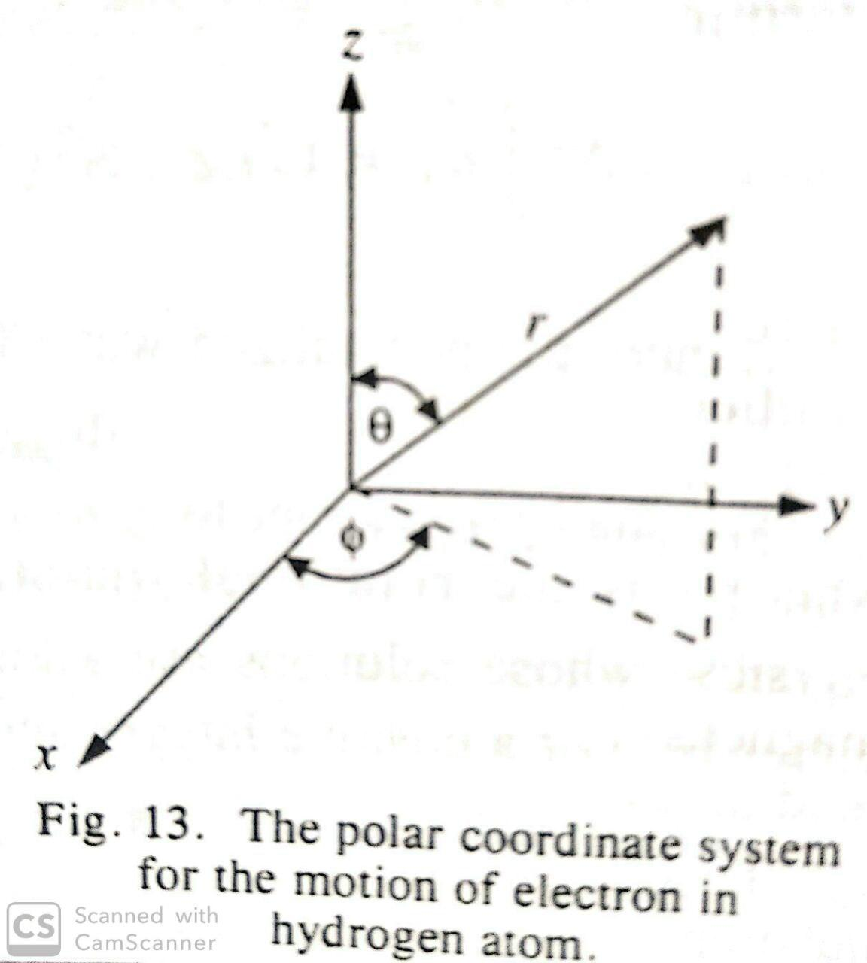
Since this attractive potential has spherical symmetry depending only upon r,it is convenient to express the Schrödinger equation in terms of polar coordinates (r,θ,ϕ),rather than Cartesian coordinates(x,y,z).The Cartesian coordinates are related to polar coordinates as follows:
x = r sin θ cos ϕ
y = r sin θ sin ϕ
z = r cos θ

Slide 24
The Schrödinger equation for hydrogen atom in terms of polar coordinates becomes
……….(5)
where μ is reduced mass,μ= m_{e}m_{n}/(m_{n}+m_{e})
Assuming that V(r) is a function of r only, the above wave equation can be solved by separating the variables:
Ψ(r,θ,ϕ) = R(r)Θ(θ)Ф(ϕ) …………..(6)
Where R(r) is the radial function of r only,and Θ(θ) and Ф(ϕ) are angular functions.
Substituting Eq.6 into Eq.5 we get an equation which can be separated into three equation which are :
………………(7)
……………..(8)

Slide 25
Or ………..(9)
Where m and β are constants.
The complete solution of Eq.5 comprises the solutions of Eqns.7,8 and 9 .
The energy values of hydrogen –like atoms are found to be given by
…………….(10)
These energy levels are the same as those obtained from Bohr theory.The normalized solutions of radial equation.7 are found to be –
………….(11)

Slide 26
Where and
are the associated Legendre polynomials defined as-
……………..(12)
Where s = 2l+1 and r = n+l and n=1,2,3,4,……
The number n is called the principal quantum number
The probability of finding the electron between r and r+dr is given by the quantity R*(r)R(r)r²dr.
Angular Wave Functions. The solution of Eq.8 gives
…………….(13)
Where are called associated Legendre polynomials defined as-
…………….(14)

Slide 27
In the above equation ,the quantum number l(=0,1,2,….)is the azimuthal quantum number.It determines the shape of the atomic orbital.The solution of Eq.9 gives
……………..(15)
Where 1/√2π is the normalization constant and m=0,±1,±2,……,±l is the magnetic quantum number.
To sum up ,the solution of eq.7 gives quantum numbers n and l.The solution of Eq.8 gives quantum numbers l and m, and the solution of eq.9 gives quantum number m.In other words,the quantum numbers n, l, and m follow directly from the wave mechanical treatment.

Slide 28
Problems-
Given that the work function for sodium metal is 1.82 eV,Calculate the threshold frequency υ₀ for sodium.
Sol-We must first convert ϕ from eV to Joules
ϕ =1.82 eV = (1.82 eV)(1.602 x 10⁻¹⁹ J.eV⁻¹)
= 2.92 x 10⁻¹⁹ J
ϕ = hυ₀
∴ υ₀= ϕ / h
= 2.92 x 10⁻¹⁹ J/6.626 x 10⁻³⁴ J.s
= 4.40 x 10¹⁴ Hz

Slide 29
2)When lithium is irradiated with light ,the kinetic energy of the ejected electrons is
2.935 x 10⁻¹⁹ J for λ=300.0 nm and 1.280 x 10⁻¹⁹ J for λ=400.0 nm.Calculate
(a) the Planck constant, (b)the threshold frequency, and (c) the work function of lithium.
Sol : (a) we know that :– K.E. =hν – hν₀
or
From which we obtain ,
(b)Using the λ=300 nm data,we have
ν̥ =5.564 x 10¹⁴ Hz
(c) Φ =hν̥ = 3.687 x10⁻¹⁹ J = 2.301 eV

Slide 30
3) Calculate the de Broglie wavelength for a baseball(5.0 oz) travelling at 90 mph.
Sol: Five ounces corresponds to,1oz = 0.0283 kg
m =(5.0 oz )(0.0283kg) = 0.14 kg
And 90 mph corresponds to, 1mile =1610 m
The momentum of the baseball is-
p = mν =(0.14 kg)(40 m.s⁻¹) =5.6 kg.m.s⁻¹
The de-Broglie wavelength is –

Slide 31
4) Calculate the de –Broglie wavelength of an electron travelling at 1.00% of the
speed of light.
Sol: The mass of an electron is 9.109 x 10⁻³¹ kg.One percent of the speed of light is
ν = (0.0100)(2.998 x10⁸ m.s⁻¹) = 2.998 x 10⁶ m.s⁻¹
The momentum of the electron is given by –
p = m_{e}ν = (9.109 x 10⁻³¹ kg)(2.998 x 10⁶ m.s⁻¹)
=2.73 x 10⁻²⁴ kg.m.s⁻¹
The de Broglie wavelength of this electron is –

Slide 32
5) Calculate the uncertainty in the position of a baseball thrown at 90 mph if we
measure its momentum to a millionth of 1.0%.
Sol – 90 mph – 5.6 kg.m.s⁻¹
A millionth of 1.0% of this value is 5.6 x 10⁻⁸ kg .m.s⁻¹
So ∆p = 5.6 x 10⁻⁸ kg.m.s⁻¹
The minimum uncertainty in the position of the baseball is
= 1.2 x 10⁻²⁶ m

Slide 33
6)What is the uncertainty in momentum if we wish to locate an electron within an atom, so that ∆x is approximately 50 pm ?
Sol -
= 1.3 x 10⁻²³ kg.m.s⁻¹
Because p = mν and the mass of the electron is 9.11 x 10⁻³¹ kg
∴
= 1.4 x 10⁷ m.s⁻¹

Slide 34
Transition Dipole Moment Integral-
Transition probability-
The transition probability is defined as the probability of particular spectroscopic transition to take place.
It depends on two things-
the nature of initial and final state wavefunctions.
how strongly photons interact with an eigenstate.
Selection rules are utilized to determine whether a transition is allowed or not.
Selection rules have been divided into the electronic selection rules, vibrational selection rules, and rotational selection rules.

Slide 35
Transition Moment-
In an atom or molecule, an electromagnetic wave can induce an oscillating electric or magnetic moment. If the frequency of the induced electric or magnetic moment is the same as the energy difference between one eigenstate Ψ₁ and another eigenstate Ψ₂, the interaction between an atom or molecule and the electromagnetic field is resonant (which means these two have the same frequency).
Typically, the amplitude of this (electric or magnetic) moment is called the transition moment. In quantum mechanics, the transition probability of one molecule from one eigenstate Ψ₁ to another eigenstate Ψ₂ is given by , and is called the transition dipole moment, or transition moment, from Ψ₁ to Ψ₂.

Slide 36
In mathematical form it can be written as-
If we have a system with n molecules and each has charge Q_{n}, and the dipole moment operator is can be written as
the is the position vector operator.

Slide 37
Transition Moment Integral-
Based on the Born-Oppenheimer approximation, the fast electronic motion can be separated from the much slower motion of the nuclei. As a result, the total wavefunction can be separated into electronic, vibrational, and rotational parts:
Ψ(r,R)=Ψ_{e}(r,Re)Ψ_{v}(R)Ψ_{r}(R)
The Born-Oppenheimer approximation assumes that the electronic wavefunction, Ψ_{e}, is approximated in all electronic coordinates at the equilibrium nuclear coordinates (R_{e}).
Since mass of electrons is much smaller than nuclear mass, the rotational wavefunction, Ψ_{r}, only depends on nuclear coordinates. The rotational wavefunction could provide important information for rotational selection rules.With the rotational part removed, the transition moment integral can be expressed as
M=∬Ψ′_{e}(r,R_{e})⋅Ψ′_{v}(R)(μ_{e}+μ_{n})Ψ′′_{e}(r,R_{e})⋅Ψ′′_{v}(R)drdR

Slide 38
Both the nuclear and electronic parts contribute to the dipole moment operator. The above equation can be integrated by two parts, with μ_{n} and μ_{e} respectively.
A product of two integral is obtained:
M=∫Ψ′_{e}(r,R_{e})⋅μ_{e}⋅Ψ′′_{e}(r,R_{e})dr∫Ψ′_{v}(R)⋅Ψ′′_{v}(R)dR+∫Ψ′_{v}(R)⋅μ_{n}⋅Ψ′′_{v}(R)dR∫Ψ′_{e}(r,R_{e})Ψ ′′_{e}(r,R_{e})dr
Because different electronic wavefunctions must be orthogonal to each other, hence ∫Ψ′_{e}(r,R_{e})Ψ′′_{e}(r,R_{e})dr is zero, the second part of the integral should be zero.
The transition moment integral can be simplified as
M=∫Ψ′_{e}(r,R_{e})⋅μ_{e}⋅Ψ′′_{e}(r,R_{e})dr∫Ψ′_{v}(R)⋅Ψ′′_{v}(R)dR
The above equation is of great importance because the first integral defines the electronic selection rules, while the second integral is the basis of vibrational selection rules.

Slide 39
Rotational Selection rules
1. Transitions with ΔJ=±1 are allowed;
Photons do not have any mass, but they have angular momentum. The conservation of angular momentum is the fundamental criteria for spectroscopic transitions. As a result, the total angular momentum has to be conserved after a molecule absorbs or emits a photon. The rotational selection rule relies on the fact that photon has one unit of quantized angular momentum. During the photon emission and absorption process, the angular moment J cannot change by more than one unit.
Let's consider a single photon transition process for a diatomic molecule. The rotational selection rule requires that transitions with ΔJ=±1 are allowed. Transitions with ΔJ=1 are defined as R branch transitions, while those with ΔJ=-1 are defined as P branch transitions.

Slide 40
2. ΔJ=0 transitions are allowed when two different electronic or vibrational states are involved: (X'', J''= m) → (X', J'= m).
The Q branch transitions will only take place when there is a net orbital angular momentum in one of the electronic states. Therefore, Q branch does not exist for ¹Σ↔¹Σ electronic transitions because Σ electronic state does not possess any net orbital angular momentum.
On the other hand, the Q branch will exist if one of the electronic states has angular momentum. In this situation, the angular momentum of the photon will cancel out with the angular momentum of the electronic state, so the transition will take place without any change in the rotational state.

Slide 41
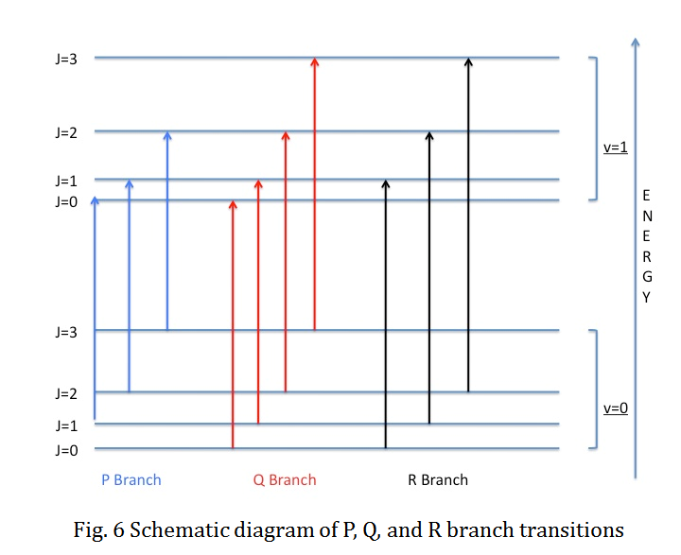
The schematic of P, Q, and R branch transitions are shown below:

Slide 42
With regard to closed-shell non-linear polyatomic molecules, the selection rules are more complicated than diatomic case. The rotational quantum number J remains a good quantum number as the total angular momentum if we don't consider the nuclear spin. Under the effect of single photon transition, the change of J is still limited to a maximum of ± 1 based on the conservation of angular momentum.
However, the possibility of Q branch is greatly enhanced irrelevant to the symmetry of the lower and upper electronic states. The rotational quantum number K is introduced along the inertial axis. For polyatomic molecules with symmetric top geometry, the transition moment is polarized along inertial axis. The selection rule becomes ΔK=0.

Slide 43
Electronic Selection Rules
In atoms
Atoms are described by the primary quantum number n, angular momentum quantum number L, spin quantum number S, and total angular momentum quantum number J. Based on Russell-Saunders approximation of electron coupling, the atomic term symbol can be represented as ^{2S+1}L_{J}.
The total spin cannot change, ΔS = 0;
The change in total orbital angular momentum can be ΔL= 0, ±1, but L= 0 ↔ L= 0 transition is not allowed;
The change in the total angular momentum can be ΔJ = 0, ±1, but J=0 ↔J=0 transition is not allowed;
The initial and final wavefunctions must change in parity. Parity is related to the orbital angular momentum summation over all elections Σl_{i}, which can be even or odd; only even ↔ odd transitions are allowed.

Slide 44
In molecules
.
The electronic-state configurations for molecules can be described by the primary quantum number n, the angular momentum quantum number Λ, the spin quantum number S, which remains a good quantum number, the quantum number Σ (S, S-1, ..., -S), and the projection of the total angular momentum quantum number onto the molecular symmetry axis Ω, which can be derived as Ω=Λ+Σ. The term symbol for the electronic states can be represented as
^{2S+1}Λ^{(+/−)}_{Ω,(g/u)}
Group theory makes great contributions to the prediction of the electronic selection rules for many molecules.

Slide 45
1. The total spin cannot change, ΔS=0; the rule ΔΣ=0 holds for multiplets;
If the spin-orbit coupling is not large, the electronic spin wavefunction can be separated from the electronic wavefunctions. Since the electron spin is a magnetic effect, electronic dipole transitions will not alter the electron spin. As a result, the spin multiplicity should not change during the electronic dipole transition.
2. The total orbital angular momentum change should be ΔΛ=0, ±1;
For heteronuclear diatomic molecules with C_{∞v} symmetry, a Σ⁺ ↔Π transition is allowed according to ΔΛ selection rule.
3. Parity conditions are related to the symmetry of the molecular wavefunction reflecting against its symmetry axis. For homonuclear molecules, the g ↔ u transition is allowed.
For heteronuclear molecules, + ↔ + and - ↔ - transitions apply;
Similarly, for a molecule with an inversion center, a subscript g or u is used to reveal the molecular symmetry with respect to the inversion operation, i. The x, y, and z components of the transition dipole moment operator have u inversion symmetry in molecule with inversion center.Therefore, only g ↔ u transition is allowed.

Slide 46
Vibrational Selection rules
Transitions with Δv = ±1, ±2, ... are all allowed for anharmonic potential, but the intensity of the peaks become weaker as Δv increases.
v = 0 to v = 1 transition is normally called the fundamental vibration, while those with larger Δv are called overtones.
Δv = 0 transition is allowed between the lower and upper electronic states with energy E₁ and E₂ are involved, i.e. (E₁, v'‘ = n) → (E₂, v‘ = n), where the double prime and prime indicate the lower and upper quantum state.
The geometry of vibrational wavefunctions plays an important role in vibrational selection rules. For diatomic molecules, the vibrational wavefunction is symmetric with respect to all the electronic states. Therefore, the Franck-Condon integral is always totally symmetric for diatomic molecules. The vibrational selection rule does not exist for diatomic molecules

Slide 47
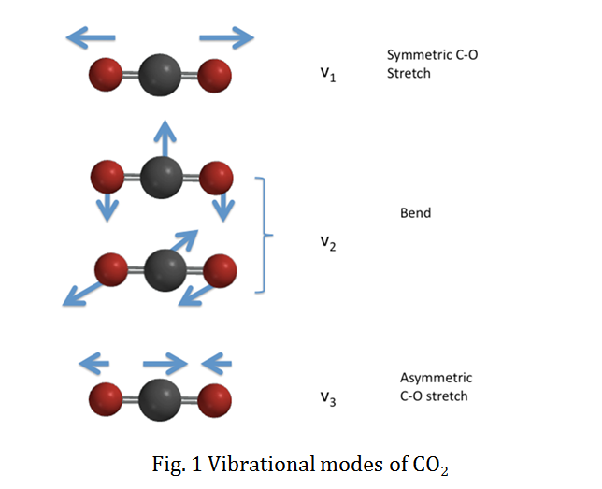
For polyatomic molecules, the nonlinear molecules possess 3N-6 normal vibrational modes, while linear molecules possess 3N-5 vibrational modes. Based on the harmonic oscillator model, the product of 3N-6 normal mode wavefunctions contribute to the total vibrational wavefunction, i.e.
ψ_{vib}=∏_{3N−6}ψ₁ψ₂ψ₃...ψ_{3N−6}
We will use CO₂ as an example to specify the vibrational selection rule. CO₂ has four vibrational modes as a linear molecule. The vibrational normal modes are illustrated in the figure below:

Slide 48
Vibronic Coupling
Why can some electronic-forbidden transitions be observed as weak bands in spectrum? It can be explained by the interaction between the electronic and vibrational transitions. The word "vibronic" is the combination of the words "vibrational" and "electronic.“
Because the energy required for one electronic state to another electronic state (electronic transition, usually in the UV-Vis region) is larger than one vibrational state to another vibrational state (vibrational transition, usually in the IR region), sometimes energy (a photon) can excite a molecule to an excited electronic and vibrational state. The bottom figure shows the pure electronic transition (no vibronic coupling) and the electronic transition couples with the vibrational transition (vibronic coupling).

Slide 49
