Slide 1
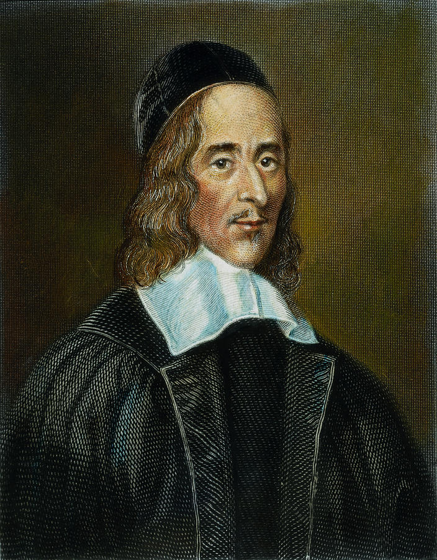
THE COLLAR
George Herbert
Mr: J.B.Khot
Assistant Professor
Kisan Veer Mahavidyalaya, Wai
Dist: Sat ara MAHARASHTRA

Slide 2
About the Poet
George Herbert (3 April 1593 – 1 March 1633) was a Welsh-born poet, orator, and priest of the church of England.
A major metaphysical poet
Notable for the purity and effectiveness of his choice of words.
One of the foremost British devotional lyricists.
He served in the Parliament of England in 1624 and briefly in 1625.

Slide 3
About the Poem
Published in 1633.
The poem depicts a man who is experiencing a loss of faith and feelings of anger over the commitment he has made to God.
He denounces his commitments and proclaims himself "free".
The poem's themes include the struggle with one's beliefs and the desire for autonomy in defiance of religious restriction.

Slide 4
The Collar
I struck the board, and cried, “No more;
I will abroad!
What? shall I ever sigh and pine?
My lines and life are free, free as the road,
Loose as the wind, as large as store.
Shall I be still in suit?
Have I no harvest but a thorn
To let me blood, and not restore
What I have lost with cordial fruit?

Slide 5
Sure there was wine
Before my sighs did dry it; there was corn
Before my tears did drown it.
Is the year only lost to me?
Have I no bays to crown it,
No flowers, no garlands gay? All blasted?
All wasted?
Not so, my heart; but there is fruit,
And thou hast hands.

Slide 6
Recover all thy sigh-blown age
On double pleasures: leave thy cold dispute
Of what is fit and not. Forsake thy cage,
Thy rope of sands,
Which petty thoughts have made, and made to thee
Good cable, to enforce and draw,
And be thy law,
While thou didst wink and wouldst not see.
Away! take heed;
I will abroad.

Slide 7
Call in thy death’s-head there; tie up thy fears;
He that forbears
To suit and serve his need
Deserves his load.”
But as I raved and grew more fierce and wild
At every word,
Methought I heard one calling, Child!
And I replied My Lord.

Slide 8
Thank
You

