Slide 1
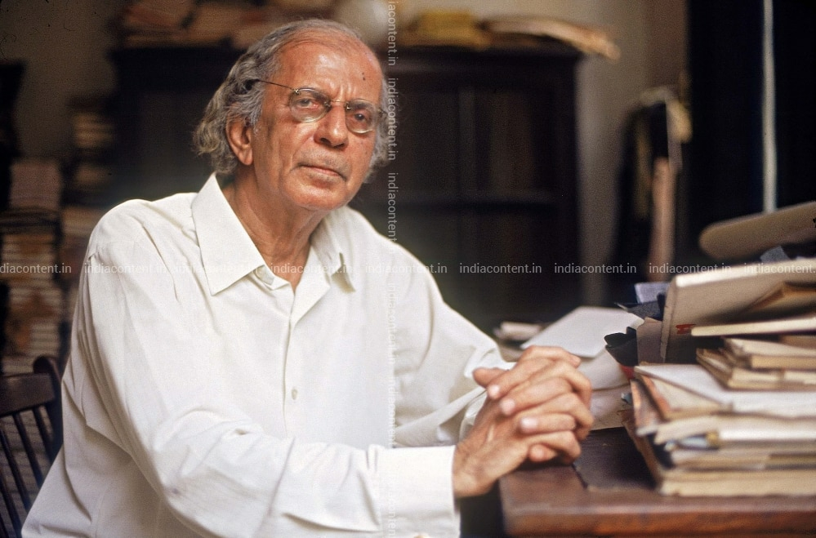
THE PROFESSOR
Nissim Ezekiel ( 1924 – 2004)
Mr : J. B. Khot
MA SET
Department of English
Kisan Veer Mahavidyalaya, Wai (Satara)

Slide 2
About the Poet
He was awarded the Sahitya Akademi Award in 1983 for his collection, "Latter-Day Psalms", by the Sahitya Akademi, India's National Academy of Letters.
Ezekiel has been applauded for his subtle, restrained and well crafted diction.

Slide 3
About the Poem
A satire on typical Professors of India.
A dramatic monologue.
A professor namely Professor Seth meets a person who was once his student.
The professor begins boasting about himself and about his sons and sons-in-law.
He mispronounces various words and also uses the wrong phrases.
The poem consists of a single stanza having 35 lines.

Slide 4
Remember me? I am Professor Sheth. Once I taught you geography. Now I am retired, though my health is good. My wife died some years back. By God’s grace, all my children Are well settled in life. One is Sales Manager,One is Bank Manager, Both have cars.Other also doing well, though not so well. Every family must have black sheep. Sarala and Tarala are married, Their husbands are very nice boys. You won’t believe but I have eleven grandchildren.

Slide 5
How many issues you have? Three? That is good. These are days of family planning. I am not against. We have to change with times. Whole world is changing. In India also We are keeping up. Our progress is progressing. Old values are going, new values are coming. Everything is happening with leaps and bounds. I am going out rarely, now and then Only, this is price of old age But my health is O.K. Usual aches and pains. No diabetes, no blood pressure, no heart attack. This is because of sound habits in youth. How is your health keeping? Nicely? I am happy for that.

Slide 6
This year I am sixty-nine and hope to score a century. You were so thin, like stick, Now you are man of weight and consequence. That is good joke. If you are coming again this side by chance, Visit please my humble residence also. I am living just on opposite house’s backside.

Slide 7
Thank
You

