Slide 1
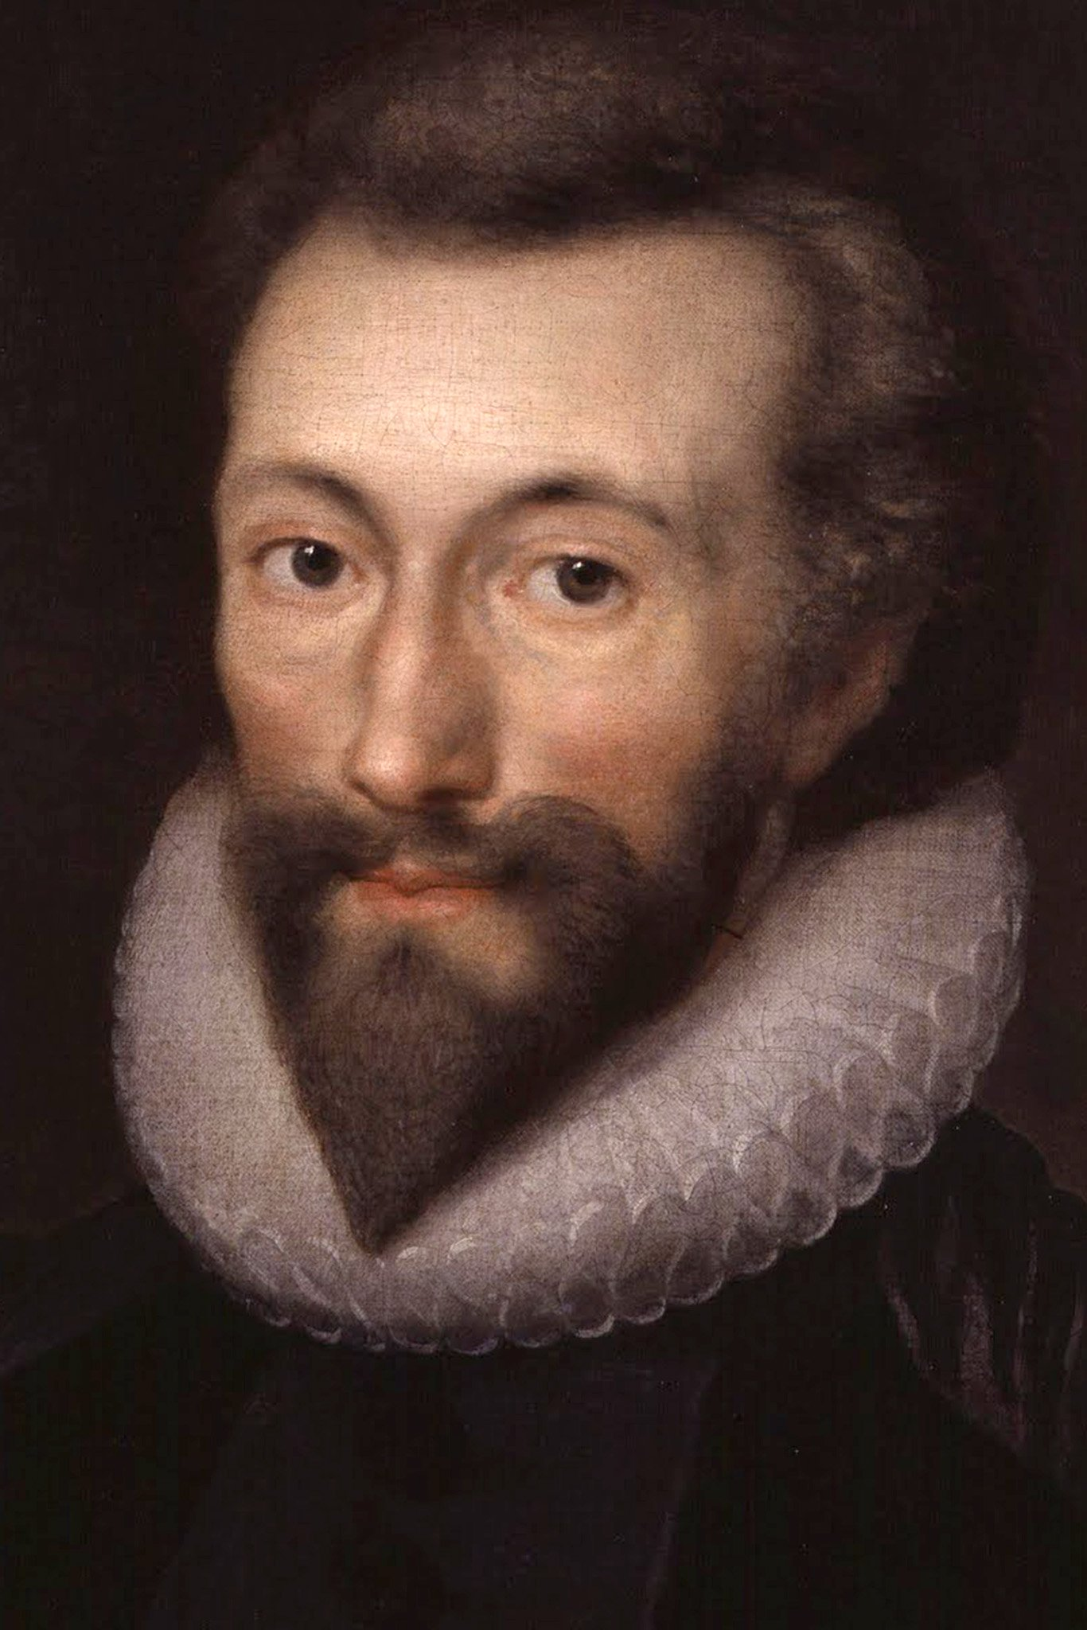
THE RETREAT
Henry Vaughan( 1621–1695)
Mr: J.B.Khot
Department of English
Kisan Veer Mahavidyalaya, Wai
Dist: Satara

Slide 2
About the Poet
Henry Vaughan is a metaphysical poet whose work has often been overshadowed by that of the better-known George Herbert.
The first to use slant rhyme or half rhyme (words that have similar, but not identical, sounds).
Influenced by the poet George Herbert.
Herbert celebrated the institution of the church, while Vaughan found more in common with the natural world.

Slide 3
Poem
Happy those early days! When I
Sined in my angel infancy. Before I understood this place Appointed for my second race, Or taught my soul to fancy aught But a white, celestial thought; When yet I had not walked above A mile or two from my first love, And looking back, at that short space, Could see a glimpse of His bright face; When on some gilded cloud or flower My gazing soul would dwell an hour, And in those weaker glories spy Some shadows of eternity;

Slide 4
Poem
Before I taught my tongue to wound My conscience with a sinful sound, Or had the black art to dispense A several sin to every sense, But felt through all this fleshly dress Bright shoots of everlastingness. O, how I long to travel back, And tread again that ancient track! That I might once more reach that plain Where first I left my glorious train, From whence th’ enlightened spirit sees That shady city of palm trees. But, ah! my soul with too much stay Is drunk, and staggers in the way. Some men a forward motion love; But I by backward steps would move, And when this dust falls to the urn, In that state I came, return.

Slide 5
THANK
YOU

