Slide 1
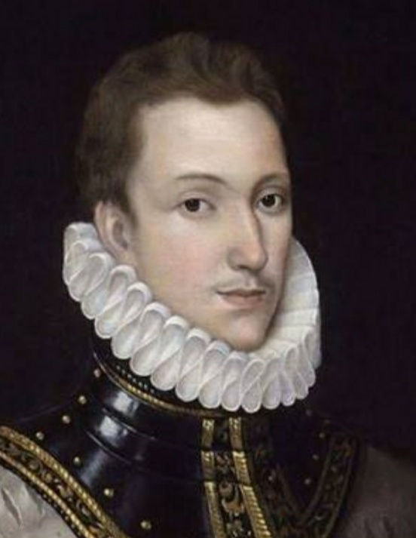
SONNET TO THE MOON
Sir Philip Sidney (1554-1586)
Mr: J. B. Khot
MA, SET
Department of English
Kisan Veer Mahavidyalaya,Wai
Dist: Satara

Slide 2
Introduction to the Poet:
Born on November 30, 1554 Penshurst, Kent, England—died October 17, 1586, Arnhem,Netherlands.
Elizabethan courtier, statesman, soldier, poet, and patron of scholars and poets.
Among the many poets and prose writers who sought his patronage were Edmund Spenser, Abraham Fraunce, and Thomas Lodge.
NOTABLE WORKS:
“The Defence of Poesie”
“Astrophel and Stella”
“Arcadia”
.

Slide 3
Introduction to the Poem:
It is sonnet 31 from Sir Philip Sidney’s “Astrophel and Stella”.
Inspired by his unrequited love for Penelope Rich (nee Devereux).
Sidney addresses the moon as a potential fellow-sufferer from Cupid’s cruel arrows.
It follows the Petrarchan sonnet model.

Slide 4
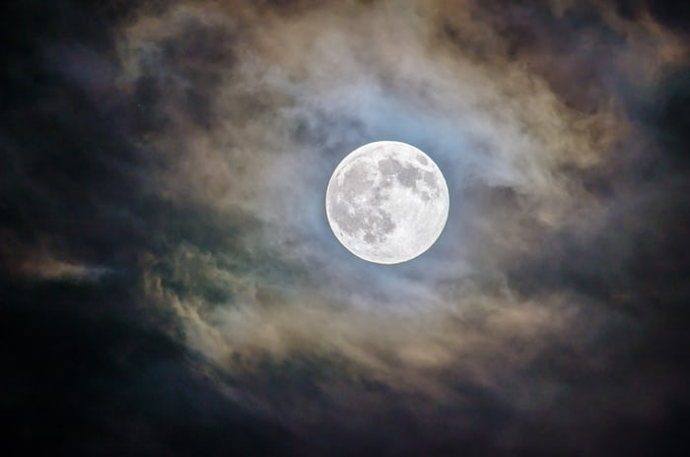
Poem
With how sad steps, O moon, thou climb’st the skies;
How silently, and with how wan a face. What, may it be that even in heavenly place That busy archer his sharp arrows tries? Sure, if that long-with-love-acquainted eyes Can judge of love, thou feel’st a lover’s case; I read it in thy looks; thy languished grace To me, that feel the like, thy state descries. Then, even of fellowship, O moon, tell me, Is constant love deemed there but want of wit? Are beauties there as proud as here they be? Do they above love to be loved, and yet Those lovers scorn whom that love doth possess? Do they call virtue there ungratefulness?

Slide 5
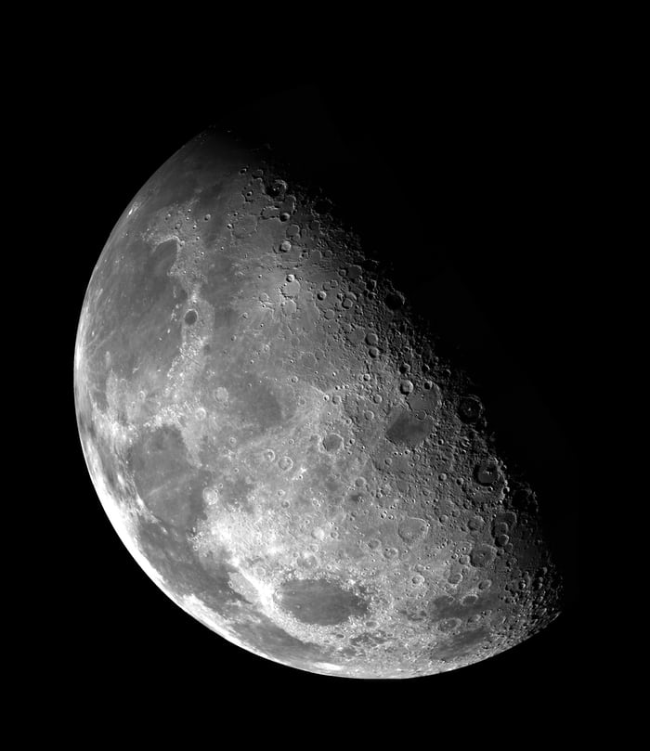
With how sad steps, O moon, thou climb’st the skies;
How silently, and with how wan a face. What, may it be that even in heavenly place That busy archer his sharp arrows tries?

Slide 6
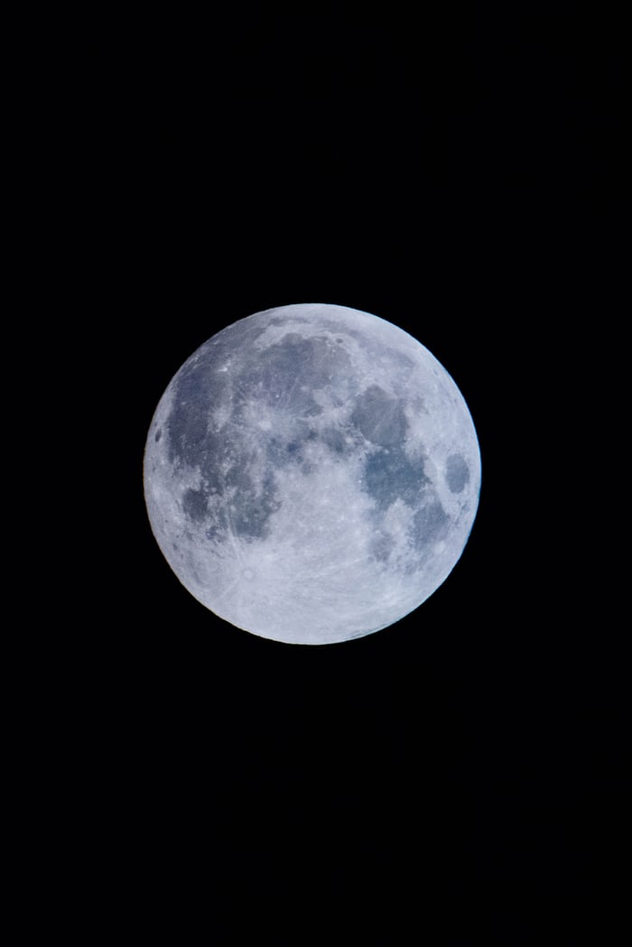
Sure, if that long-with-love-acquainted eyes Can judge of love, thou feel’st a lover’s case; I read it in thy looks; thy languished grace To me, that feel the like, thy state descries.

Slide 7
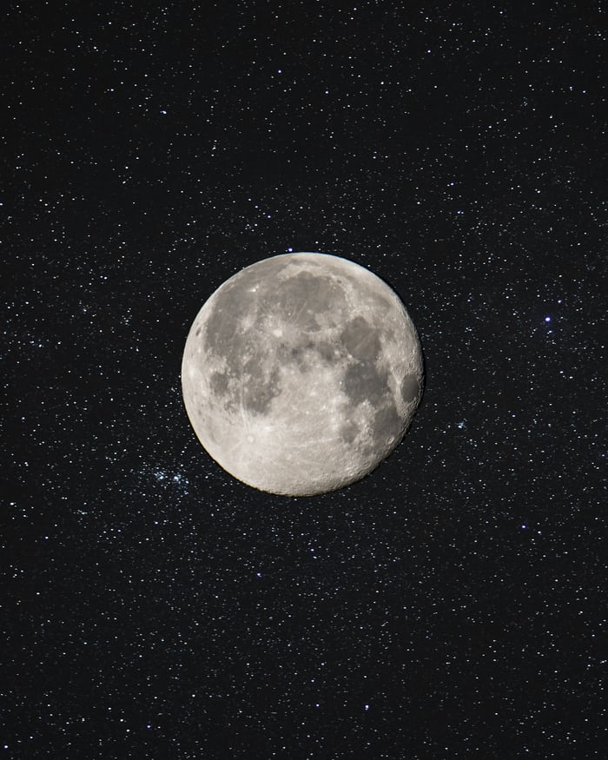
Then, even of fellowship, O moon, tell me, Is constant love deemed there but want of wit? Are beauties there as proud as here they be?

Slide 8
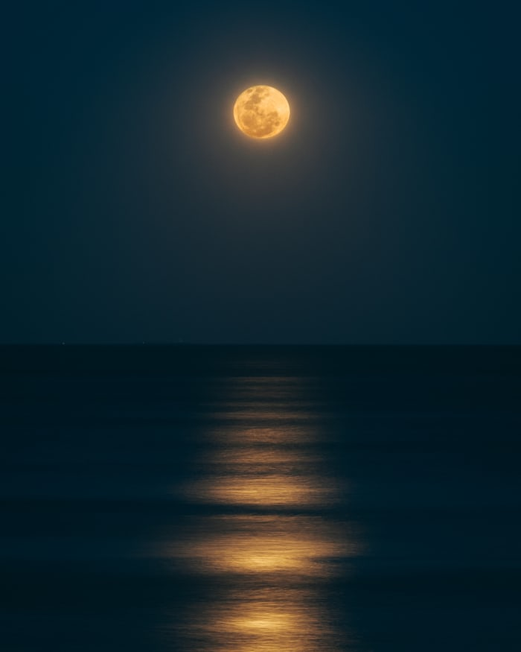
Do they above love to be loved, and yet Those lovers scorn whom that love doth possess? Do they call virtue there ungratefulness?

Slide 9
Thank you

