Slide 1
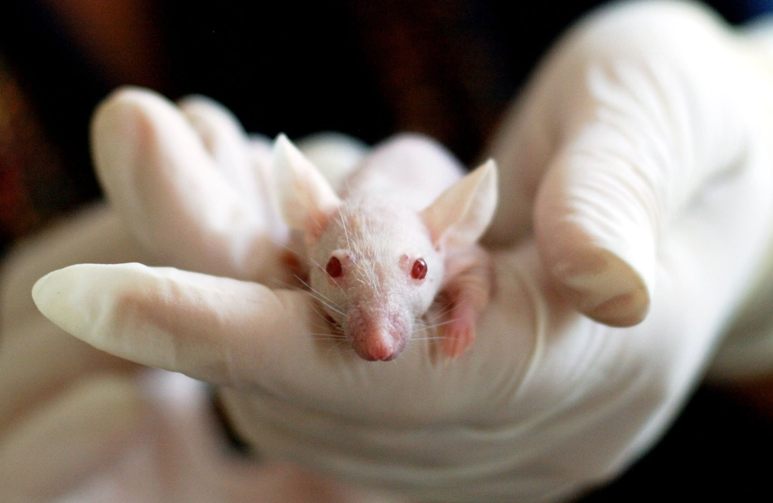
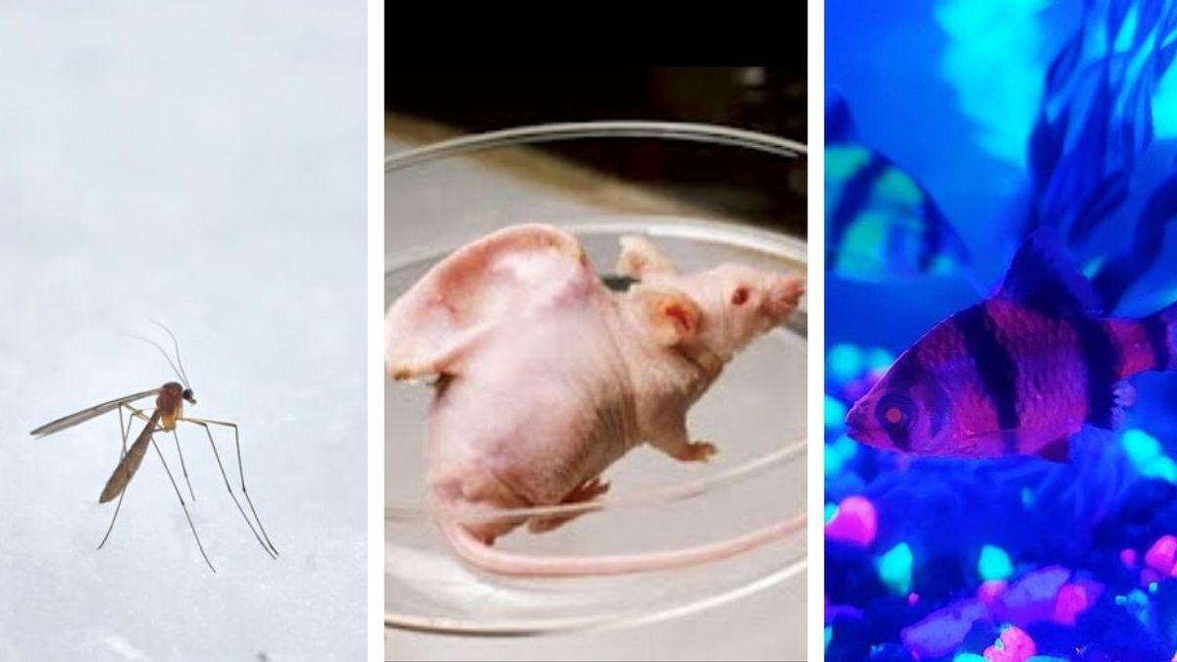
Transgenic Animals
By Miss Renjar J. K.

Slide 2
Overview
Introduction
Methods used to produce transgenic animals
Examples
Applications
Advantages and Disadvantages
Knockout Mice

Slide 3
Introduction
Nowadays break through in molecular biology are happening at an existed before rate, one of them is the ability to engineer transgenic animals.
The combination of the successful transfer of genes into mammalian sales and the possibility of creating genetically identical animals by transplanting nuclear from somatic cells into in enucleated eggs. (nuclear transfer or nuclear cloning)
Researchers to consider putting single function gene or gene clusters into the chromosomal DNA of higher organism.

Slide 4
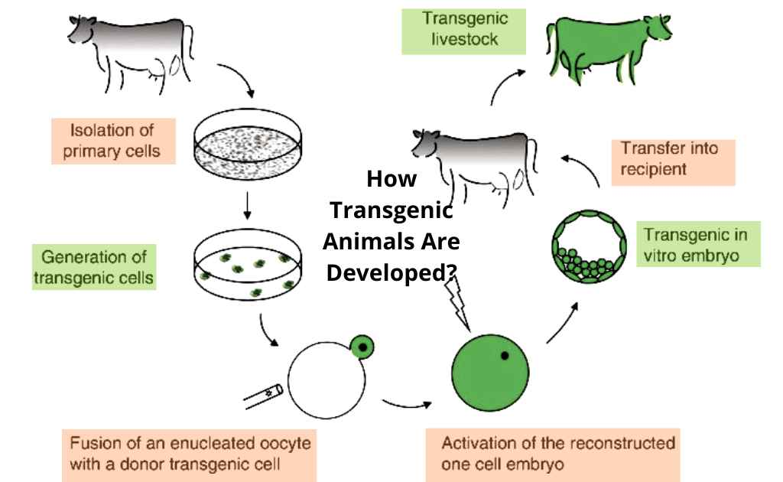
What are the transgenic animals?
The animals with the modified genome are called transgenic animals.
A foreign gene with desired (to produce more quantity) characteristics is inserted into the animal to modify its DNA.
This gene is passed on to the successive generations.
This method is used for to improve the genetic traits of the target animals.
The transgenic animals are genetically engineered and are hence called as genetically modified organisms (GMOs).

Slide 5
Methods
Even though there are many methods for producing transgenic animals, there are three basic methods used for producing them.
Nuclear Transplantation
Retroviral Method
DNA Microinjection

Slide 6
1.Nuclear Transplantation
This method is also called as embryonic stem cell mediated gene transfer.
This method involves prior insertion of the desired gene by homologous recombination into an invitro culture of embryonic stem (E S) cells.
These cells are then incorporated into the inner cell mass of an embryo at the blastocyst stage of development.
The blastocyst is transferred into the recipient female. The result is a chimeric animal.
This method is used for inactivation (Knock out)

Slide 7
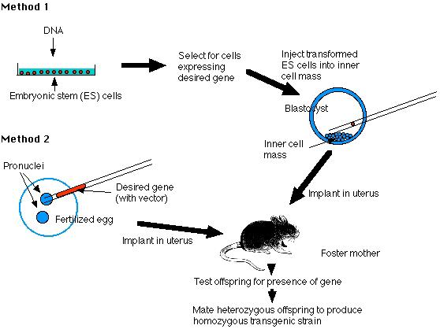
Nuclear Transplantation

Slide 8
2. Retroviral Method
This method involves gene transfer by means of a viral vector such as retrovirus.
Since retroviruses have ability to inject the host cell, they are used as vectors to transfer the target gene into the animal genome.
In this method, the desired gene is inserted invitro at a very early stage embryo (8 cell stage)
The embryo is then transferred into recipient female.

Slide 9
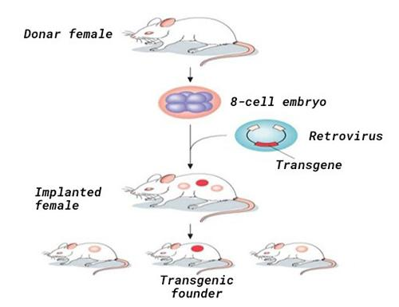
Retroviral Method

Slide 10
3. DNA Microinjection
This method involves the direct microinjection of a desired gene into the pronucleus of a fertilized ovum.
The manipulate fertilized ovum is transferred into recipient female.
This method is applicable to a wide variety of species improve like stocks, wool characteristics, rate of weight gain and egg laying frequency.

Slide 11
DNA Microinjection

Slide 12
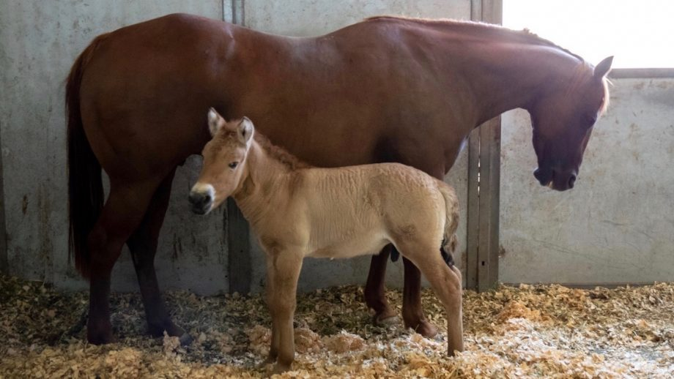
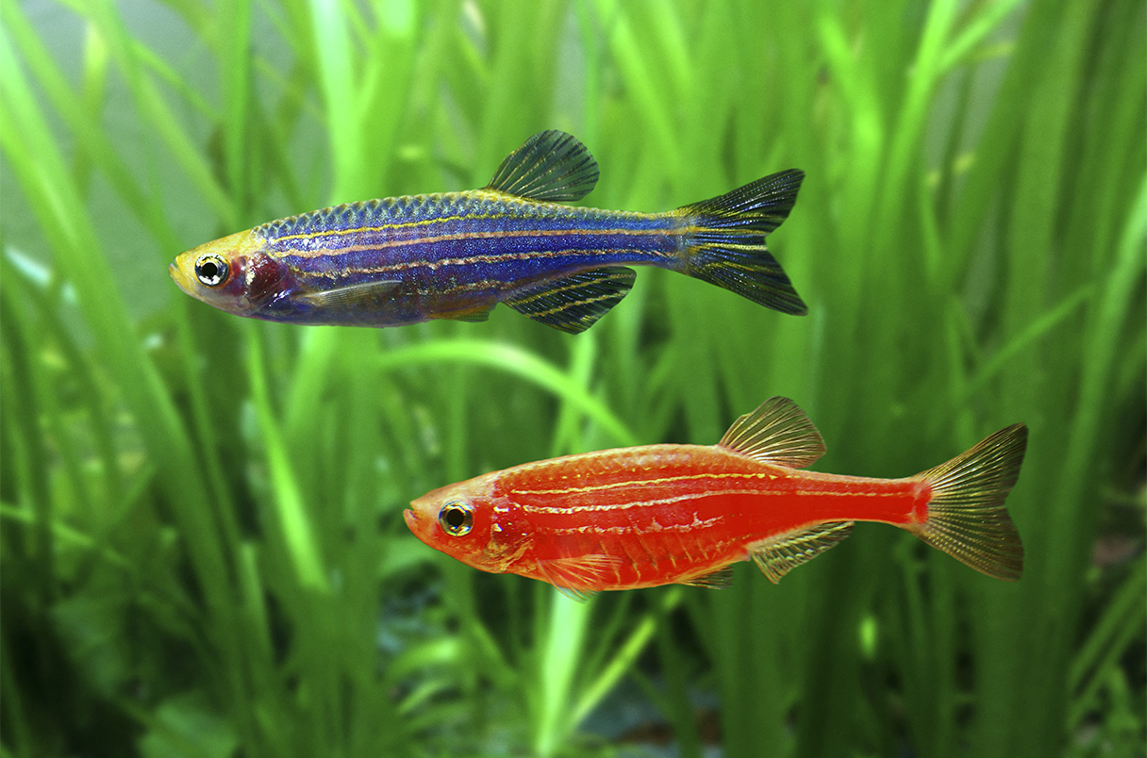
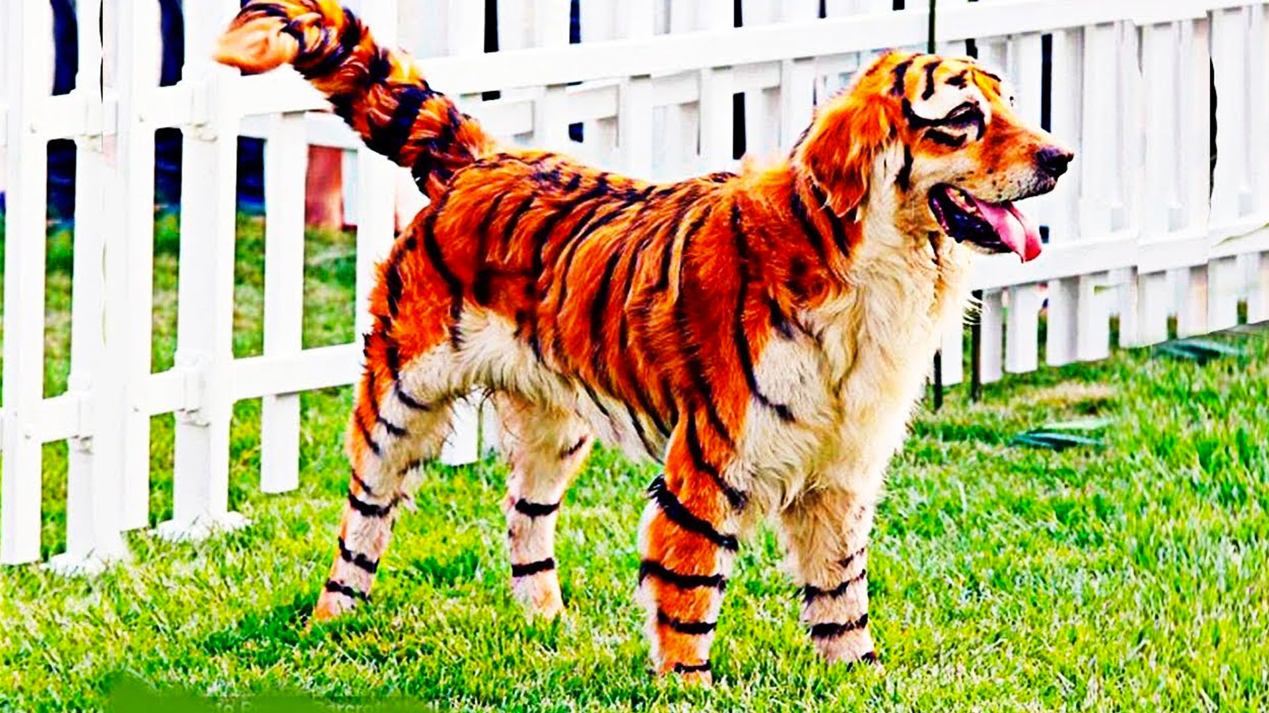
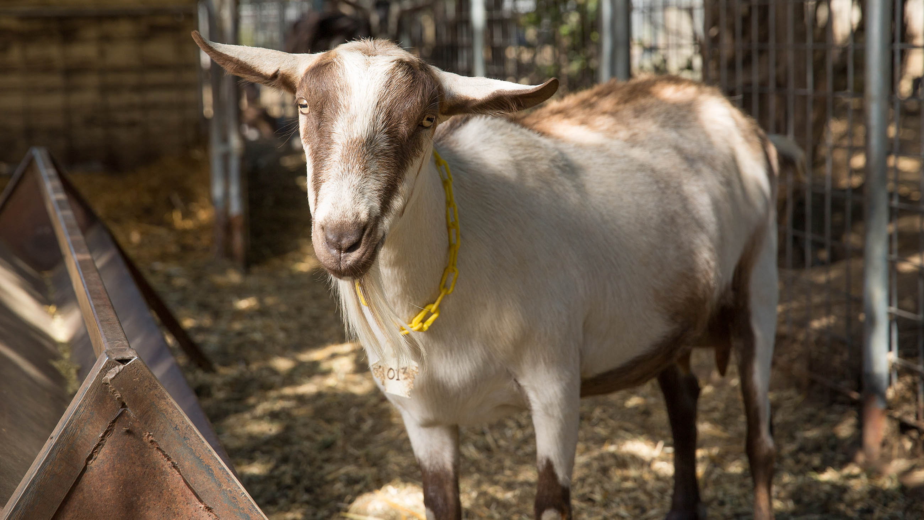
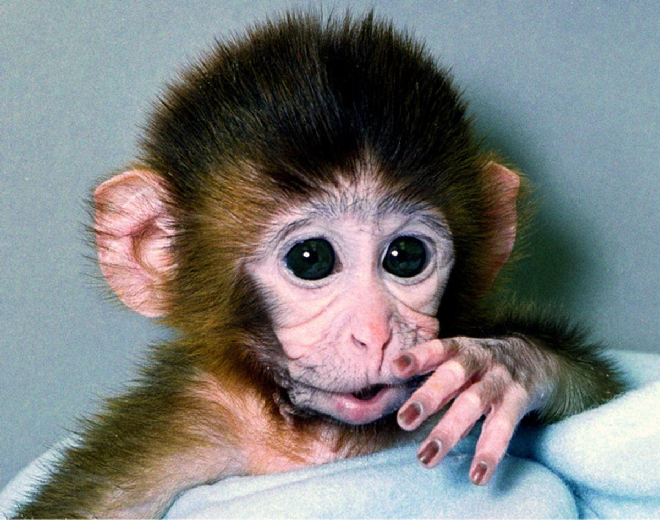
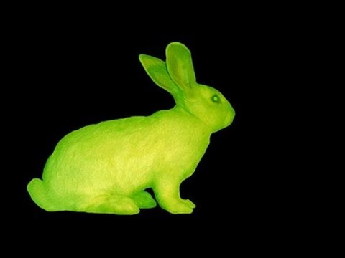
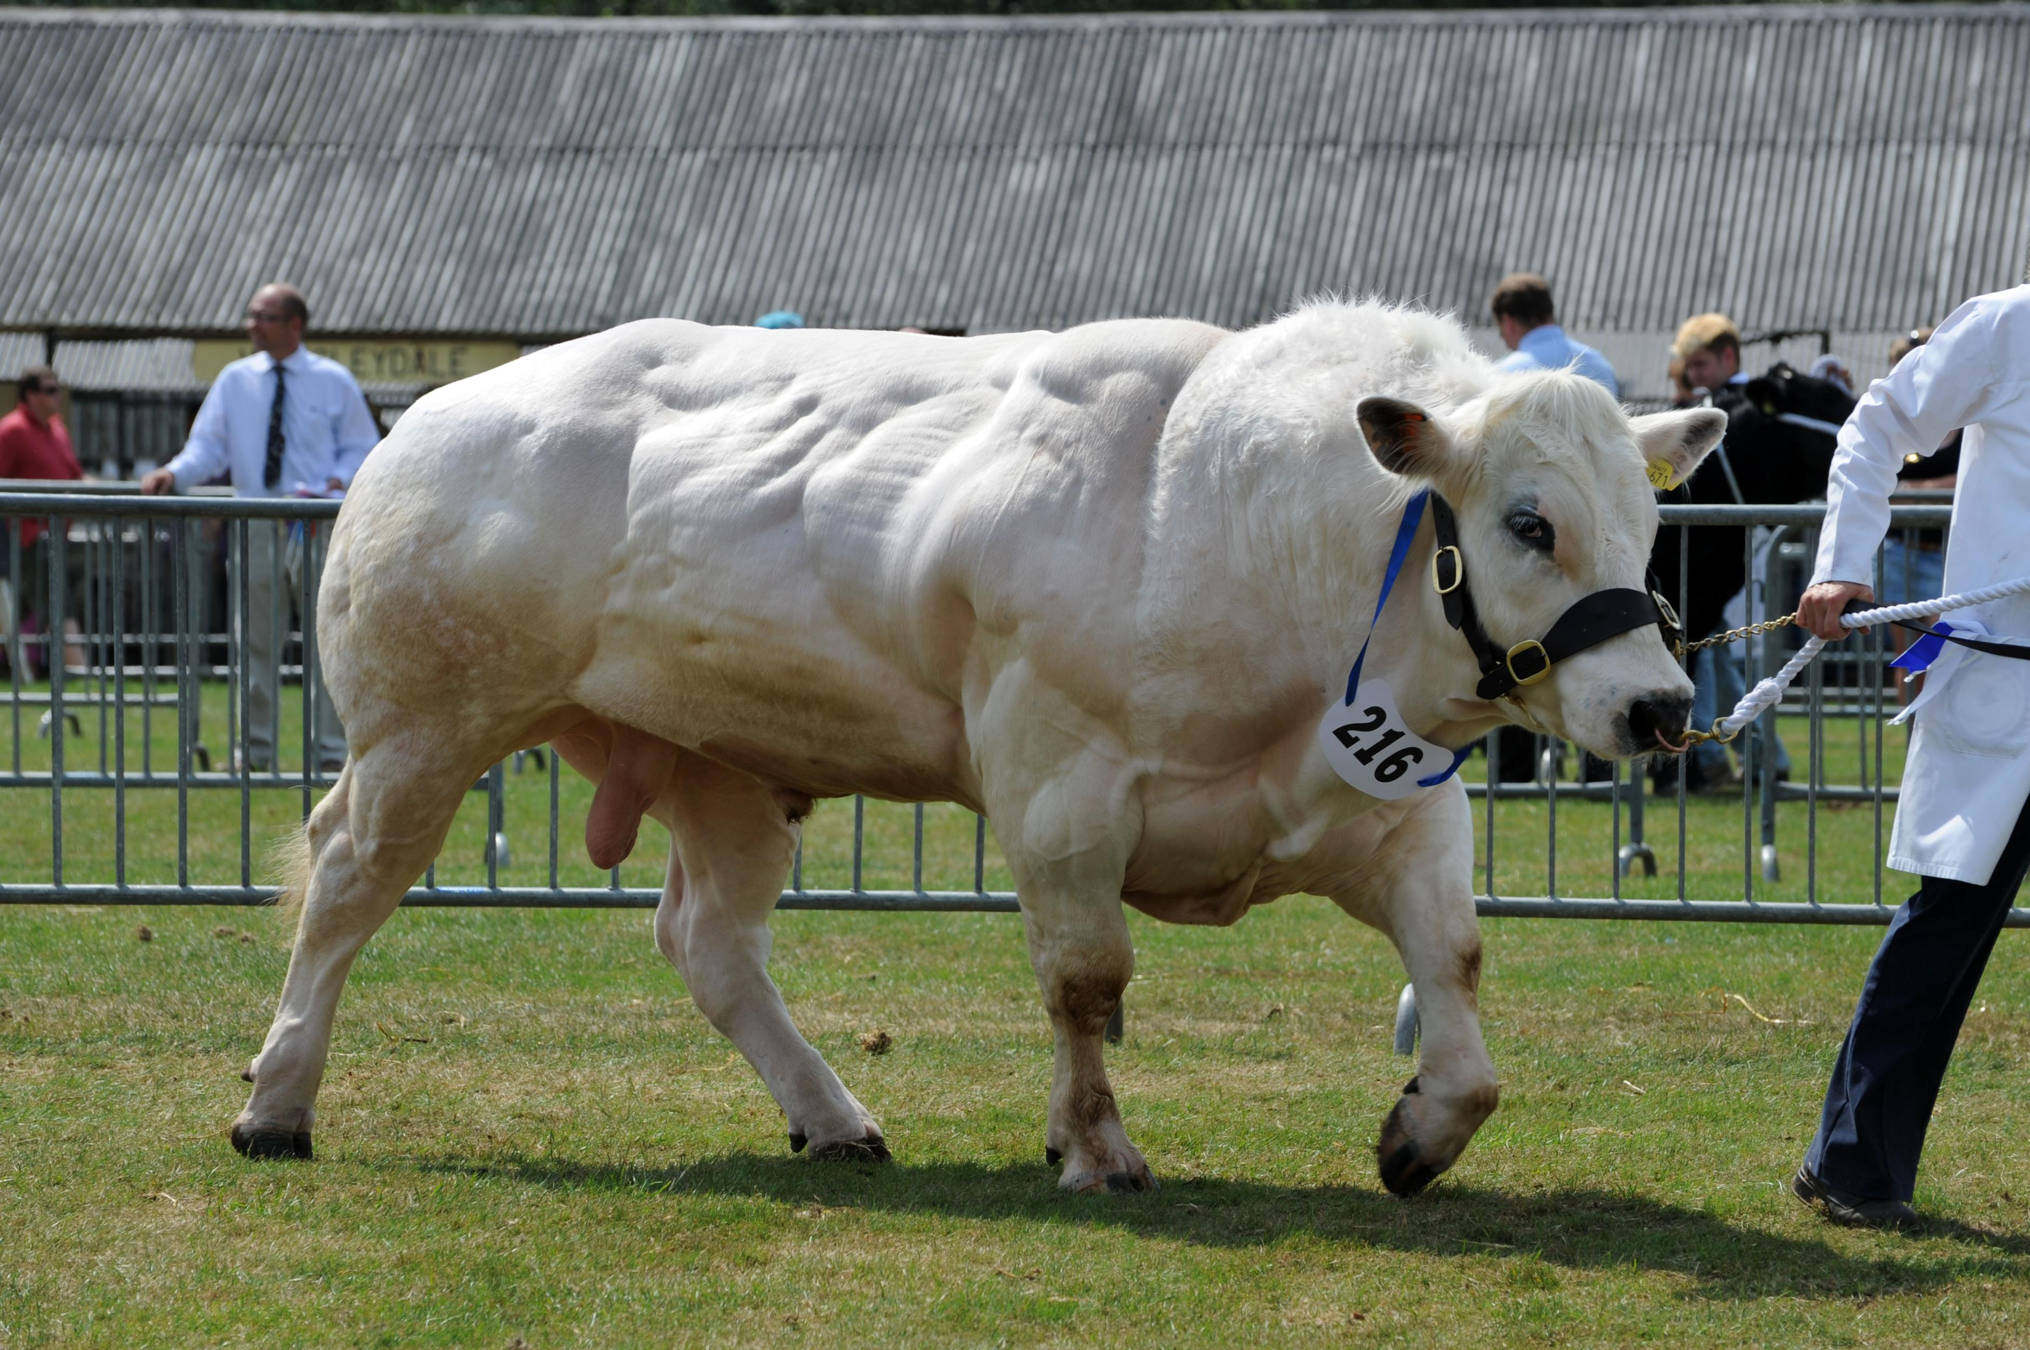
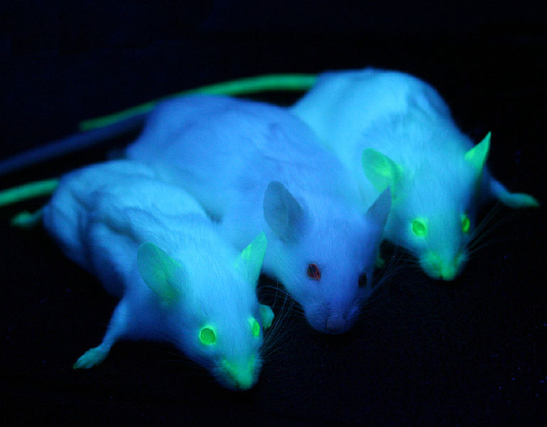
Examples of transgenic animals

Slide 13
Applications of transgenic animals
Used to study normal physiology and development of an animal. In transgenic animals, a foreign gene is introduced due to which the native gene is altered. This facilitate to study it’s effect on the every day functions of body.
Production of Pharmaceuticals
Production of organ donar

Slide 14
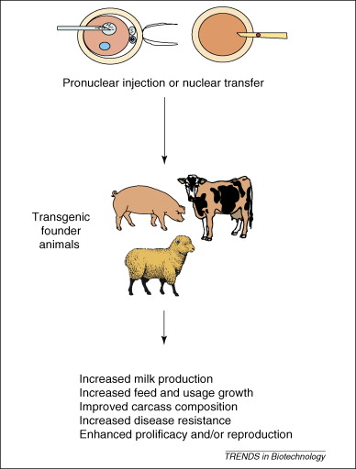
1. Production of pharmaceuticals

Slide 15
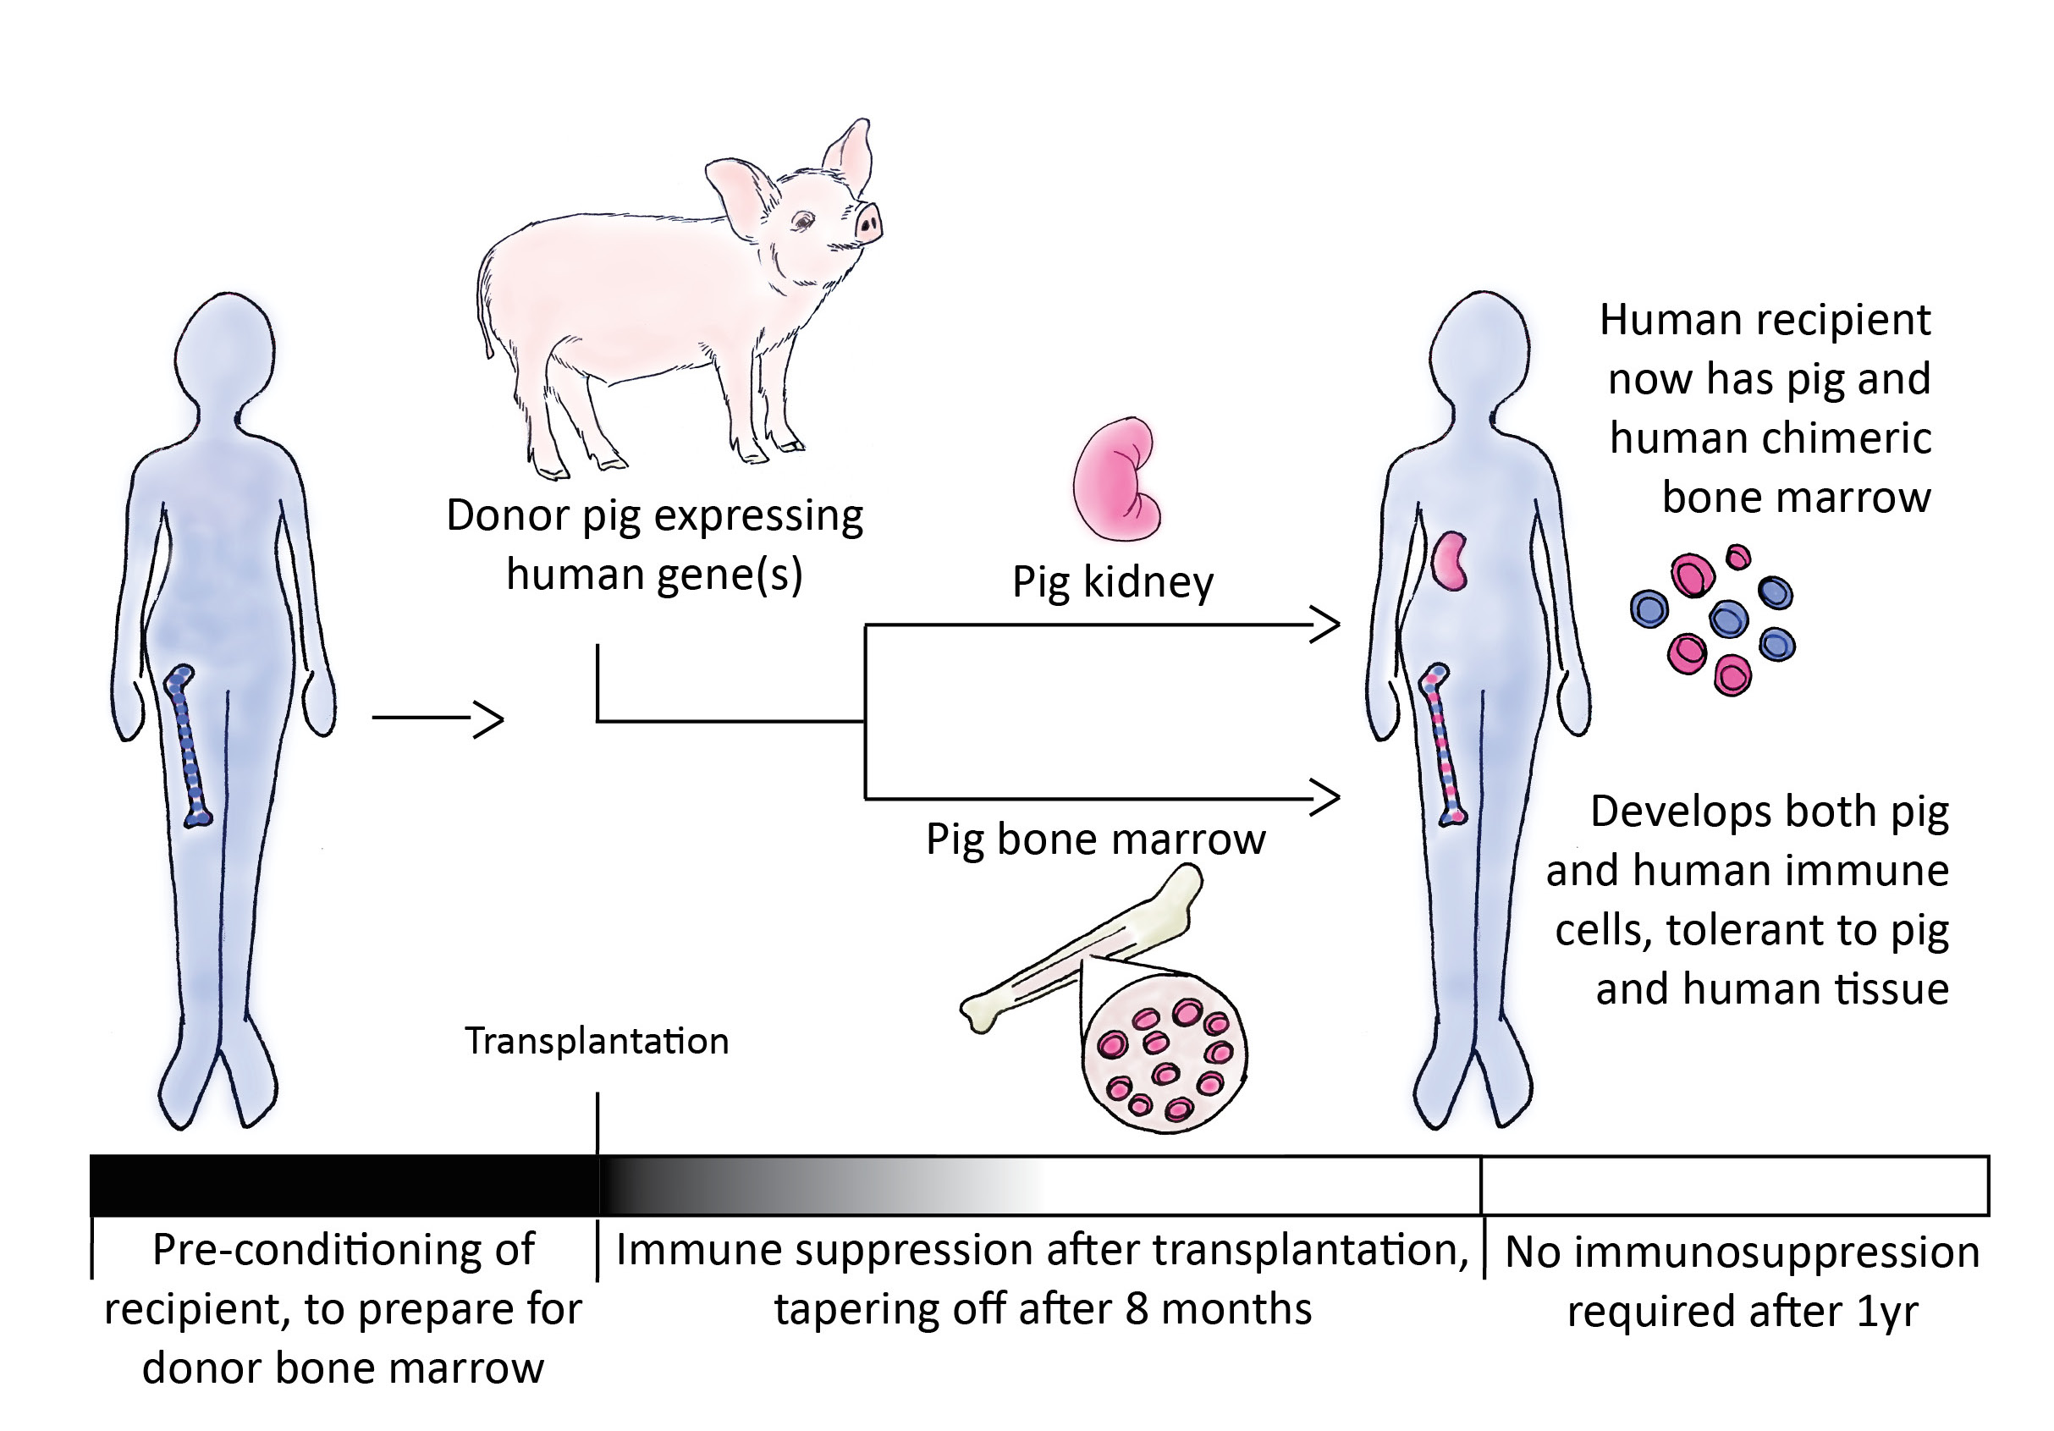
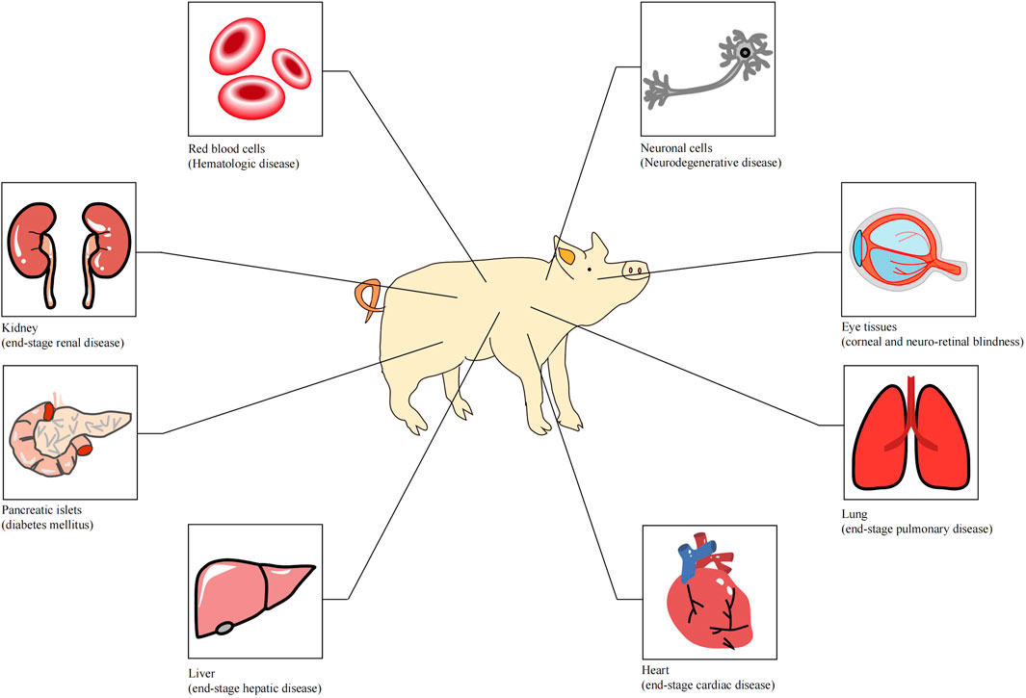
2. Production of organ donar

Slide 16
Advantages of transgenic animals
Increased growth rate
Improved diseased resistance
Improved food conservation rate
Increased muscle mass
Improved nutritional value
Improved wool quality

Slide 17
Disadvantages
Inserted gene has multiple functions
Breeding problem
Sometimes leads to mutagenesis and functional disorder
Low survival rate of transgenic animals

Slide 18
Knockout mice
A knockout mice is a mice in which a specific gene has been inactivated or “knocked out” by replacing or disrupting it with an artificial piece of DNA.
The loss of gene activity often cause changes in a mice phenotype and thus provides valuable information on the function of the gene.

Slide 19
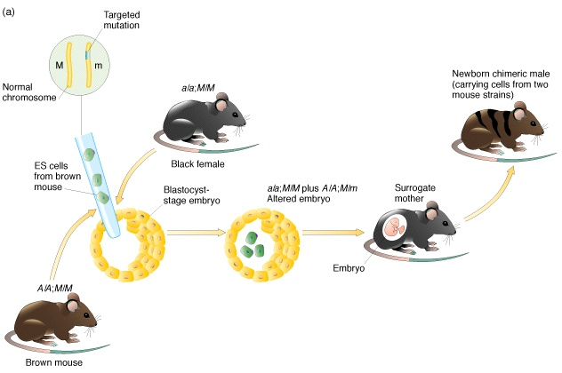
Knockout mice

Slide 20
