Slide 1
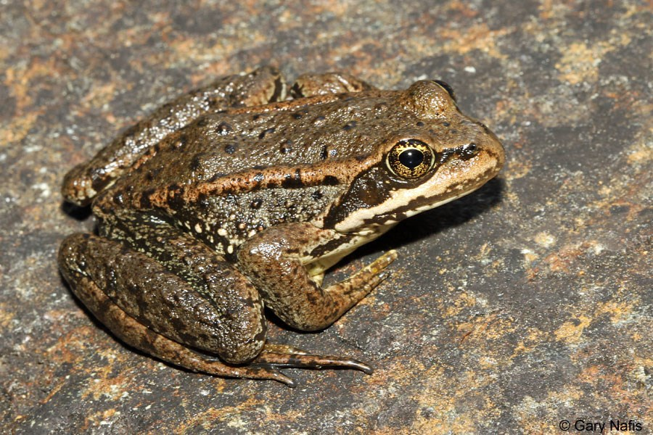
B.Sc. Part – II ZOOLOGY Semester II, Paper V DSC – C (Animal Diversity II)
Unit II – Amphibia
Type Study Frog
Systematic position, Habit and Habitat, Morphology
Miss Renjar J. K.

Slide 2
Systematic position
Phylum – Chordata
Sub-phylum – Vertebrata
Super Class – Gnathostomata
Class – Amphibia
Order – Anura
Family – Ranidae
Genus – Rana
Species - tigrina

Slide 3
Habits and Habitat
The habitat of frog is usually near water.
The skin of the frog is to be kept moist. This is essential for skin respiration.
When skin tends to be dry it takes a dip into water.
The frog is a cold blooded animal. It’s body temperature varies with the temperature of surrounding.
During winter the frog is unable to generate enough heat. It undergoes the winter sleep or hibernation.
Just a winter sleep, Indian frog has been summer sleep. It is called aestivation.

Slide 4
Morphology
The body of frog is bilaterally symmetrical and dorsoventrally flattened.
Body is divisible into head and trunk.
There is no neck and tail.
Skin color of frog Is green with black or brown patches dorsally.
Ventrally it is light pale yellow in color with no spots.
Head is broad and triangular in shape.
The two large protruded eyes are placed on head dorsally.
Each eye is protected by three eyelids namely upper eyelid, lower eyelid and a nictitating membrane.

Slide 5
Neck is completely absent, as in the aquatic vertebrates fusion head and trunk is a special adaptation for swimming.
Tongue is the basic tool of hunting the prey which is always kept ready to snap at moving prey.
Trunk is flat and ovoid, continuous with the head in front.
The trunk bears laterally two pairs of limbs of very unequal size.
Camouflage in frog is a defensive mechanism which assists them in hiding.
Hibernation and aestivation are the winter sleep and summer sleep of frog respectively which is the peculiar style of adaptation for survival.

