Slide 1
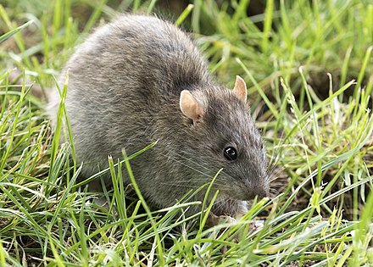
B.Sc.Part-I, Semester-II Zoology,DSC15B,Paper III
Unit I – Animal Diversity
Type Study – Rat
Systematic position, Habits and Habitat, External Morphology
Miss Renjar J. K.

Slide 2
Systematic position
Phylum – Chordata
Sub- phylum – Vertebrata (Craniata)
Division – Gnathostomata
Super Class – Tetrapoda
Class – Mammalia
Sub Class – Placentalia
Order – Rodentia
Genus – Rattus
Species – rattus

Slide 3
Habits and Habitat
Nocturnal in habits.
Good climber and live in burrows near human dwellings.
It is also found in store places and warehouse.
Rat uses its burrows for rest, shelter, as a nursery for the young and for food storage.
Rat was herbivorous animal. Food is various kinds of seed and grains.
Rat damage clothes, books, papers, furniture and many other stored material.
Rat is very prolific breeder.

Slide 4
The average life span is hardly three years.
The rate of reproduction is high.
Rat mature when it is 2 to 3 months old.
It produces 4 to 5 litters a year.
Each litter contains 4 to 10 young ones.
A female rat produces about 30 young ones in an year.

Slide 5
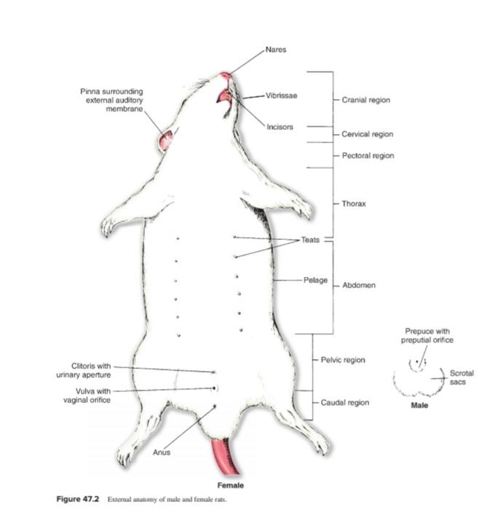
External Morphology
The body of Rat is soft, cylindrical and gradually tapering at the both ends.
The body of Rat is broadly divisible Into head, neck, trunk and tail.

Slide 6
(a) Head
The head is conical in shape. It is slightly compressed laterally.
It tapers towards the anterior end and forms a pointed snout.
The snout bears pair of nostrils
It also bears a narrow mouth, having soft upper and lower lips.
The snout bears long and stiff hairs which are sensitive.
The eyes are situated one on either side of the head.
Behind the eyes a pair of rounded external ears are present.
(b) Neck
The neck is short which joins the head to the trunk.
It allows free movement to the head

Slide 7
(c) The Trunk
It is elongated part which is divisible into thorax and abdomen.
The thorax is the anterior part and abdomen is posterior part of trunk.
The thorax is supported by ribs and a breast bone. The abdomen is without any support.
The ventral side of abdomen is soft. The teats are present in female rat, three pairs on thoracic region and three pairs on abdominal region
The trunk bears two pairs of limbs, fore limbs and hind limbs.
The anus and the external sex organs are situated at the end of the trunk region.
The external sex organs lie on the ventral side of the posterior region of the abdomen in front of the anus.

Slide 8
(d) The tail
At the posterior end of the trunk there is a tail
Tail is longer than trunk, cylindrical and gradually tapers towards posterior end.
It covered by overlapping epidermal scales arranged in rings.
The rat has about 210 rings on tail.
The tail is used as a balancing organ.

