Slide 1
Presentation on
Ultrasonic Waves and Piezoelectric Effect
Presented by
Miss Neha Narendra Sawant
M.Sc (Physics)

Slide 2
Content
Piezoelectric Generator
Detection of Ultrasonic Waves
Properties of Ultrasonic waves
Applications of Ultrasonic waves

Slide 3
Production of Ultrasonics by Piezoelectric Generator
Principle :-
Piezoelectric generator works on the principle of converse piezoelectric effect i. e. when a pair of opposite faces of a properly cut crystal are subjected to high frequency alternating EMF then the crystal start vibrating with the frequency of alternating EMF and there by Ultra waves are generated.

Slide 4
For example, Quartz crystal cut in plane perpendicular to its optic axis. The dimension of crystal decides the natural frequency of the crystal the frequency of crystal is given by
n = P/2l (√Y/ ρ )
where P = 0, 1, 2, ... and l is the length of crystal and is the velocity of sound in crystal and Y - Young's modulus, ρ - density of crystal

Slide 5
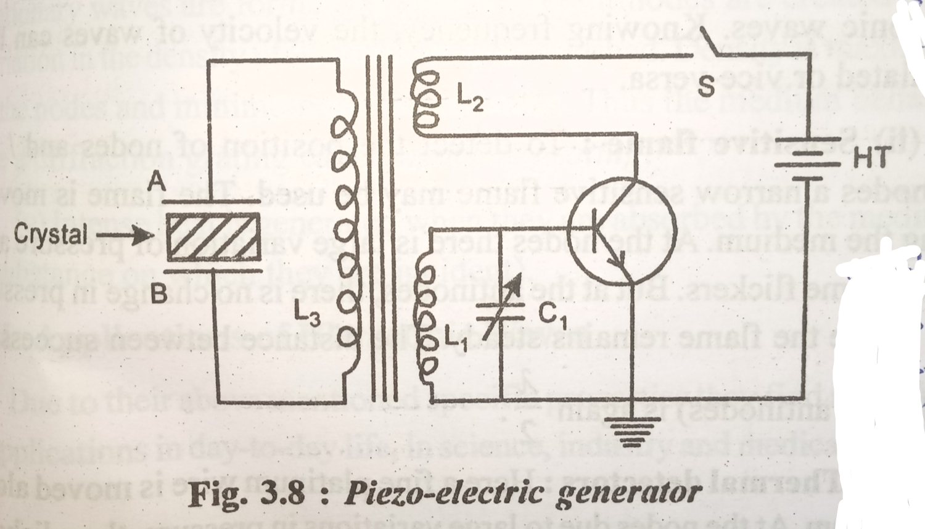
Construction and Working of Piezoelectric Generator

Slide 6
The Piezoelectric generator mainly employs electronic oscillator as shown in fig. Here the coils L₁, L₂ and L₃ are inductively coupled. Coil L₁ with a variable condenser C₁ form the oscillator tank circuit. The oscillations in the output through coil L₂ are coupled with L₃ which is connected to metal plates A and B. The dimensions of crystal are properly selected so that natural frequency of crystal matches with electronic frequency of generator which controlled by tank circuit.
When circuit switched on, crystal start oscillating with high frequency and hence ultrasonic waves are generated. Ultrasonic frequency as high as 5 × 10 ⁸ Hz can be obtained.

Slide 7
Detection of Ultrasonic Waves
i) Kundt's tube :-
It is a long glass tube with lycopodium powder spread uniformly. When ultrasonic waves are incident on one end of the tube, stationary waves are formed due to reflection of waves at other end. The powder collects at node. The distance between successive nodes is λ/2 where λ is wavelength of ultrasonic waves.

Slide 8
ii) Sensitive flame :-
This flame is moved along the medium. At nodes there is large variation of pressure and hence flame flickers. But at antinodes, there is no change in pressure and Hance flame remains unsteady. The distance between successive nodes (or antinode) is again λ/2.
iii) Thermal detectors :-
Here is fine platinum wire moved along medium. At nodes due to large variations in pressure, the adiabatic changes in temperature take place and hence resistance of platinum wire changes with time. But at antinodes there is no change in resistance of platinum wire.

Slide 9
iv) Quartz crystal :-
The ultrasonic waves when incident on a properly cut crystal, produce pressure variations periodically which results in creating an alternating voltage signal across a pair of opposite faces of quartz crystal.

Slide 10
Properties of Ultrasonic Waves :
i) Ultrasonic waves are very high frequency waves.
ii) Just like ordinary sound waves they also get reflected, refracted and absorbed.
iii) As their wavelengths are very small, they spread very little and hence they can travel through very large distances practically without loss of energy.
(iv) If ultrasonic waves travelling in a liquid medium get reflected and travel simultaneously in the same medium in opposite direction, then stationary waves are formed i.e. nodes and antinodes are created.Density is maximum at the nodes and minimum at the antinodes. Thus the medium behaves like a diffraction grating called acoustic grating.
(V) Intense heat is generated when they are absorbed by the medium (a substance on which they are incident).

Slide 11
Applications of Ultrasonic Waves
(i) Signaling :-
Due to very high frequency, ultrasonics are highly directional and hence there is very little loss of energy during the travel of ultrasonic waves. Therefore, they are suitable for signaling over large distances.
(ii) Sonar:
Similar to Radar (Radio wave detection and system sonar systems are also in use. Sonar means sound navigation and ranging. Sonar system consists of a ultrasonic transmitter an ultrasonic receiver. After reflection of ultrasonic waves from an echo is produced and received, which is analyzed by computer. Thus the distance and direction of reflecting object like ship, submarine etc. can be estimated and displaced on the screen.

Slide 12
(iii) Measurement of sea depth: The sonar system even in moving ship can also be used to measure sea-depth.
(iv) Sonography: This is a technique used in medicine for no destructive imaging of the objects normally not visible e.g. pregnancy test, detection of stones in gall-blader, kidney etc.
(v) Ultrasonic massaging: This technique is used to relieve pains in muscles, arthritis, joint points etc.
(vi) Industrial applications: Ultrasonic waves are used to detect flaws, cracks etc. in metals. They can be used for welding, cutting, formation of alloys etc.
(vii) They can be used for bloodless surgery, sterilization and to kill some lower animals like rats, frog etc.

