Slide 1
Introduction to Electrostatics
Electrostatics is a fundamental branch of physics that deals with the study of static electric charges and the forces they exert on one another. This field encompasses the principles governing the behavior of electric fields, electric flux, and electric potential, laying the groundwork for our understanding of more complex electrical phenomena. By exploring the fundamental concepts of electrostatics, we can gain valuable insights into the nature of electricity and its role in both the natural world and technological applications.
At the heart of electrostatics lies the understanding of electric charges and their interactions. Charges can be either positive or negative, and they generate electric fields that influence the motion and behavior of other charges in their vicinity. The study of these electric fields, their properties, and their mathematical descriptions is a crucial aspect of electrostatics. Additionally, the concept of electric flux, which represents the total number of electric field lines passing through a surface, is essential in understanding the behavior of electric fields and their relationship to the charges that create them.

Slide 2
Electrostatic Field
The electrostatic field is a fundamental concept in electromagnetism, describing the force exerted on a stationary electric charge by the surrounding electric environment. This field is generated by the presence of electric charges and can be visualized as a series of lines radiating outward from positive charges and converging inward towards negative charges. The strength of the electrostatic field is measured in Newtons per Coulomb (N/C) and is a vector quantity, meaning it has both magnitude and direction.
The electrostatic field is a conservative field, meaning that the work done in moving a charge around a closed path is zero. This property allows us to define the electric potential, which is the potential energy per unit charge at a given point in the field. The electric potential is a scalar quantity, meaning it has only magnitude and no direction.
Understanding the electrostatic field is crucial for many applications in physics and engineering, such as the design of electrical circuits, the study of atomic and molecular structure, and the analysis of charged particle motion. By studying the properties and behavior of the electrostatic field, we can gain deeper insights into the fundamental nature of electricity and its interactions with matter.

Slide 3
Electric Flux and Gauss's Theorem
The concept of electric flux is fundamental to understanding the behavior of electrostatic fields. Electric flux represents the total number of electric field lines passing through a given surface. This flux is directly proportional to the net electric charge enclosed within that surface, as described by Gauss's theorem of electrostatics.
Gauss's theorem states that the total electric flux through any closed surface is equal to the net electric charge enclosed within that surface, divided by the permittivity of free space. This powerful theorem allows us to easily calculate the electric field in situations with high symmetry, such as a uniformly charged sphere or an infinite plane of charge, by relating the electric field to the enclosed charge.
Understanding electric flux and Gauss's theorem is crucial for solving a wide range of electrostatics problems, from finding the electric field due to complex charge distributions to determining the capacitance of various geometries. These concepts form the foundation for many advanced topics in electromagnetism and are essential for a deep comprehension of the behavior of electric fields.

Slide 4
Electric Potential and Line Integral of Electric Field
Electric potential is a scalar field that describes the potential energy per unit charge at a given point in an electrostatic field. It is defined as the work done per unit charge in moving a test charge from infinity to that point, against the electrostatic force. The electric potential at a point is equal to the line integral of the electric field along any path from infinity to that point.
The relationship between electric potential (V) and electric field (E) is given by the equation V = ∫E·dl, where the line integral is taken along any path from infinity to the point of interest. This allows us to calculate the electric potential at a point if we know the electric field, or to determine the electric field from the gradient of the electric potential.
Visualizing the electric potential and electric field lines together provides a powerful way to understand electrostatic phenomena. The electric field lines are always perpendicular to the equipotential surfaces, and the density of the field lines indicates the strength of the electric field. Understanding these concepts is crucial for analyzing the behavior of charges, conductors, and dielectrics in electrostatic systems.

Slide 5
Potential Due to a Point Charge
The electric potential due to a point charge is a fundamental concept in electrostatics. A point charge is an idealized charge that is concentrated at a single point in space, with no spatial extent. The electric potential created by a point charge varies inversely with the distance from the charge, decreasing as the distance increases.
The formula for the electric potential, V, due to a point charge, Q, at a distance r from the charge is given by V = k * Q / r, where k is the Coulomb constant (approximately 8.99 × 10^9 N⋅m^2/C^2). This equation describes how the potential varies with the distance from the charge, allowing us to calculate the potential at any point in the electric field created by the point charge.
Understanding the potential due to a point charge is crucial for analyzing more complex charge distributions, as the total potential can be calculated by summing the individual contributions from each point charge. This concept forms the foundation for understanding electric fields, electric flux, and the behavior of charged particles in electrostatic systems.

Slide 6
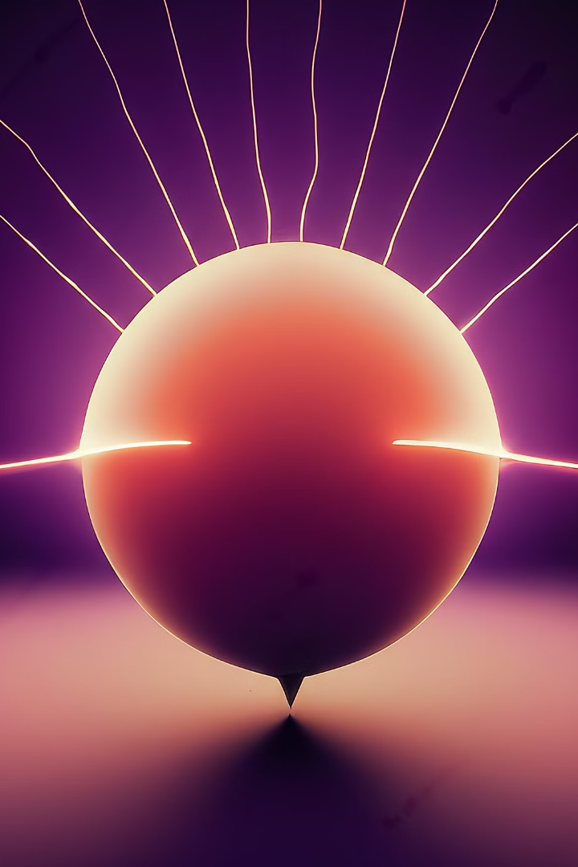
Electric Dipole
An electric dipole is a pair of equal and opposite electric charges separated by a small distance. The electric dipole is a fundamental concept in electrostatics and is used to model the electric field of many charge distributions. The electric dipole consists of two equal and opposite point charges, +q and -q, separated by a distance d. The vector connecting the two charges is called the dipole moment and is denoted by the symbol p.
The electric field lines of an electric dipole radiate outward from the positive charge and converge inward toward the negative charge. The field lines are concentrated between the two charges and become increasingly sparse at greater distances from the dipole. The electric potential of a dipole varies inversely with the square of the distance from the dipole, decreasing more rapidly than the potential of a single point charge.
Electric dipoles are important in understanding the behavior of polar molecules, which have a natural separation of charge and exhibit dipole-dipole interactions. Dipoles also play a crucial role in the study of dielectrics and the functioning of many electronic devices, such as capacitors and transistors.

Slide 7
Uniformly Charged Spherical Shell and Solid Sphere
In electrostatics, two important geometries are the uniformly charged spherical shell and the uniformly charged solid sphere. These geometries have unique properties that make them valuable for understanding fundamental principles of electrostatics.
A uniformly charged spherical shell is a hollow, thin sphere with a constant surface charge density. The electric field outside the shell is identical to the field that would be produced by a point charge located at the center of the shell, with a magnitude equal to the total charge on the shell divided by the permittivity of free space. Inside the shell, the electric field is zero, as the charges on the outer surface precisely cancel each other out.
A uniformly charged solid sphere, on the other hand, has a constant volume charge density. The electric field outside the sphere is the same as that of a point charge located at the center, but the field inside the sphere varies linearly with the distance from the center. The potential inside the sphere also varies quadratically with the distance from the center.
These unique properties of charged spherical shells and solid spheres have important applications in electrostatics, such as in the design of electrostatic shielding and in the analysis of the behavior of charged particles in particle accelerators and other devices.

Slide 8
Calculating Electric Field from Potential
Understand the Relationship
Use the Gradient Formula
Apply to Specific Geometries
Electric field and electric potential are intrinsically linked - the electric field is the negative gradient of the electric potential. This means that the electric field can be calculated directly from the electric potential, providing a powerful tool for understanding and analyzing electrostatic systems.
To calculate the electric field from the electric potential, you can use the gradient formula: E = -∇V, where E is the electric field vector and V is the electric potential. This formula allows you to take the derivative of the potential function to find the direction and magnitude of the electric field at any point in space.
The process of calculating the electric field from the potential becomes more complex when dealing with specific geometries, such as point charges, dipoles, or charged spheres. In these cases, you'll need to use the appropriate potential functions and apply the gradient formula to derive the electric field expressions. This requires a solid understanding of the underlying mathematics and the physical relationships involved.

Slide 9
Capacitance of an Isolated Spherical Conductor
Understanding Capacitance
Formula for Spherical Capacitance
Implications and Applications
Factors Affecting Capacitance
Capacitance is a fundamental concept in electrostatics that describes the ability of a conductor to store electric charge. When an isolated spherical conductor is charged, the electric charge distributes evenly over the surface of the sphere. The capacitance of this system is a measure of how much charge the sphere can hold for a given electric potential difference.
The capacitance of an isolated spherical conductor has important implications in various fields of physics and engineering. For example, it is used in the design of electrical components like capacitors, which are essential for storing and filtering electrical energy in electronic circuits. Additionally, the concept of spherical capacitance is crucial in the study of electrostatics and the behavior of charged particles in electromagnetic fields, such as in the design of particle accelerators and charged particle detectors.
The capacitance of an isolated spherical conductor is affected by factors such as the material and surface properties of the sphere, as well as the surrounding environment. For instance, the presence of other conductors or dielectric materials near the sphere can influence its capacitance. Understanding these factors is essential for accurate modeling and prediction of the behavior of spherical conductors in real-world applications.
The formula for the capacitance of an isolated spherical conductor is given by: C = 4πε₀R, where C is the capacitance, ε₀ is the permittivity of free space (8.854 x 10⁻¹² F/m), and R is the radius of the spherical conductor. This formula shows that the capacitance of a sphere is directly proportional to its radius - the larger the sphere, the greater its ability to store charge.

Slide 10
Parallel Plate, Spherical, and Cylindrical Capacitors
In the study of electrostatics, three common types of capacitors are the parallel plate, spherical, and cylindrical capacitors. Each of these geometries has unique properties and applications.
Parallel Plate Capacitor
Spherical Capacitor
Cylindrical Capacitor
Consists of two flat, parallel metal plates separated by a dielectric material. The electric field between the plates is uniform.
Consists of two concentric spherical metal shells separated by a dielectric material. The electric field is radial and inversely proportional to the square of the radius.
Consists of two coaxial cylindrical metal shells separated by a dielectric material. The electric field is inversely proportional to the radius and is uniform in the radial direction.
Capacitance is directly proportional to the plate area and inversely proportional to the plate separation distance.
Capacitance is proportional to the product of the inner and outer radii, and inversely proportional to the difference between them.
Capacitance is proportional to the length of the cylinders and inversely proportional to the logarithm of the ratio of the outer to inner radii.
Each type of capacitor has specific applications. Parallel plate capacitors are commonly used in electronic circuits, filters, and as energy storage devices. Spherical capacitors are used in high-voltage equipment, such as X-ray tubes and particle accelerators. Cylindrical capacitors are employed in coaxial cables, radio frequency (RF) circuits, and as bypass capacitors in electronic devices.

Slide 11
Energy in Electrostatic Fields
The energy per unit volume in an electrostatic field is determined by the electric field strength. This energy density is a crucial factor in understanding the behavior and effects of electric fields in various applications.

Slide 12
Dielectric Media and Polarization
When a dielectric medium is placed in an electric field, the material becomes polarized. This polarization vector describes the alignment and density of electric dipoles within the medium, which affects the overall electric field.
The polarization of the dielectric medium can be quantified by the polarization density, which is defined as the dipole moment per unit volume. This polarization density contributes to the overall energy stored in the electric field. The presence of the dielectric medium alters the electric field strength and results in a decrease in the energy density compared to the energy density in vacuum.

Slide 13
Displacement Vector and Polarization
The displacement vector in a dielectric medium is related to both the electric field and the polarization vector. This vector represents the total electric flux, including the contribution from the polarized material.
The displacement vector is given by the sum of the electric field and the polarization vector multiplied by a factor called the permittivity of the medium. The polarization vector is in turn related to the electric field strength through the susceptibility of the material. Understanding these relationships is crucial for designing and modeling various applications of electric fields in dielectric media.

Slide 14
Gauss's Theorem in Dielectrics
1
Electric Flux
2
Polarization Effects
3
Boundary Conditions
Gauss's theorem relates the electric flux through a closed surface to the total charge enclosed by that surface.
In dielectric materials, the polarization of the medium must be considered when applying Gauss's theorem.
Gauss's theorem helps determine the boundary conditions for the electric field and displacement vector at the interface between different dielectric materials.

Slide 15
Parallel Plate Capacitor with Dielectric
Capacitor Structure
Dielectric Filling
Polarization Effects
A parallel plate capacitor consists of two conductive plates separated by a dielectric material.
When the capacitor is completely filled with a dielectric, the electric field becomes more uniform and the charge storage capacity increases.
The polarization of the dielectric material changes the electric field distribution and affects the overall capacitance.

Slide 16
Capacitance of Parallel Plate Capacitor with Dielectric
1
Vacuum Capacitance
The initial capacitance of the parallel plates without a dielectric material.
2
Dielectric Constant
The dielectric constant of the material affects the capacitance, increasing it by a factor equal to the dielectric constant.
3
Increased Capacitance
The final capacitance of the parallel plate capacitor with the dielectric material is greater than the initial vacuum capacitance.

Slide 17
Energy Storage in Dielectric Capacitor
Stored Energy
Dielectric Strength
The energy stored in a parallel plate capacitor with a dielectric material is related to the capacitance and the applied voltage.
The dielectric strength of the material determines the maximum voltage that can be applied before breakdown occurs, limiting the stored energy.
Efficiency
Applications
Dielectric materials with high permittivity and breakdown strength can store more energy per unit volume, improving the efficiency of the capacitor.
Dielectric capacitors are widely used in energy storage, filtering, and pulse power applications, leveraging their high energy density.

Slide 18
Factors Affecting Energy Storage
Electric Field Strength
Dielectric Constant
Dielectric Strength
The energy density is directly proportional to the square of the electric field strength.
Materials with a higher dielectric constant can store more energy per unit volume.
The maximum electric field before dielectric breakdown limits the energy storage capacity.

