Slide 1
Presentation on
Magnetic Properties of Material
Presented by
Miss Neha Narendra Sawant
M.Sc SET(Physics)

Slide 2
Magnetic Properties of Material :-

Slide 3
A) Magnetic Induction B :-
Magnetic flux passing per unit area of material is called as magnetic induction B. It's S.I. unit is wb/m.
Let m be the pole strength developed and the length L to be very small so that the poles can be supposed to be situated at the ends of bar. Then magnetic moment P = mL. It's S.I. unit is Am².

Slide 4
B) Magnetic Intensity :-
The magnetic moment developed per unit volume is defined as magnetic intensity for the magnetic susubstance, It's intensity of magnetisation denoted by M.
M = P/V where V is volume of substance.
V = A.L
M = P/V = m.L/A.L = m/A
Intensity of magnetisation is also the pole strength developed per unit area of cross section of substance, magnetisation being perpendicular to area of cross section.
S. I. unit of M is A/m.

Slide 5
Equivalence between a magnetic shell and current loop :-
The magnetic shell of dipole moment P_{m} and area of cross section A is placed in a uniform magnetic field of induction B with its cross sectional area parallel to field, it is acted upon by a torque T = P_{m}B.( Fig. a)

Slide 6
When a conducting loop area A is carrying current I and is held in a uniform magnetic field of induction B with its plane parallel to field it is acted upon by a torque T' = B.A.i ( Fig. b)
If T = T' then P_{m} = Ai
A current loop of area A and carrying current I is equivalent to a magnetic shell of dipole moment Pm = Ai
The S. I. unit of magnetic dipole moment is Am2.
M = P_{m} / V = A.i/A.L = i/L
Intensity of magnetisation is also the surface current per unit length of magnet.
S. I unit of M is A/M.

Slide 7
C) Permeability :-
When a magnetic substance is placed in magnetic field, it gets magnetised and produces its own magnetic field. There are two magnetic fields, I) The original magnetic field called the magnetising field II) the magnetic field due to the magnetisation of substance, it is called induced magnetic field.
For a toroid (infinite solenoid ) having a n number of turns per unit length and carrying current i . Then the magnetic induction is B₀ = u₀ni
ni is current per unit lengh which is nothing but intensity of magnetisation. It is also called strength of magnetising field denoted by H.
ni= H
It's unit is A/m.
Hence, B₀ = u₀H

Slide 8
If M is intensity of magnetisation, it is surface current per unit length of substance. M = I/L
Total current per unit length H' = H + M = ni + I/L
If B is resultant magnetic induction along the axis of toroid, B = u₀H' = u₀ ( H + M) = u₀ (ni + M)
As B₀ = u₀H, we write B = uH by analogy.
u is called permeability of magnetic material.
u = B/H
The permeability of a magnetic material is the ratio of magnetic induction per unit magnetising field intensity.B It's S. I. unit is Weber / Am.

Slide 9
Now B/B₀ = uH / u₀H = u/u₀
This ratio is called relative permeability of material denoted by k. Thus k = u/u₀
The relative permeability of a magnetic substance is defined as the ratio of permeability of the substance to the permeability of free space.
B = u₀(ni + M)
uH = u₀ ( H + M)

Slide 10
D) Magnetic Susceptibility :-
It is defined as the ratio of the intensity of magnetisation induced in the magnetic substance to the intensity of magnetic field. It is denoted by X.
X = M/H
For given material, it also depends on temperature.
uH = u0 (H + M)
(u/u0) H = H + M
kH = H + M
k = 1 + M/H
k = 1 + X

Slide 11
A current loop has a magnetic dipole moment , each electron in an atom has magnetic dipole moment due to orbital motion. Also electron has spin motion because of which it has spin magnetic moment. The resultant magnetic moment is vector sum of all such magnetic moment.
The magnetic moments of the electrons of an atom have tendency to cancel in pairs. So resultant magnetic moment is zero. But in some cases, it is not zero. Such an atom may be represented by permanent magnetic moment.
Depending upon properties of material, material divided into 3 groups :-
1) Diamagnetic Material 2) Paramagnetic material 3) Ferromagnetic material

Slide 12
Diamagnetic Materials :-
Diamagnetic materials are weakly repelled by the magnetic field. The magnetic dipole moment of all electrons in atoms of diamagnetic substance cancel each other and resultant magnetic dipole moment of the atom is zero.
Properties of diamagnetic material :-
1) Every atom of diamagnetic material has zero magnetic dipole moment.
2) Diamagnetic materials are weakly repelled by magnet.
3) Permeability of diamagnetic materials is less than that of free space i.e. u < u₀

Slide 13
4) The relative permeability of diamagnetic materials is less than one. i.e. k = u / u₀ < 1
5) Susceptibility of these materials is negative i.e. X < 0
6) In an external magnetic field diamagnetic materials are weakly magnetised in direction opposite to the magnetic field.
7) Diamagnetic Materials lose their magnetism on removal of external magnetic field.
8) Dimagnetism is found in solid, liquid and gases. for ex. Silver, lead , silicon, nitrogen, sodium chloride, bismuth, copper, antimony, gold, mercury, water, air, hydrogen
9) If diamagnetic gas is introduced between the pole pieces of magnet, it spreads at right angles to the magnetic field.

Slide 14
Paramagnetic Materials :-
In Paramagnetic materials, due to obital and spin motion of electrons, every atom processes net magnetic moment but it is very small.
When this substances are placed in external magnetic field, the atomic dipole moments try to orient themselves in the direction of external field and the substance gets weekly magnitized in the direction of external field. But such magnetization is temporary. That is substance becomes unmagnetic as soon as magnetizing field is removed.
Since paramagnetic material lose their magnetism on removal of external field, they cannot be used to make permanent magnets.

Slide 15
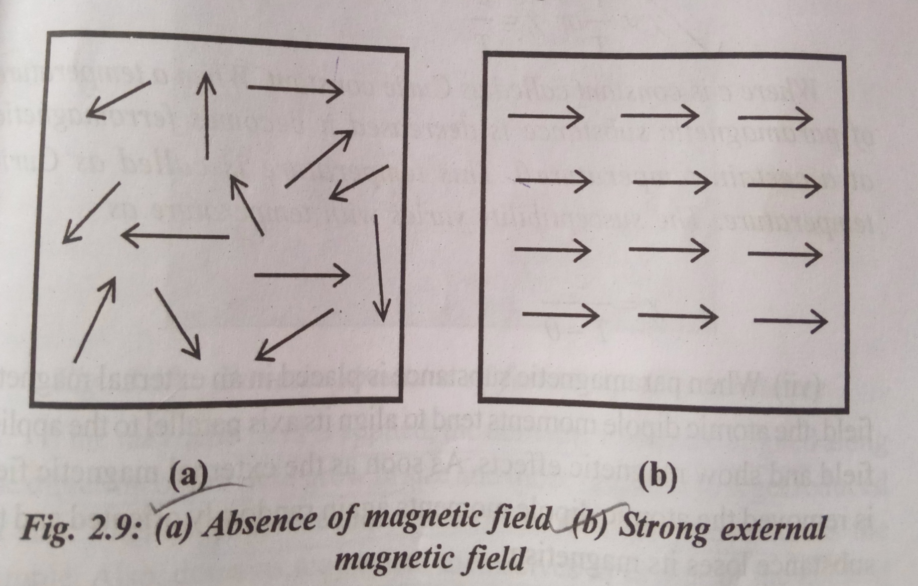

Slide 16
Properties of Paramagnetic material :-
1) Every atom of paramagnetic material has non zero magnetic dipole moment.
2) Paramagnetic materials are weekly attracted by magnet.
3) Permeability of paramagnetic materials is slightly greater than that of free space u > u0
4) The relative permeability of paramagnetic materials is greater than one. k > 1.
5) Susceptibility of these materials is positive i.e. X > 0 but small.

Slide 17
6) Permeability and susceptibility of paramagnetic materials depend upon the temperature. The susceptibility increases with decreasing temperature and at a particular temperature © substance becomes ferromagnetic. This temperature is called Curie temperature.
Curie law :- Curie law states that the susceptibility of paramagnetic material substance is inversely proportional to absolute temperature.
7) When paramagnetic substance is placed in an external magnetic field the atomic dipole moment tends to align its axis parallel to external applied field and show magnetic effects. As soon as the external magnetic field is removal the atomic dipole moments again randomly oriented and the substance loses its magnetism.
8) Paramagnetism is found in solid liquid and gases.

Slide 18
9) If a paramagnetic gas is introduced between pole pieces of the magnet, it spreads in the direction of magnetic field.
10) Aluminium, calcium, magnesium, chromium platinum, sodium, lithium, liquid oxygen, tungsten are example of paramagnetic material.

Slide 19
Ferromagnetic materials :-
In ferromagnetic materials, the permanent atomic dipole moments have strong tendency to align themselves even without any external field. Hence these materials are used to make permanent magnets.
The force between neighbouring atoms, responsible for their alignment, is called exchange coupling.
In normal unmagnetized state, the atoms in any domain have magnetic moments in the same direction giving a net large magnetic moment to domain.

Slide 20
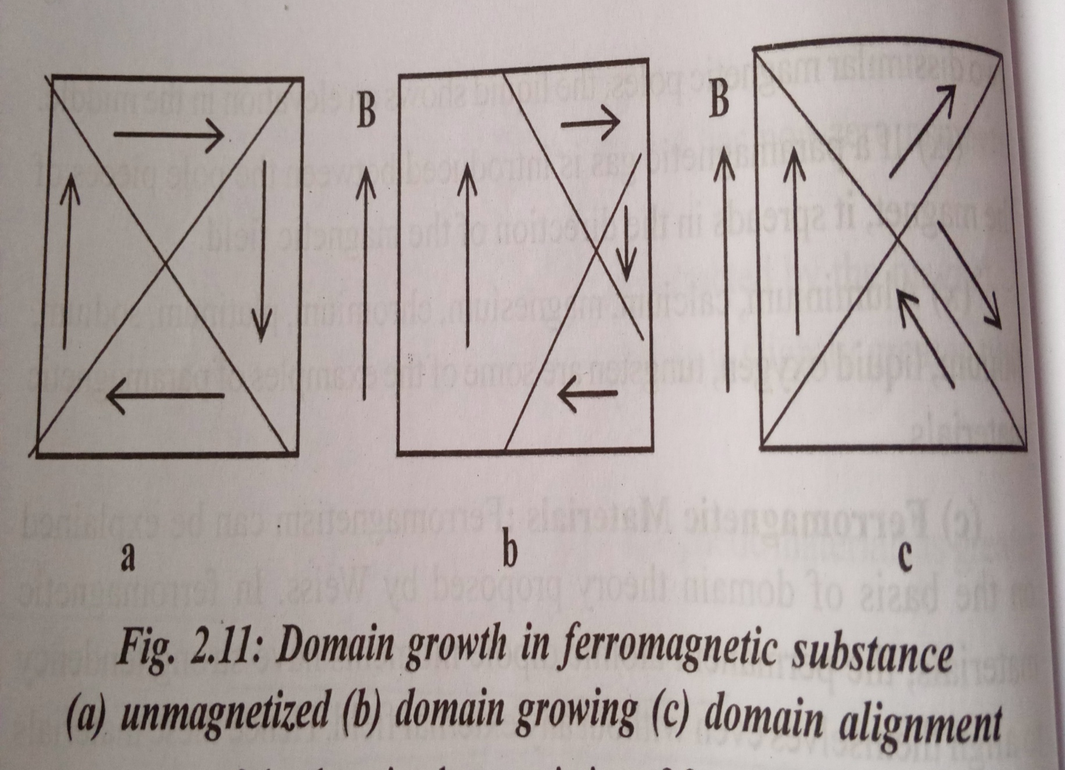

Slide 21
Properties of ferromagnetic materials :-
1) The atoms of ferromagnetic material forms a domain which possesses large magnetic dipole moment.
2) Ferromagnetic materials are strongly attracted by magnet.
3) Permeability of ferromagnetic materials is much greater than that of free space i.e. u >> u0
4) The relative permeability of the ferromagnetic materials is much greater than the one. k >> 1.
5) Susceptibility of these materials is positive and very large.

Slide 22
6) Permeability and susceptibility of ferromagnetic materials depend upon temperature. The susceptibility decreases with increase in temperature and at a particular temperature 0 there is sudden decrease in susceptibility and substance become paramagnetic. This temperature is called Curie temperature.
7) Ferromagnetic material gets strongly magnetised when placed in external magnetic field.
8) Ferromagnetism is normally found in solid.
9) Examples are iron cobalt and nickel.

