Slide 1
Mass Spectroscopy
M.Sc- II Sem-III
Paper X
Advanced Spectroscopic Methods
Miss. Jaigude Pooja Shankar
Assist. Prof. Department of Chemistry
Kisan Veer Mahavidyalaya, Wai

Slide 3
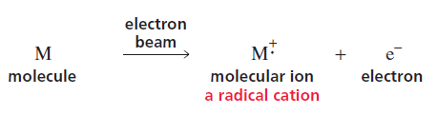
MASS SPECTROMETRY - PRINCIPLE
Mass spectrometry allows us to determine the molecular mass and the molecular formula of a compound, as well as certain structural features of the compound.
In mass spectrometry, a small sample of a compound is introduced into an instrument called a mass spectrometer, where it is vaporized and then ionized as a result of an electron’s being removed from each molecule. Ionization can be accomplished in several ways.
The most common method bombards the vaporized molecules with a beam of high-energy electrons. The energy of the electron beam can be varied, but a beam of about 70 electron volts (eV) is commonly used.
When the electron beam hits a molecule, it knocks out an electron, producing a molecular ion, which is a radical cation—a species with an unpaired electron and a positive charge.

Slide 4
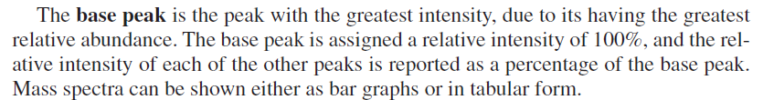

Molecular ion peak: Molecular weight of the compound
Base Peak

Slide 5
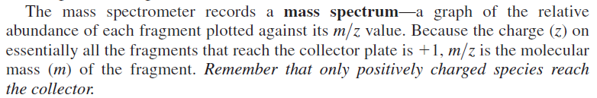

Slide 6
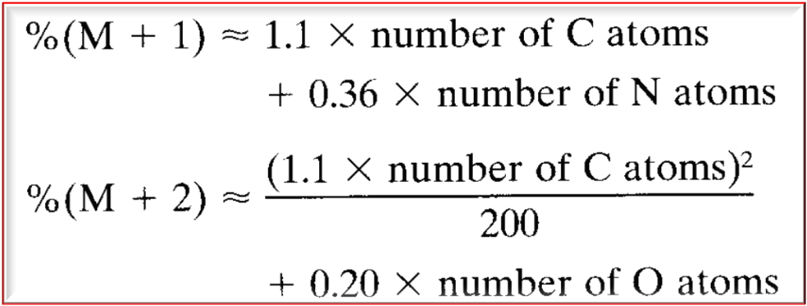
Calculating the Relative Abundance of
Isotope Peaks

Slide 7
Calculating the Relative Abundance of
Isotope Peaks

Slide 8
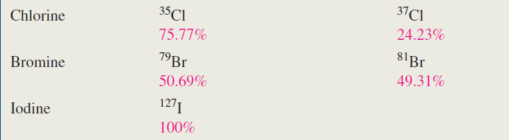
Applications of Isotope Peaks
(i) To calculate the number of CARBON atoms
(ii) To calculate the number of halogens like Cl & Br
M+2 peak 3:1 Chlorine
M+2 peak 1:1 Bromine

Slide 11
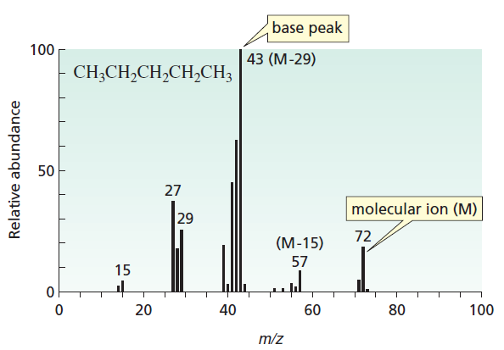
Rules For Fragmentation in MS
MS of n-Pentane
MS of Isopentane

Slide 12
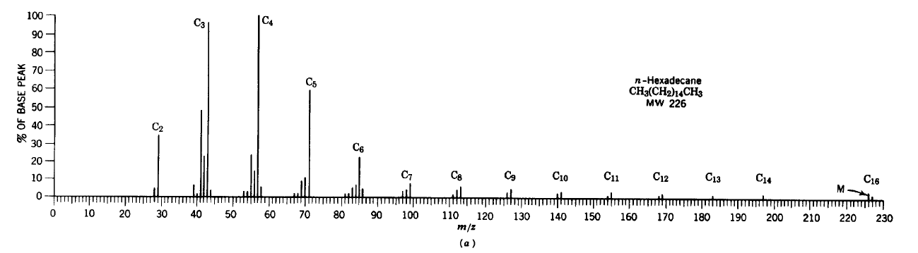
Rules For Fragmentation in MS

Slide 13
Rules For Fragmentation in MS

Slide 14
Rules For Fragmentation in MS

Slide 15
Rules For Fragmentation in MS

Slide 16
Rules For Fragmentation in MS

Slide 17
Rules For Fragmentation in MS

Slide 19
Rules For Fragmentation in MS

Slide 20
McLafferty
Rearrangement

Slide 21
McLafferty Rearrangement

Slide 22
McLafferty Rearrangement

Slide 23
Arene

Slide 24
Alkyl Halide

Slide 25
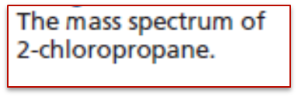

Slide 26


Slide 27

IONIZATION TECHNIQUES
EI: Electron Impact
CI: Chemical Ionisation

Slide 28
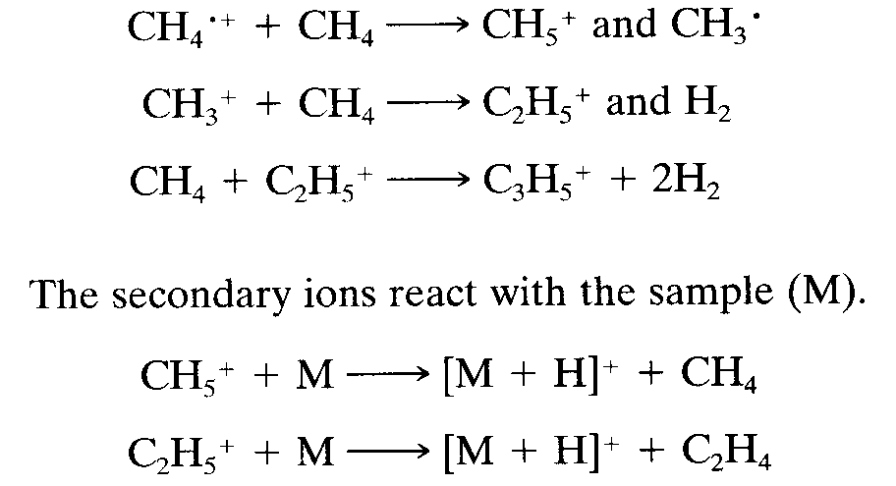
Chemical Ionization (CI)
The vapourized sample is introduced in to the mass spectropeter with an excess of a ‘reagent’ gas (commonly) at a pressure of about 1 torr.
The excess carrier gas is ionized by electron impact to the primary ions CH4^{.+} and CH₃⁺. These react with the excess methane to give secondary ions.

Slide 29

Field Desorption (FD)
Stable molecular ions are obtained from a sample of low volatility, which is placed on the anode of a pair of electrodes, between which there is an intense electric field.
Desorption occurs, and molecular and quasimolecular ions are produced with insufficient internal energy for extensive fragmentation.
Usually the major peak represents the [M+H]⁺ ion.
Synthetic polymers with molecular weights on the order of 10,000 Da have been analyzed, but there is a much lower molecular weight limit for polar biopolymers.

Slide 30
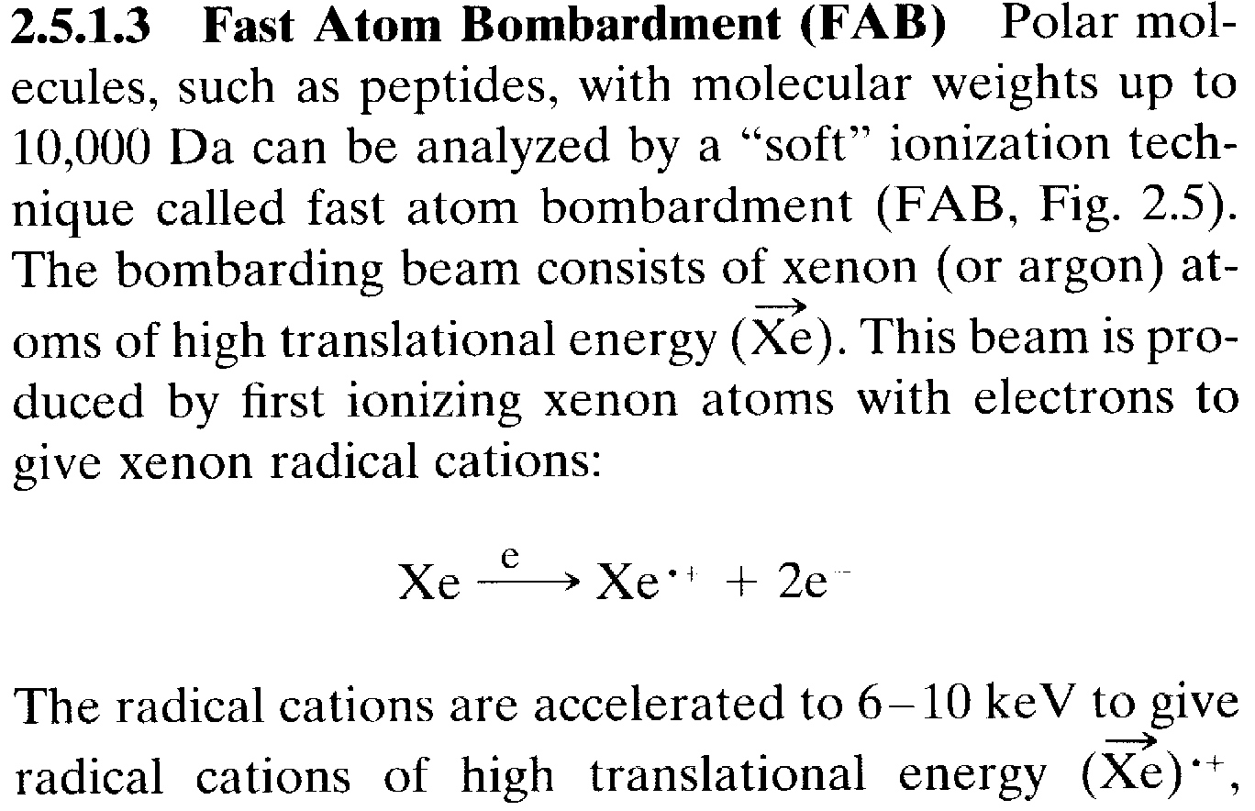
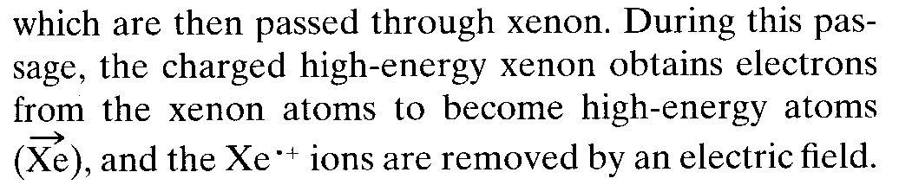

Slide 31
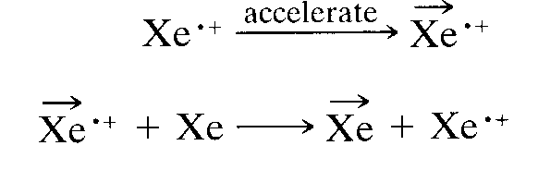
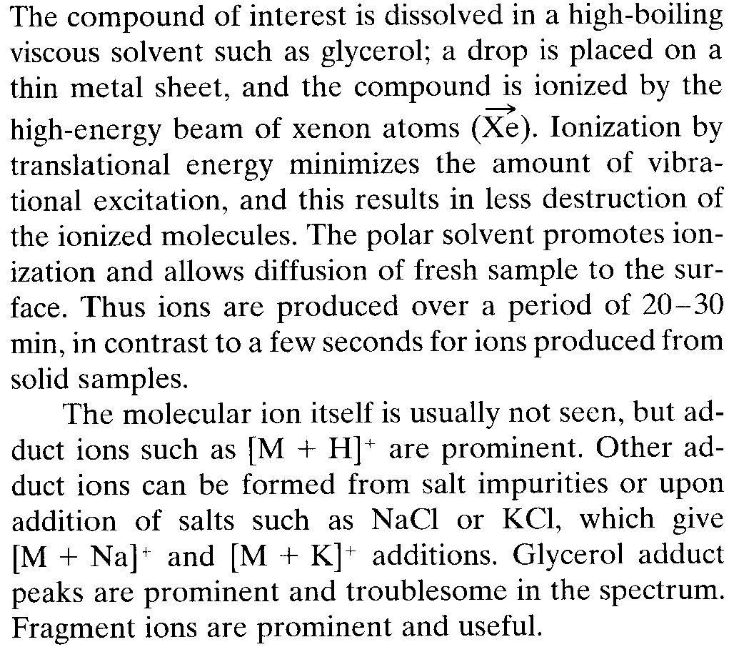

Slide 32
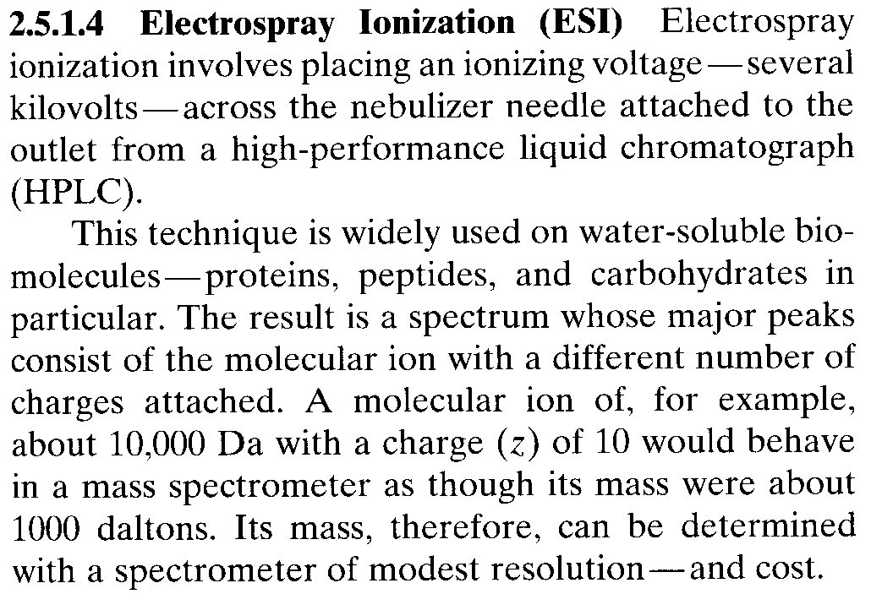

Slide 33
Thank you

