Slide 1
Poultry farming

Slide 2
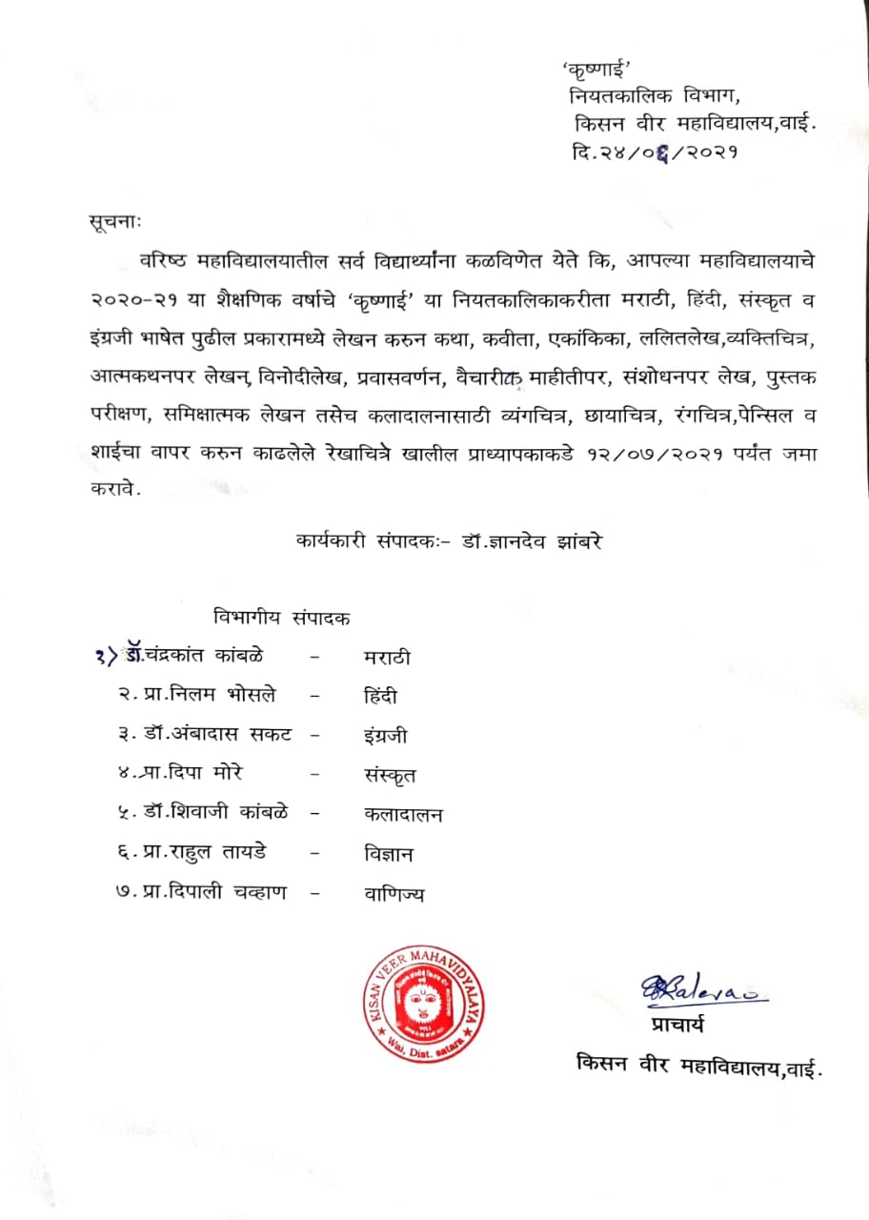

Slide 3
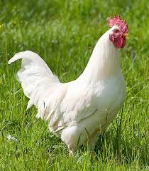
White leghorn Mediterranean breed

Slide 4
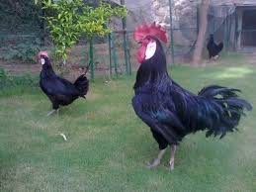
Black Minorca

Slide 5
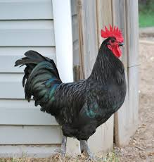
Australorp

Slide 6
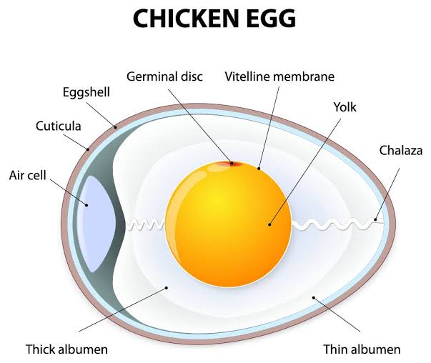

Slide 7
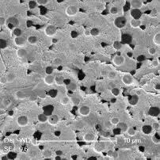

Slide 8
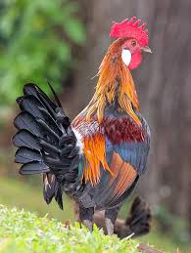
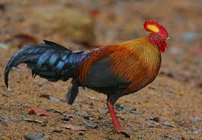
Wild fowl Gallus lafayetti

Slide 9
Exotic Hens Breed

Slide 10
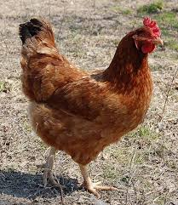
Rhode island red hen

Slide 11
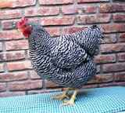
Polymouth rock hen

Slide 12
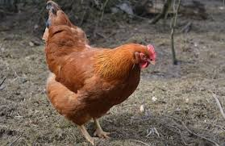
New Hampshire hen

Slide 13
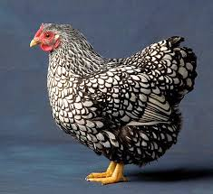
Wyandotte hen

Slide 14
Asiatic breed

Slide 15
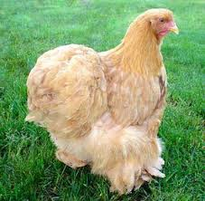
Cochin hen

Slide 16
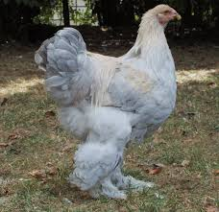
Brahma hen

Slide 17
English breed

Slide 18
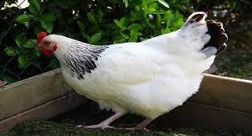
Sussex hen

Slide 19
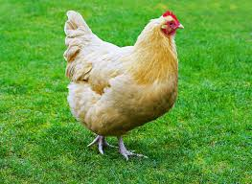
Orpington hen

Slide 20
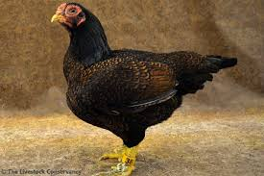
Cornish hen

Slide 21
Housing

Slide 22
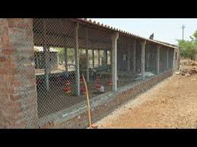
Housing

Slide 23
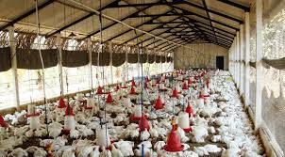

Slide 24
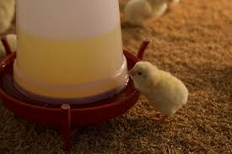
Cheap typ waterer

Slide 25
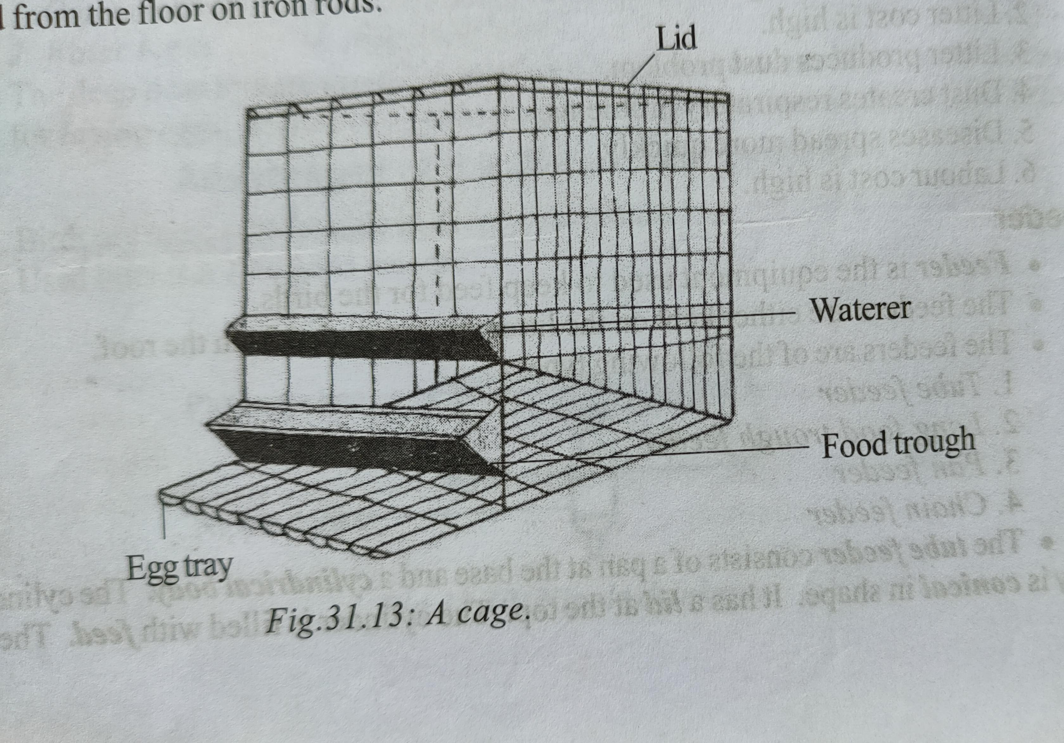

Slide 26
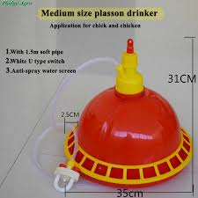

Slide 27

Nipple drinker

Slide 28

Tube feeder

Slide 29

Long food trough

