Slide 1
Surface Tension: The Captivating Force at the Interface
Surface tension is a unique and fascinating property of liquids that arises from the cohesive forces between the molecules at the liquid-air interface. This invisible yet powerful force has profound implications in various scientific and everyday phenomena.

Slide 2
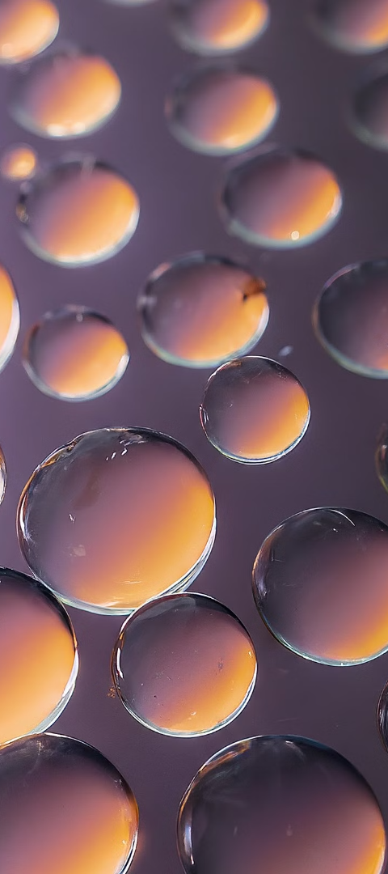
Molecular Theory of Surface Tension
1
Cohesive Forces
At the surface, water molecules experience stronger attractive forces towards their neighbors compared to those in the bulk liquid, resulting in a higher energy state.
2
Minimizing Surface Area
The liquid seeks to minimize its surface area to reduce the number of high-energy surface molecules, leading to the formation of spherical droplets and curved interfaces.
3
Elasticity and Tension
This tendency to minimize surface area manifests as an elastic-like property, known as surface tension, which acts to resist any change in the surface area.

Slide 3
Angle of Contact: A Measure of Wettability
Defining Contact Angle
Wetting and Non-wetting
Significance of Contact Angle
The angle between the liquid-solid interface and the liquid-air interface at the point where they meet is called the contact angle.
A low contact angle (< 90°) indicates a wetting surface, where the liquid spreads out. A high contact angle (> 90°) indicates a non-wetting surface, where the liquid beads up.
The contact angle provides insights into the adhesive and cohesive forces at the liquid-solid interface, which are crucial in understanding wettability and many applications.

Slide 4
Young Equation: Relating Surface Tension and Wettability
Young Equation
Wettability Prediction
The Young equation mathematically describes the relationship between the surface tensions of the solid-vapor, solid-liquid, and liquid-vapor interfaces, and the contact angle.
By measuring the contact angle, the Young equation can be used to determine the relative strengths of the solid-liquid and solid-vapor surface tensions, which governs the wettability of the surface.
Applications
Understanding wettability through the Young equation is crucial in diverse fields, from coating technologies and self-cleaning surfaces to adhesion and capillary action.

Slide 5
Surface Tension and Excess Pressure
Laplace Pressure
Excess Pressure
Significance
Due to surface tension, the pressure inside a curved liquid surface (like a droplet) is higher than the pressure outside, a phenomenon known as the Laplace pressure.
The difference between the internal and external pressures is the excess pressure, which is directly proportional to the surface tension and inversely proportional to the radius of curvature.
This excess pressure plays a crucial role in many natural and engineered systems, from biological cells to the design of microfluidic devices.

Slide 6
Radius of Curvature and Surface Tension
1
Curved Surfaces
2
Inverse Relationship
3
Capillary Action
The curvature of a liquid surface, characterized by its radius of curvature, is intimately linked to the surface tension.
As the radius of curvature decreases, the excess pressure across the interface increases, following an inverse relationship.
This relationship underpins the phenomenon of capillary action, where liquids can spontaneously rise or fall in narrow tubes due to the interplay between surface tension and curvature.

Slide 7
Key Takeaways
1
Cohesive Forces
2
Wettability and Contact Angle
Surface tension arises from the cohesive forces between molecules at the liquid-air interface.
The contact angle between a liquid and a solid surface determines the wettability, with low angles indicating wetting and high angles indicating non-wetting.
3
Excess Pressure and Curvature
4
Diverse Applications
The excess pressure across a curved liquid surface is inversely proportional to the radius of curvature, leading to phenomena like capillary action.
Surface tension plays a crucial role in a wide range of applications, from soap bubbles and self-cleaning surfaces to microfluidic devices.

Slide 8
Experimental Determination of Surface Tension by Jaeger's Method
Prepare the Sample
1
The first step in the Jaeger's method is to carefully prepare the liquid sample. This involves measuring the desired volume of the liquid and transferring it to a clean, dry container.
2
Measure the Weight
Next, the weight of the liquid sample is measured using a high-precision balance. This weight will be used in the calculation of the surface tension.
Determine the Rise Height
3
The liquid sample is then allowed to rise up a thin, vertical capillary tube. The height of the liquid column in the tube is carefully measured and recorded. This rise height is a key parameter in the Jaeger's method.

Slide 9
Principle of Jaeger's Method
Capillary Rise
Calculating Surface Tension
Advantages of Jaeger's Method
The Jaeger's method relies on the principle of capillary rise, where the liquid is drawn up a narrow tube due to the combined effects of surface tension and gravity. The height to which the liquid rises is inversely proportional to the diameter of the tube and directly proportional to the surface tension of the liquid.
By measuring the weight of the liquid sample and the height to which it rises in the capillary tube, the surface tension can be calculated using the Laplace-Young equation. This equation relates the surface tension, the liquid's density, the gravitational acceleration, and the capillary rise height.
The Jaeger's method is a relatively simple and accurate technique for determining the surface tension of liquids. It requires minimal equipment and can be easily replicated in a laboratory setting, making it a popular choice for both educational and research purposes.

Slide 10
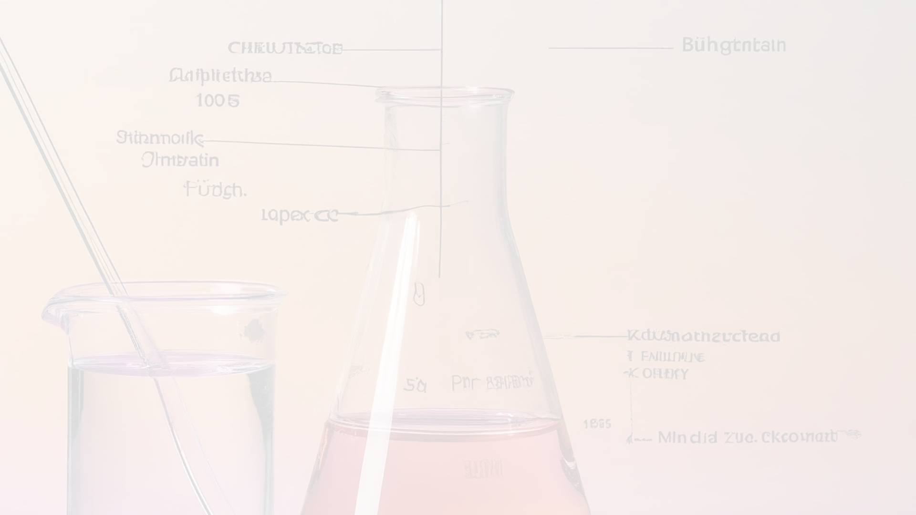
Experimental Setup and Procedure
1
Prepare the Capillary Tube
The first step is to select a clean, dry capillary tube with a known diameter. The tube should be vertically mounted and its height carefully measured.
2
Add the Liquid Sample
The liquid sample is then carefully added to a beaker or container placed beneath the capillary tube. The liquid should be allowed to rise up the tube until it reaches a stable height.
3
Measure the Rise Height
The height of the liquid column in the capillary tube is measured using a precise ruler or scale. This rise height is a crucial parameter in the Jaeger's method calculation.

Slide 11
Factors Affecting Surface Tension
1
Temperature
2
Solutes
The surface tension of a liquid is known to decrease with increasing temperature. As the temperature rises, the cohesive forces between the liquid molecules weaken, resulting in a lower surface tension.
The addition of solutes, such as salts or surfactants, can significantly affect the surface tension of a liquid. Solutes can either increase or decrease the surface tension, depending on their chemical properties and concentration.
3
Impurities
4
Surfactants
The presence of impurities in a liquid can also influence its surface tension. Even small amounts of contaminants can alter the intermolecular forces at the liquid's surface, leading to changes in the observed surface tension.
Surfactants are a class of molecules that can dramatically reduce the surface tension of a liquid. They work by adsorbing at the liquid-air interface, disrupting the cohesive forces between the liquid molecules and creating a more stable surface.

Slide 12
Effect of Temperature on Surface Tension
Molecular Explanation
Practical Implications
Experimental Observations
As the temperature of a liquid increases, the kinetic energy of the molecules increases, causing them to move more rapidly and break free from the cohesive forces that hold them together at the surface. This weakening of intermolecular attractions leads to a decrease in the surface tension of the liquid.
The temperature dependence of surface tension has important practical applications, particularly in processes involving the wetting and spreading of liquids on surfaces. Understanding how surface tension changes with temperature is crucial in industries such as coatings, printing, and microfluidics.
Numerous studies have confirmed the inverse relationship between temperature and surface tension for a wide range of liquids, including water, alcohols, and organic solvents. The rate of change in surface tension with temperature is often reported as the surface tension temperature coefficient, which can be used to predict the surface tension at different temperatures.

Slide 13
Effect of Solutes on Surface Tension
Surfactants
Salts and Electrolytes
Organic Solutes
Surfactants are a class of solutes that can significantly reduce the surface tension of a liquid. They work by adsorbing at the liquid-air interface, disrupting the cohesive forces between the liquid molecules and creating a more stable surface. As the concentration of surfactants increases, the surface tension of the liquid decreases dramatically.
The addition of salts and other electrolytes to a liquid can also affect its surface tension, though the effect is generally less pronounced than that of surfactants. Electrolytes can either increase or decrease the surface tension, depending on their specific chemical properties and their ability to interact with the liquid molecules at the surface.
Organic solutes, such as alcohols and sugars, can also influence the surface tension of a liquid. These solutes can either increase or decrease the surface tension, depending on their structure and their interactions with the liquid molecules. The effect is often more subtle than that of surfactants or electrolytes.

Slide 14
Applications of Surface Tension
Capillary Action
Wetting and Spreading
Insect Locomotion
Chemical and Biological Processes
Surface tension is responsible for the phenomenon of capillary action, where liquids are drawn up narrow tubes or between closely spaced surfaces. This effect is utilized in a wide range of applications, from the transport of water and nutrients in plants to the operation of inkjet printers.
The ability of some insects, such as water striders, to walk on the surface of water is facilitated by the high surface tension of water. The insects' lightweight and specialized foot structure allow them to exploit the water's surface tension to support their weight and move across the surface.
The surface tension of a liquid determines its ability to wet and spread on a surface. This property is crucial in applications such as coatings, paints, and adhesives, where the wetting and spreading behavior of the liquid on the substrate is essential for achieving the desired performance.
Surface tension plays a crucial role in various chemical and biological processes, including the formation of emulsions, the transport of molecules through cell membranes, and the stability of foams and bubbles. Understanding and controlling surface tension is essential in fields such as nanomaterials, pharmaceuticals, and food science.

